Slide 1
pneumonia

Slide 2
Definition
Pneumonia is an acute infection of lung parenchyma characterized by (accumulation of secretions and inflammatory cells in alveoli).

Slide 3
Clinical classification
Community-acquired pneumonia (CAP):
Onset in community or during 1st 2 days of
hospitalization.
Hospital-acquired Pneumonia(HAP/nosocomial):
Occurring 48 hrs after hospitalization
Aspiration pneumonia
Pneumonia in immunocompromised patient

Slide 4
Anatomical classification
Lobar pneumonia if one or more lobe is involved
Broncho-pneumoniamore patchy alveolar consolidation associated with bronchiolar inflammation often affecting both lower lobes

Slide 5
causes
Streptococcus pneumonia .
H. influenza
mycoplasma pneumonia .
Others like moraxella catarrhalis, legionella,, chlamydia, gram negative bacteria, coxiella, viral ,staphylococcus aureus and MRSA .

Slide 6
Factors that predispose to pneumonia
Cigarette smoking
Upper respiratory tract infections
Alcohol
Corticosteroid therapy
Old age
Recent influenza infection
Pre-existing lung disease
HIV
Indoor air pollution

Slide 8

Exposure to contaminated air-conditioning cooling towers, recent travel
associated with a stay in a hotel--- Legionella pneumophila
Outbreak of pneumonia in shelters for homeless men, jails, military training camps--- Streptococcus pneumoniae; Mycobacterium tuberculosis
Exposure to turkeys, chickens, ducks, or psittacine birds---C. psittaci

Slide 9
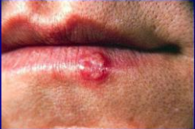
Clinical features
Fever
Rigor
Cough with purulent sputum
Pleuritic chest pain
Dyspnea
+- confusion

Slide 10
Typical pneumonia:
Respiratory symptoms are
more than constitutional symptoms
Atypical pneumonia:
Constitutional symptoms are more than respiratory symptoms

Slide 11
Atypical pneumonia
Causative agent | Mycoplasma pneumoniae
Onset Symptoms Signs | Gradual Fever (low -grade)+ chills but no rigors Non-productive cough Headache – malaise Signs are usually minimal; Scattered crepitations and ronchi – sinus tenderness – No signs consolidation –

Slide 12
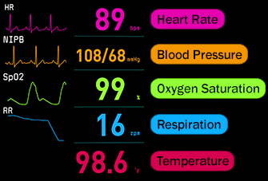
On examination
Fever Tachycardia and tachypnea( Pulse oximetry)
When consolidated, conduction of sound is enhanced the lung is typically dull to percussion and,as conduction of sound is enhanced, auscultation reveals bronchial breathing and crackles .
( in many patients, signs are more subtle with reduced air entry only, but crackles are usually present)

Slide 13
Atypical Pneumonia
Pt. has mainly constitutional symptoms and not respiratory symptoms.
Cause:
  Mycoplasma (most common), legionella, chlamydia, coxiella, viral.

Slide 14
D/Diagnosis
Pulmonary edema
Pulmonary embolism.
Pulmonary TB
Pulmonary ca.
Pulmonary haemorrhage.

Slide 15
investigations
The aims of investigation are
Confirm the diagnosis
Exclude other conditions
Assess the severity
Identify the development of complications

Slide 16
Investigations
CBC: leukocytosis
Haemolytic anaemia: occasional complication of Mycoplasma
CRP&ESR:
Urea:lft
Blood culture
Sputum: Gram stain / C&S
Chest x ray
ABG
Serology: Acute and convalescent titres for Mycoplasma,Chlamydia, Legionella and viral infections
➢Urine Pneumococcal and/or Legionella antigen
➢Pleural fluid
Always aspirate and culture when present in more than trivial amounts, preferably with ultrasound guidance

Slide 17
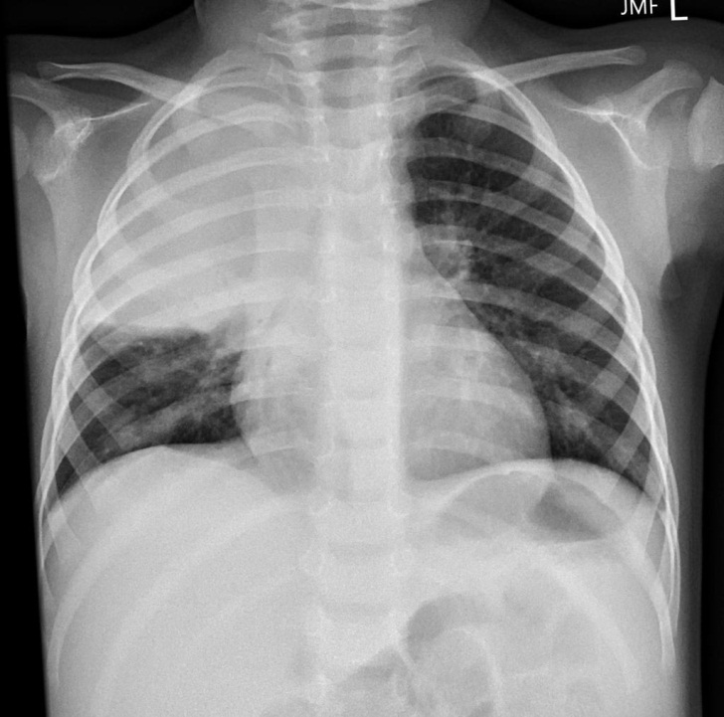
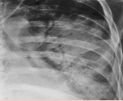
Radiological classification
Lobar Pneumonia:
Homogeneous consolidation with air Broncho gram of one or more lung lobes.
Mainly caused by Streptococcus pneumonia.

Slide 18
Bronchopneumonia:
- Usually bilaterally affecting lower lobes.

Slide 19
treatment
Adequate oxygenation
Appropriate fluid balance (case wise)
Antibiotics
Oxygen IV fluids.Analgesia .
Antibiotics (Empiric antibiotic therapy)
Out pt.: Amoxicillin + macrolide ( azithromycin)
In hospital: {{3rd generation Cephalosporin or Amoxi-clvulenic acid}} + Macrolide (azithromycin)

Slide 20
Use of ntibiotics
clinical context.
severity assessment.
local knowledge of antibiotic resistance patterns.
any available epidemiological information.

Slide 21
CURB-65 score
C -Confusion
U - Urea > 20 mg/dl
R -Respiratory rate >30\min
B -BP <90 systole or <60 diastole
65 -Age >65
{ One Degree for each point }
. 0-1 outpatient treatment with oral antibiotics
. 2 Admission to the hospital
. ≥ 3 severe pneumonia treated at ICU

Slide 22
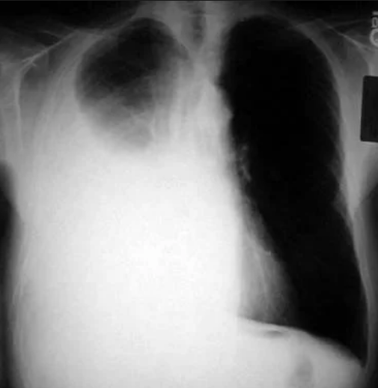
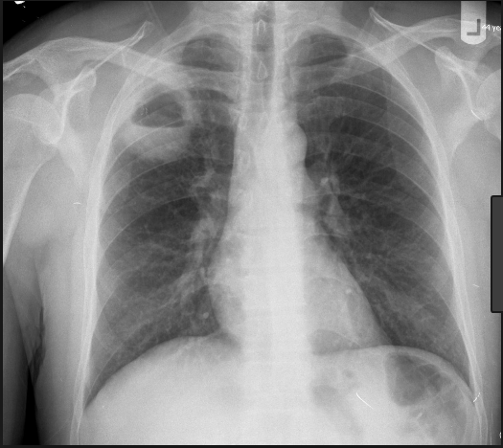
Complications of Pneumonia
Respiratory failure type I
Para-pneumonic effusion .
Empyema
Lung abscess
ARDS .
Renal failure.
Septicemia.

Slide 23
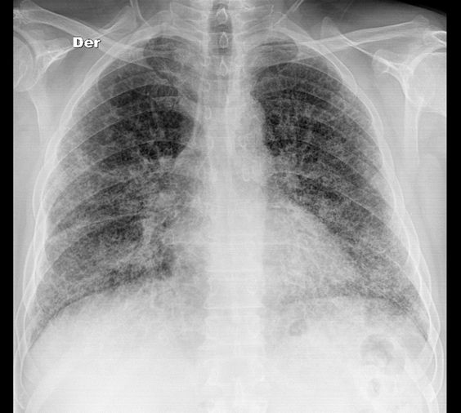
Interstitial pneumonia

Slide 24
Delayed resolution
?incorrect diagnosis.
Incorrect microbiological diagnosis . Fungal, tubercular recurrent aspiration
Improper antibiotic or insufficient dose
pneumonia may be secondary to a proximal bronchial obstruction ca OR FBody
complication has occurred (Empyema or atelectasis)
Immunocompromised patient

Slide 25
A 21-year-old woman with no known medical history or prior hospitalization was presented to the emergency department with complaints of shortness of breath,cough, and fevers for 3 days.
On examination : blood pressure of 120/80 mmHg, heart rate o 110/min, respiratory rate of 18/min,temperature 38.1ºC, and oxygen saturation 95% on room air. And She had few crackles in the LLL.
Laboratory evaluation showed white blood cell count
14,000/m/μL with a left shift , hemoglobin 14 g/dL,
platelets300,000/μL, sodium 145 mEq/L, potassium 4 mEq/L,
chloride 101 mEq/L, bicarbonate 28 mEq/L, blood urea
nitrogen 16 mg/dL, creatinine 0.6 mg/dL, glucose
100 mg/dL. and chest radiography
revealed LLLC.

Slide 26
What antibiotics should she be treated with?
A. Ceftriaxone 1 g intramuscularly once a day
B. Azithromycin and ceftriaxone for at least 3 days and then continue to de-escalate if patient improves
C. Vancomycin and cefepime for at least 3 days and then continue to de-escalate if patient improves
D. Hold antibiotics until further tests such as Legionella urine antigen and strep urine antigen.
E. Azithromycin 500 mg PO daily for 3 days.

Slide 27
Thank u

