Slide 1


الجامعـــة الليبيـــة الدوليــــة للعلـــوم الطبيــــة
LIBYAN INTERNATIONAL MEDICAL UNIVERSITY
Impact of COVID-19 on Mental Health in Adolescents
Tutor: Alaa Benali
Presenter: 3237 Rania Jalal Boujalawi
Block : PTS
كلية العلوم الطبية التطبيقية
FACULTY OF APPLIED MEDICAL SCIENCES
Date: 4 June, 2022

Slide 2
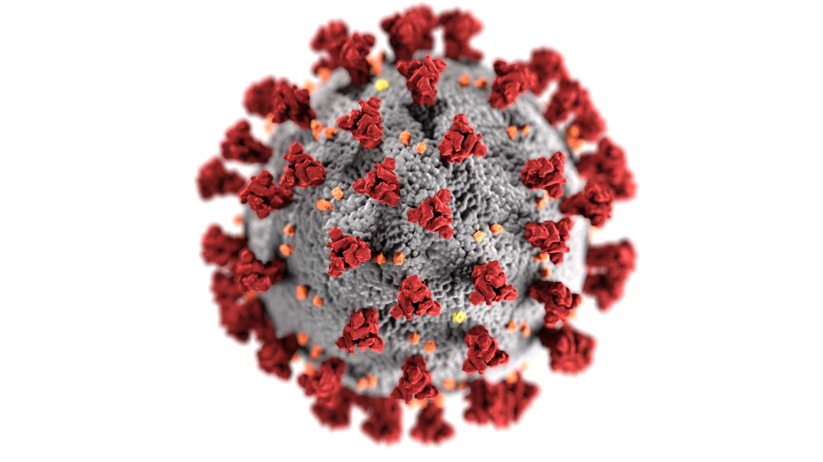
Objectives :
Definition of COVID-19.
Effect of COVID-19 on Mental Health.
Covid Anxiety Syndrome Symptoms.
Effect on Social Distancing.
Recommendations.

Slide 3
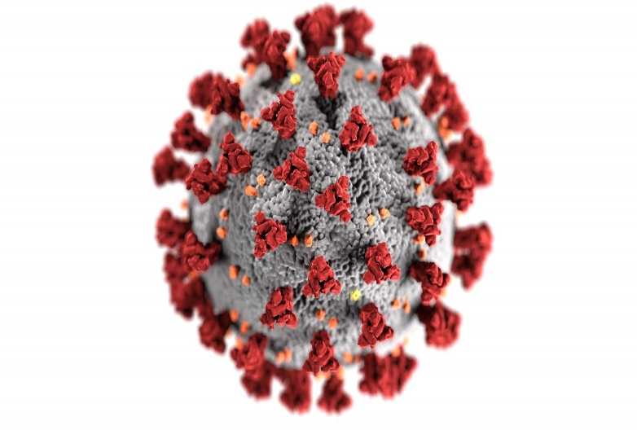
Definition:
Covid-19
is a new strain of coronavirus that has not been previously identified in humans.
Coronaviruses
are a large family of viruses that are known to cause illness ranging from the common cold to more severe diseases.
Severe Diseases:
Severe Acute Respiratory syndrome (SARS), and
Middle East Respiratory Syndrome (MERS).

Slide 4
Effect of COVID-19 on Mental Health
Adolescents are potentially at risk for negative psychological effect from COVID-19 social distancing.
Adolescence is a period associated with increased risk for the development of many psychiatric disorders, such as anxiety and depression
Notes:
We can say >>>>> Examining connections between social distancing motivations and mental and social health among youth may provide important insight into potential avenues for reducing the psychological consequences of social distancing among this population.
Due to the negative outcomes associated with poor mental health statuses among adolescents, such as suicide, behavior problems, and emotional distress and the need for quality research to build resilience and to reduce anxiety among adolescents, it is imperative to review the impact of COVID-19 on adolescent health in the United States and abroad in order to understand the global state of adolescent mental health and to provide strategies that prevent poor mental health outcomes, such as anxiety and depression, presently and in the future.

Slide 5
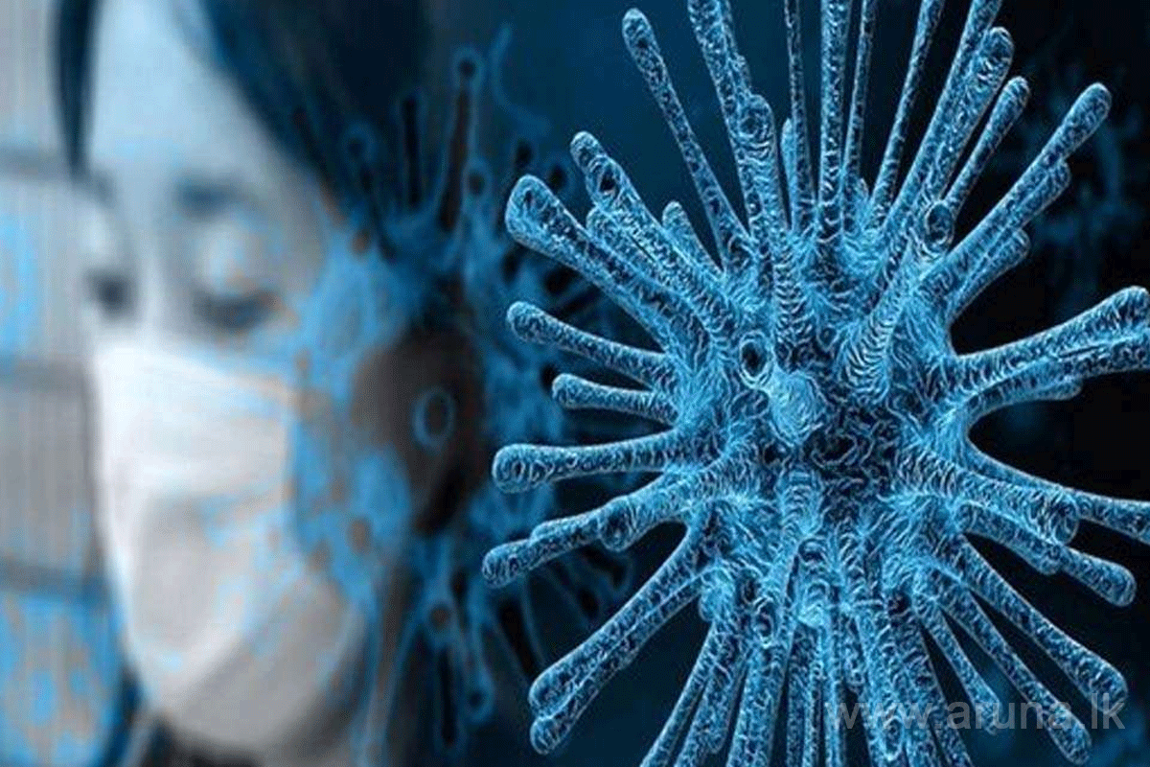
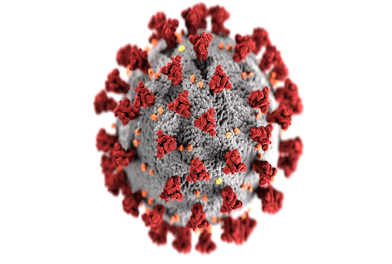
Most of us were on high alert initially, experiencing fear and worry over the impact this virus may have. However, researchers have noticed that people were developing a particular set of traits on a larger scale.
Despite vaccines being distributed and an overall decrease in COVID prevalence, some people are starting to experience what experts call COVID-19 anxiety syndrome.

Slide 6
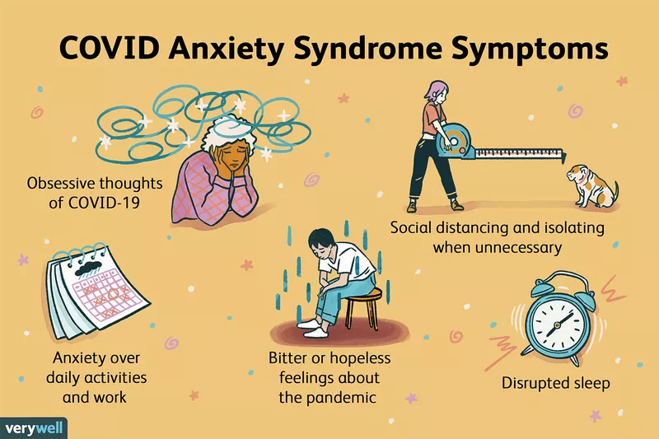
Notes:
Most of us were on high alert initially, experiencing fear and worry over the impact this virus may have. However, researchers have noticed that people were developing a particular set of traits on a larger scale.
Despite vaccines being distributed and an overall decrease in COVID prevalence, some people are starting to experience what experts call COVID-19 anxiety syndrome.¹
COVID-19 anxiety syndrome (CAS) is defined by:
1. Compulsively checking for symptoms of covid
2. Avoidance of public places
3. Obsessive cleaning
4. Other maladaptive behaviors

Slide 7
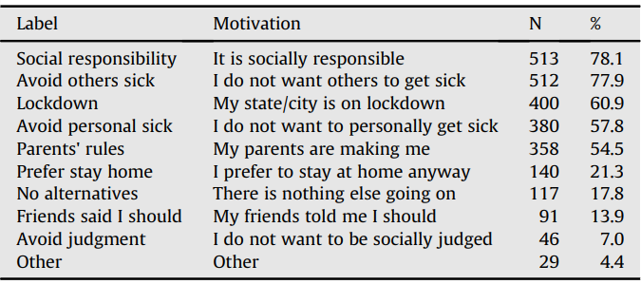
Research Study – Social Distancing
Participants: 657 adolescents residing in the US.
Age: between the ages of 13 and 18 years.
Adolescents' Motivations to Engage in Social Distancing

Slide 8
Recommendations
It is important that adolescents receive the physical and mental care they need to develop, to grow, and to thrive.
It is important to seek and to use all of the available resources and therapies to help adolescents mediate the adjustments caused by the pandemic.
More research is needed on the improvement of adolescent mental health during COVID-19.

Slide 9
Conclusion
The COVID-19 pandemic has impacted adolescent mental health.
Stressful life events, extended home confinement, worry, overuse of the internet and social media are factors that could influence the mental health of adolescents during this pandemic.
Adolescents from across the world face mental challenges due to COVID-19.

Slide 10


Slide 11
Thank You…

Slide 12
References:
Jones EA, Mitra AK, Bhuiyan AR. Impact of COVID-19 on mental health in adolescents: A systematic review. International journal of environmental research and public health. 2021 Jan;18(5):2470.
Oosterhoff, B., Palmer, C. A., Wilson, J., & Shook, N. (2020). Adolescents' Motivations to Engage in Social Distancing During the COVID-19 Pandemic: Associations With Mental and Social Health. The Journal of adolescent health : official publication of the Society for Adolescent Medicine, 67(2), 179–185.
What is covid-19? [Internet]. coronavirus. [cited 2022May12]. Available from: https://coronavirus.dc.gov/page/what-covid-19
Cuncic A. What is Covid Anxiety Syndrome? [Internet]. Verywell Mind. Verywell Mind; 2021 [cited 2022May12]. Available from: https://www.verywellmind.com/what-is-covid-anxiety-syndrome-5187154

