Slide 1


Learning disability
Manar Adel Faraj
2987
PTS Block
2022

Slide 2
Objective
01
02
03
04
Outline the causes and the types of learning disability
Explain the necessary assessment of LDs
Discuss the Complication of learning disability
Discuss the Management of learning disability

Slide 3
introduction
It is disorders involved in understanding or using language, manifested in imperfect ability to listen, think, speak, read, write, spell, or do mathematical calculations

Slide 4



Learning academic skills for at least 6 months
The academic skills are substantially below expectations for the individual age
It affect the both gender equally

Slide 5




cases of learning disability:
Genetic defect
Enviromental exposure
Problem during pregnancy or birth
illness, or injury in early childhood

Slide 6
Come after
Sensory impairment :
Visual or hearing
Neurological disorder
Mental disorder :
Depression ,anxiety

Slide 7
Types of learning disability
Dysgraphia
Dyscalculia
Dyslexia
is defined as difficulty reading
is defined as difficulty writing
is defined as difficulty performing mathematical calculations

Slide 8

Tom Cruise

Slide 9


Dyslexia
Is the common representing in 80% of cases LDs
At least 80% of all LDs, results from deficits in phonologic processing
Affect writing and oral communication

Slide 10
Reading impairment
01
02
03
04
Reading impairment
Word accurancy
Rate and fluency
comprehasion

Slide 11
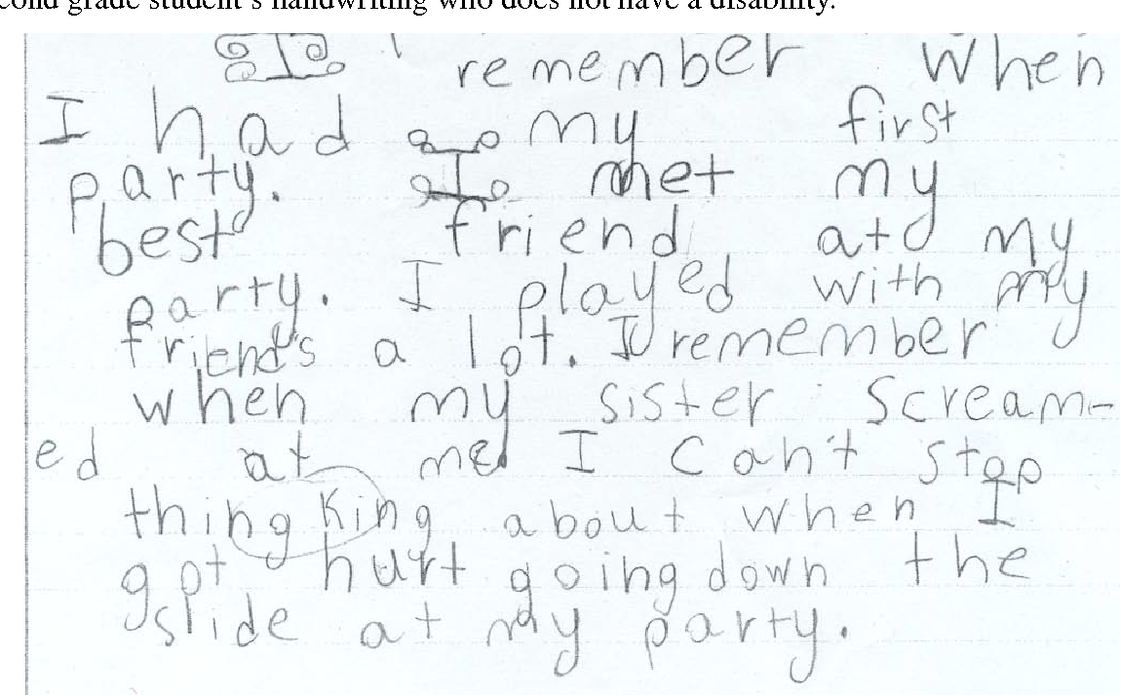
Dysgraphia
Children with dysgraphia will produce inconsistent and illegible handwriting while rarely staying within the margins.

Slide 12









Writing impairment
Spelling accuracy
Grammar
Punctuation accuracy
Clarity and organization of written expression

Slide 13
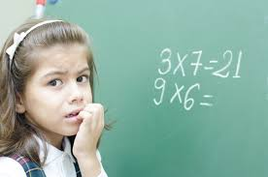
Dyscalculasia
Presents as a weakness in performing arithmetic operations
Patients will not experience impediments organizing problems

Slide 14
Mathematic impairment
Number sense
Memorization arithmetic facts
Accurate or fluent calculation
Accurate math reasoning

Slide 15
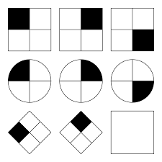
Learning disabilities are diagnosed by two tests :
An in­telligence (or IQ) test
Standardized achievement (reading, writing, arith­metic) test.
Most children found to have a learning disability have normal IQ.

Slide 16

Management

Slide 17
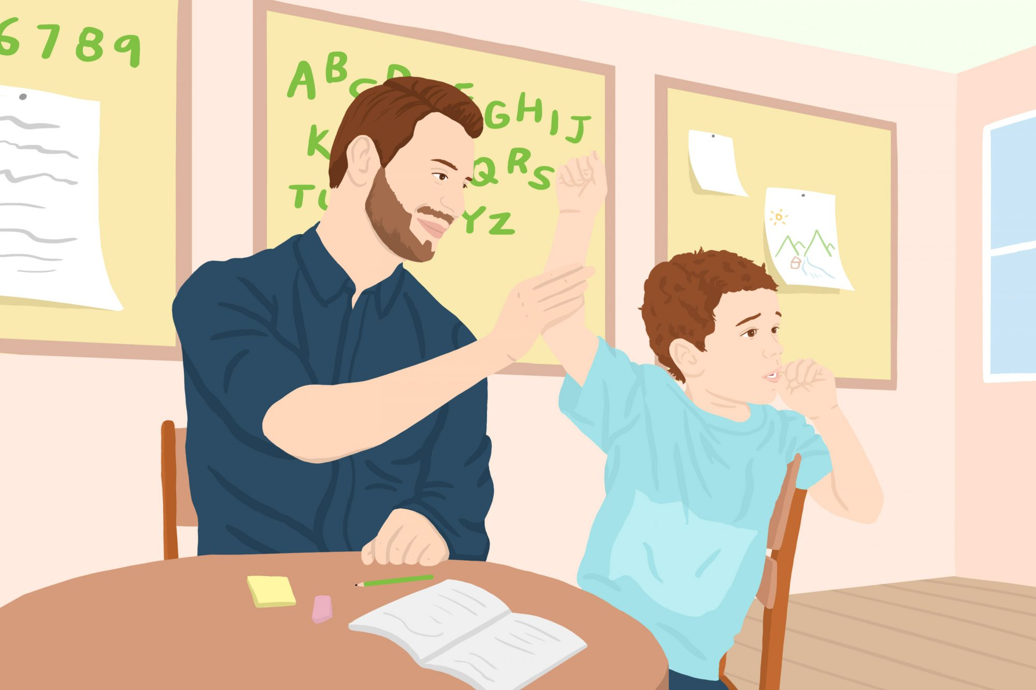
Early intervention and support
The most common treatment for learning disabilities is special education
Educators may try special teaching methods, that can assist your child's learning needs

Slide 18




Interprofessional care is crucial in the identification and treatment of learning disabilities
Interprofessional team that can be composed of educators, educational remediation specialists, psychologists, special services, and physicians
Special education sessions will increase Communication among members of the team improves outcomes

Slide 19
Complication
Increase in the risk of low academic performance in children with learning disabilities
That can affect their social and career trajectory
Negative self-concept, stemming from continued academic failure, and depression.

Slide 20

Conclusion
A learning disability cannot be cured or fixed; it is a lifelong challenge.
However, with appropriate support and intervention, people with learning disabilities can achieve success in school, at work, in relationships, and in the community.

Slide 21
Reference
1. kotob n. language disorder in children and adult. 2nd ed. cairo: el hariry print; 2018.
2. American psychiatric association (APA) (2013). Neurodevelopmental disorder. Diagnostic and statistical manual of mental diseases ,fifth edition . Washington American psychiatric association
3. Topics H. Learning Disabilities: MedlinePlus [Internet]. Medlineplus.gov. 2022 [cited 12 March 2022]. Available from: {https://medlineplus.gov/learningdisabilities.html}
4. Learning Disorders in Children | CDC [Internet]. Centers for Disease Control and Prevention. 2022 [cited 12 March 2022]. Available from: {https://www.cdc.gov/ncbddd/childdevelopment/learning-disorder.html}

Slide 22
THANKS for your time !

Slide 23
ALTERNATIVE ICONS

Slide 24
ALTERNATIVE RESOURCES

