Slide 1


Libyan International Medical University
Faculty of Business Administration
The Major Types of Buying Decisions Behaviors
Dana Elgheriani
dana_3792@limu.edu.ly
ID:3792

Slide 2
Contents :
1. Introduction
2.
The major types of buying decisions behaviors
3.
List the stages in the buyer decision process
4.
Summary
5.
References
1

Slide 3
Introduction
1- A consumer’s buying decision depends on the type of products that they need to buy.
2- buyer decision process helps markets identify how consumers complete the journey from knowing about a product to making the purchase decision.
2

Slide 4
1-The major types of buying decisions behaviors
A consumer’s buying decision depends on the type of products that they need to buy. The behavior of a consumer while buying a coffee is a lot different while buying a flat ,There are four types of consumer buying behavior.
3

Slide 5
01
02
04
03
Complex buying behavior
Dissonance-reducing buying behavior
the buyer will pass through a learning process. He will first develop beliefs about the product, then attitudes, and then making a thoughtful purchase choice.
In this situation, because perceived brand differences are not wide, buyers may shop around to learn what is available, but relatively quickly. They may respond primarily to an attractive price or to purchase convenience.
Habitual buying behavior
Variety seeking behavior
Consumers do not look for extensive information about the brands. They do not evaluate brand features and make strong decisions about which brands to buy. Instead, they passively receive information from the media to which they are exposed.
Here consumers often do a lot of brand switching. The cost of switching products is low, and hence consumers might want to try out new products just out of curiosity or boredom.
4

Slide 6
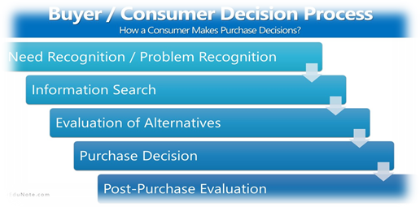
2-List the stages in the buyer decision process
buyer decision process helps markets identify how consumers complete the journey from knowing about a product to making the purchase decision. Understanding the buyer buying process is essential for marketing and sales.
5

Slide 7
Consumers go through 5 stages in deciding to purchase any goods or service :
Problem Recognition or Need Recognitio
Information Search
Evaluation of Alternatives
Purchase Decision
Post-Purchase Evaluation
6

Slide 8
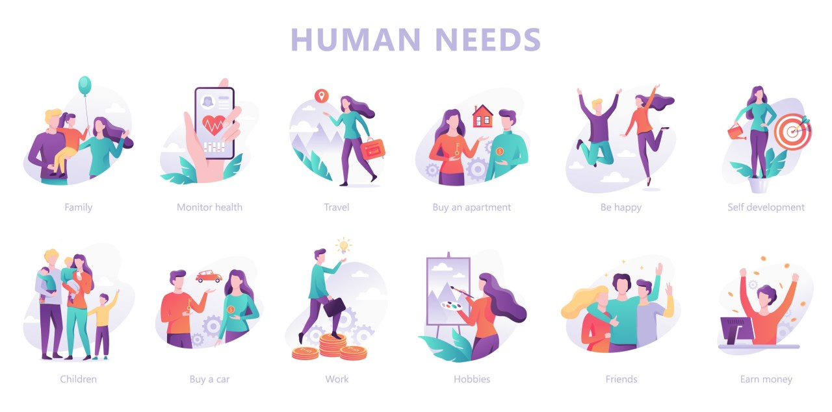
1. Problem or Need Recognition
In this first stage, the consumer recognizes that he has an unmet need and is driven to action by a need or desire. Unsatisfied needs create discomfort to the consumer, so that he begins to recognize that this need can be met by acquiring or consuming goods and services.
7

Slide 9

2. Information Search
The consumer may have heightened attention or may undertake an active search for information. The amount of searching a consumer will depend on the strength of his drive, and the satisfaction he gets from searching.
9

Slide 10

3. Evaluation of Alternatives
At this stage, consumers evaluate different products/brands on the basis of varying product attributes, and whether these can deliver the benefits that the customers are seeking .This stage is heavily influenced by one's attitude, as "attitude puts one in a frame of mind: liking or disliking an object, moving towards or away from it.
9

Slide 11

4. Purchase Decision
the consumer buys the product. After the alternatives have been evaluated, consumers decide to purchase products and services. They decide to buy the best brand. But their decision is influenced by others’ attitudes and situational factors.
10

Slide 12

5. Post-Purchase Evaluation
In the buyer decision process’s final stage, the consumer determines if they are satisfied or dissatisfied with the purchasing outcome. Here is where cognitive dissonance occurs, “Did I make the right decision.”
11

Slide 13
Summary :
1- Consumer buying decisions are depended on the consumer behavior.
2- The consumer decision-making process can seem mysterious, but all consumers go through basic steps when making a purchase to determine what products and services will best fit their needs.
12

Slide 14
References :
1- Clootrack.com. 2022. What are the 4 types of customer buying behavior? - Clootrack. [online] Available at: <https://clootrack.com/knowledge_base/types-of-consumer-behavior/> [Accessed 13 April 2022].
2- iEduNote. 2022. Types of Buying Decision Behavior. [online] Available at: <https://www.iedunote.com/types-of-buying-decision-behavior> [Accessed 13 April 2022].
3- iEduNote. 2022. Consumer Decision Process (Buyer Decision Process). [online] Available at: <https://www.iedunote.com/buyer-decision-process> [Accessed 13 April 2022].
4- Vargas, C., 2022. 5 Stages of the consumer buying decision process • Imagine Hub. [online] Imagine Hub. Available at: <https://imagine-hub.com/en/blog/consumer-buying-decision-process/> [Accessed 13 April 2022].
13

Slide 15
