Slide 1
TRAUMATIC HEAD INJURY
Dr. Abdalla Benehmaid

Slide 2
TYPES OF HEAD INJURY
Congenital: before or during birth
Acquired: After birth
traumatic:
Open
Closed
non traumatic

Slide 3
Traumatic brain injury
Sudden damage to the brain tissues due to an external force.
Two types
Closed: head is forcibly collides with a solid object without penetration of the skull.
Open: when an object (eg a bullet) fracture a skull, enters the brain and rips the brain tissue in its path.

Slide 4
Two classes of TBI
Primary
At the time of impact
Skull fracture
Brain contusion
ICH
DAI
Secondary
Minutes to days
Brain oedema
Increased ICP
Infection
Epilepsy
Hypoxemia
High or low BP
Brain anoxia

Slide 5
Brain edema in TBI is called Cytotoxic edema and is not responding to steroids
Vasogenic brain edema is caused by brain tumors and is well responding to steroids

Slide 6
Severity
Mild: GCS 14-15, headache, amnesia
Moderate: concussion, amnesia, vomiting, seizures, GCS 9-13
Severe: GCS 8 or less

Slide 7
Pathophysiology
Scalp laceration skull fracture
heamatoma from torn blood vessels
scalp
subgaleal hematoma
epidural
subdural
intra cerebral

Slide 8
Contusions (bruising)
At site of impaction (coup)
Opposite site of the brain (countrecoup)
Major damage is produced by rotational and lateral motion of the brain within the skull

Slide 9
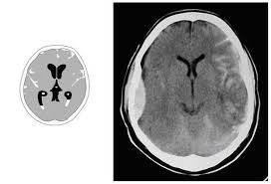

Slide 10
SKULL FRACTURES
Simple/linear
Depressed / blow out fracture
Skull base fracture

Slide 11
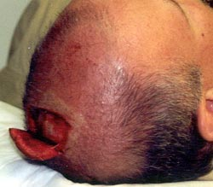

Slide 19
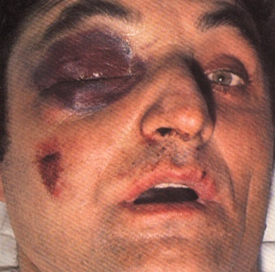
Signs of skull base fracture
Peri orbital hematoma
Black eye
Panda eye
If bilateral Raccoon’s eye
Otorrhea
Rhinorrhea

Slide 20
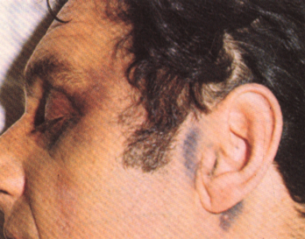
Battle’s sign

Slide 21
Bing bong fracture
Depressed skull fracture of infant.
Birth trauma or postnatal blunt traumas

Slide 22
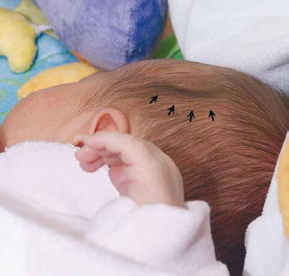
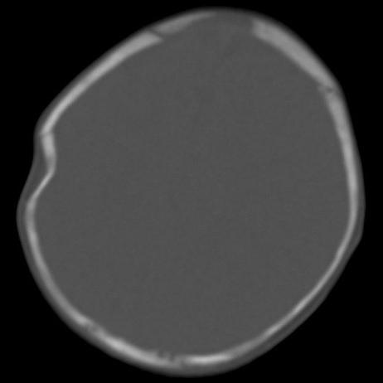

Slide 23
Treatment of depressed fracture
Surgical treatment if compressing underlying brain
Elevation
Craniotomy and reconstruction
Debridement

Slide 24
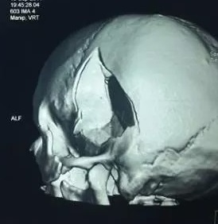



Slide 25
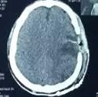

Slide 26
Intracranial hemorrhage
Epidural hematoma
Subdural hematoma
Subarachoid hemorrhage
Intracerebral hemorrhage
Intraventricular hemorrhage

Slide 27
EDH
Acute
Usually arterial
Biconvex or lens shaped
Not crossing sutures
Operate if > 1cm thickness, > thickness of skull, radiological evidence of compression on brain tissue.

Slide 29
Operated by craniotomy, evacuation of the EDH, and hitching of the dural edges.
Lucid interval.

Slide 31
Acute SDH
Usually venous
More diffuse than EDH
Crescent shaped
Cross sutures
Poor prognosis compared to EDH
Needs more aggressive management

Slide 32
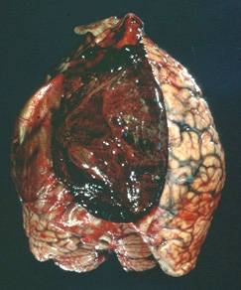

Slide 33
Operated by hemicraniectomy and dural widening procedure.

Slide 34
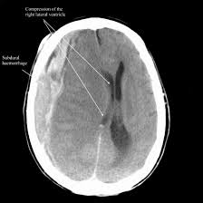

Slide 35
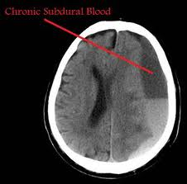
Chronic SDH
Elderly population
Mechanism
Minor trauma
Good prognosis

Slide 36
Simple burr holes and drainage.

Slide 37
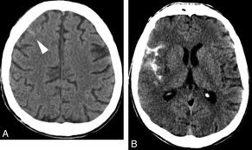
Subarachniod Hemorrhage
Presence suggests severity of trauma
Blood follows sulci and fissures

Slide 38
Traumatic ICH
Could be present at time of trauma or presented as delayed ICH hours to days after trauma.
Patient needs close observation and intensive therapy
Small without mass effect no surgical intervention
Large ICH needs evacuation.

Slide 40
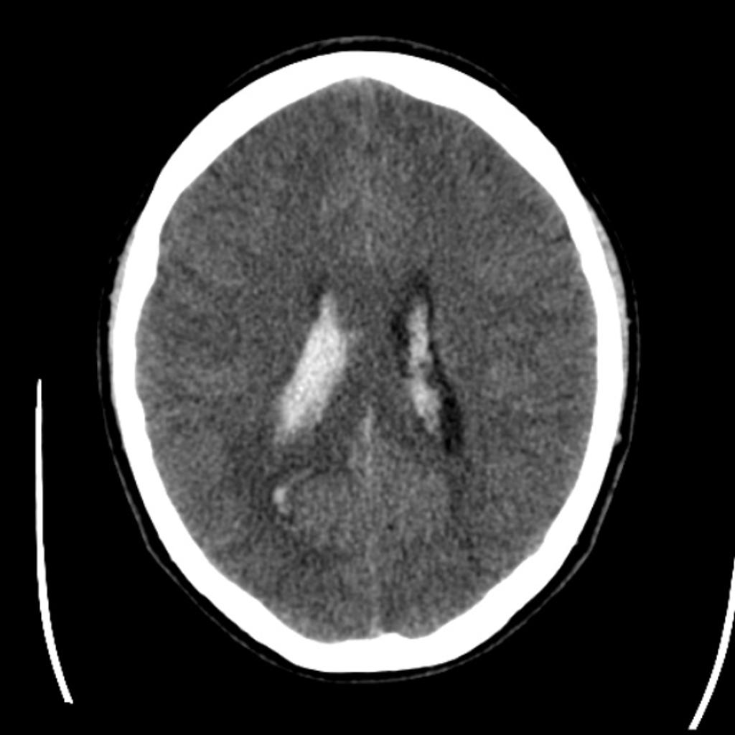
Intraventricular hge
Risk for post traumatic hydrocephalus
Treat with external ventricular drain

Slide 41
Management of TBI
ABC with
spine stabilization (associated spine injury)
Prevent secondary brain injury
Lower high ICP
Replace blood loss and improve oxygenation
IV antibiotics if open TBI
operation

Slide 42
Lowering ICP
Head bed elevation 30 degrees
Remove any neck compression
ICP monitoring
Mannitol or hypertonic saline
GA
Intermittent short hyperventilation
Surgery (hemicraniectomy)

Slide 43
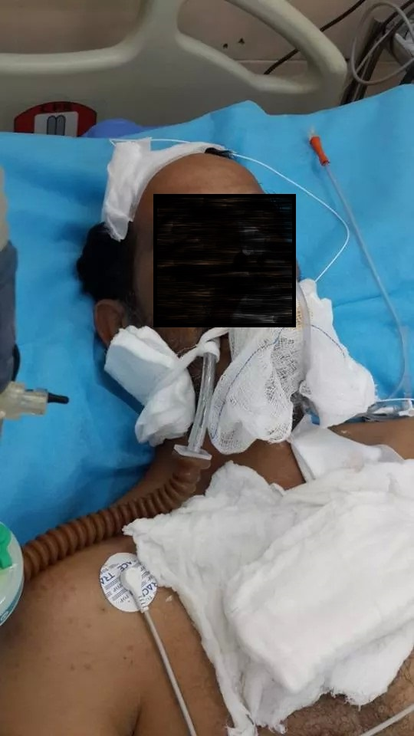
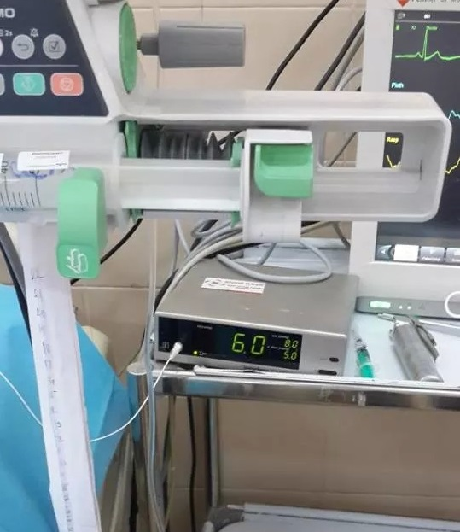

Slide 44
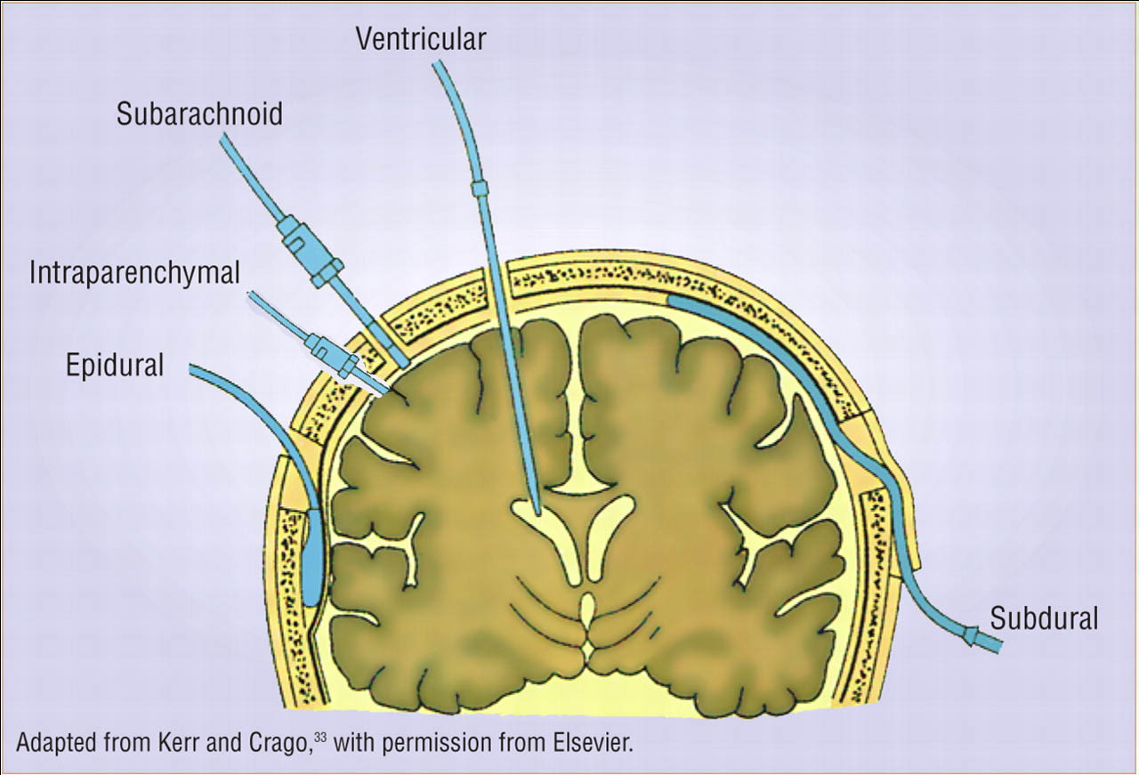

Slide 45
Aim is to control ICP and not exceeding 20 mm gh
Steroids are obsolete.

Slide 46
THANK YOU

