Slide 1
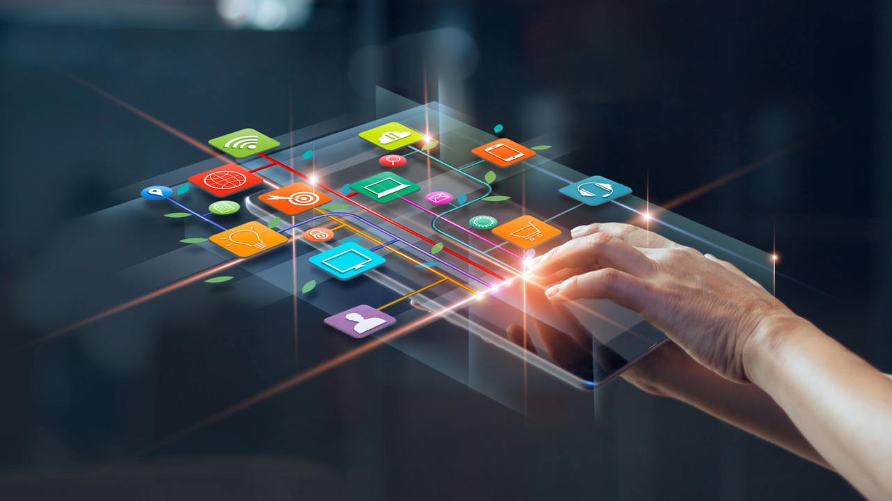

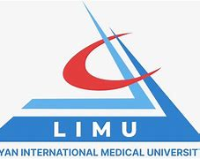
Tables of Content
  Libyan International Medical University
Faculty of Business Administration
ELEMENTS OF IMC
Integrated Marketing Communication- (Brand Equity)
DIFFERENCE BETWEEN DIGIRAL AND TRADITIONAL MARKETING
REFERENCES AND CONCLUSION
By Ghudai Dreza (2830) 9th of November 2022

Slide 2
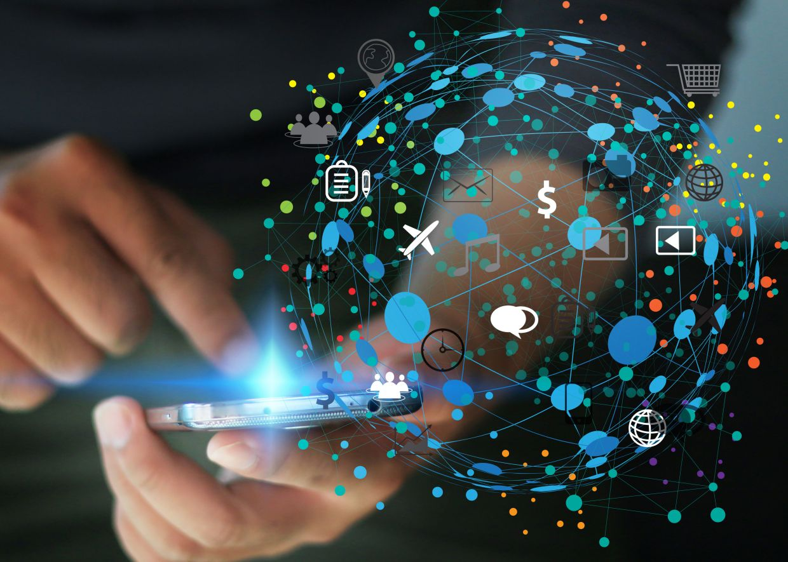
Integrated Marketing Communication- (Brand Equity)
Introduction
Tables of Content
INTRODUCTION
ELEMENTS OF IMC
INFORMATION PROCESS MODEL OF COMMUNICATION
DIFFERENCE BETWEEN DIGIRAL AND TRADITIONAL MARKETING
BENEFITS OF IMC
REFERENCES AND CONCLUSION

Slide 3
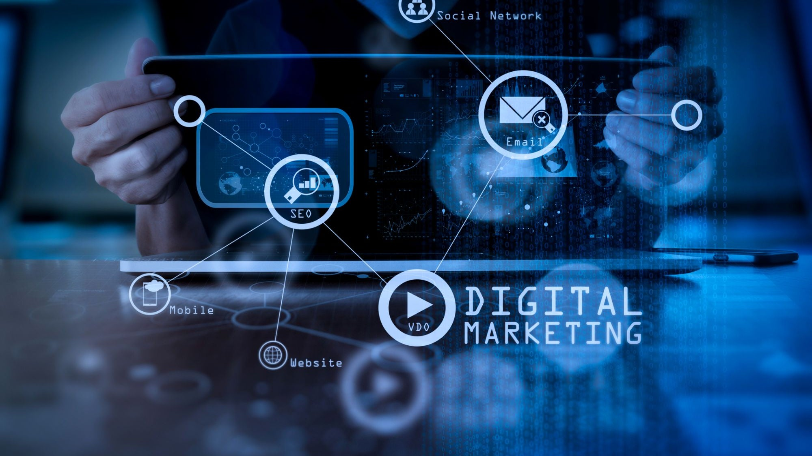
Introduction
IMC has five distinct elements that are used with accordance to marketing communication:
Public Relations
Social Media
Audience Analytic
Business Development Principles
Advertising
Integrated marketing communication is the process of unifying a brands messaging system to make it consistent with all the used media platforms, that either the business or brand uses to reach out for their targeted audience.

Slide 4
Elements of IMC
How can marketing contribute to a brands equity?
Identity (Building Brand Awareness)
Meaning (Communicating what the brand is about and what it stands for)
Response (Changing how the customer thinks and feels about the brand)
Relationship (Building stronger and deeper bonds with the customer, that is purely based on trust and loyalty)
IMC has five distinct elements that are used with accordance to marketing communication:
Public Relations
Social Media
Audience Analytic
Business Development Principles
Advertising

Slide 5
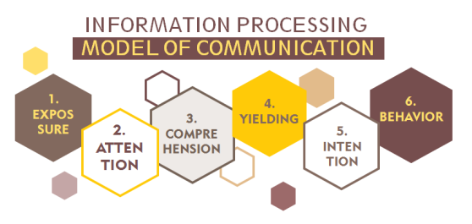
How can marketing contribute to a brands equity?
Identity (Building Brand Awareness)
Meaning (Communicating what the brand is about and what it stands for)
Response (Changing how the customer thinks and feels about the brand)
Relationship (Building stronger and deeper bonds with the customer, that is purely based on trust and loyalty)

Slide 6
  Information Processing Model of Communication
This model assumes that the receiver- in a persuasive communicating situation such as advertising- is an information processor or problem solver.

Slide 7
  What’s The Difference Between Digital and Traditional Marketing?
  Information Processing Model of Communication
Exposure is the process of strategically extending your brands message to the consumer. And advertising is a vital part in this psychologically systemised process.
Attention is being able to understand, as well as, notice the behaviour taken by the brands managers, to reach out for the consumer.
Comprehension is when a consumer develops an understanding for things or objects that are associated with the brand itself.
Yield means the consumer ‘gives-in’ to the brands intended message, hence they become favourable towards it.
Intentions are to plan an act for the desired manner of the communication.
Behaviour the consumer start to act upon the communicating behaviour exerted e.g. going to buy these new Nike trainers.

Slide 8
  What’s The Difference Between Digital and Traditional Marketing?
The difference between digital marketing and traditional marketing, is that one uses traditional platforms and channels which are sometimes displayed as a one-way process. Whereas, the other use’s digital media channels to reach out for their targeted audience. And which also associates with a two-way process.

Slide 9
  Examples of Traditional Marketing Platforms
Radio Advertisements
TV Advertisements
Billboards
Printed Media (Newspapers, Magazines, Leaflets (Flyers) etc…)
Mail Advertisements

Slide 10
  Examples of Digital Marketing Platforms
Social Media Advertisements
Website Advertisements
Email Advertisements
SEO (Search Engine Optimisation)
Affiliated Marketing

Slide 11
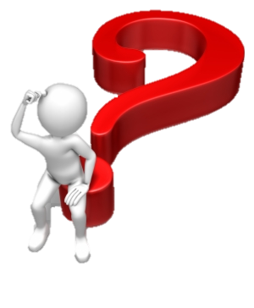
  CONCLUSION
  Benefits of IMC
There are numerous benefits to Integrated Marketing Communication, and some of those are the following:
Brand Reinforcement
Competitive Advantage
Cost Effectiveness
Expanding Reach for Targeted Audiences
Companies, as well as, Brands choose to use IMC (Integrated Marketing Communication) for purposes of reaching out to wider, and much focused targeted audiences.

Slide 12
  CONCLUSION
Companies, as well as, Brands choose to use IMC (Integrated Marketing Communication) for purposes of reaching out to wider, and much focused targeted audiences.

Slide 13
  References
Chaudhry Follow Banker and Teacher, J. (n.d.). Chapter 6 ((integrating marketing communications to build brand equity)) Retrieved November 20, 2022, from https://www.slideshare.net/ajc4040405/chapter-6-integrating-marketing-communications-to-build-brand-equity
Hendricks, B. (2022, April 1). benefits-of-integrated-marketing-communication. Study.com | Take Online Courses. Earn College Credit. Research Schools, Degrees & Careers. Retrieved November 20, 2022, from https://study.com/academy/lesson/benefits-of-integrated-marketing-communication.html
HARRIS, A. I. N. S. L. E. Y. (2015, August 15). The Top 10 Business Rivalries in history - fast company. Top-10-business-rivalries. Retrieved November 20, 2022, from https://www.fastcompany.com/3048493/the-top-10-business-rivalries-in-history
Bailey, J. (n.d.). Digital Marketing vs. traditional marketing Explained. What is the difference between Traditional Marketing and Digital Marketingthul. Retrieved November 20, 2022, from https://99designs.com/blog/marketing-advertising/digital-marketing-vs-traditional-marketing/

Slide 14
  THANK YOU FOR
  LISTENING

