Slide 1


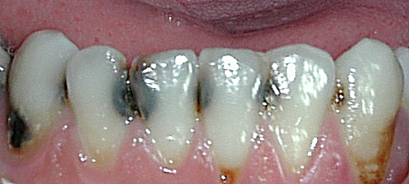
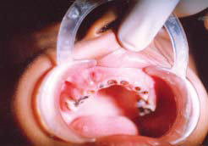
Lower Incisors of an Individual with Rampant Decay
Libyan International Medical University
Faculty Of Basic Medical Science
Rampant Caries
By: Amina A. Kweri 2nd year Dentistry
Introduction
Discussion
Treatment
Rampant caries is a suddenly appearing, rapidly burrowing type of caries resulting in early pulp involvement, in which more than 10 new lesions appear every year on healthy teeth surfaces.
Provisional restorations
Diet assessmet
Oral hygiene instruction
Home and professional fluoride treatment
Nursing bottle rampant caries is very common in infants.
Infants sleep with the nipple of the nursing bottle, containing milk and sugar
The sugar containing liquid provides an excellent culture medium for acidogenic microorganisms.
During sleep the salivary flow is decreased. ,The clearance of the liquid from the oral cavity is very much slowed, resulting in rampant caries.
Adolescent rampant caries – When rampant caries occurs in adolescent age, it is called adolescent rampant caries. During adolescence, some children habitually take chocolates, toffees and biscuits in their mouth and go to sleep.
Xerostomia-induced rampant caries the result from decrease in the secretion of the saliva due to hypofunction of salivary gland .
Conclusion
The rampanat caries result quickly in the pulp and have 3 types.
Nursing bottle rampant caries is the most common type and it is rarely in the adult , the Xerostomia-induced rampant caries result from decrease in the secretion of the saliva.
Lower Incisors of an Individual with Rampant Decay
Types Of Rampant Caries
Nursing bottle rampant caries.
Adolescent rampant caries.
Xerostomia-induced rampant caries
References
Chandra S, Chandra S, Chandra G. In: Textbook of Operative Dentistry. 1st ed. New Delhi: Jaypee Brothers; 2007. Clinical aspects of dental caries; p. 37.
Shafer WG, Hine MK, Levy BM. In: A textbook of Oral Pathology. 4th ed. Philadelphia: W.B. Saunders Co; 1983. Dental Caries; pp. 433–4.

