Slide 1


Gfgy
The Difference Between CSR and Corporate Citizenship
Libyan International Medical University
Faculty of Business Administration
BY: Salim Alshuhoomi
ID:2708
EMAIL:salim_2708@limu.edu.ly
1

Slide 2
Contents
1. Corporate social responsibility
2. What Is Corporate Citizenship
3. What is good corporate citizenship
4. Conclusion
5. References
2

Slide 3
Corporate Social Responsibility
A business model in which companies make a concerted effort to operate in ways that enhance rather than degrade society and the environment. CSR helps both society and the brand image of companies.
Corporate responsibility programs are a great way to raise morale in the workplace.
3

Slide 4

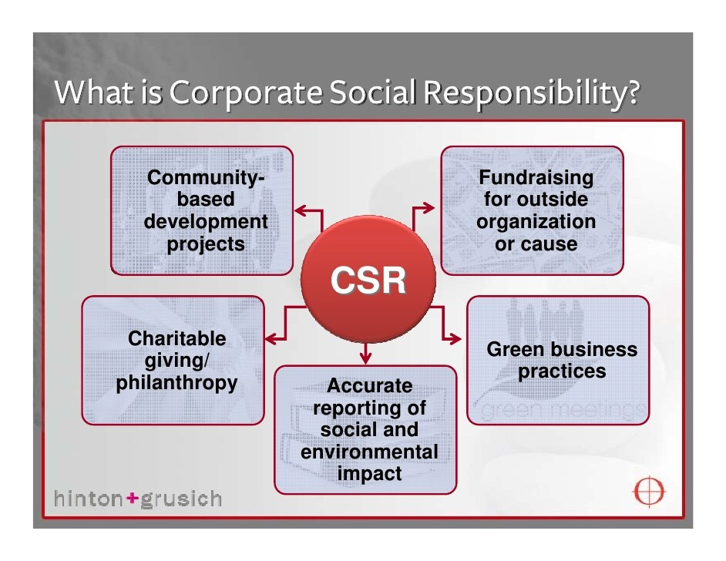
4

Slide 5
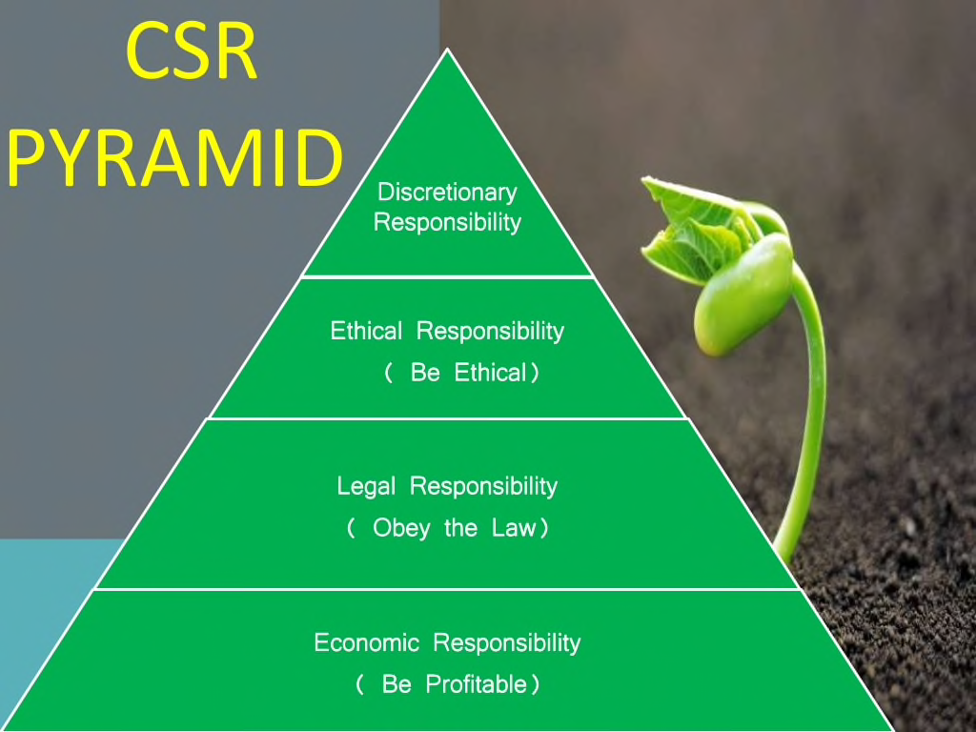
5

Slide 6
What Is Corporate Citizenship?
Often mentioned in tandem with CSR, corporate citizenship is used to describe the contribution a business or organization makes to the local community or society as a whole. It follows that a company which is strong on the CSR agenda with several initiatives on the go is also a good corporate citizen.
6

Slide 7
What is Good Corporate Citizenship?
A good corporate citizen means being guided by strong moral and ethical standards in daily interactions with customers shareholders, employee.
7

Slide 8
Conclusion
Corporate citizenship refers to a company’s responsibilities toward society. The goal is to produce higher standards of living and quality of life for the communities that surround them and still maintain profitability for stakeholders.
8

Slide 9
References
Editors of Encyclopedia Britannica. (2018). citizenship | TheDefinition, History, & Facts. In Encyclopædia Britannica. https://www.britannica.com/topic/citizenship
Hayes, A. (2021, September 21). Corporate citizenship: What you should know. Investopedia. Retrieved October 27, 2021, from https://www.investopedia.com/terms/c/corporatecitizenship.asp.
9

