Slide 1


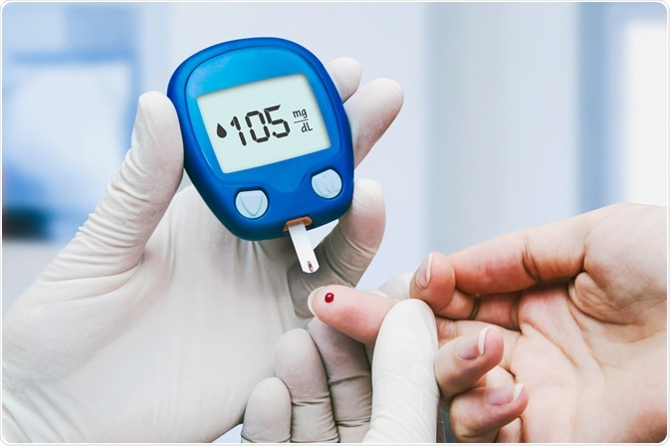
CARBS INTAKE &
DIABETES
Manar Abdulsalam
3365
1/6/2022
Year 1
PTS block

Slide 2
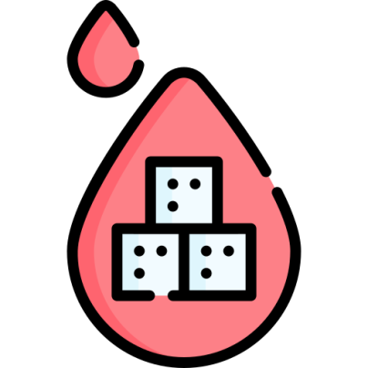
Introduction
The number of people with diabetes rose from 108 million in 1980 to 422 million in 2014.
In 2019, diabetes was the ninth leading cause of death with an estimated 1.5 million deaths directly caused by diabetes

Slide 3

Objectives
Define Diabetes mellitus
List Signs of Diabetes mellitus
Describe Diabetes type II causes
Outline Complications of Diabetes mellitus
Enumerate Ketogenic diet and Diabetes mellitus

Slide 4
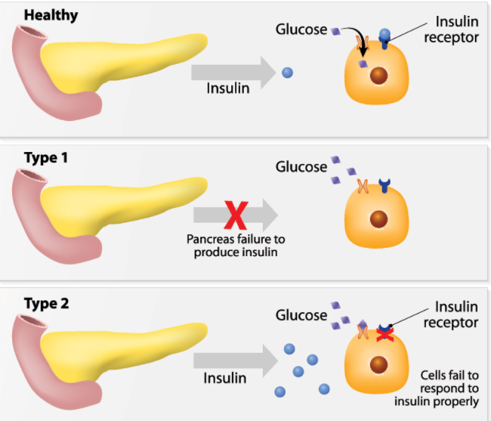
Types of diabetes

Slide 5
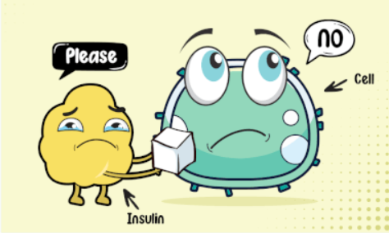
Diabetes mellitus
It’s a disease may be genetic or developed over time by having unhealthy lifestyle
Body does not generate enough insulin or insulin is not being used very well due to insulin resistance
Blood glucose level is too high as the insulin fails to let the glucose get into body cells

Slide 6
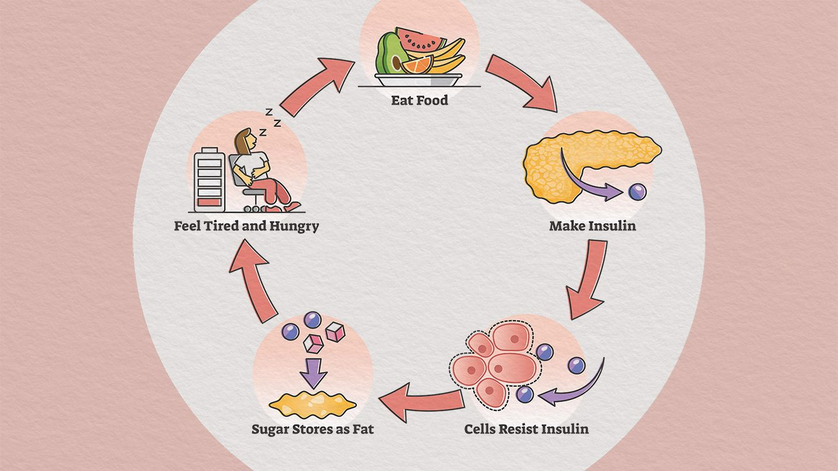
Insulin Resistance

Slide 7
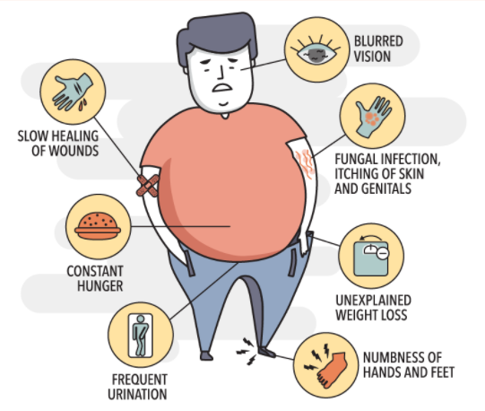
Signs of diabetes mellitus
Fatigue.
Constant hunger
Weight loss
Frequent urination
Thirst
Blurred vision

Slide 8
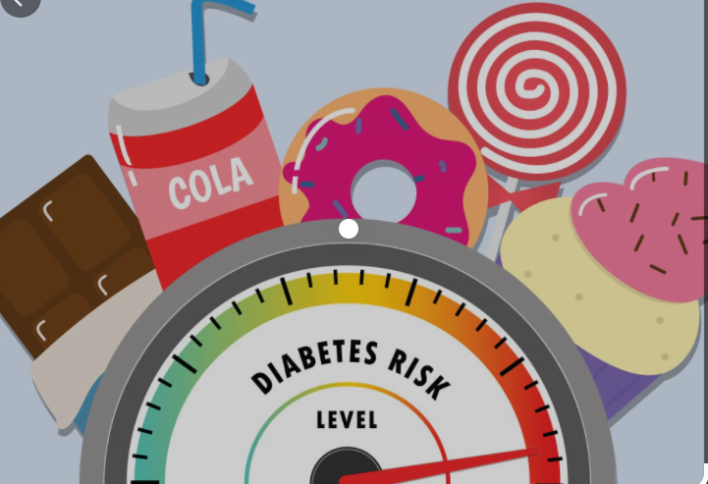



Causes of Diabetes mellitus II
Insulin resistance
Diet
Physical inactivity
Excess body fat
Certain medications
Hormonal disorders
Genetic conditions

Slide 9
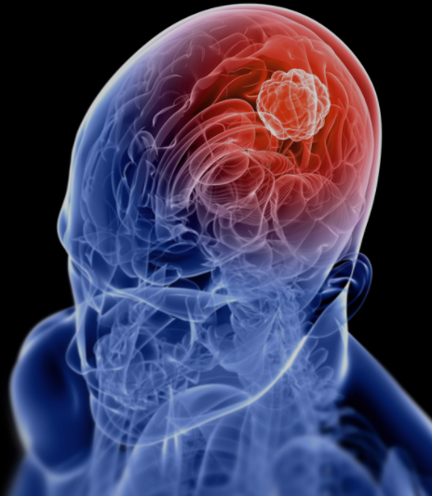
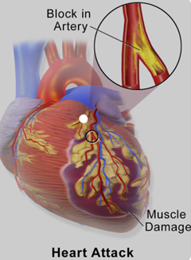
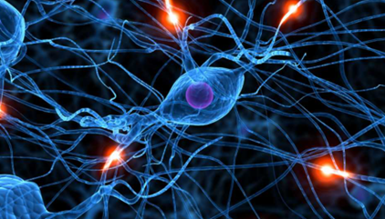
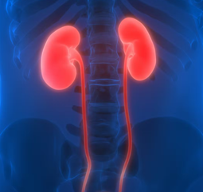
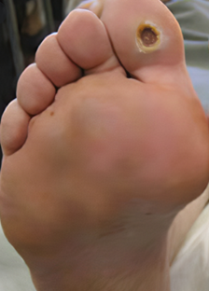
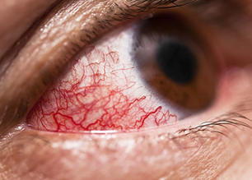
Complication of Diabetes mellitus
Heart attack
Stroke
Kidney problems
Eye damage
Nerve damage
Diabetic foot

Slide 10


Treatment for Diabetes II
Healthy diet (Ketogenic diet )
Exercise
Weight loss
Intermittent fasting

Slide 11
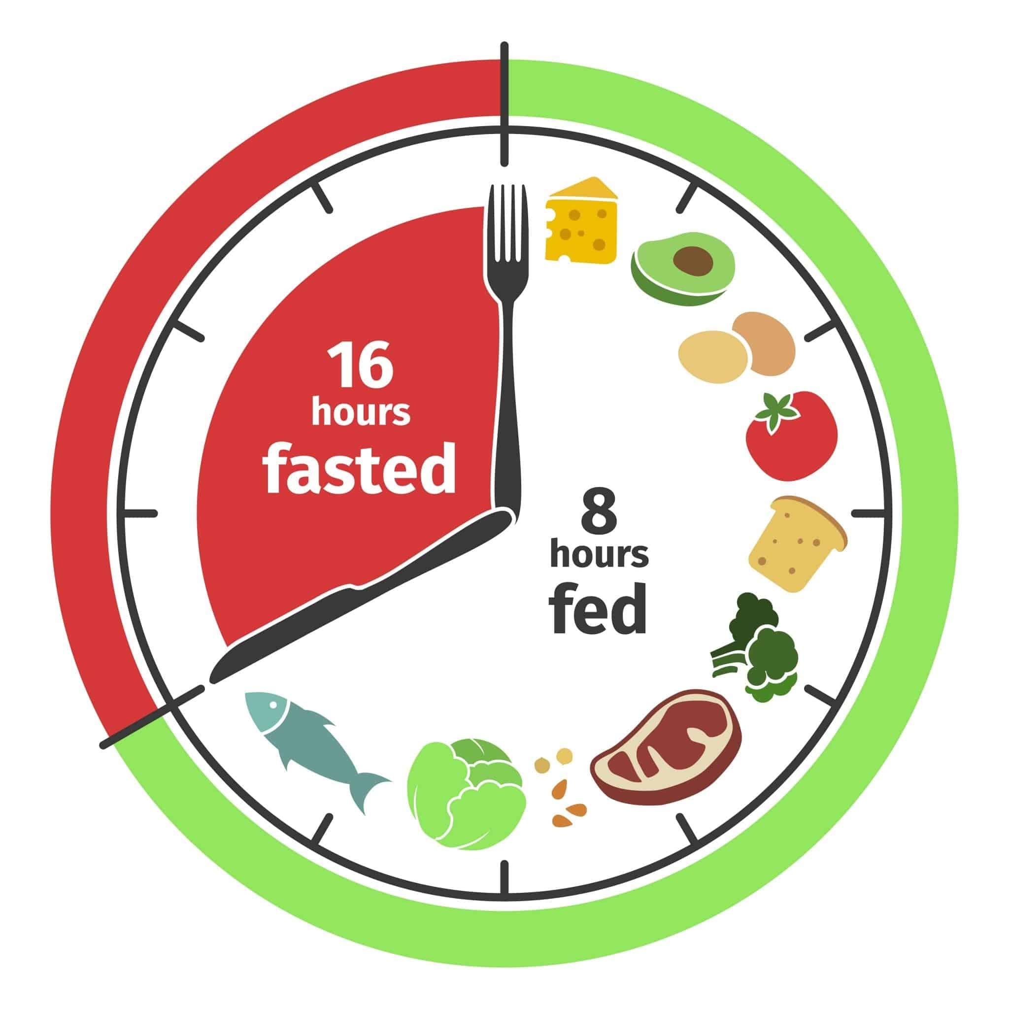
Intermittent fasting

Slide 12
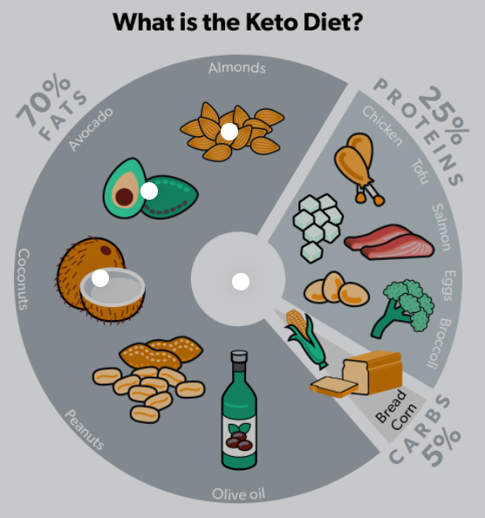
Ketogenic diet
The ketogenic diet (KD) is a high-fat, low-carbohydrate, and adequate-protein diet
Regulate blood sugar level
No risk for obesity or cardiovascular diseases.

Slide 13

Conclusion
‘‘Those who think they have no time for healthy eating , will sooner or later have to find time for illness”

Slide 14
References
U.S. National Library of Medicine. (2022, March 17). Type 2 diabetes| adult-onset diabetes. MedlinePlus. Retrieved April 20, 2022, from https://medlineplus.gov/diabetestype2.html
Who.int. 2022. Diabetes. [online] Available at: <https://www.who.int/news-room/fact-sheets/detail/diabetes> [Accessed 27 April 2022].
Papatheodorou, K., Banach, M., Edmonds, M., Papanas, N., & Papazoglou, D. (2015). Complications of diabetes. Journal of diabetes research. Retrieved April 27, 2022, from https://www.ncbi.nlm.nih.gov/pmc/articles/PMC4515299/
Insulin resistance: What it is, causes, symptoms & treatment. Cleveland Clinic. (n.d.). Retrieved April 27, 2022, from https://my.clevelandclinic.org/health/diseases/22206-insulin-resistance

Slide 15
References
Mobbs, C. V., Mastaitis, J., Isoda, F., & Poplawski, M. (2013). Treatment of diabetes and diabetic complications with a ketogenic diet. Journal of Child Neurology, 28(8), 1009–1014. https://doi.org/10.1177/0883073813487596

Slide 16



By Manar Abdulsalam
Thank
you !

