Slide 1




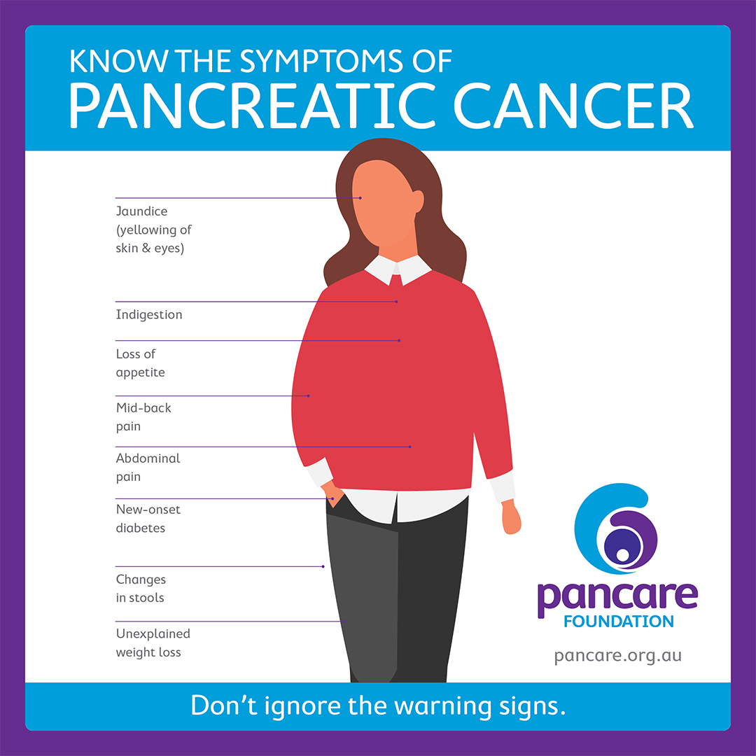
Is There any Association Between Diabetes Type II and Pancreatic Cancer
Libyan International Medical University
Faculty of Medicene
Ali Salah Al fallah (1554) 4th year Medical student
LIMU
Introduction
Does Metaformin has a Role ?
, Type 2 DM is likely the third modifiable risk factor for pancreatic cancer after cigarette smoking and obesity, long-term type 2 DM is associated with a 1.5-fold to 2.0-fold increase in the risk of pancreatic cancer, The relationship between diabetes and pancreatic cancer is complex. Diabetes or impaired glucose tolerance is present in more than 2/3rd of pancreatic cancer patients. Epidemiological studies have consistently shown a modest increase in the risk of pancreatic cancer in type 2 diabetes .¹
Signs & Symptoms of pancreatic cancer
A number of studies of diabetics have shown that treatment with metformin, the most commonly used antidiabetic drug, is associated with lower risk of cancer than is treatment with insulin.
Metformin can inhibit proliferation and stimulate apoptosis in tumor cell lines
These observations suggest that metformin is a promising chemopreventive drug for use against cancer and that use of it may not be limited to patients with diabetes.
The main molecular mechanism of metformin's effect on metabolism and growth inhibition are mediated through the liver kinase B1 (LKB1)/5′ AMP-activated protein kinase (AMPK) signaling Pathway^{2,3}
Risk Factors of pancreatic cancer
Conclusion
Modifiable
Non -Modifiable
The observed causal relationship between long-term type 2 diabetes mellitus and pancreatic cancer and the protective effect of the antidiabetic drug metformin against pancreatic cancer may decrease the risk of pancreatic cancer in type 2 diabetes.
Obesity
Smoking
Chronic Pancreatitis
Diabetes
Genetic
Family History
Race
Age (older than 60)
Male
Courovoisier Sign
Palpable Gall bladder
References
Nihgov. (2013). PubMed Central (PMC). Retrieved 12 May, 2020, from https://www.ncbi.nlm.nih.gov/pmc/articles/PMC3238796/
Hindawicom. (2013). Hindawicom. Retrieved 12 May, 2020, from https://www.hindawi.com/journals/isrn/2013/583786/
Wileycom.(2011). Wileycom. Retrieved 12 May, 2020, from http://onlinelibrary.wiley.com/wol1/doi/10.1002/mc.20771/
Diabetic Related Mechanisms
Suggested Hypothesis
Signaling pathways that regulate the metabolic process play important roles in cell proliferation and tumor growth. Along with Insulin Resistance, Hyperglycemia , Hyperinsulinemin, Inflammation²
Insulin level
Insulin resistance and compensatory hyperinsulinemia as well as elevated levels of circulating insulin-like growth factors (IGFs) are perhaps the most hypothesized mechanisms underlying the association between type 2 diabetes mellitus and pancreatic Cancer²

