Slide 1


The Impact of Socioeconomic Statues on Life Quality
-Block: PTS.
-Date: 3/4/2022
-Presented by: Tahani Yousef Hilali.
-Roll No: 2722.
1

Slide 2
Objectives
Define environmental quality.
Discuss the Socioeconomic Environment and measuring status.
Outline risk factors for poverty and low socioeconomic status.
Discuss the Health impacts of Socioeconomic status.
Discuss the Indoor Environments and Health.
2

Slide 3
ENVIRONMENTAL QUALITY:
Is properties and characteristics of the environment, either generalized or local, as they impinge on human beings and other organisms.
Such as:
Air and Water purity or pollution
Access to open space
The Visual effects of buildings
Potential effects
3

Slide 4
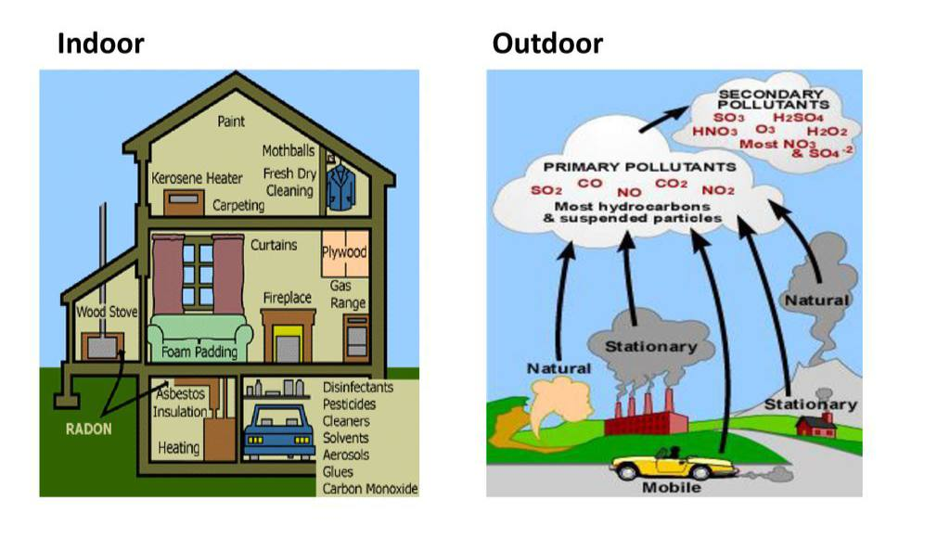
4
4

Slide 5
Socioeconomic Environment:
Is a complex relationships between economic systems and social
structures. These systems and structures impact the distribution of
resources, money and power in a community and around the world.
Measuring Status
A person’s SES is comprised of their:
Economic Status Income and Education
Social Status Power and rank in a group
Work Status Occupation
5

Slide 6
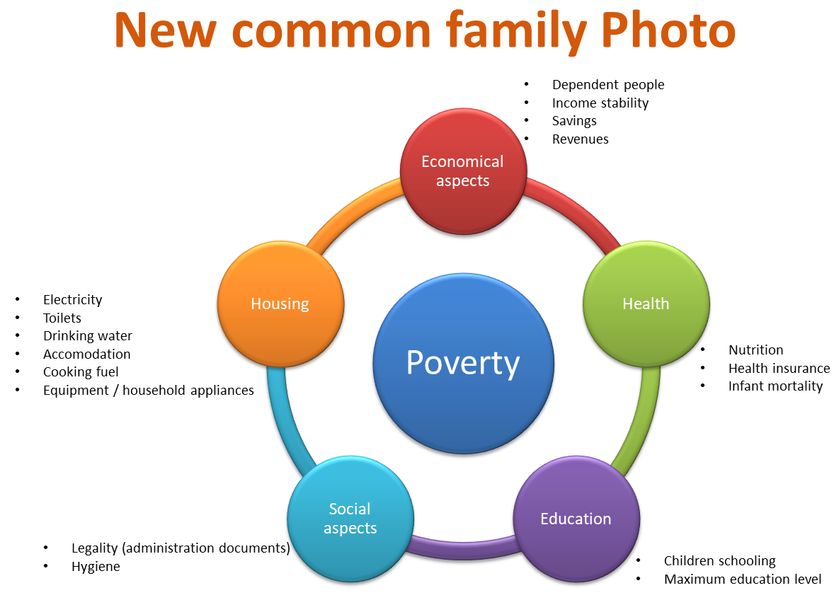
POVERTY
Insufficient resources to meat basic human needs.
6

Slide 7
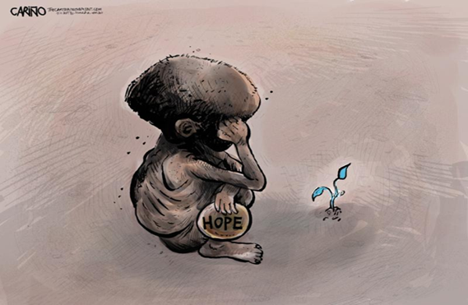
Risk factors for low socioeconomic status
Illness.
Single parenthood.
High child:adult ratio.
Teenage pregnancy.
Unplanned pregnancy.
Maternal social isolation.
Low parental involvement.
Low educational attainment.
7

Slide 8
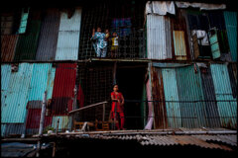
Health Impacts of SES
A pattern of disease and premature death corresponds to the social and economic environment in which a person lives, known as the
social determinants of health.
8

Slide 9
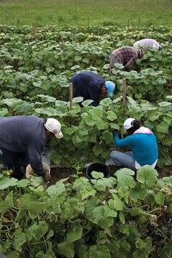
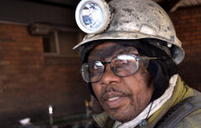
Occupation and Health
Health Outcomes of Work-related Stress
In blue-collar workers, overtime is associated with fatigue, sleep deprivation and risk for work related accidents.
In white-collar workers, job strain is associated with modest
increases in blood pressure.
Men with job strain and low SES are at increased risk of elevated blood pressure.
9

Slide 10

Education and Health
Individuals with higher educational attainment are more likely to live
longer and healthier lives, as are their children.
10

Slide 11
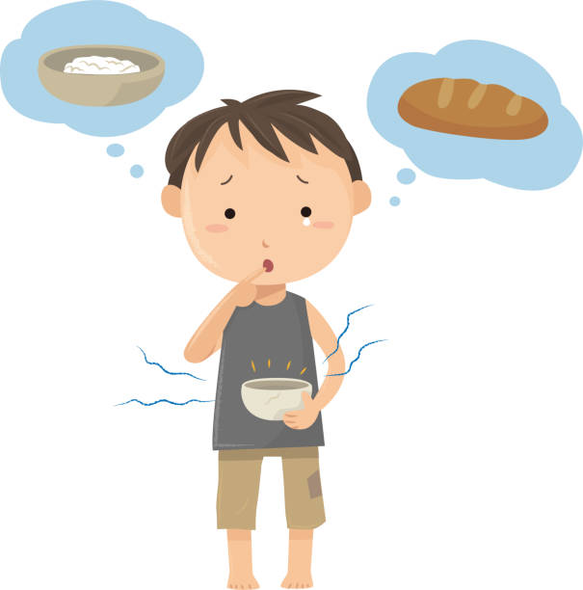
Nutrition and Poverty
Poverty increases the risk of poor nutrition.
Globally, poverty is associated with chronic kidney disease (CKD).
Low-income families are more likely to experience maternal nutritional deficiencies and, especially in developing countries, preterm birth, low birth weight and other poor birth outcomes.
11`

Slide 12
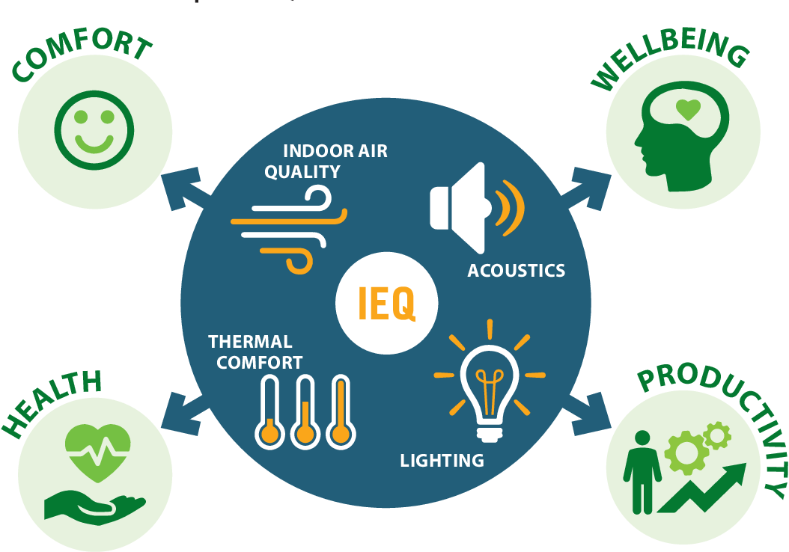
Indoor Environmental Quality
“ The features of our indoor environments that can affect our health and well-being include noise, temperature, humidity and mold, light, air
quality, lead paint, electromagnetic and radiofrequency radiation and
water quality.”
12

Slide 13
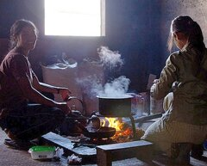
Indoor Environments and Health
According to the WHO:
About 3 billion people using open fires and simple stoves burning biomass and coal.
more than 4 million people die prematurely
More than 50 percent of premature deaths due to pneumonia among
(children under 5)
3.8 million premature deaths from noncommunicable diseases (stroke, IHD,COPD and lung cancer).
13

Slide 14
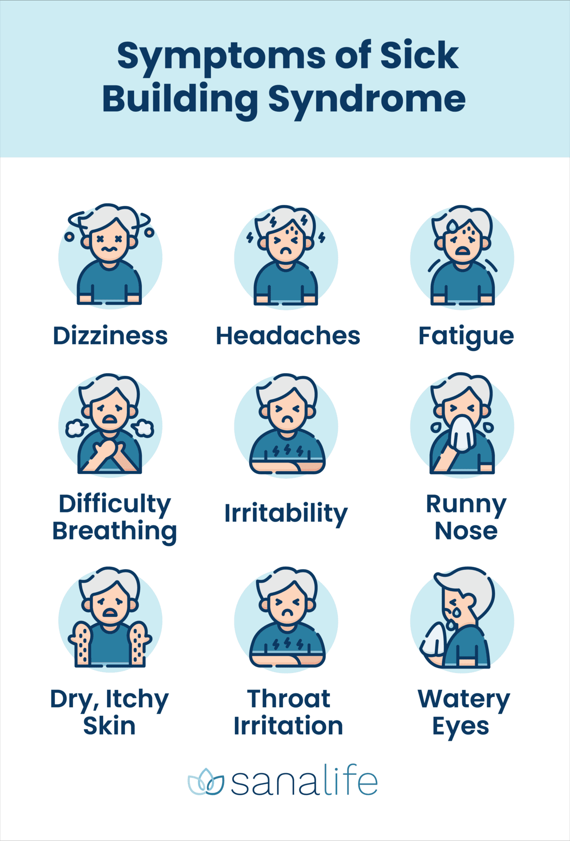
Sick Building Syndrome and Building-related Illnesses
"Sick building syndrome" (SBS) describes situations in which building
occupants experience acute health effects that appear to be linked to time
spent in a building, but no specific illness or cause can be identified.
"Building-related illness" (BRI) refers to diagnosable illnesses that can be
attributed directly to airborne contaminants in buildings
14

Slide 15
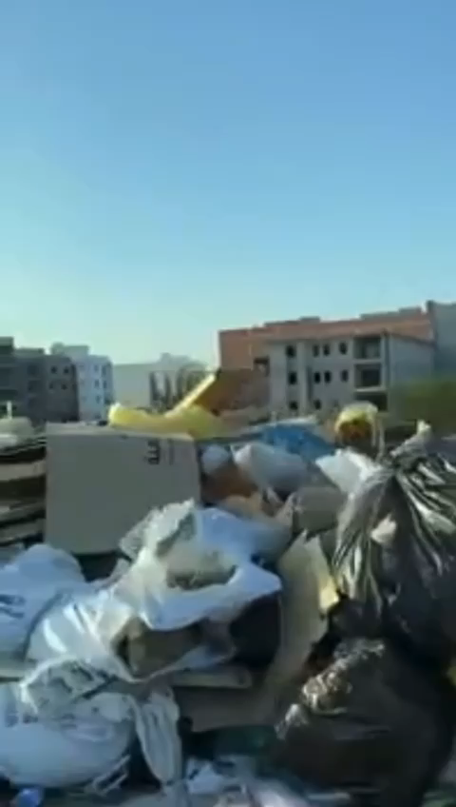
15
Notes:
Tripoli, Libya, July2019

Slide 16
Conclusion
Control Pollutants
Introduce daylight and views
Provide occupants with controls
Acoustic and thermal comfort
Maintain high quality indoor environments
Minimize the risk of building related health problems
16

Slide 17
“We won’t have a society if
we destroy the environment”
Margaret Mead
17

Slide 18
References
Environmental Quality | Healthy People 2020 [Internet]. Healthypeople.gov. 2020 [cited 20 February 2022]. Available from: https://www.healthypeople.gov/2020/leading-health-indicators/2020-lhi-topics/Environmental-Quality.
Built Environment [Internet]. The Collaborative on Health and the Environment. 2020 [cited 2 March 2022]. Available from: https://www.healthandenvironment.org/environmental-health/environmental-risks/built-environment.
Socioeconomic Environment [Internet]. Collaborative on Health and the Environment. 2020 [cited 2 March 2022]. Available from: https://www.healthandenvironment.org/environmental-health/environmental-risks/socioeconomic-environment.
Hajat A, Hsia C, O'Neill MS. Socioeconomic Disparities and Air Pollution Exposure: a Global Review. Curr Environ Health Rep. 2015 Dec;2(4):440-50. doi: 10.1007/s40572-015-0069-5. PMID: 26381684; PMCID: PMC4626327.
18

Slide 19
THANK You
19

