Slide 1
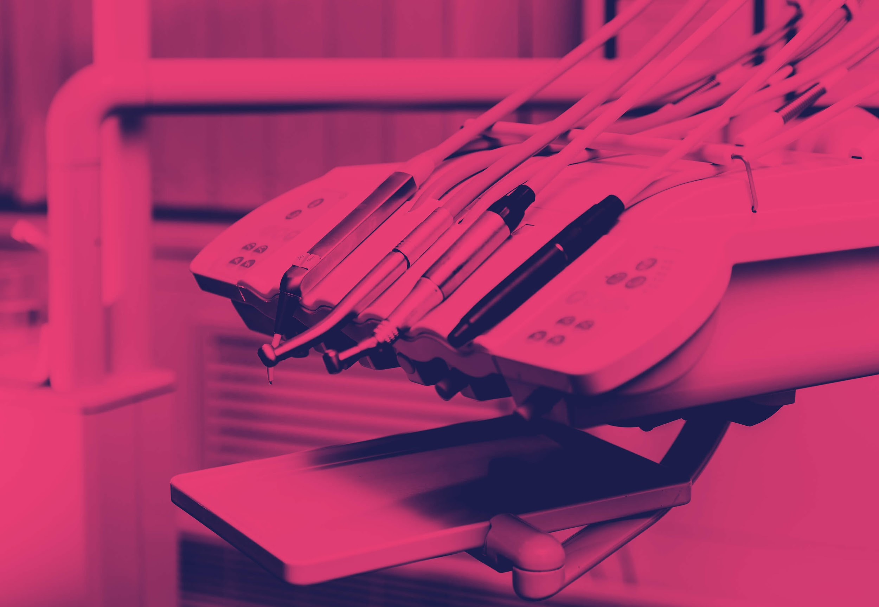


Fluoride and its association
With dentin hypersensitivity
By:
Abdul Nasser Saad Bakar
2884
Second Year:
Dental student

Slide 2
Objectives
Role of fluoride in management of dentin hypersensitivity.
Short-term efficacy of an occluding toothpaste providing D-H relief.
Inadequate or excessive fluoride effect on D-H and caries.
Lazer effect on prevention and treatment of D-H.
2

Slide 3
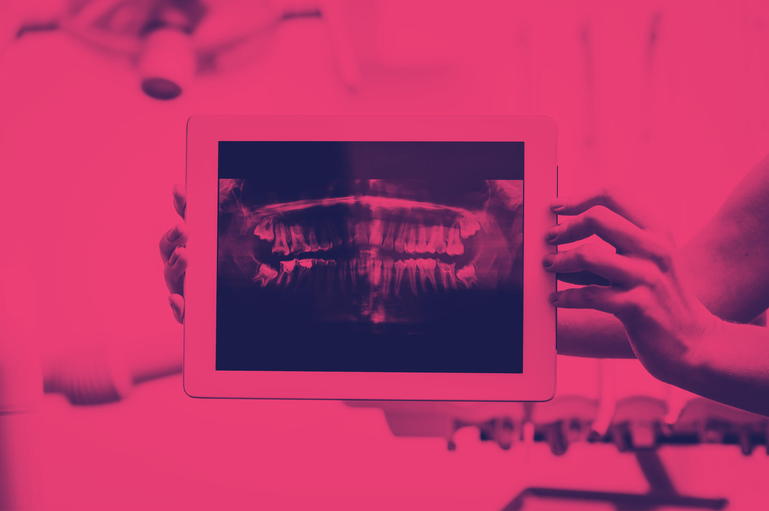
Introduction
What is Dentin hypersensitivity?
It is characterized by rather specific sharp intensive short duration tooth pain, caused when the cervical Cementum/Dentin surfaces exposed for different stimulis.
3

Slide 4
Stimulation of D-H :
Thermal
Evaporative
Tacticle
Osmotic
Chemical
Electrical
(Cold-warm)
(Air blast)
(Prob-scaling)
(sugars)
(Acids)
(Pulp-testers)
4

Slide 5
Factors causing sensitivity:
Diet high in acidic foods and beverages which wear away the tooth enamel.
Aggressive tooth brushing damage the enamel and causes gum recession.
poor oral hygiene.
Genetics.
5

Slide 6
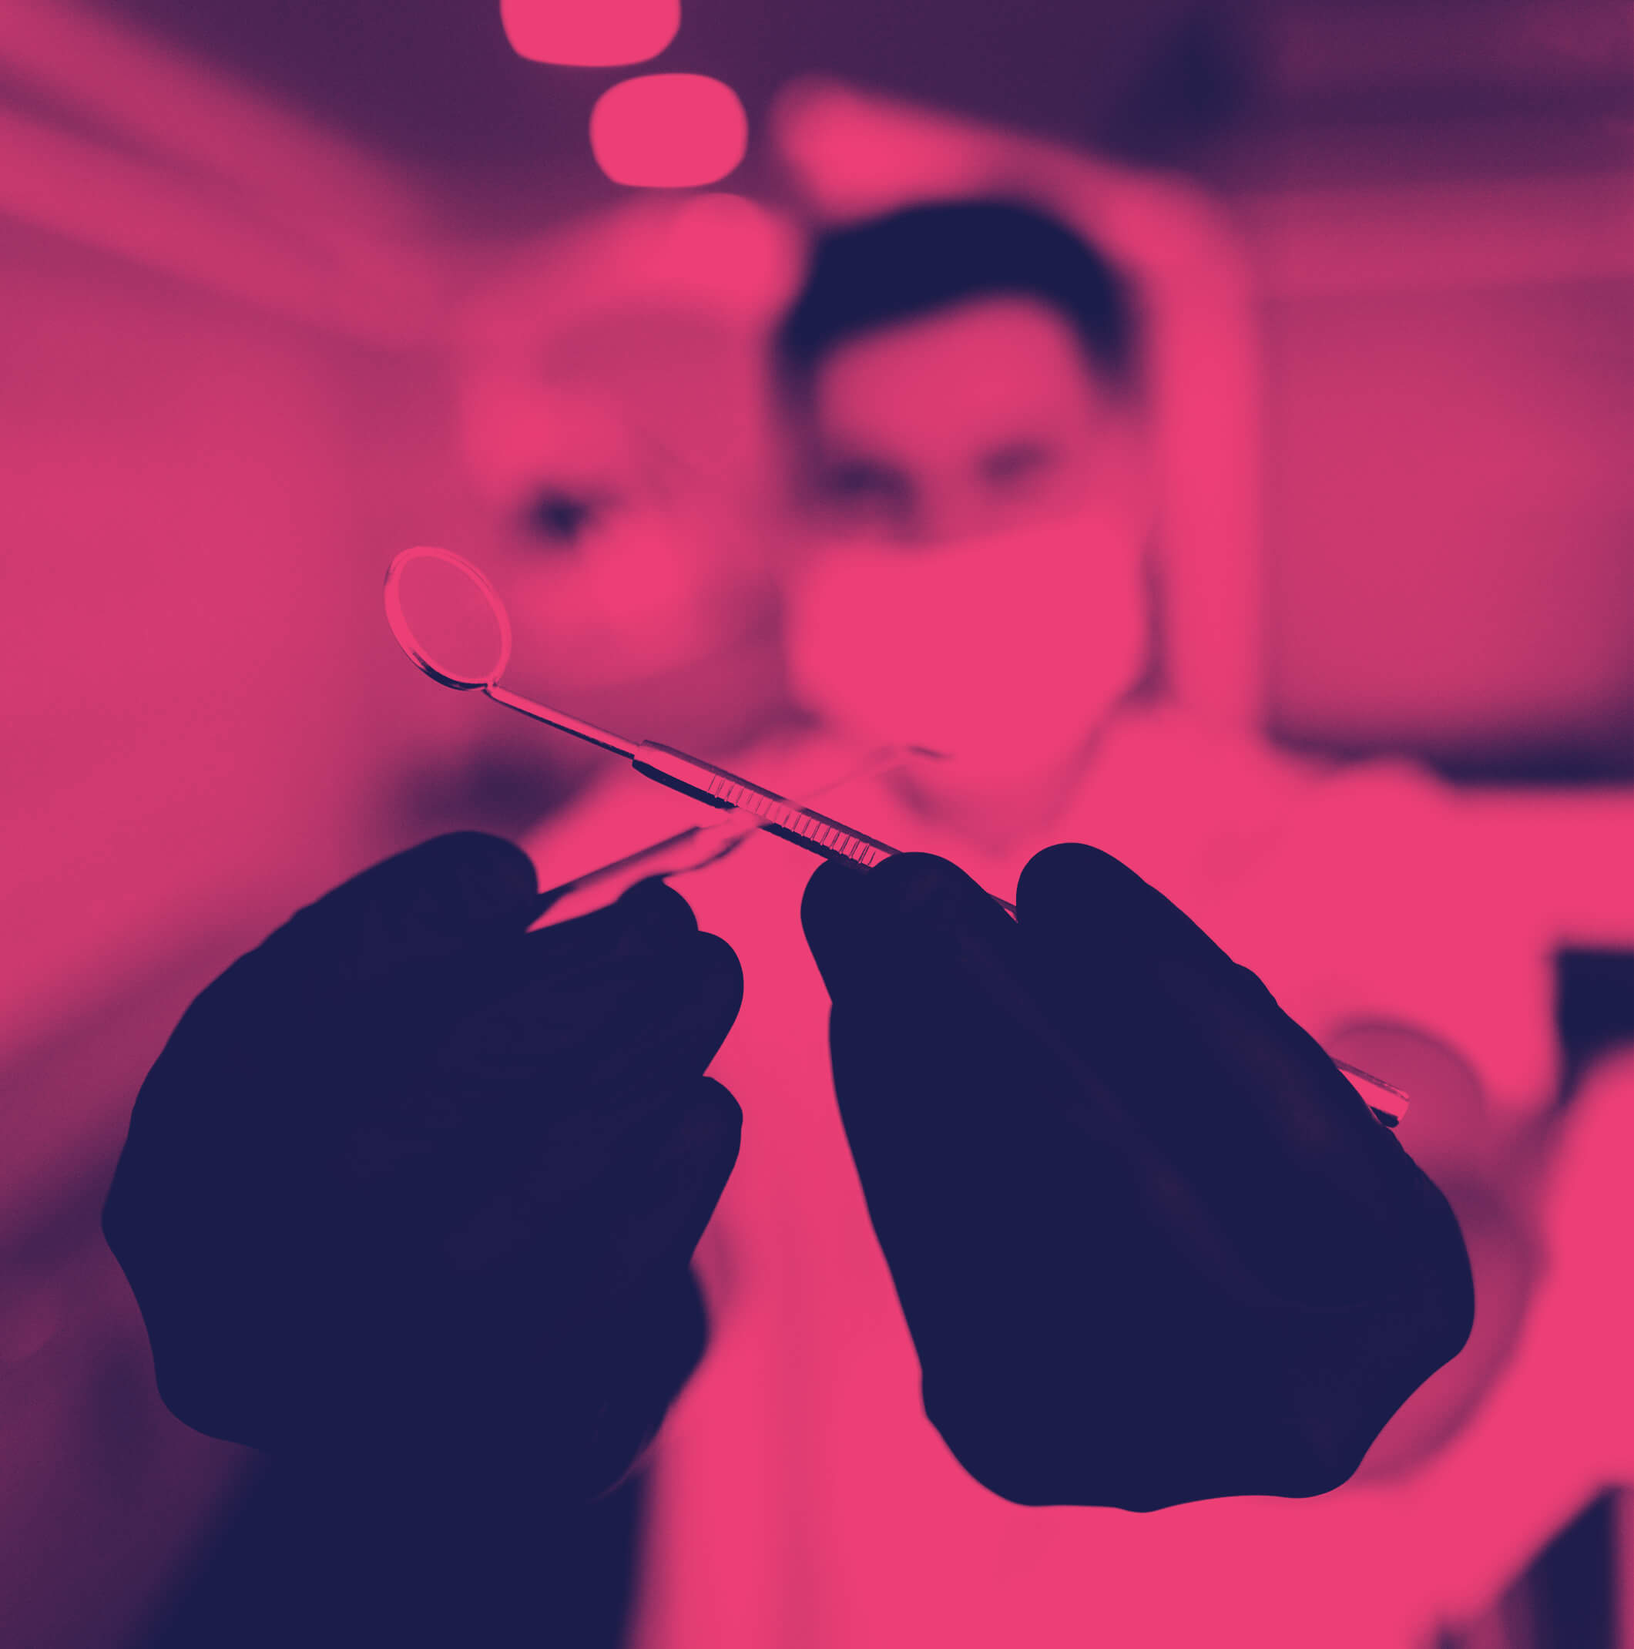
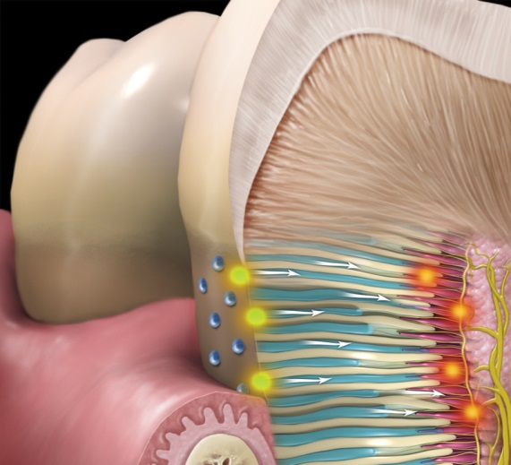
1
Role of flouride in management of D-H
6

Slide 7
The main management is following identification and removal of predisposing factors.
Twice a day use of desenitizing fluoride toothpaste.
This will help the formation of calcium flouride crystals block the open dentin tubule.
7

Slide 8
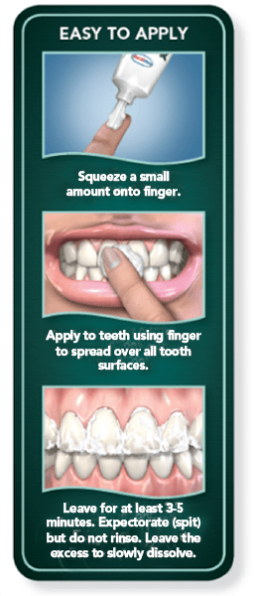
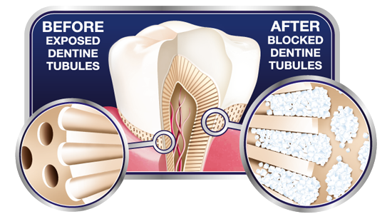
2
Short-term efficacy of an occluding toothpaste providing D-H relief
8

Slide 9
The effective occluding ingredient used is fluoride (snf2).
The "three day study" showed that using toothpaste that contain flouride on finger tip for 60s twice a day, relief D-H control.
These studies focused brushing with (snf2) reduces D-H compared with conventional toothpaste.
9

Slide 10
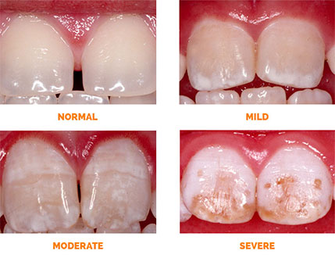
3
Inadequate and excessive fluoride effect on D-H
10

Slide 11
Inadequate flouride increase the risk of caries and D-H, because the enamel is less resistant and the optimal hygiene is not provided.
Adequate intake has beneficial effect on oral health, prevent caries and D-H by several actions when present in saliva makes the enamel more resistant.
High intake can induce toxic effects by binding with calcium, Enamel flurorosis can develop only in children during tooth development.
11

Slide 12
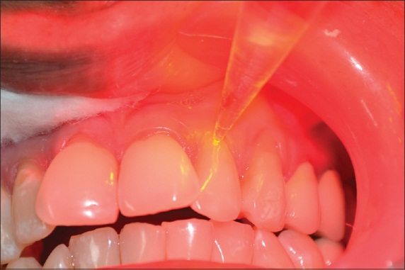
4
Lazer effect on prevention and treatment of D-H
12

Slide 13
Diode lasers reduce D-H immediately after bleaching.
Also protect cervical restoration from D-H due to tubular occlusion.
The application of lasers is effective not only in terms of treatment of D-H, also in prevention of this intensive tooth pain.
YAG laser has shown the best result in D-H treatment.
13

Slide 14
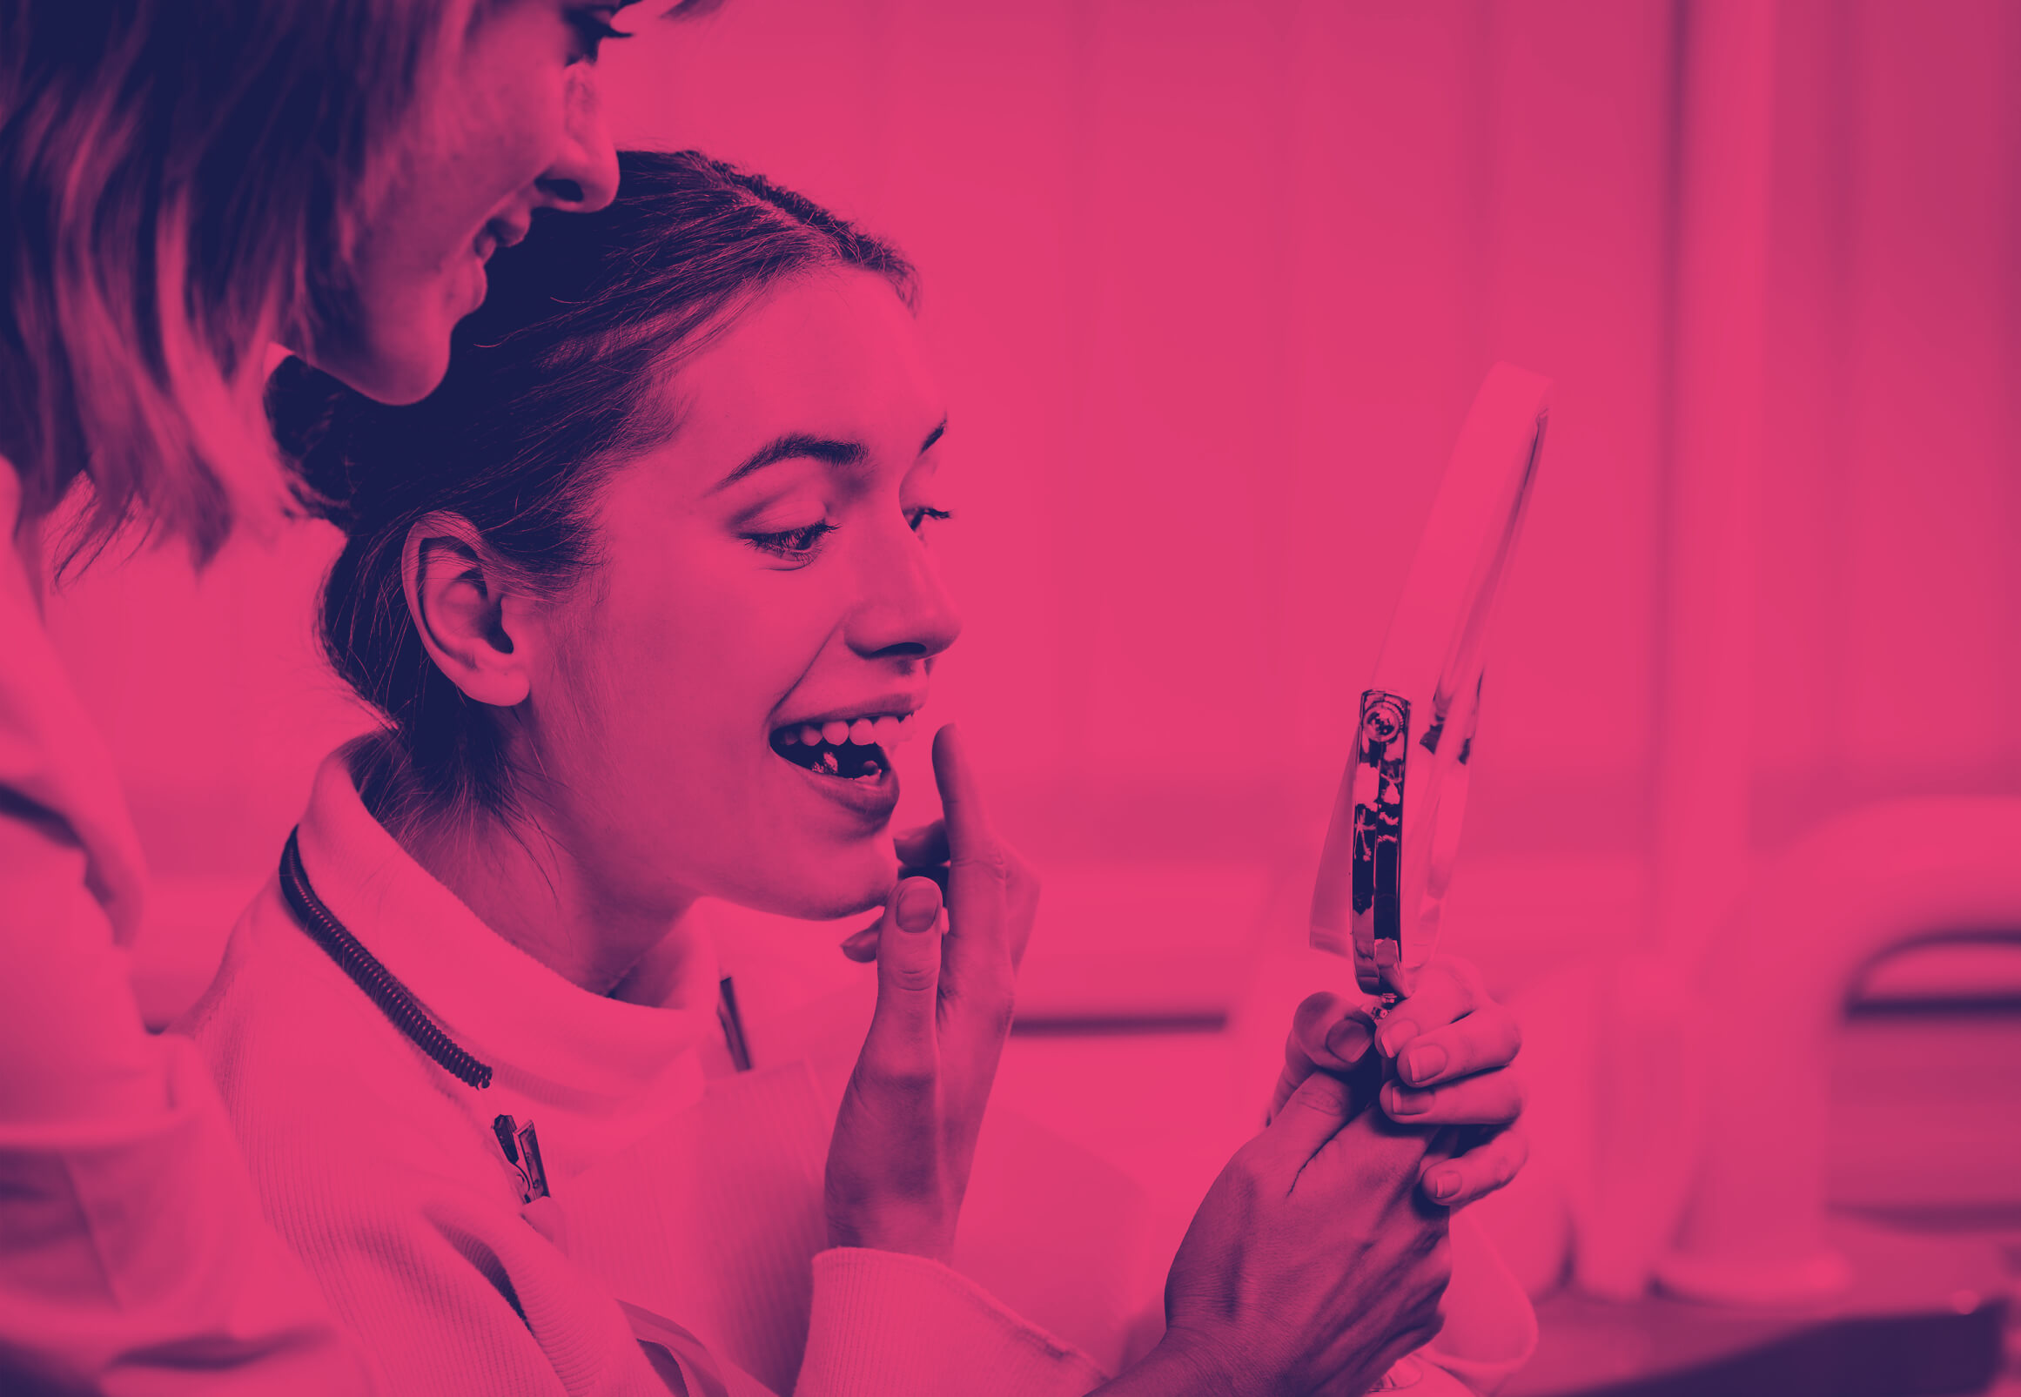
Conclusion
1
Fluoride is important in management of D-H.
2
Hygiene is so important for your oral health, especially when it comes to Fluoride containing Toothpaste.
3
It's important to use the perfect amount of fluoride to prevent the side effects.
4
Lazer beneficial effects on D-H.
14

Slide 15
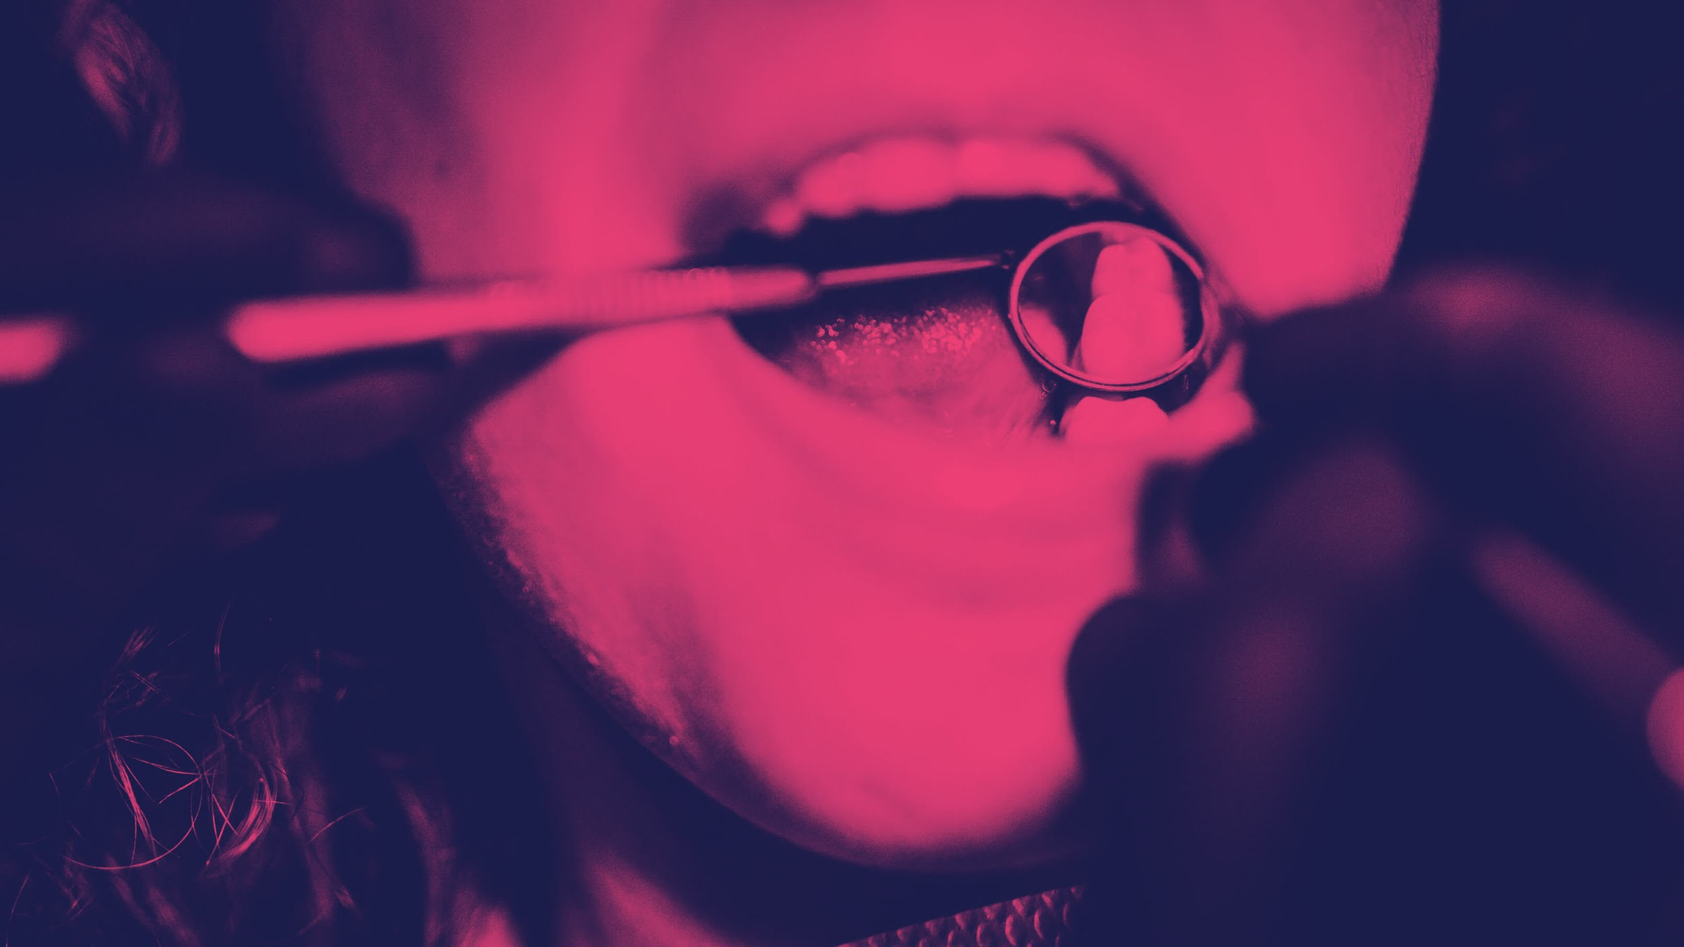
— So we all should take care of our oral health
Having sensitive teeth can make it difficult to enjoy some of life greatest pleasure like a cup of hot coffee in the morning, or a scoop of ice cream in the summer time.
15

Slide 16
Resources:
Petersson LG. The role of fluoride in the preventive management of dentin hypersensitivity and root caries. Clinical oral investigations. 2013 Mar;17(1):63-71.
Creeth J, Gallob J, Sufi F, Qaqish J, Gomez-Pereira P, Budhawant C, Goyal C. Randomised clinical studies investigating immediate and short-term efficacy of an occluding toothpaste in providing dentine hypersensitivity relief. BMC Oral Health. 2019 Dec;19(1):1-9.
World Health Organization. Oral health surveys: basic methods. World Health Organization; 2013.
Rezazadeh F, Dehghanian P, Jafarpour D. Laser effects on the prevention and treatment of dentinal hypersensitivity: a systematic review. Journal of lasers in medical sciences. 2019;10(1):1.
16

Slide 17
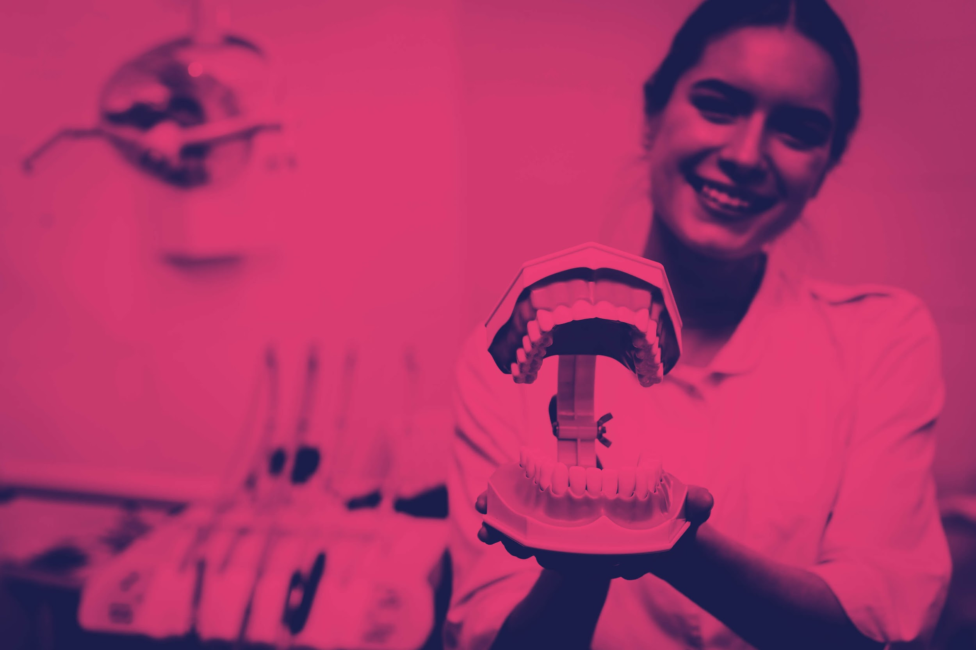
Thanks
Do you have any questions?
17

