Slide 1


Libyan International
Medical University
Faculty of
Business Administration
The Exchange Process
Prepared and presented by:
Heba N Bushiha
Email: hbitalla3285@limu.edu.ly
ID Number:
3285
Notes:
Download more minimal templates here: https://crmrkt.com/GK9Dwa

Slide 2
Introduction
01
02
What Is The Exchange Process?
TABLE OF CONTENTS
Real life examples of the exchange process
03
Types of Exchanges
04
2
Conclusion
06
References
07

Slide 3

3
Introduction
Marketing is about making trades. An exchange takes place when two parties allow something of value to each other to satisfy their particular needs or wants. In a ordinary trade, a buyer exchanges money for a good or service.. (Gitman,2018)

Slide 4
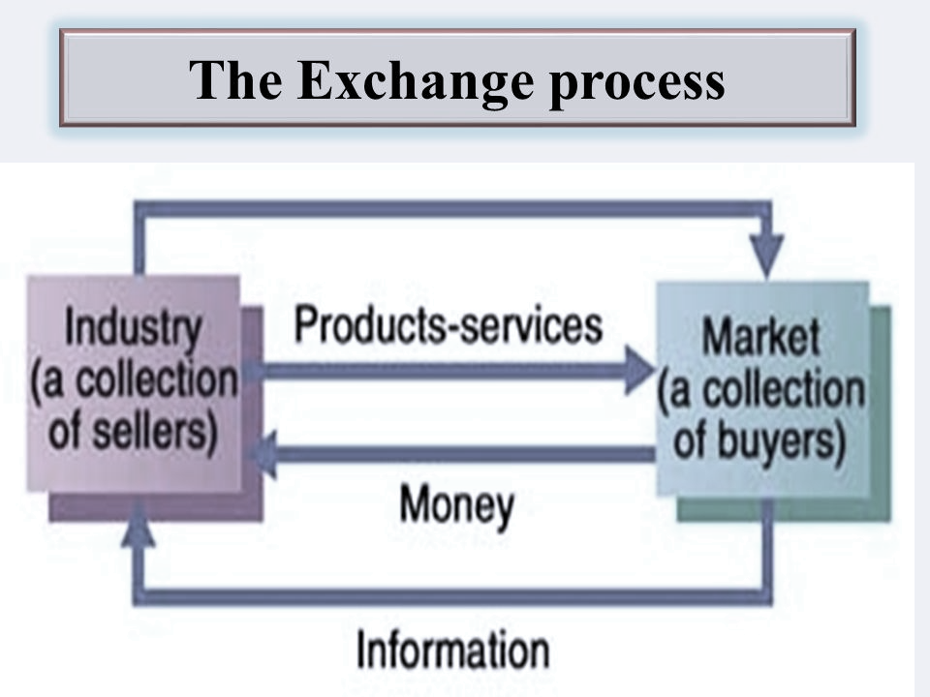
What Is The Exchange Process?
4
4
Some theorists claimed that marketing exchange is when two or more individuals exchange goods or services. In marketing theory, each exchange is supposed to create "utility," which implies the value of what you exchange is less than the value of what you get from the exchange.

Slide 5

5
5
Real life examples of the exchange process
For example, when a woman wants to buy a bag from the store, she should have enough money to buy it and they should be able to provide her with a bag according to her wants and needs. Both parties must be able to communicate with each other and must want to exchange something and be able to do so.

Slide 6
Types of Exchanges
6
Restricted Exchanges
Complex Exchanges
This types of exchange in marketing is known as the simple or "restricted" exchange, so called because there are only two parties to the exchange.
Most types of relationship marketing are complex, meaning they involve networks of participants who both give and receive in more than one relationship with each other.
Generalized Exchanges
This type of exchange involves at least three parties, and each party gives utility to one participant, but receives utility from a different participant.
(Contributor,2020)

Slide 7

Conclusion
7
To sum up, an exchange can be caried by two or more parties who must communicate and exchange their needs or wants, and there are three different types of exchanges that differs in the number of parties involved.

Slide 8
REFERNCES
8
Gitman, Lawrence J., et al. “The Marketing Concept.” Opentextbc.ca, 18 Sept. 2018, opentextbc.ca/businessopenstax/chapter/the-marketing-concept/#:~:text=Marketing%20is%20about%20creating%20exchanges. Accessed 21 Mar. 2022.
“What Is a Marketing Exchange?” Smallbusiness.chron.com, smallbusiness.chron.com/marketing-exchange-61868.html.
‌

Slide 9
THANK YOU
Heba N Bushiha
Notes:
Download more minimal templates here: https://crmrkt.com/GK9Dwa

