Slide 1


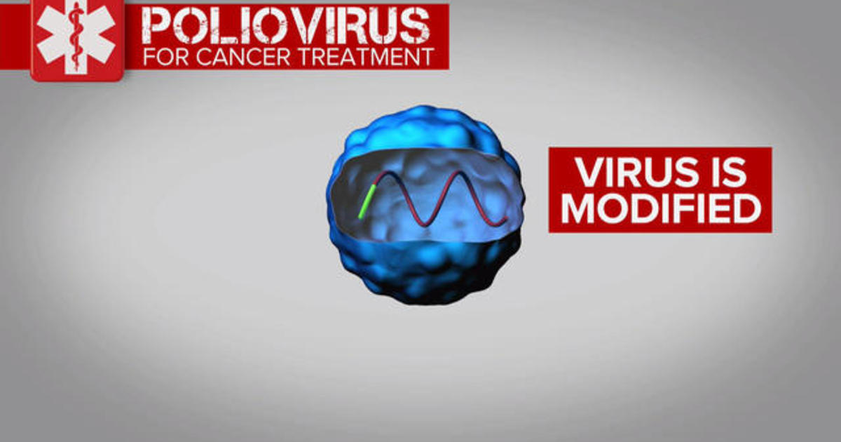
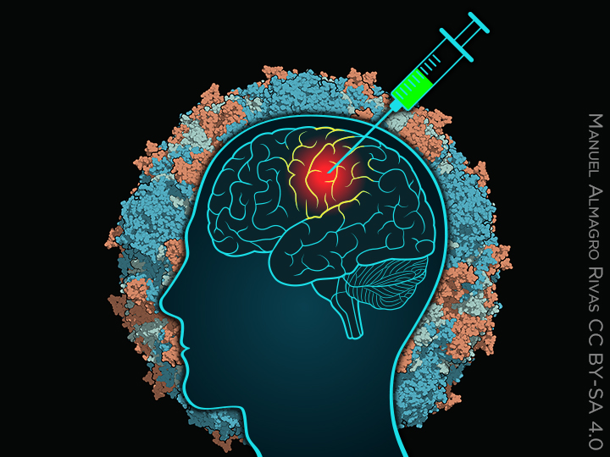
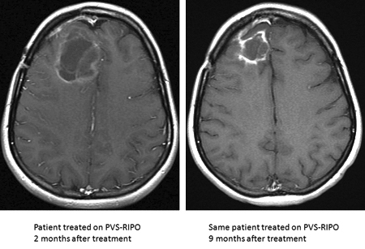
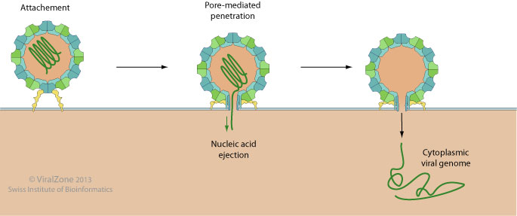
Could We Use Poliovirus In Treatment Of Brain Cancer
By: Aisha Bushiha 1490
Faculty Of Medicine
Libyan International Medical University
كلية الطب البشري
Faculty of Medicine
Introduction
Methodology
Disadvantages
The idea that viruses may be co-opted to do good rather than harm isn’t entirely new. Viruses are being used as vectors or carriers that take the required material for the treatment of a disease to various target cells. They have been studied extensively in the management of inherited diseases and genetic engineering as well as cancers. Some viruses tend to infect and kill tumor cells. Known as oncolytic viruses this group includes viruses found in nature as well as viruses modified in the laboratory to reproduce efficiently in cancer cells without harming healthy cells. (1) this poster describes the use of modified poliovirus as the treatment of glioblastomas.
scientists led by a team at Duke University engineered a poliovirus This was accomplished by swapping out one of the poliovirus’ genes for a similar one found in the rhinovirus that causes the common cold engineered poliovirus activates the immune system but not cause polio (figure1A) . From May 2012 through May 2017, a total of 61 patients were enrolled and received engineered poliovirus that was designed to target glioblastoma Among a group of 61 people who had failed to respond to current therapies, which include radiation and chemotherapy. treatment for glioblastoma started with implanting a catheter right into the center of the glioblastoma.⁽¹⁾ (figure2 B)
The treatment causes a lot of brain inflammation, and two thirds of patients had side effects. The most common ones were headaches, muscle weakness, seizure, trouble swallowing and altered thinking skills. Doctors stressed that these were due to the immune response in the brain and that no one got polio as a result of treatment.
One patient had serious brain bleeding right after the procedure. Two patients died relatively soon after treatment — one from worsening of the tumor and the other from complications of a drug given to manage a side effect. The planned doses had to be reduced because there were too many seizures and other problems at the higher doses initially chosen.
The Duke researchers have started a follow-up study combining the treatment with a chemotherapy drug to try to improve the results. They also plan to combine the treatment with other drugs, including some called checkpoint inhibitors, harness the immune system to fight cancer.⁽⁶⁾
Rate of survival in months
Gioblastoma
Figure3: comparison in rate of survival between poliovirus treatment and chemotherapy
It’s the most common type of malignant brain tumor among adults. usually, it's very aggressive, which means it can grow fast and spread quickly. Glioblastomas belong to a group of brain tumors known as gliomas, as they grow from a type of brain cell called a glial cell. Glioblastoma is very difficult to be treated due to several complicating factors:
The tumor cells are very resistant to conventional therapies.
The brain is susceptible to damage from conventional therapy.
The brain has a very limited capacity to repair itself.
Many drugs cannot cross the blood–brain barrier to act on the tumor.⁽²⁾
conclusion
Figure2 A: genetically engineered poliovirus
Figure2 B
A new approach to treating glioblastoma, one of the deadliest brain cancers, has shown promising results. A genetically engineered poliovirus is no longer making the person sick with polio, but instead destroys glioblastoma cells and prolongs patients’ lives.
Results
Overall average survival time for the 61 patients who received the experimental therapy was 12.5 months, compared with 11.3 months for a control group of matched patients who received standard treatment (chemotherapy) (figure3). Poliovirus has evolved to become quite adept at infecting certain human cells, by targeting a molecular receptor on these cells known as CD155. This receptor is found on cells in the intestines, and in motor nerves in the spinal cord. It is also found on many solid tumors as well, including glioblastoma. modified poliovirus infected these brain cancer cells, it began to kill some of them. But more importantly, the virus also recruited other immune system cells to launch an attack on the cancer cells. Some of the poliovirus therapy patients have shown -- and continue to show -- remarkable resilience: (figure4) One who began treatment at age 20 and another who began at age 60 have remained alive for more than 69 months -- nearly six years -- and are still alive today, according to the authors of the study. ⁽¹⁾
Figure4: MRI of a patient’s brain, axial view, at 2 months and 9 months after PVS-RIPO treatment (Source: Duke Preston Robert Tisch Brain Tumor
Center website)
References
Polio virus
1-Chen, G. and Wang, P. (2018). Comment to “Recurrent Glioblastoma Treated with Recombinant Poliovirus”. Chinese Medical Journal, 131(21), p.2645.
2- Lawson, H. Christopher; Sampath, Prakash; Bohan, Eileen; Park, Michael C.; Hussain, Namath; Olivi, Alessandro; Weingart, Jon; Kleinberg, Lawrence; Brem, Henry (2006). "Interstial chemptherapy for malignant gliomas: the johns Hopkins experience" Journal of Neuro-Oncology.
3- . Mandell, Douglas, and Bennett's Principles and Practice of Infectious Diseases Book • 8th Edition • 2015.
.
Poliovirus, the causative agent of poliomyelitis (commonly known as polio), is a human enterovirus and member of the family of Picornaviridae, Poliovirus is composed of an RNA genome. Poliovirus infects human cells by binding to an immunoglobulin-like receptor, CD155, (also known as the poliovirus receptor (PVR) on the cell surface.⁽³⁾ (figure1)
Anecdote
Stephanie Hopper, 27, from South Carolina, was the first patient treated in the study in May 2012 and it allowed her to finish college and become a nurse. Scans as recent as early June show no signs that the tumor is growing, she said: "I truly believe that it was the cure for me," she said. Her only lasting symptom has been seizures, which medicines help control. "Most people wouldn't guess that I had brain cancer.“⁽¹⁾
Figure1: mechanism of entry of poliovirus

