Slide 1



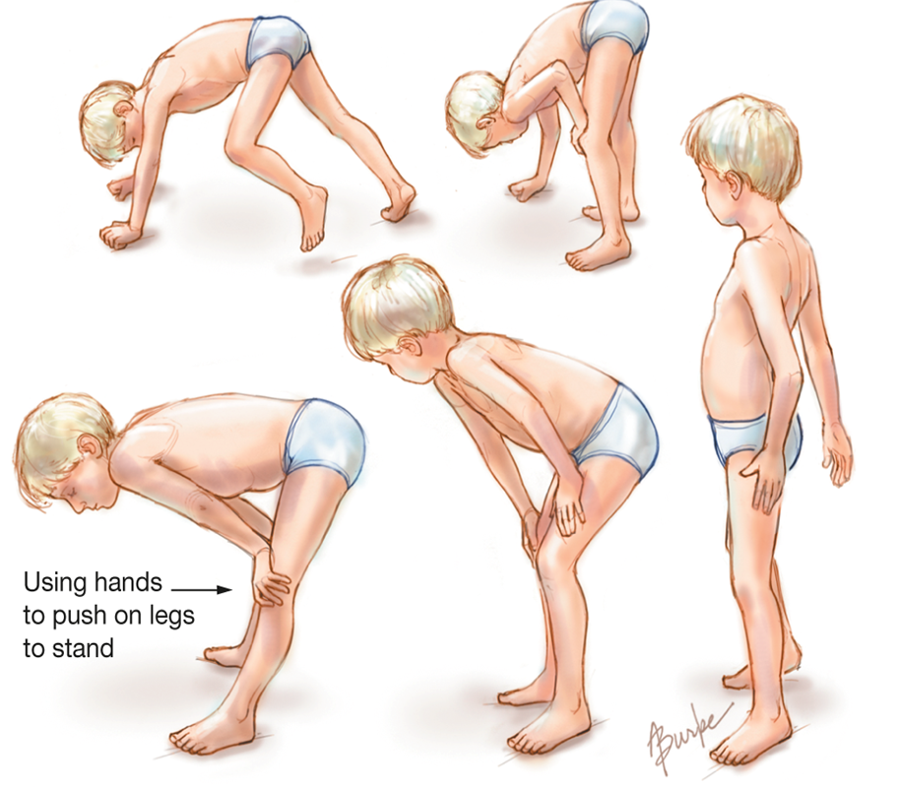
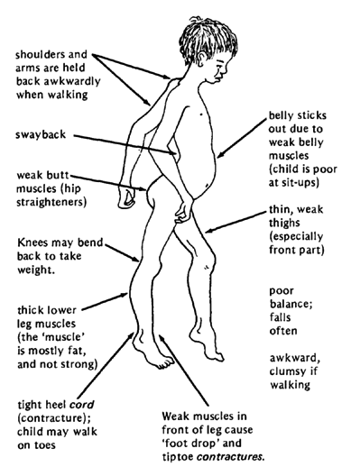
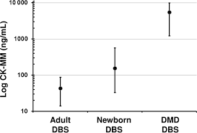
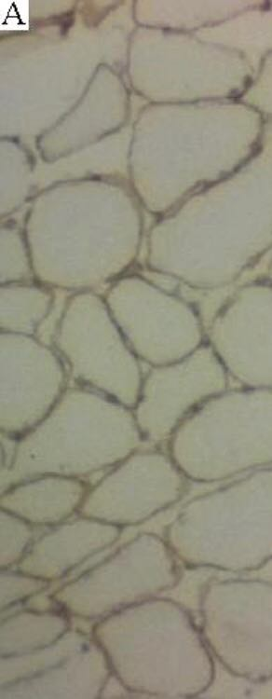
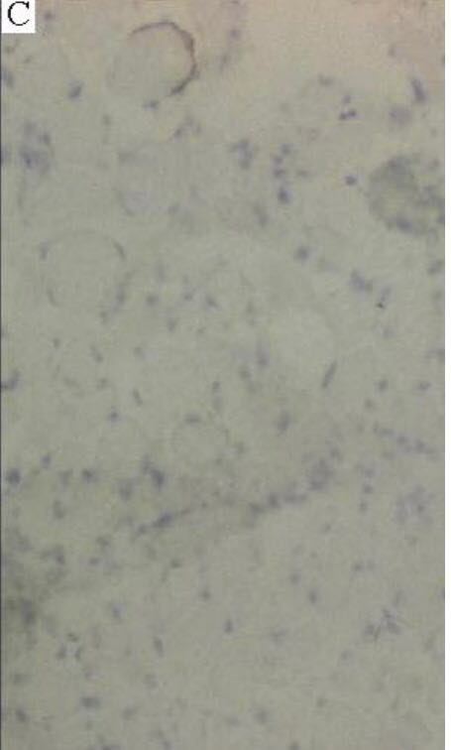
Is Your Child Having Trouble in Climbing Stairs
(Duchenne Muscular Dystrophy)
Doaa Alawami 2nd Year Medical Student
Faculty Of Basic Medical Science
Libyan International Medical University
Introduction
Signs and symptoms
diagnosis
The levels of serum creatine phsphokinase (CPK ) are always increased mostly at younger age And it is gradually decreasing because the mass of the muscle is reducing, and use Electromyography (EMG) to diagnosis the muscles, in general, the proximal of the lower extremities may exhibit the more prominent EMG findings.(1-2)
Duchenne muscular dystrophy (DMD) is the most sever and the most common form of muscular dystrophy, with incidence of about 1 per 3500 live male births. DMD become clinically evident by age 5, with progressive weakness leading to wheelchair dependence by age 10 to 12 years, and death by the early 20s. (1)
Dystrophinopathies
Dystrophin protein is integral to the structural stability of the myofiber. Without dystrophin, muscles are susceptible to mechanical injury and undergo repeated cycles of necrosis and regeneration. Duchenne muscular dystrophies are caused by mutations in same gene encoding dystrophin. These disorders almost exclusively affect males because of the X-linked inheritance pattern.(1-3)
Figure 3
Gowers sign
Stage 3: Late ambulatory
Around age 8 years, most patient notice difficulty with ascending stairs, and respiratory muscle strength begins as a slow but steady decline and cannot arise from the floor.(2)
Figure 4
Level of (CPK)
Conclusion
Figure 2
Common signs and symptoms of (DMD)
Duchenne muscular dystrophy (DMD) is a genetically X-linked disorder of skeletal muscle characterized by progressive muscle atrophy. DMD is caused by various mutations in the DMD gene and result in a loss of the skeletal muscle protein dystrophin, which leads to a degradation of skeletal muscle.
Stage 1: presymptomatic
Creatin kinase levels are usually elevated and Patient have a positive family history.(2)
Stage 4: Early nonambulatory
Add your information, graphs and images to this section.
Patient can self-propel for some time, able to maintain posture and possible development of scoliosis.(2)
Stage 2: Early ambulatory
References
Waddling gait, manifesting in children aged 2-6 years; often the first clinical symptom in patients with Duchenne muscular dystrophy and is secondary to hip girdle muscle weakness, initially in the lower extremities, but later involving the neck flexors, shoulders, and arms , because of proximal lower back and extremity weakness, parents often note that the boy pushes on his knees in order to stand, this is know as the Gowers sign.(2)
1) Klatt, E., Kumar, V. and Robbins, S. (2010). Robbins and Cotran review of pathology. 8th ed. Philadelphia: Saunders/Elsevier
Figure 3
Stage 5: Late nonambulatory
Scoliosis may progress, especially when more wheelchair dependent, if wheelchair bound and profoundly weak, patients develop terminal respiratory or cardiac failure, usually by early 20s, if not sooner; poor nutritional intake can also be a serious complication in individuals with sever end-stage Duchenne muscular dystrophy.(2)
2) Ervasti JM, Campbell KP. Membrane organization of the dystrophin-glycoprotein complex. Cell. 2013 Sep 20. 66(6):1121-31. [Medline].
Figure 1
(A)Normal dystrophin staining.
(C) Absent dystrophin staining in a patient with Duchenne muscular dystrophy.
3)Bushby K, Straub V. Nonmolecular treatment for muscular dystrophies. Curr Opin Neurol. 2005 Oct. 18(5):511-8. [Medline].
TRIFOLD AREA – THIS GUIDE WILL BE REMOVED BEFORE PRINTING – TRIFOLD AREA – THIS GUIDE WILL BE REMOVED BEFORE PRINTING – TRIFOLD AREA – THIS GUIDE WILL BE REMOVED BEFORE PRINTING – TRIFOLD AREA – THIS GUIDE WILL BE REMOVED BEFORE PRINTING – TRIFOLD
TRIFOLD AREA – THIS GUIDE WILL BE REMOVED BEFORE PRINTING – TRIFOLD AREA – THIS GUIDE WILL BE REMOVED BEFORE PRINTING – TRIFOLD AREA – THIS GUIDE WILL BE REMOVED BEFORE PRINTING – TRIFOLD AREA – THIS GUIDE WILL BE REMOVED BEFORE PRINTING – TRIFOLD

