Slide 1


الجامعة الليبية الدولية للعلوم الطبية كلية العلوم الطبية
Life revived !
Presented by:
Rawad faraj elmozogi
3464
Academic year:
2021/2022
1

Slide 2
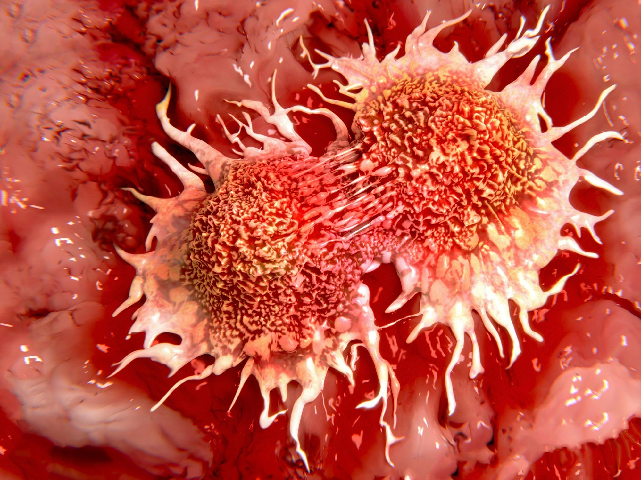
Objectives:
Define cancer
Outline types of cancer
Outline sypmtoms of cancer
Treatment for cancer

Slide 3

INTRODUCTION
Cancer is a common disease in our world that happens due to some irrgular changes in our body And it is the second cause of death in the world.
3

Slide 4
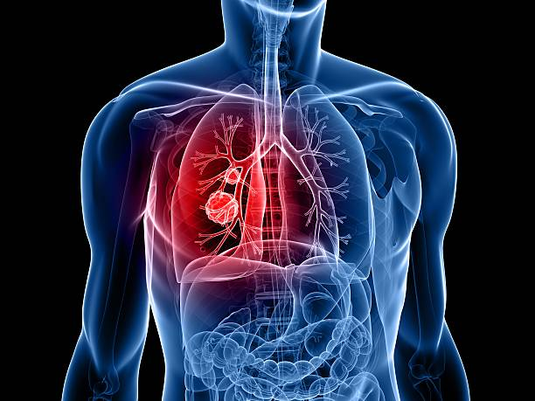
01
What is cancer?
4

Slide 5
What is cancer?
Cancer is: a disease in which some of the body's cells grow uncontrollably and spread to other parts of the body
Cancer is a condition where cells in a specific part of the body grow and reproduce uncontrollably
5

Slide 6
02.Common types of cancer

Slide 7
02: Common types of Cancer!
01.Breast cancer
02.Bladder cancer
03.Prostate cancer
04.Brain cancer
6

Slide 8
Causes of the previous cancer types!
01.More common in old age , family history , radiation exposure , sex.
02.Exposure to certain chemical ,smoking , previous cancer treatment.
03.Hight calcium intake , high body mass low physical activity, smoking.
04.Gender , exposure to viruses and infections.
7

Slide 9
03. SYMPTOMS OF THE DISEASE
8

Slide 10

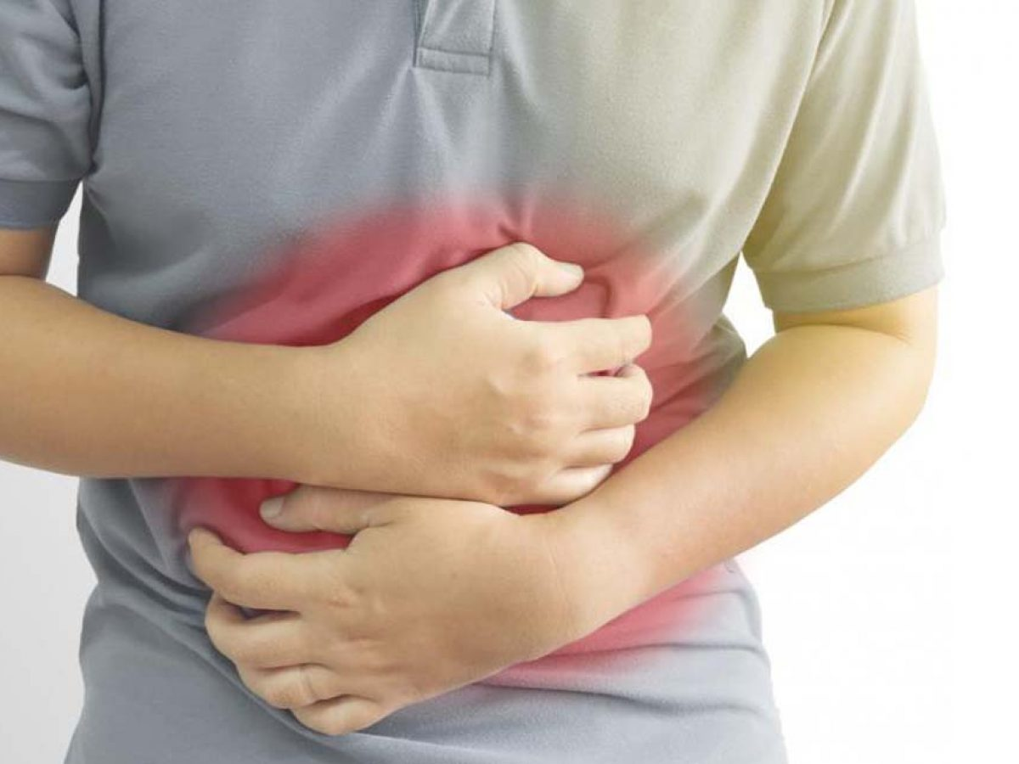
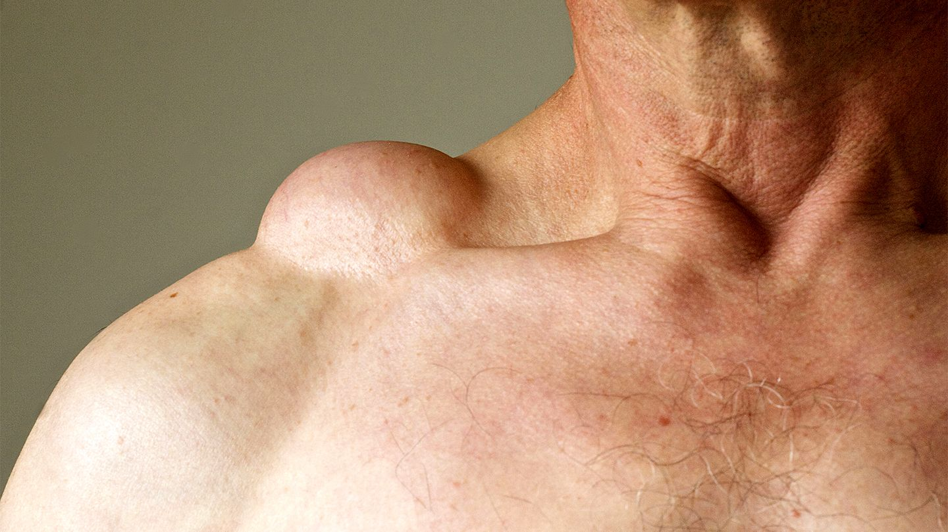

03:SYMPTOMS OF THE DISEASE
01.Weight loss and loss of appetite .
02.Eating problems such as not feeling hungry, trouble swallowing, belly pain, or nausea and vomiting.
03.Fatigue or extreme tiredness that doesn't get better with rest.
04.Swelling or lumps anywhere in the body.
9

Slide 11
04.Treatment.
10

Slide 12
Treatment
Treatment modalities (types)

Slide 13
treatment
surgery
radiotherapy
Medical therapy
1. chemotherapy
2.Hormone therapy
3.immunotherapy

Slide 14
CONCLUSION:
Cancer is the uncontorllabel growth of cells.
Common types of cancer are breast cancer , bladder cancer , prostate cancer , brain cancer.
3. Symptoms are nausea , fatigue , vomiting , tiredness , swelling.
4. Treatment is either by radiology, chemotherapy , hormone therapy ,etc.
13

Slide 15
REFERENCES
▪ Robbins basic pathology, 10th edition, 2018.
https://www.academia.edu/68598323/Robbins_Basic_Pathology_10th_Edition
Lippincott
https://lippincott.com
14

Slide 16

15

