Slide 1


Module: Operations Management
Instructor Name: Dr. Zuhair Bousnaina
Group Four
Libyan International Medical University
Faculty of Business Administration
Product and Service Design
Student Name: Shahed Elhasia, Asria Khaled, Loaloah Mohammed, Sondos Aloud
Student ID: 2186, 1982, 1925, 1500
Student E-mail: shahed_2186@limu.edu.ly , asria_1982@limu.edu.ly loloah_1925@limu.edu.ly , sudus_1500@limu.edu.ly

Slide 2
Content:
01
02
03
04
Introduction
10
Concurrent engineering
11
Definition of product design and process design
Sequential VS Concurrent engineering
Product design and process / service design
12
Conclusion
13
References
Market analysis (Product Life Cycle)
05
Economic analysis
06
Technical analysis
07
Why you need a design strategy?
08
Improving product design
09
Factors affecting the DFM
02

Slide 3
Iintroduction:
Products and services fuel your business with the revenue they generate. Because they are at the heart of your business operations, it’s important to take a calculated, strategic approach to designing your products and services.
Service design is the coordination and combination of people, communication, and material components to create quality service.
Product design is the combination of manufacturing capabilities with product and business knowledge to convert ideas into physical and usable objects.
03

Slide 4
Definitions of Product desigN:
Design: To design refers to the process of originating and developing a plant for a product, service or process.
Process: Is any part of organization which takes a set of input resources, which are then used to transform into outputs of products and service.
04

Slide 5
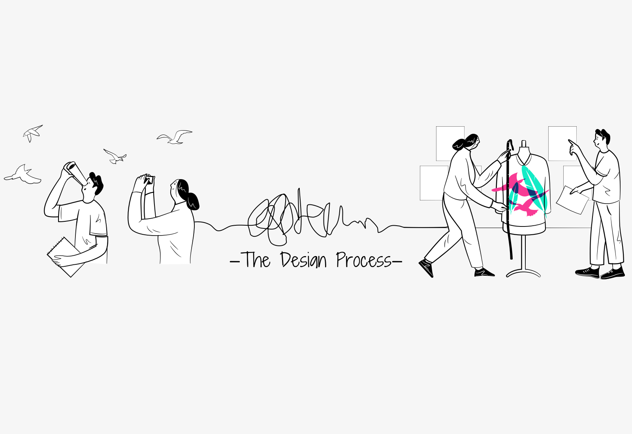
Process Design and Product/ Service Design :
Service industry: it is impossible to separate service design and process design- they are the same.
Manufacturing industry: It is possible to separate product design and process design.
05

Slide 6
Product and service design involves:
1
2
3
4
Generating Ideas
Product Screening
Preliminary Design
Final Design
06

Slide 7
1. GeNeratiNg Ideas:
Market research.
Customer viewpoints.
Competitors.
Reverse Engineering: is a systematic approach to dismantling and inspecting a competitor’s product to look for the aspects of design that could be incorporated into the organization own product.
Benchmarking: compares a product against what is considered to best in the market segment and the making recommendations on how the product can be improved to meet the standard.
07

Slide 8

2. Product Screening:
This process consist of Market Analysis, Economic Analysis and Technical Analysis.
08

Slide 9
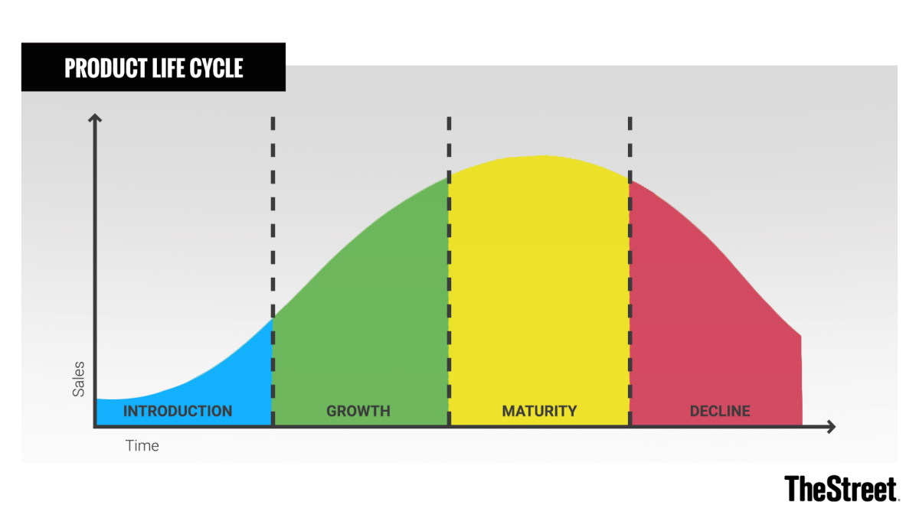
Market Analysis ( Product life cycle )
09

Slide 10
Prodct life cycle (cont.)
1. Introduction: This phase generally includes a substantial investment in advertising and a marketing campaign focused on making consumers aware of the product and its benefits.
2. Growth: If the product is successful, it then moves to the growth stage. This is characterized by growing demand, an increase in production, and expansion in its availability.
3. Maturity: This is the most profitable stage, while the costs of producing and marketing decline.
4. Decline: A product takes on increased competition as other companies emulate its success—sometimes with enhancements or lower prices. The product may lose market share and begin its decline.
10

Slide 11
Economic Analysis:
Consists of developing estimates of production and demand costs in the market and comparing them with estimates of demand. In order to perform the analysis requires accurate estimates of demand as possible derives from statistical forecasts and estimates of market share in the sector the product is competing in.
There are several techniques to assess product productivity such as
Cost- Benefit Analysis.
Net Present Value (NPV).
Internal Rate of Return (IRR).
Cost Volume Profit Model.
11

Slide 12
Economic analysis (Cost Benefit Analysis):
It is a technique used to compare the total cost of the program / project against its benefits, using a common measure. This allows the calculation of the net cost or interest associated with the program.
As a method, it is most often used at the beginning of a program project when different options or course of action are evaluated and compared as an option to choose the best approach.
12

Slide 13
Economic analysis (Net Present Value (NPV)):
This is determined by calculating costs (negative cash flow) and benefits (positive cash flow) for each investment period. It is therefore the difference between the present value of cash flow in and cash flow out over a period of time.
It is used in capital budgeting and investment planning to analyze the profitability of the expected investment or project.
13

Slide 14
Economic analysis (Internal Rate of Return (IRR)):
It is a measure used in capital budgeting to estimate the profitability of potential investments. In other words, it is the expected composite annual rate of return that will be derived from the project or investment.
Economic analysis (Cost Volume Profit Model):
It is used to determine how changes in cost and volume affect a company's operating income and net income.
In conducting this analysis, there are several assumptions. The price of sales per unit is constant, the cost of variables per unit is constant and the total fixed costs are constant.
14

Slide 15

Technical Analysis:
Consists of determining whether technical capability to manufacture the product.
This covers such issues as ensuring materials are available to make the product to the specification required and ensuring the appropriate machinery and skills are available to work with these materials.
15

Slide 16
3. Preliminary Design:
Product concepts that pass the feasibility stage enter preliminary design. The specification of the components of the package requires a product / service structure that describes the relationship between the components and a bill of materials or a list of component quantities derived from the product structure.
The process by which the package is created must also be specified in terms of mapping out the sequence of activities that are undertaken. This can be achieved with the aid of such devices as process flow charts.
16

Slide 17

4. Final Design
The final design stage involves the use of a prototype to test the preliminary design until a final design can be chosen.
17

Slide 18
Why you need a Design Strategy?
To know what is your product
Steps of the product successful
Helps you understand what you should design.
18

Slide 19

Design
Business
Technology
Sustainability
Leads to
20

Slide 20
Improving Product Design:
There are number of methods help in improving product design.
Design of Manufacture (DFM)
(DFM) is a concept which provides guidelines on how to produce the product easily and at low cost using techniques such as Simplification, Standardization and Modularization.
Improving Product Design
Simplification | Standardization | Modularization
20

Slide 21
Five factors affect the Design of Manufacture (DFM) are:
The design itself
Review manufacturing process
Material selection.
Environmental consideration
Compliance and testing.
21

Slide 22
Concurrent Engineering:
Concurrent engineering is a long term business strategy, with long term benefits to business. Though initial implementation can be challenging, the competitive advantage means it is beneficial in the long term. It removes the need to have multiple design reworks, by creating an environment for designing a product right the first time round.
Concurrent engineering, also known as simultaneous engineering, is a method of designing and developing products, in which the different stages run simultaneously, rather than consecutively.
22

Slide 23
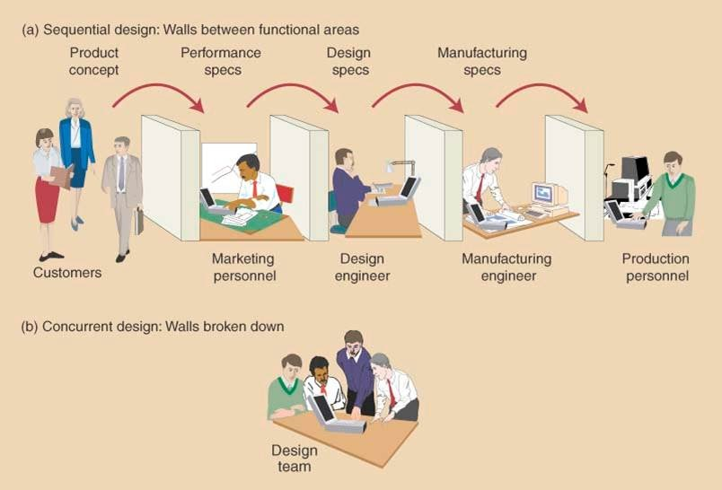
Sequential engineering vs. Concurrent Engineering
23

Slide 24
Why Concurrent Engineering?
Traditional sequential engineering is the term used to describe linear product development processes, where design and development steps are carried out one after another focusing on one field of expertise at a time.
During the industrial revolution, this forced companies to hire specialized people and departments due to products getting more complex. This in turn, paved way to “over the wall” mentality where each team member or department only focused on their tasks and passed the completed work onto the next
Concurrent engineering is an approach developed in the 1980s to eliminate some of the issues with the ‘over the wall’ method.
24

Slide 25
conclusion
Product and service design is a key factor in satisfying the customer. To be successful in product and service design, organizations must be continually aware of what customers want, what the competition is doing, what government regulations are, and what new technologies are available.
Successful design often incorporates many of these basic principles: Determine what customers want as a starting point; minimize the number of parts needed to manufacture an item or the number of steps to provide a service; simplify assembly or service, standardize as much as possible; and make the design robust.
25

Slide 26
References
Meng, H., Wang, M., Olumayegun, O., Luo, X., & Liu, X. (2019). Process design, operation and economic evaluation of compressed air energy storage (CAES) for wind power through modelling and simulation. Renewable Energy, 136, 923-936.‏
Albert Porter, Operation Management, 2009, ISBN 978-87-761-464-9.
Engineering, C. (n.d.). What is concurrent engineering? Concurrent Engineering. Retrieved January 1, 2022, from https://www.concurrent-engineering.co.uk/what-is-concurrent-engineering?fbclid=IwAR20mBbTWgAD_Itr75EHgnE6QIbS6yPFqyGpCMeTFr5VEciBI61HZTRFTg0.
Product and service design. Teamwork Solutions Group. (n.d.). Retrieved January 1, 2022, from https://www.winwithteamwork.com/what-we-do/all-services/product-and-service-design?fbclid=IwAR1ZCFl_yAUxYaP9T1d_i03-w9fCoknthFKqdTd9u4g91B8kuA0WS_I1c_o.
Prakash, S. J. (2021, December 31). Concurrent and Sequential Engineering - New Product Development. Engineering Product Design. Retrieved January 1, 2022, from https://engineeringproductdesign.com/concurrent-vs-sequential-engineering/?fbclid=IwAR0qUwVRul2GXrR-qo2FarTC9HN7j-PqOxXmpbosCpLLYlHfBUd4vjix0EM.
26

Slide 27
THANK you for listening!
any questions?

