Slide 1
Parathyroid disease
Dr Mousa Tuwati Alfakhri

Slide 2
objectives
Anatomy of parathyroid glands
Parathyroid hormone function
Hyperparathyroidism
hypoparathyroidism

Slide 3
Anatomy
There are normally four parathyroid glands situated posterior to thyroid
Each gland is about size of a grain of rice (weighs approximately 30 m.grams and is 3-4 mm in diameter)
parathyroid glands share similar blood supply, venous drainage, and lymphatic drainage to the thyroid glands
occasionally additional glands may be found elsewhere in neck or mediastinum

Slide 4
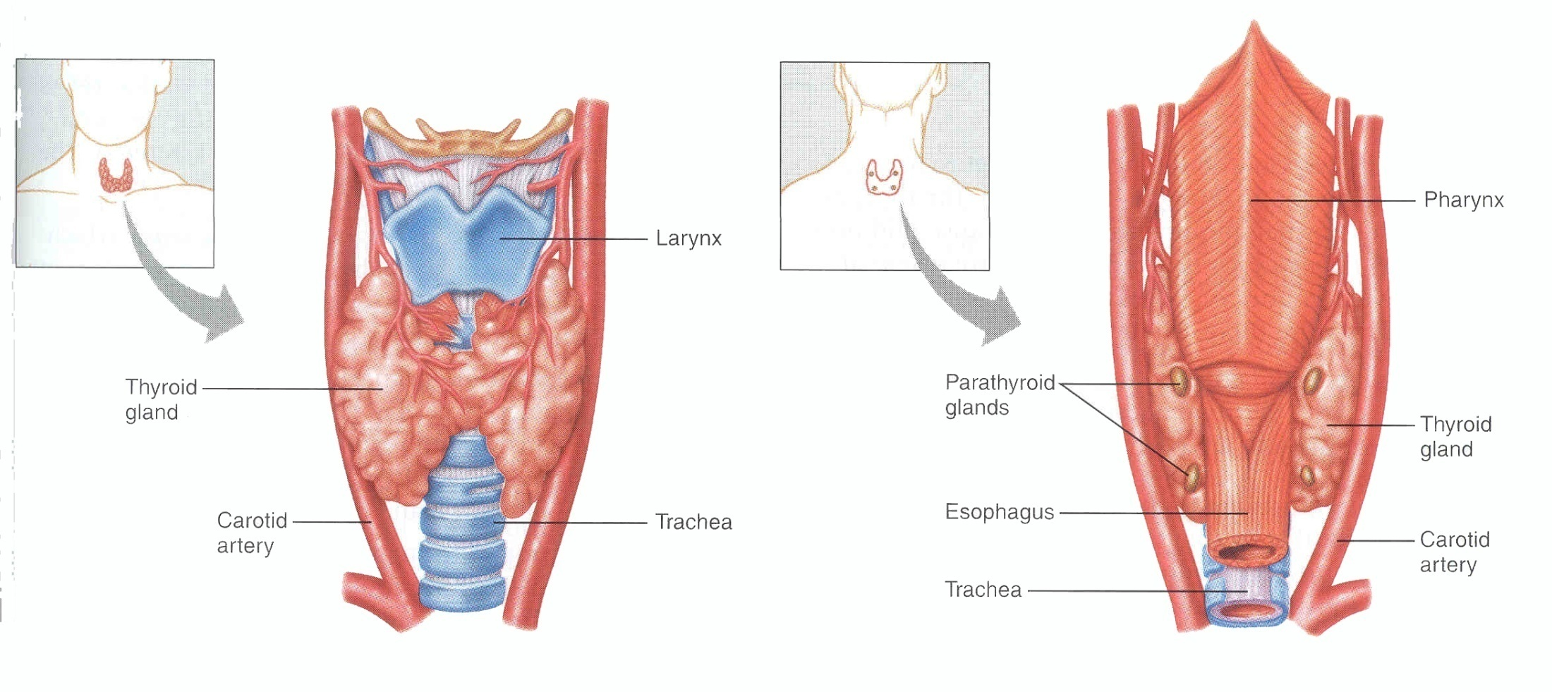

Slide 5
Parathyroid Hormone
84-AA hormone,secreted from chief cells of parathyroid glands. PTH levels rise as serum ionized calcium falls. Which detected by calcium-sensing receptors on plasma membrane of parathyroid cells.
PTH increase plasma calcium by:
increasing osteoclastic resorption of bone
increasing renal tubular reabsorption of calcium
increasing synthesis of 1,25-(OH)2D3 ( increasing intestinal absorption of calcium)
PTH effects are mediated at specific membrane receptors on target cells.

Slide 6
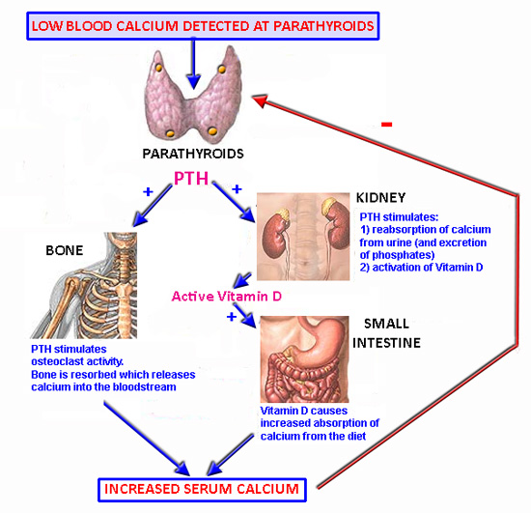

Slide 7
Classification of diseases of the parathyroid glands
Hormone deficiency | Hormone excess
Hypoparathyroidism Post-surgical Autoimmune Inherited | Primary hyperparathyroidism Parathyroid adenoma Parathyroid carcinoma Parathyroid hyperplasia
 | Secondary hyperparathyroidism Vitamin D deficiency Chronic kidney disease malabsorption
 | Tertiary hyperparathyroidism Following prolonged Secondary hyperparathyroidism

Slide 8
Primary hyperparathyroidism
Primary hyperparathyroidismis due to excessive production of PTH by one or more of hyperfunctioning parathyroid glands. This leads to hyprcalcemia which fails to inhibit gland.
PHPT is leading cause of hypercalcemia and one of most common endocrine disorders
It is observed mainly in postmenopausal women (female-to-male ratio of 3–4:1) over 50 years old

Slide 9
Primary hyperparathyroidism
Caused by autonomous secretion of PTH ,either by single (>80%) parathyroid adenomas or by diffuse hyperplasia of all the glands (15–20%)
Diffusehyperplasia of parathyroid glands may be part of a familial syndrome (e.g. multiple endocrine neoplasia (MEN) syndrome type 1 or 2a).
Parathyroid carcinoma is rare (<1%), though it usually produces severe and intractable hypercalcaemia.

Slide 10
Clinical features of Primary hyperparathyroidism
90% are asymptomatic, accidental diagosed on routine investigation
Symtomes of hypercalcemia
Renal and bones complication

Slide 11
Clinical Features
Renal
Nephrolithiasis
Nephrogenic Diabetes Insipidus
Nephrocalcinosis

Slide 12
Clinical Features
Skeleton
Bone pains
Arthritis
Osteoporosis
Osteitis fibrosa cystica(subperiosteal resorption of the distal phalanges, distal tappering of the clavicles, a “salt and pepper” appearance of the skull ,bone cysts and brown tumors of the long bones )

Slide 13
Clinical Features
Abdominal
Nausea, vomiting
Severe anorexia, weight loss
Constipation (not relieved by Rx.)
Abdominal pain (vague and diffuse)
Pancreatitis
Peptic ulcer disease

Slide 14
Clinical Features
Psychological
Impaired concentration
Impaired memory, Depression
Confusion, stupor, coma
Lethargy and severe fatigue
Extreme muscle weakness

Slide 15
Clinical Features
Cardiovascular
Hypertension, Increased risk of CHD
ECG changes of shortened QT interval, PR prolonged, QRS widened, ST , Bradycardia
Cardiac arrhythmias; Vascular calcification
Others
Itching (Generalized Pruritus)
Keratitis, conjunctivitis
Corneal calcification (band keratopathy)

Slide 16
Diagnosis of primary hyperparathydism
:
Biochemical investigation
Imaging
Pre-operative localization of the abnormal parathyroid gland

Slide 17
Biochemical investigation
Presence of established hypercalcaemia in more than one serum measurement accompanied by elevated PTH is characteristic
Serum phosphate is usually low but may be normal.
Blood alkaline phosphatase (of bone origin) are commonly elevated when the bones are involved

Slide 18
24-hour urine calcium excretion
In primary hyperparathyroidism there is increase in urinary excretion of ca more than 100mg /24 hr
Values below 100 mg/24 hours or a calcium to creatinine ratio of <0.01 are suggestive of Familial hypocalciuric hypercalcaemia

Slide 19
Familial hypocalciuric hypercalcaemia
FHH
benign condition easily mistaken for mild hyperparathyroidism.
AD inherited disorder characterized by hypocalciuria (usually < 50 mg/24 h), and normal or minimally elevated levels of PTH.
Calcium-sensing receptors in renal tubules are affected and this leads to increased renal tubular reabsorption of calcium and hypocalciuria.
inactivating mutation in calcium sensing receptor gene, reduces ability of parathyroid gland to ‘sense’ ionised ca. concentrations. As result, highe calcium levels fails to suppress PTH secretion
These patients do not normalize their hypercalcemia after subtotal parathyroid removal and should not be subjected to surgery.
excellent prognosis and is easily diagnosed with family history and urinary calcium clearance determination

Slide 20
Imaging
Skeletal X-rays.
In the early stages there is demineralisation, with subperiosteal erosions and terminal resorption in the phalanges,“salt and pepper” appearance may be seen on lateral X-rays of the skull.
Reduced bone mineral density, resulting in either osteopenia or osteoporosis, is most common skeletal manifestation of hyperparathyroidism. This is usually not evident radiographically and requires assessment by DEXA scan.

Slide 21
Skeletal x-ray
Plain radiograph of both hands showing subperiosteal resorption involving proximal phalanges

Slide 22
Skull x-ray
Plain radiograph of skull lateral view showing osteopenia with multiple lytic lesions, “salt and pepper” appearance

Slide 23
Pre-operative localization of the abnormal parathyroid gland:
Ultrasound: not sensitive for small tumours, but it is simple and safe
High-resolution CT scan or MRI (more sensitive)
Radioisotope scanning using 99mTc-sestamibi, which is approximately 90% sensitive in detecting adenomas.

Slide 24
Treatment
Surgical treatment
Conservative treatment

Slide 25
Guidelines for the management of primary hyperparathyroidism
Patients with classic symptoms of PHPT should be referred for surgery
The current indications for surgery in asymptomatic PHPT
1. Serum Ca value 1 mg/dL above the upper limit of normal.
2. Peri- or post-menopausal women and men at least 50 years old who have a T-score ≤ −2.5 ( DEXA scan)at the lumbar spine, femoral neck, hip, or distal 1/3 radius.
3. Creatinine clearance of less than 60 mL/minute.
4. Presence of hypercalciuria (more than 400 mg/day)
5. Age of less than 50 years.

Slide 26
Non-surgical treatment
Patients who are treated conservatively without surgery should have calcium biochemistry and renal function checked annually and bone density monitored periodically
Cinacalcet is calcimimetic enhances sensitivity of calcium-sensing receptor, so reducing PTH levels, and is licensed for tertiary hyperparathyroidism and treatment for patients with primary hyperparathyroidism who are unwilling to have surgery or are medically unfit

Slide 27
What is parathyroid crisis ?
Hypercalcemic crisis caused by excess PTH
Patients commonly present with altered sensorium and serum calcium >14 mg/dl and highly elevated PTH levels (>20 fold).
Parathyroid crisis is rare in patients with PHPT.
mechanism parathyroid crisis is not known, but may be related to life- threatening intercurrent illness, volume depletion.

Slide 28
Other causes Of Hypercalcaemia
More than 90 percent of hypercalcemia cases are
Primary hyperparathyroidism and malignancy

Slide 29
Causes of Hypercalcemia
 Ca⁺⁺
PTH
Vitamin D
Malignancy
Medicines
Endocrine
Genetic

Slide 30
Endocrine Diseases
Hyperthyroidism
Adrenal insufficiency
Acromegaly
Pheochromocytoma
Genetic
Familial hypocalciuric hypercalcemia (FHH)
Parathyroid hormone-related
Primary hyperparathyroidism
Tertiary hyperparathyroidism
Medications
Thiazide diuretics
Lithium
Milk-alkali syndrome (calcium + antacids)
Vitamin A intoxication
Malignancy
Humoral hypercalcemia of malignancy (mediated by PTHrP) – common cause Solid tumors, especially lung, head and neck squamous cancers ,Renal Cell Carcinoma
Local osteolysis (mediated by cytokines)
Multiple Myeloma,Breast cancer
Vitamin D-related
VitaminD intoxication
Granulomatous-diseases
(Sarcoidosis, Tuberculosis)
Hodgkin’s lymphoma

Slide 31
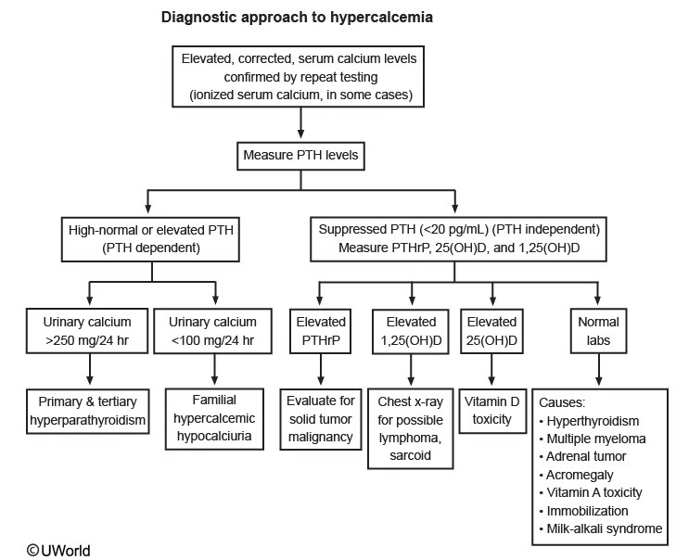

Slide 32
Secondary hyperparathyroidism
is physiological compensatory hypertrophy of all parathyroids because of hypocalcaemia, such as occurs in chronic kidney disease or vitamin D deficiency. PTH levels are raised but calcium levels are low or normal, and PTH falls to normal after correction of the cause of hypocalcaemia where this is possible

Slide 33
Tertiary hyperparathyroidism
is the development of apparently autonomous parathyroid hyperplasia after longstanding secondary hyperparathyroidism, most often in renal failure.
Plasma calcium and phosphate are both raised.
Parathyroidectomy is necessary at this stage.

Slide 34
Hypoparathyroidism
Deficient secretion of PTH which manifests itself biochemically by hypocalcemia, hyperphospatemia diminished or absent circulating PTH and clinically the symptoms of neuromuscular hyperactivity.

Slide 35
Hypoparathyroidism
most common cause of is damage to parathyroid glands (or their blood supply) during thyroid surgery.
Rarely, occur as result of infiltration of glands with iron in haemochromatosis or copper in Wilson’s disease .
There are number of rare congenital or inherited forms of hypoparathyroidism.
Autoimmune polyendocrine syndrome type 1 (hypoparathyroidism, adrenal insufficiency and mucocutaneous candidiasis )
DiGeorge syndrome( Hypoparathyroidism, deafness, and renal dysplasia syndrome).

Slide 36
Clinical features of Hypoparathyroidism
Symptoms and signs of hypocalcaemia
Peri-oral and digital paraesthesiae
Positive Trousseau’s and Chvostek’s signs
Tetany and carpopedal spasm
Laryngospasm
ECG changes (prolonged QT interval) and arrhythmia
Seizure

Slide 37
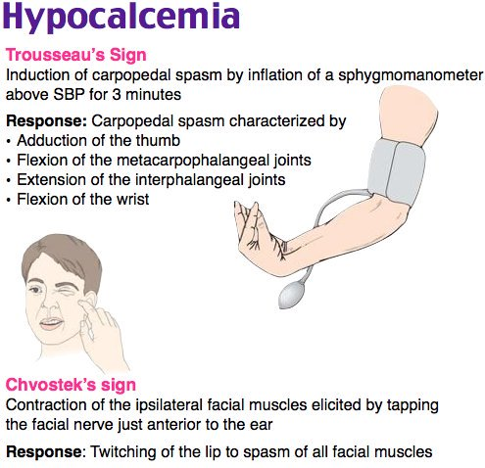

Slide 38
Investigations
The clinical history and picture is usually diagnostic and is confirmed by a low serum calcium
PTH levels in the serum: absent or inappropriately low in hypoparathyroidism, high in other causes of hypocalcaemia
Renal function test
1,25 dihydroxy vitamine D3 level
Phosphate,and Magnesium

Slide 39
Management of hypoparathyroidism
oral calcium and vitamin D analogues, either 1α-hydroxycholecalciferol (alfacalcidol) or 1,25 dihydroxycholecalciferol (calcitriol).
needs careful monitoring because of the risks of iatrogenic hypercalcaemia, hypercalciuria and nephrocalcinosis.
Recombinant PTH is available as subcutaneous injection therapy for osteoporosis and, although not currently licensed, has been used in hypoparathyroidism . It is much more expensive than calcium and vitamin D analogue therapy but has the advantage that it is less likely to cause hypercalciuria.

Slide 40
Concurrent hypomagnesemia
Hypomagnesemia is common cause of hypocalcemia, by inducing resistance to PTH and by diminishing secretion
in hypocalcemic-hypomagnesemic patient, Magnesium should be corrected first

Slide 41
Pseudohypoparathyroidism
individual is functionally hypoparathyroid but, instead of PTH deficiency, there is tissue resistance to effects of PTH, PTH concentrations are markedly elevated.
characterised by hypocalcaemia and hyperphosphataemia, in association with short stature, short fourth metacarpals and metatarsals, rounded face, obesity and subcutaneous calcification; these features are collectively referred to as Albright’s hereditary osteodystrophy (AHO).

Slide 42
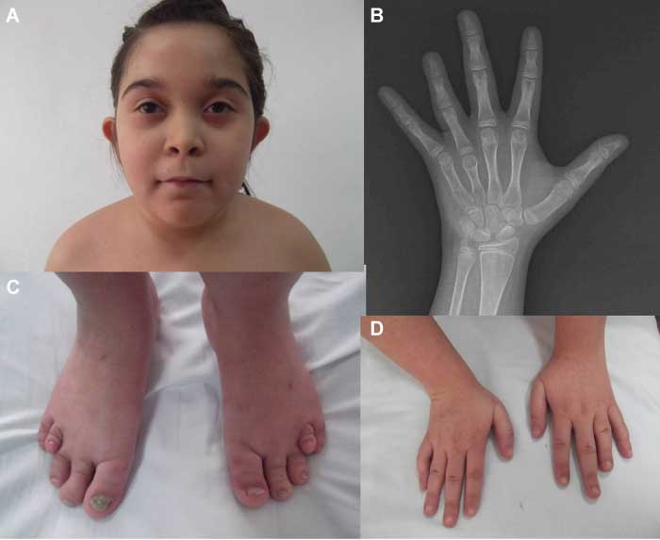

Slide 43
Pseudo-pseudohypoparathyroidism
The term pseudopseudohypoparathyroidism is used to describe patients who have clinical features of AHO but normal serum calcium and PTH concentrations.

Slide 44
Differential diagnosis of hypocalcaemia
Hypoalbuminaemia
Alkalosis
Vitamin D deficiency
Chronic renal failure
Hypoparathyroidism
Pseudohypoparathyroidism
Acute pancreatitis
Hypomagnesaemia

Slide 45
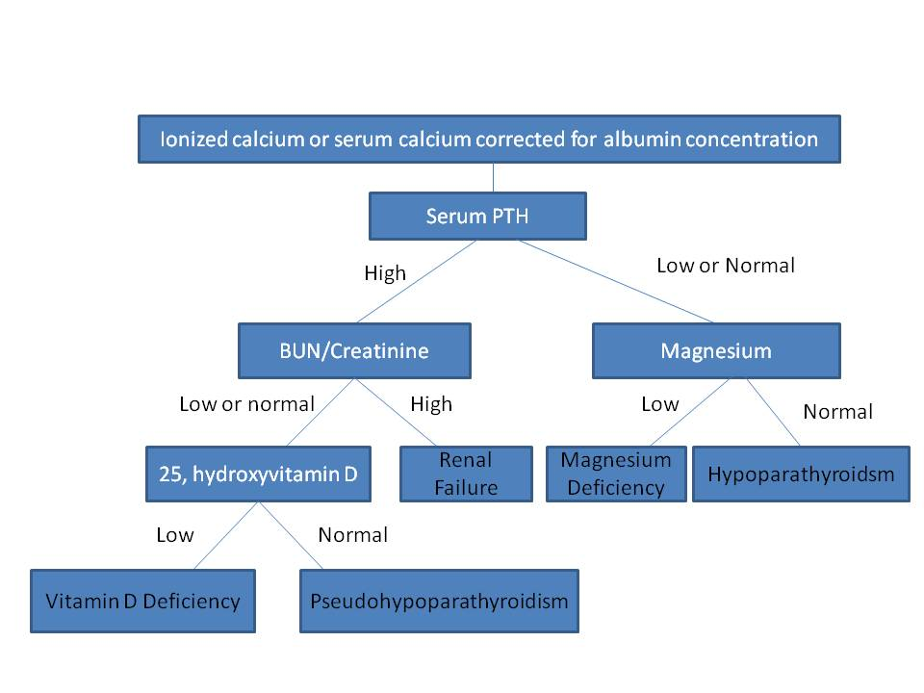
Approach to hypocalcaemia

Slide 46
thanks

