Slide 1
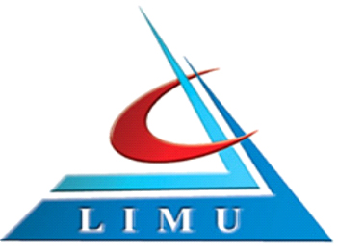

Privatization and Its Implementation
Libyan International Medical University
Faculty Of Business Administration
24th of November, 2021
Arwa Fawzi Ghaith 3275 Arwa_3275@limu.edu.ly

Slide 2
Contents
Introduction : What is Privatization?
The Ways in Which a Company Can Be Privatized
How Privatization is Implemented?
Pros and Cons of Privatization
Conclusion
References

Slide 3
Introduction
What is privatization?
Privatization occurs when a government-owned business, operation, or property becomes owned by a private, non-government party.

Slide 4

The Ways in Which a Company Can Be Privatized
Government companies are transformed into private companies in two ways:
Transfer of ownership
By the withdrawal of the government from the ownership and management of public sector company.

Slide 5


2. Disinvestment
Selling off parts of the equity of public sector undertakings (psus) to the private sector is known as disinvestment.

Slide 6

How Privatization is Implemented?
There are five methods of implementing privatisation:
Public sale of shares
Public auction
Direct negotiations
Transfer of control of enterprises that were controlled by the state or by municipalities
Lease with a right to purchase

Slide 7
Pros and Cons of Privatization
Pros
Cons
Private companies often operate more efficiently than public companies
Less bureaucratic work style
May attract more highly-qualified people
Higher wages
Product and service quality may improve
Lower product prices
Harmful if the business has a monopolistic character
Public companies may be sold too cheap to private corporations
Insufficient regulation
Responsibilities may become unclear
Public vs. private interest
Some people may lose their jobs

Slide 8

Conclusion
For any economy, privatisation is important because it creates jobs and builds a healthy competition in the market. Privatisation increases profit by improving the quality of customer services and goods.

Slide 9
References
25 top pros & cons of privatization. E&C. (2021, August 4). Retrieved November 21, 2021, from https://environmental-conscience.com/privatization-pros-cons/.
Admin. (2021, August 30). Privatisation: Meaning, objectives, methods, advantage, example. BYJUS. Retrieved November 21, 2021, from https://byjus.com/commerce/privatisation/.
Hargrave, M. (2021, November 20). Privatization Definition. Investopedia. Retrieved November 21, 2021, from https://www.investopedia.com/terms/p/privatization.asp.

