Slide 1


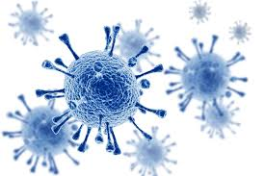
Libyan International Medical University
Faculty of basic medical science
Human Immunodeficiency Virus
HIV
BY: Israa Bojwari
2nd year AMS
2151

Slide 2
Objectives:
Define HIV and its basic properties.
Outline the diagnosis, treatment & prevention of HIV.
Differentiate between HIV & AIDS.
Define and outline the clinical features of AIDS.

Slide 3
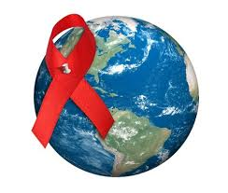
Human Immunodeficiency Virus
1

Slide 4
Human Immunodeficiency Virus
Acquired Immunodeficiency first described in 1981, HIV-1 isolated in 1984, and HIV-2 in 1986 Belong to the lentivirus subfamily of the retroviridae
Human immunodeficiency virus (HIV) is the cause of acquired immunodeficiency syndrome (AIDS).
Both HIV-1 and HIV-2 cause AIDS,
HIV-1 is found worldwide,
HIV-2 is found primarily in West Africa.

Slide 5
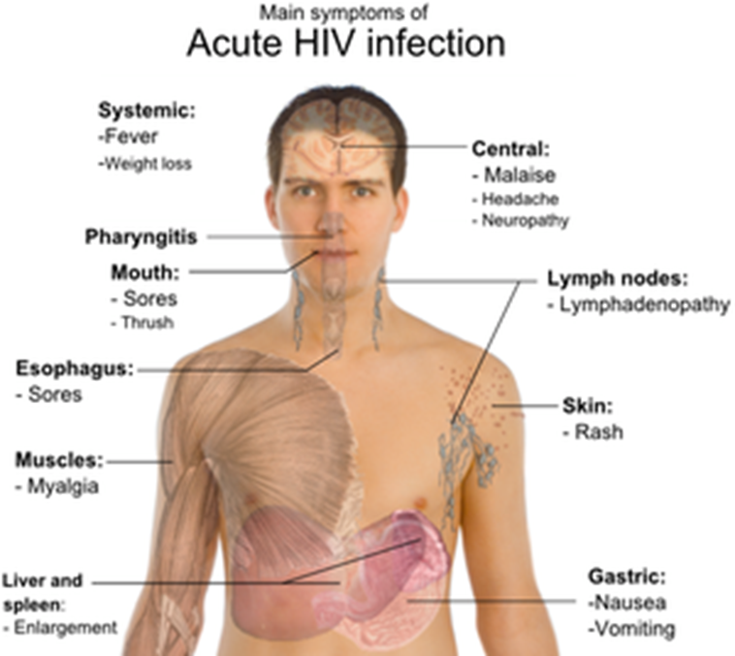
Signs and symptoms of HIV
Infected person can
infect other people
Stage 1 – Primary:
Short, flu-like illness
occurs one to six weeks after infection
Mild symptoms :
Fever
Headache
Rash
Swollen lymph nodes
Weight loss
Diarrhea and cough

Slide 6
Stage 2 - Asymptomatic
Lasts for an average of ten years
.This stage is free from symptoms
.There may be swollen glands
.The level of HIV in the blood drops to low levels
.HIV antibodies are detectable in the blood
Stage 3 - Symptomatic
The immune system deteriorates .
Opportunistic infections and cancers start to appear .

Slide 7
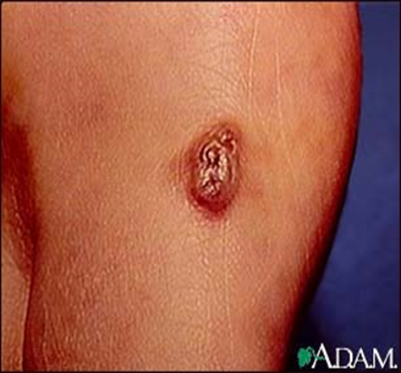
Stage 4 - HIV  AIDS
The immune system weakens too much as CD4 cells decrease in number.

Slide 8
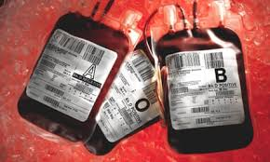
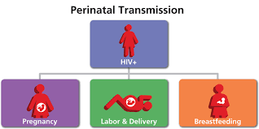
Transmission and Epidemiology
Sexual contact.
Transfer of infected blood.
Perinatal transmission from infected mother to neonate also occurs, either across the placenta, at birth, or via breast milk.

Slide 9
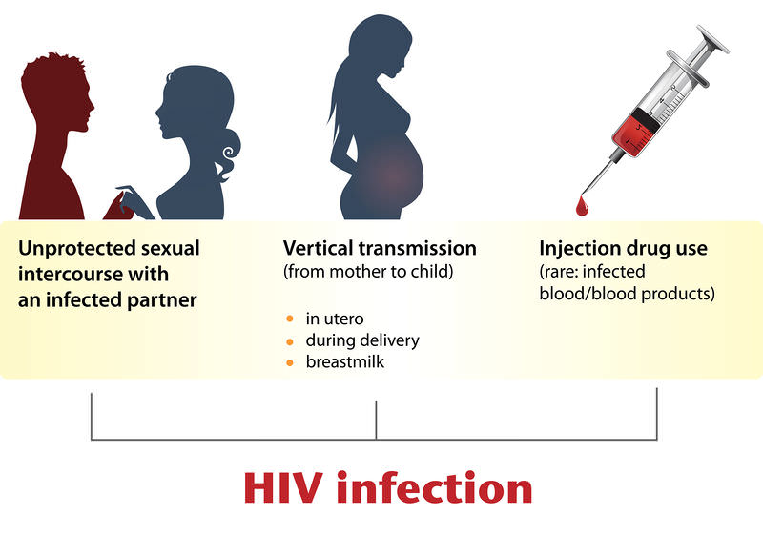

Slide 10
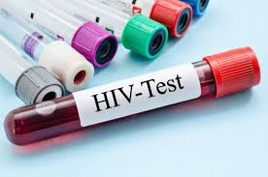
Outline the diagnosis treatment & prevention of HIV.
2

Slide 11
Laboratory Diagnosis
Enzyme-linked immunosorbent assay (ELISA) test.
Confirmatory assays - Western blot
A diagnosis of HIV infection can be made earlier by the detection of HIV antigen, pro-DNA, and RNA.

Slide 12
Prevention
Education
Safe sex
Blood/organ screening
Infection control / No vaccine is available
Prevention consists of taking measures to avoid exposure to the virus (e.g., using condoms, not sharing needles, and discarding donated blood that is contaminated with HIV)

Slide 13
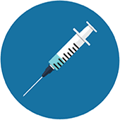
Treatment
The two specific goals of treatment are :
to restore immunologic function by increasing the CD4 count, which reduces opportunistic infections and certain malignancies
or reduce viral load, which reduces the chance of transmission to others.

Slide 14
The difference between
AIDS & HIV
HIV | AIDS
Human Immunodeficiency Virus(HIV) is the causal factor (reason) for AIDS | Acquired Immunodeficiency Syndrome (AIDS) is the disease.
HIV is a virus and like other viruses, can spread from person to person. | AIDS is a condition acquired only after the contraction of HIV

Slide 15
Define and outline the clinical features of AIDS.
3

Slide 16
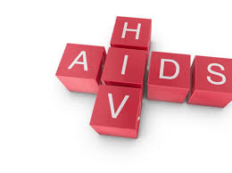
Acquired immunodeficiency syndrome (AIDS)
AIDS is a disease caused by the retrovirus human immunodeficiency virus (HIV) and is characterized by profound immunosuppression that leads to opportunistic

Slide 17
Clinical features
The typical adult patient with AIDS presents:
Fever
Weight loss
Diarrhea
Generalized lymphadenopathy
Multiple opportunistic infections, neurologic disease, and in many cases, secondary neoplasms.
Patients with AIDS have a high incidence of certain tumors, notably Kaposi sarcoma, B cell lymphoma, cervical cancer in women, and anal cancer in men

Slide 18

References
Levinson,(2012), Review of Medical Microbiology and immunology, (12th Ed.), Mc-Graw Hill.
2. Kumar, Abbas, Fausto, Aster, (2010), Robbins and Cotran Pathologic basis of disease, (8th Ed.), Saunders Elsevier.

Slide 19
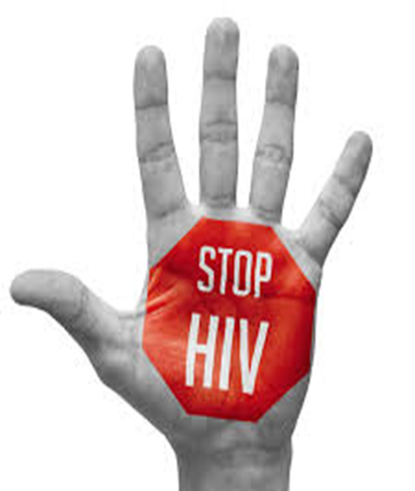
Thank you…

