Slide 1


Libyan International Medical University Faculty Of Business Administration Business Model canvas Of Uber
Presented By: Alaa Khalid Elmahgoub
ID: 1993
Instructor: Mr. Mohammed Alzwawi

Slide 2

Content
Introduction.
Uber’s Customer Segments.
Uber’s Value Propositions.
Uber’s Customer Relationships.
Conclusion
References

Slide 3

Introduction
Uber is a technological platform that has revolutionized urban transportation — and has given taxi drivers and cab companies a lot of headaches. In short, it is an app that connects drivers to users who need a ride, using a smartphone as a tool.

Slide 4
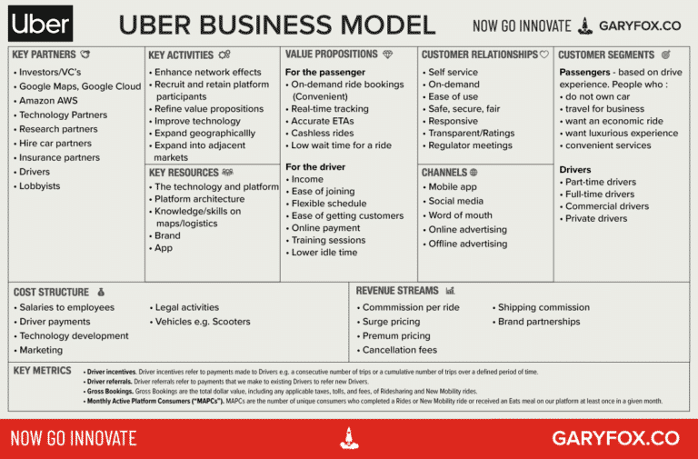

Slide 5
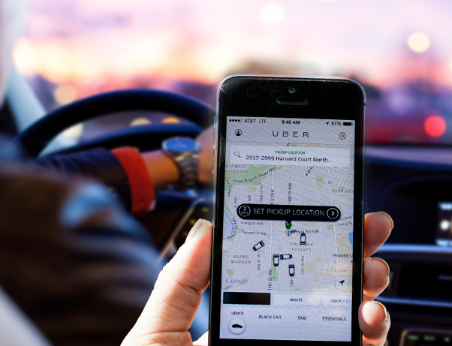
Uber’s Customer Segments
In general, Uber has two customer segments riders and drivers. The side of riders is people who either do not have their own car, need to travel outside their city of residence, or don’t want to drive at a certain time — for example, Uber Eats the defined target market will be bachelors who don't have time for cooking, people who don't know how to cook, and occasionally everyone beyond that.
This Photo by Unknown Author is licensed under CC BY-SA-NC

Slide 6

Uber’s Value Propositions
For customers, the greatest value proposition is the convenience of not having to look for a taxi — the car comes to you. Cars are available 24/7 and their route can be tracked. In addition, fares are generally lower than those charged by taxi drivers, and the rider can estimate how much the ride will cost before calling the driver.

Slide 7

Uber’s Customer Relationships
The customer relationship involves three sides: customer, driver, and regulators. Uber’s focus is predominantly on the customer. If the company has no credibility with the end-user, then it has no reason to create a relationship with the other two.

Slide 8
Uber SWOT
Uber strengths Uber’s Opportunities
Largest Ride Sharing Technology - Accountability and Performance
Strong brand awareness - Self-driving technology and other services
Low capital investment
Customer-Driver Interaction
Uber’s Weaknesses Uber’s Threats
Multiple scandals - Intensifying competition
Significant Loss - Tight Regulations
Workforce Dependence - Employee strikes
Poor working conditions - Proceedings.

Slide 9
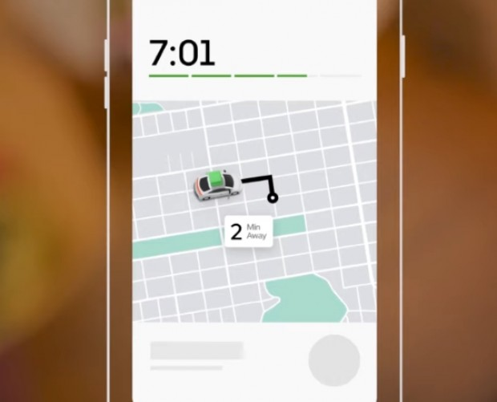
Conclusion
Any entrepreneur can draw several “lessons” from Uber’s business model. For example, you don’t need large equity to start a business. Uber doesn’t even own a car and, still, provides over 1 million rides a day. More than that, its founders saw a problem in an industry and simply sought a solution for it. And in doing so, they were able to transform the cab industry.

Slide 10
References
Uenlue, D. M. (2020, September 1). Premium products. InnovationTactics. Retrieved June 18, 2022, from https://innovationtactics.com/business-model-canvas-uber/
Pereira, D. (2022, May 13). Uber business model. Business Model Analyst. Retrieved June 18, 2022, from https://businessmodelanalyst.com/uber-business-model//

Slide 11
Thank You!

