Slide 1


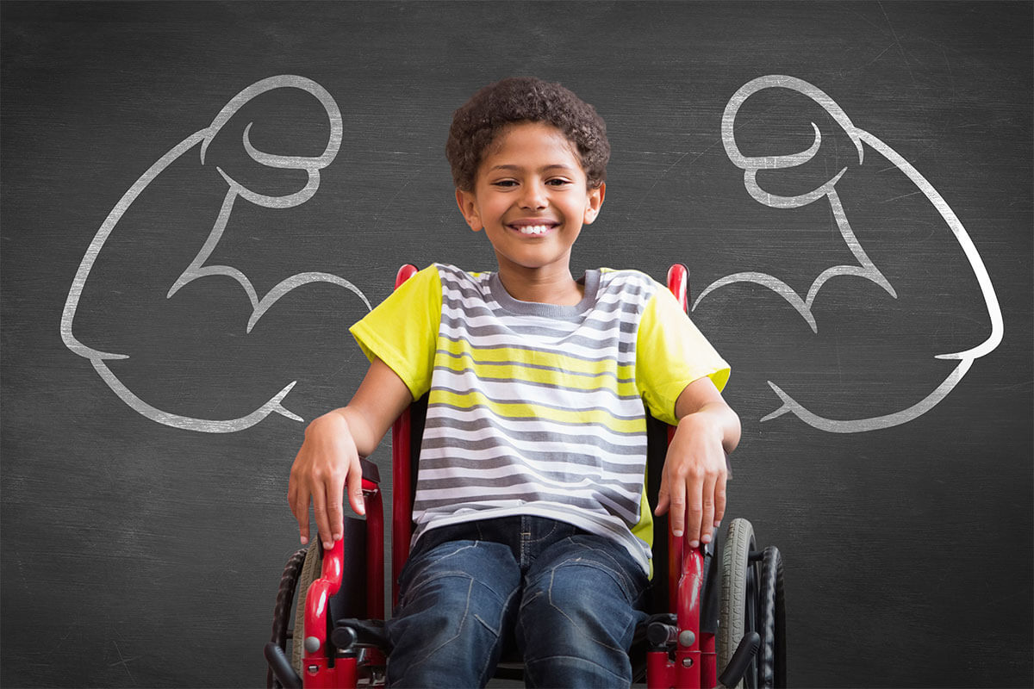
Cerebral palsy
Presented by : Sarah Altarhoni
Student ID :2750
Block: MSK
Date: 16-05-2022

Slide 2
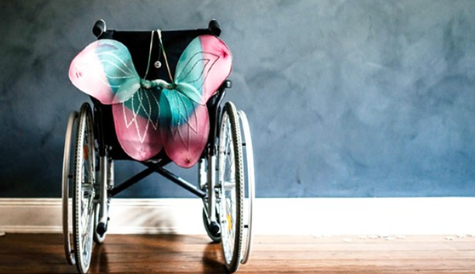
Objectives
Mercury
Planet Mercury is the closest object to the Sun
Define Cerebral Palsy (CP).
Mars
Discuss the causes of Cerebral Palsy.
Despite being red,
Mars is a cold place
Outline the types of Cerebral Palsy.
Jupiter
Complications that is associated with Cerebral Palsy.
Jupiter is a gas giant
and the biggest planet
List ways to prevent bullying among children.

Slide 3
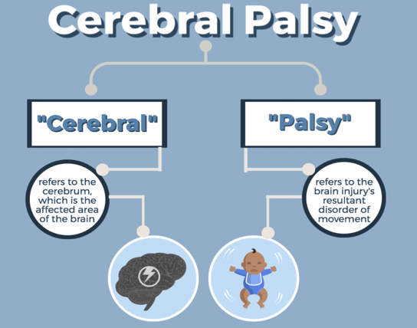
Introduction
Cerebral palsy is a group of permanent disorders affecting the development of movement and causing a limitation of activity.

Slide 4
Causes of cerebral palsy
1.CP is caused by abnormal development of the brain or damage to the developing brain that affects a child’s ability to control his or her muscles.
2.CP was mainly caused by lack of oxygen during the birth process.
The abnormal development of the brain or damage that leads to CP can happen before birth, during birth, within a month after birth, or during the first years of a child’s life, while the brain is still developing.

Slide 5
CP related to abnormal development of the brain or damage that occurred before or during birth is called congenital CP.
The majority of CP (85%–90%) is congenital.
A small percentage of CP that occurs more than 28 days after birth. This is called acquired CP, and usually is associated with an infection (such as meningitis) or head injury.

Slide 6
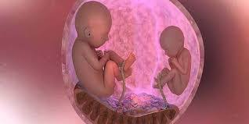
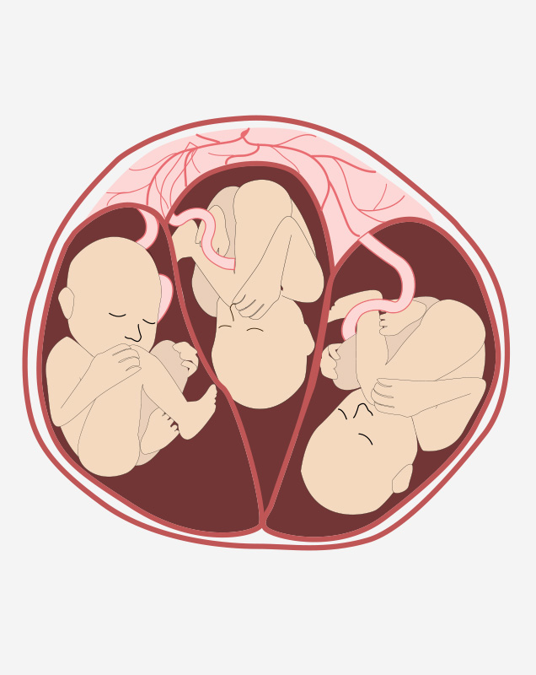
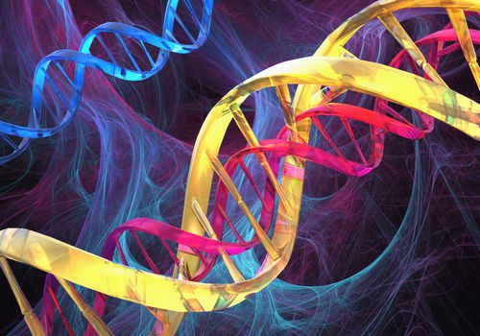
2. Multiple gestation
Other risk factors associated with Cerebral Palsy
1.Intrauterine growth
restriction (IUGR)
3. Genetic susceptibility

Slide 7
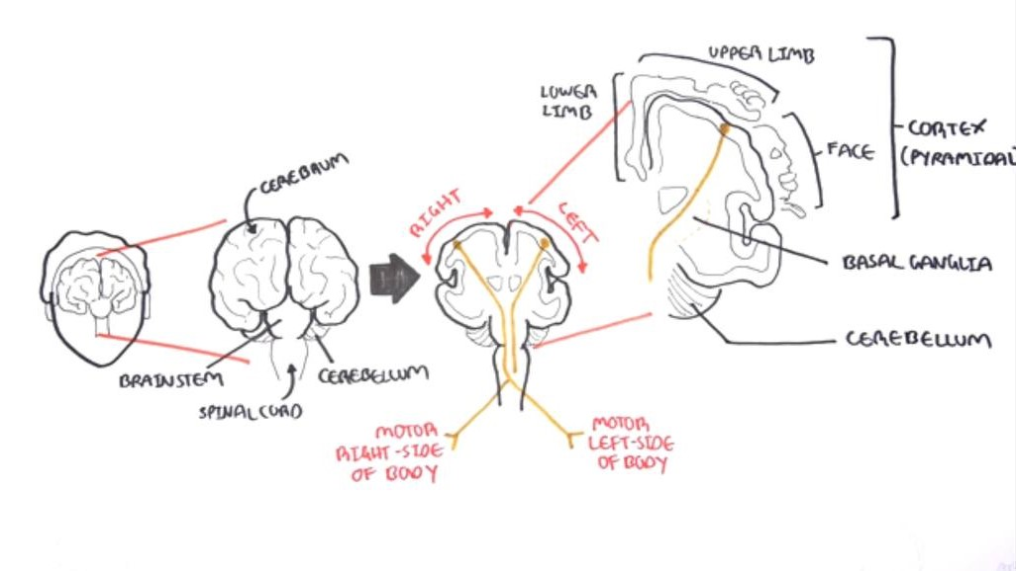

Slide 8
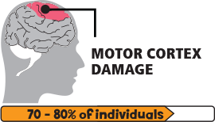
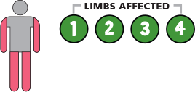
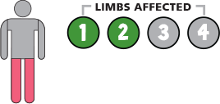
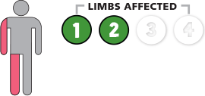
Types of CP
1.
Spastic Cerebral Palsy
Spastic quadriplegia
Spastic diplegia
Spastic hemiplegia

Slide 9
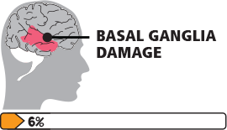
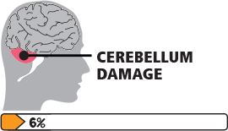
Uncontrollable movements and can be slow, writhing or rapid.
The face and tongue are affected and the person has a hard time sucking, swallowing, and talking.
2.
Dystonic cerebral palsy
3.
Ataxic cerebral palsy
Ataxic CP have problems with balance and coordination.
They might be unsteady when they walk.

Slide 10
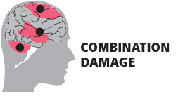
4.
Mixed cerebral palsy
Mixed cerebral palsy occurs when a child exhibits symptoms of more than one type of cerebral palsy.

Slide 11
Complications that associated with cerebral palsy
t

Slide 12

1.Help kids understand bullying. Tell kids bullying is unacceptable. Make sure kids know how to get help.
2.Keep the lines of communication open. Check in with kids often. Listen to them. Know their friends, ask about school, and understand their concerns.
3.Encourage kids to do what they love. Special activities, and interests, help kids make friends, and protect them from bullying behavior.
4.Model how to treat others with kindness and respect.
List ways to prevent bullying among children.

Slide 13

Conclusion :
DISABILITY IS THE INABILITY TO SEE ABILITY ✨🌸

Slide 14
References:
1. Hallman-Cooper J, Cabrero F. Cerebral Palsy [Internet]. Ncbi.nlm.nih.gov. 2022 [cited 15 May 2022].
2. [Internet]. 2022 [cited 15 May 2022]..
3. Causes of cerebral palsy : Current Opinion in Pediatrics [Internet]. LWW. 2022 [cited 15 May 2022].

Slide 15
