Slide 1


Impression formation process
Libyan International Medical University
Faculty of Business Administration
mohammed_3835@limu.edu.ly

Slide 2
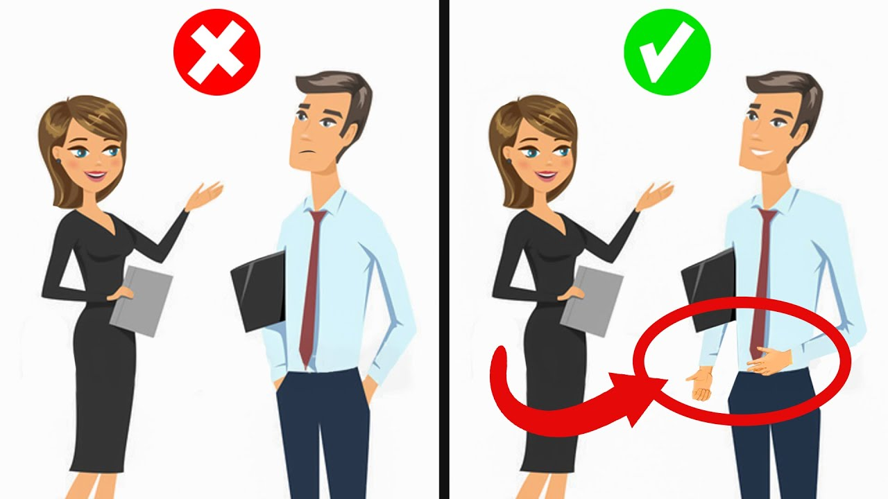
What is impression
An idea feeling or opinion about something or someone one form without conscious thought or the basis of little evidence

Slide 3

What is impression formation
A social psychological referring to the way in which stranger develop perception to each other

Slide 4

Two basics of principles of impression formation
1-on the basis of minimal information

Slide 5
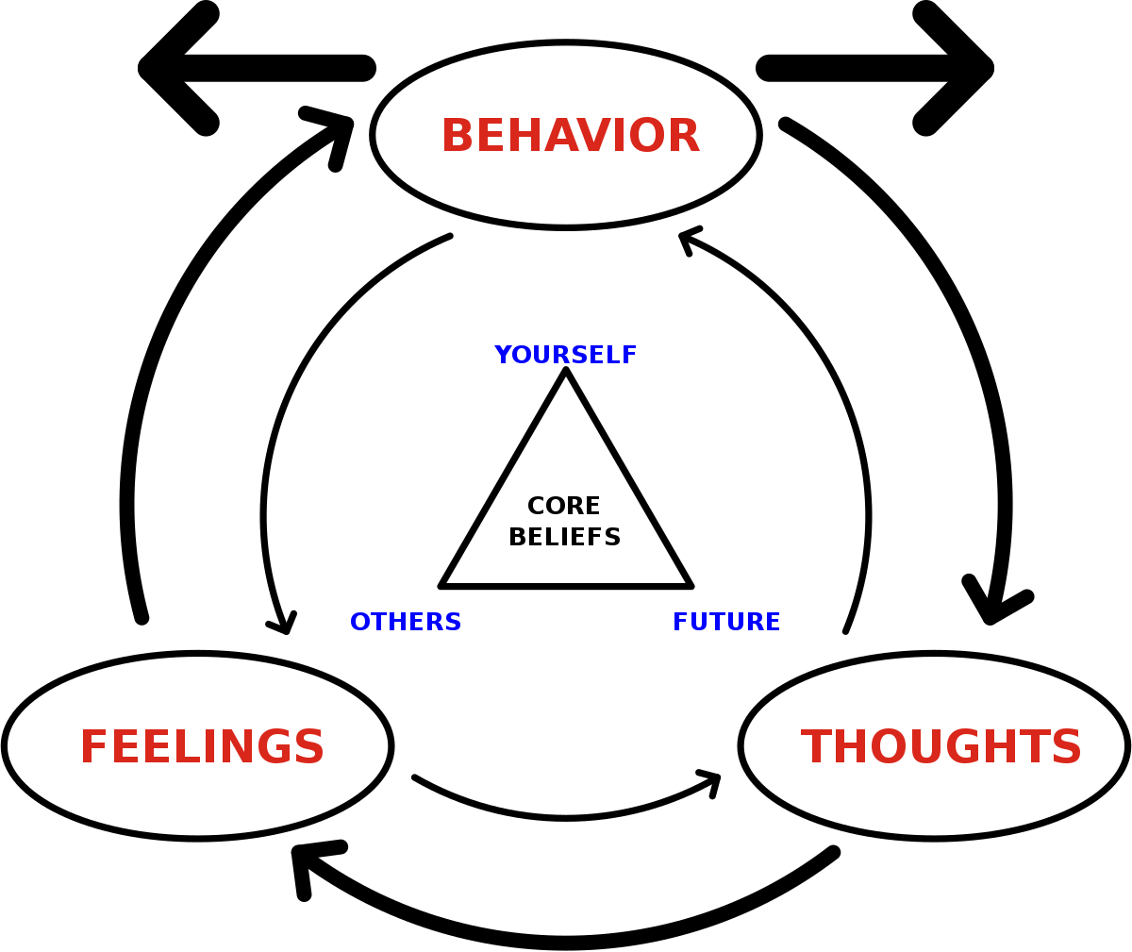
2- we use the context of a person behavior rather than interpreting behavior

Slide 6
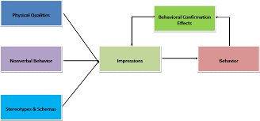
How the impression formation possess works

Slide 7
References
https://www.slideshare.net/aparnabakre/impression-formation

Slide 8
Thank you

