Slide 1


Libyan International Medical University
Faculty of business administration
The Purpose of Law in Society
Name/ Eyad mohamed
Number/4010
Email/Ayad-4010@limu.edu.ly

Slide 2
Table of contents
Introduction
The purpose
Conclusion
Reference

Slide 3
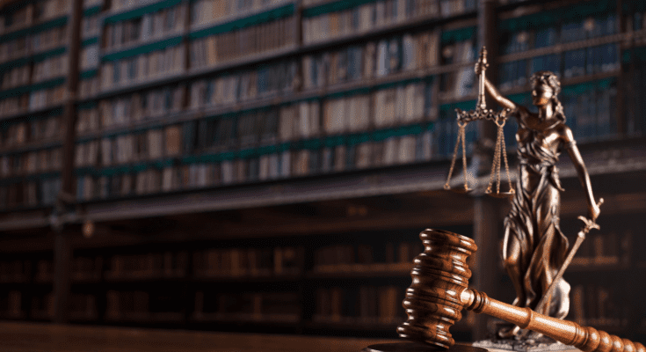
Introduction
Law is seen as a body of regulations that govern how people behave both individually and collectively in society.

Slide 4
The purpose
1- Laws provide access to justice in society
The victim of a blow has more alternatives if it is against the law to strike someone in the face than just backing away. Fairness is impartial in a perfect society.
2- Laws protect the most vulnerable in society
Numerous laws have been passed to protect certain categories of people. Laws like the Sex Discrimination Act and the Civil Rights Legislation forbid discrimination.
By Edeh Samuel Chukwuemeka ACMC / February 11, 2022

Slide 5
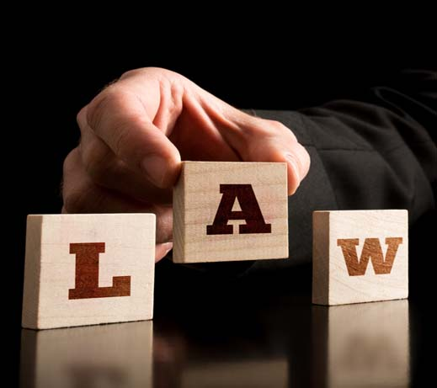
3-Laws provide a wide range of professional opportunities
The legal profession is versatile and flexible. Because there are so many diverse topics of law, there are hundreds of career prospects in the field.

Slide 6
4- Laws are important to maintain peace in society
We discussed how the law is fundamentally about resolving disputes earlier in this article. As a result, the law is necessary for keeping the peace. This is because injustice is a source of conflict.
5-
We've discussed how laws ought to be flexible and accommodate various situations. Laws would get stale if they didn't adapt, just like civilizations do.
Laws are important for social progress in society

Slide 7
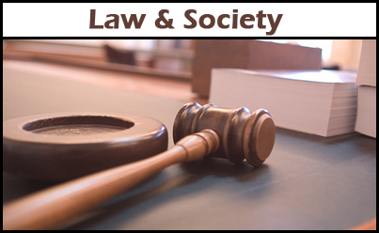
6- Laws make human rights a reality
The rule of law, in my opinion, is the cornerstone of all of our fundamental rights. Basic rights are those human rights that every individual is entitled to.

Slide 8
Conclusion
Law it is important in society because it save the right of every one and make the society live in pace and reduce the number of conflict between people so there is no society with out law.

Slide 9
Reference
1-ACMC, E. S. C., & Edeh Samuel Chukwuemeka ACMCEdeh Samuel Chukwuemeka. (2022, February 11). 8 importance of law in the society. Bscholarly.

Slide 10
•Thanks for listening

