Slide 1


The Difference Between Left, Right & Middle Political Wings
Libyan International University Faculty of Business Administration
Mohammed Jamal Elghirani 2857
Mohammed_2857@limu.edu.ly

Slide 2
CONTENT
1- Introduction.
2- The difference between lift, right & middle political wings.
3- Conclusion.
4- Reference.

Slide 3

Introduction
Whether you study politics or not, you must come across words like right wing and left wing in many newspapers which makes it hard to understand the story as you do not know the difference between these two sentences.
.

Slide 4
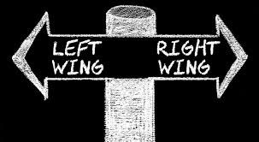
The difference between lift, right & middle political wings

Slide 5
People who belong to the right people who belong to the
Political spectrum tend to be left political spectrum tend
More past thinkers. to be more forward thinkers.
_{Right}
_{Left}

Slide 6
People tend to be present thinkers.
They are satisfied with the way things are right now.
_{middle}

Slide 7
Conclusion
The right & left wing are always disagree with government but there are people called moderates agree with people who win.

Slide 8
Reference
Ball, T. (1998, January 1). Political ideologies and the Democratic ideal. AbeBooks. Retrieved November 20, 2021, from https://www.abebooks.com/9780321005410/Political-Ideologies-Democratic-Ideal-Ball-0321005414/plp.

Slide 9
THANK YOU

