Slide 1
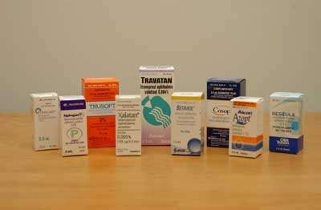
Ocular drugs
By Dr Eman Enweigi

Slide 2
Objectives
Varying routes for ocular drug applications
Different drug groups for ophthalmic use
Indication , side effects , contraindications

Slide 3
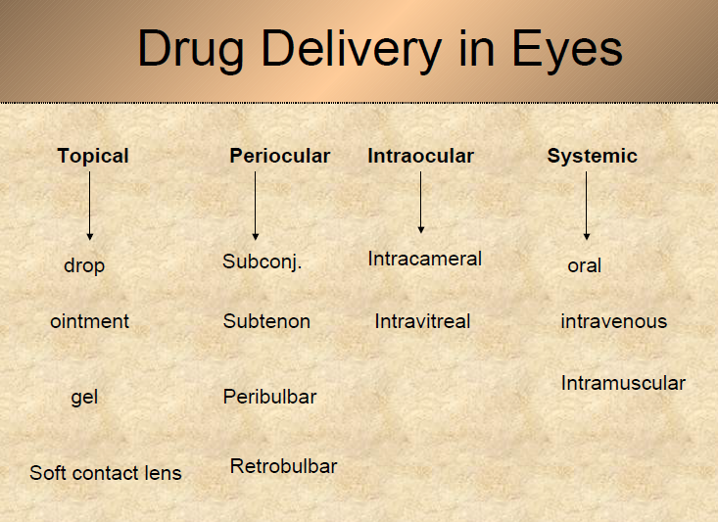
Introduction

Slide 4
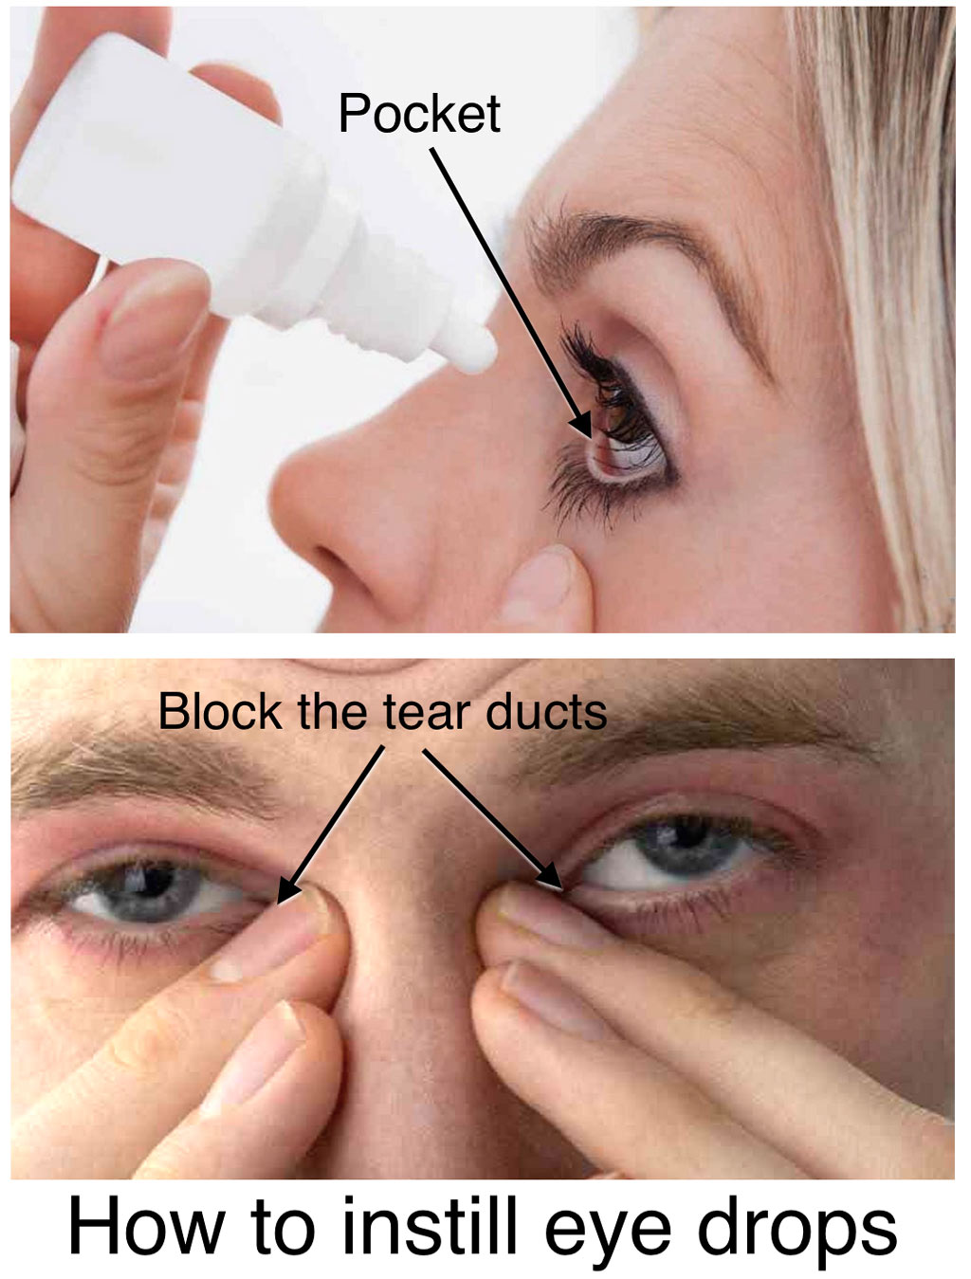
TOPICAL
Drop- simplest and more convenient
mainly for day time use
1 drop=50 microlitre
Conjuctival sac capacity=7-13 micro liter
so, even 1 drop is more than enough
Method
hold the skin below the lower eye lid
pull it forward slightly
Install 1 drop
• measures to increase drop absorption:
-wait 5-10 minutes between drops
-compress lacrimal sac
-keep lids closed for 5 minutes after instillation

Slide 5
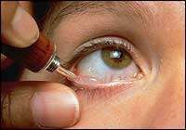
Ointments
Increase the contact time of ocular medication to ocular surface thus better effect
• It has the disadvantage of vision blurring

Slide 6
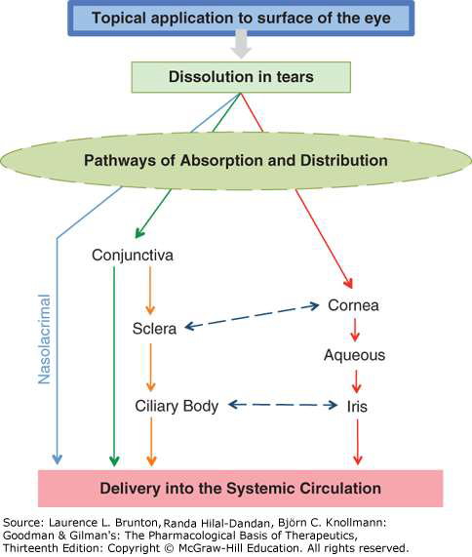

Slide 7
Peri-ocular injections
They reach behind iris-lens diaphragm better than topical application
E.g. subconjunctival, subtenon, peribulbar, or Retrobulbar
useful for
drugs with low lipid solubility
delivering medications closure to local site of action e.g. posterior subtenon
retrobulbar and peribulbar anesthesia techniques

Slide 8
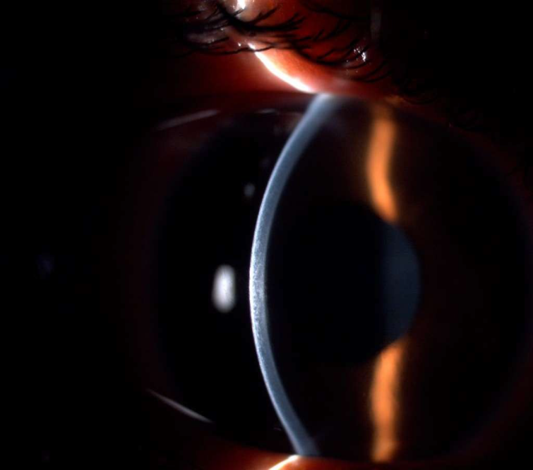
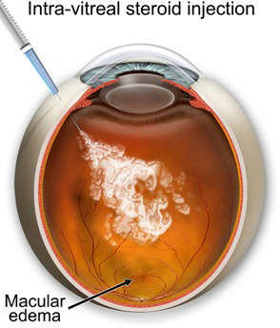
Intraocular injections
Intracameral or intravitreal
• E.g.
– Intracameral (anterior chamber) antibiotics, steroid
Acetylcholine (miochol) during cataract surgery
– Intravitreal antibiotics in cases of endophthalmitis
– Intravitreal steroid in macular edema
– Intravitreal Anti-VEGF vascular endothelial
growth factor for macular odema ,
neovascularization

Slide 9
Common ocular drugs
Mydriatics and cycloplegics
Local anesthetic
Antiglaucoma
Anti-inflammatory agents
Anti allergy
Ocular Lubricants
Antibacterial (antibiotics)
Antiviral
Antifungal

Slide 10
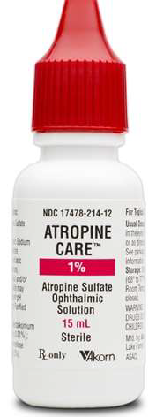
Mydriatics and cycloplegics
ATROPINE
Atropine sulfate is anticholinergic – 0.5%, 1%,3%
Strongest cycloplegic
Inhibitor of muscarinic action of acetylcholine {sphincter muscle contraction)
Produce mydriasis , paralysis of accomadation
Indication
Mydriasis & cycloplegia for fundus examination and refraction
Pupil dilation in inflammatory condition of iris
Corneal ucler
Amblyopia therapy
Post operative
Contraindication
glaucoma
Hypersensitive

Slide 11
Adverse effects
Allergic responses
Blurred vision
Photophobia
Dryness of skin & mouth
Fever , Skin rash , Flushing , Restlessness.
Feeling irritable , abnormal heart beat , tachycardia
Constipation , decrease sweating , urine retention

Slide 12
Cyclopentolate , (Cyclogel )(0.5 , 1 %)
• an anticholinergic , produce mydriasis , paralysis of accommodation
• Indication
Refraction
Fundus examination
Treatment in anterior uveitis , corneal ulcers , postoperative
• Contraindication
– Narrow angle glaucoma
– Hypersensitive
• Adverse effects
– blurring of vision, photophobia
– Psychotic reaction , CNS hallucination , disorientation
– Dryness of mouth, headache or allergic reactions

Slide 13
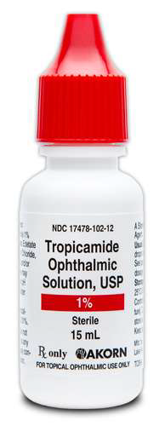
TROPICAMIDE (mydricil )
• anticholinergic rapid short acting mydriatric drug
1%, paralysis accommodation
0.5% produce mydriasis with slight cycloplegia
• Indication
– Diagnostic (fundus examination)
– Pre and post operative stages
– Infants –0.5% combination with phenylephrine
• Contraindication
Narrow angle glaucoma
Hypersensitive
• Adverse effect
Stinging sensation
Confusion or hyperactivity
Cycloplegia , blurred vision , photophobia
Dry mouth , tachycardia , headache

Slide 14
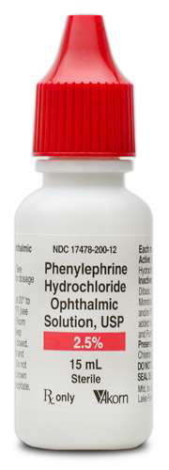
PHENYLEPHRINE (2.5% , 10%)
• Direct acting sympathomimetic
• Pupil dilation for diagnostic purpose , no effect on accommodation
• Indication
fundus examination
• Contraindication
Narrow angle glaucoma.
Hypertensives.
Hypersensitivity
Antidepression treatment
• Adverse effects
Mydriasis , blurred vision , photophobia
HTN, headache, arrhythmia , myocardial infraction

Slide 15
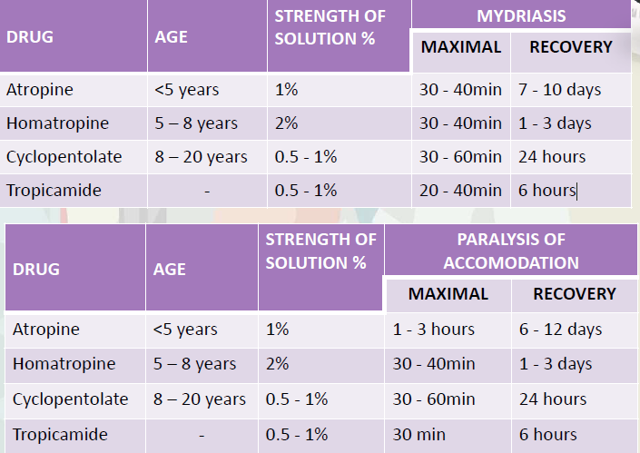

Slide 16
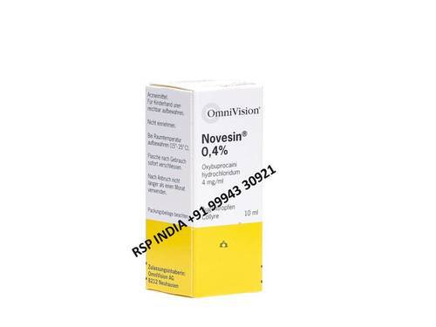
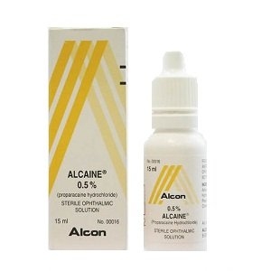
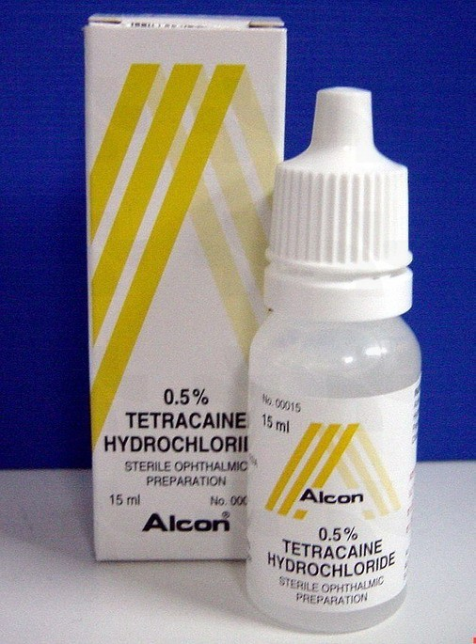
Topical anesthesia
Oxybuprocaine Hydrochloride 0.4%(Novesin) ,Propacaine, Tetracaine 0.5%
Uses:
Tonometry (measurement of intraocular pressure)
removal of corneal foreign bodies,
removal of sutures
Gonioscopy , triple mirror
Adverse effects:
toxic to corneal epithelium
Allergic reaction

Slide 17
Antiglaucoma
Mechanism of action
Decrease The
Formation Of Aqueous
Increase Aqueous
Drainage
Beta blockers
Alpha agonist
Carbonic anhydrase inhibitors
Prostaglandins
Miotics

Slide 18
Beta blockers
Mechanism of action: lower IOP by reducing aqueous formation
Selective beta 1 blockers | Non selective betablocker
betaxolol | Timolol maleate
0.5 % | 0.25% 0.5%
Little effect on the cardiopulmoary system | S/E bradycardia, hypotension Brochospam , fatigue, confusion , depression

Slide 19
Stinging, redness & dryness of eyes Corneal hypothesia | Ocular side effect Stinging, redness & dryness of eyes Corneal hypothesia
 | c/I asthmatic, COAD , slow pulse , heart block, sinus bradycardia , cardiogenic shock
Indication Ocular hypertension All types of glaucoma | Indication Ocular hypertension All types of glaucoma
Less efficacious than Timolol Protective effect on retinal neurons by blocking calcium channels | 20-35% fall in IOP within 1hr and last for 12 hours. 30% patients- additional medications

Slide 20
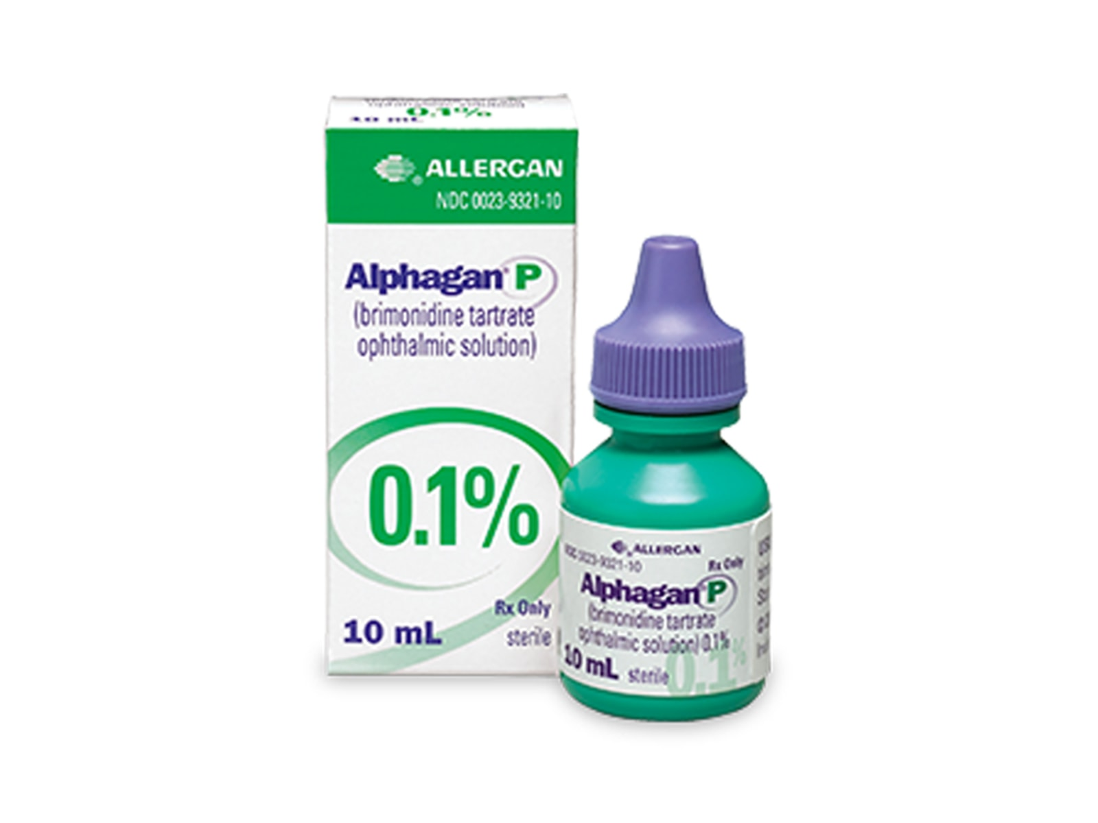
Alpha adrenergics agonist
MOA: stimulate alpha 2 receptors in the ciliary
epithelium and thereby decrease the rate of aqueous
production.

Slide 21
Adrenaline | Brimonidine (alphagan) | Apraclonidine
Allergy Black deposits (adrenochrome) Mydriasis, Cyctoid macular odema 30% of aphakic patients | Allergy 10 % | Side effects Allergy Lid retraction Conjunctival blanching Mydriasis
Tachycaria / arrythima hypertension | Dry eye & mouth • Headache • Fatigue | Dry eye & mouth • Headache • May exacerbate IHD • hypOtension !
Infrequently used | Not used At 1st year as it pass the CNS | Used for short term therapy [ it is effect lost after 3 months]
Reduces aqueous production Augments uveoscleral outflow | Reduces aqueous production | Reduces aqueous production

Slide 22
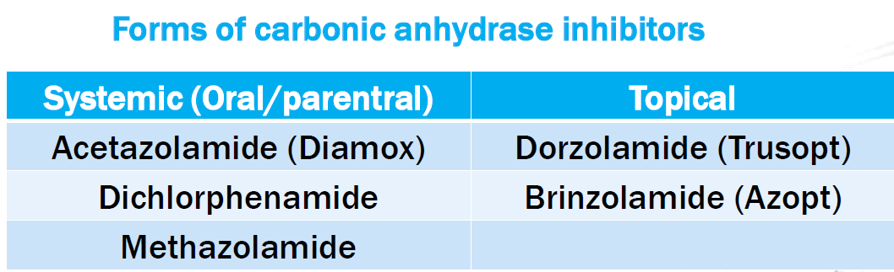
Carbonic anhydrase inhibitors
Sulphonamide derivative acts as inhibitor on the enzyme carbonic anhydraze causing ↓ aqueous formation thus decrease IOP
Topical
Indication : All types of gluacoma ,
Side effects allergy , blepharoconjunctivitis

Slide 23
Use of systemic CAI
Short term therapy with acute glaucoma
Acute congestive glaucoma iv
Bening intracranial hypertension
Preoperative
Postoperative corneal odema
Side effect
Transient myopia , Dry eye
Paresthesia , tingling
Fatigue , depresion , anorexia , decrease wt
Loss of libido
Renal stone formation
GIT up set
Steven johnson syndrome
Blood dyscrisia
Hypokalemia

Slide 24
Prostaglandins
Prostaglandin f2 alpha analogue , enhance aqueous humor outflow through uveoscleral route , used once daily in the evening
Latanoprost (Xalatan)
Brimatoprost (Lumigan)
Travoprost (Travatan)
Unoprostone (Rescula)
S/E
Lashes: darkening & lengthening
Hyperemia
Iris pigmentation 8-15% (Within 3-12 months) ✓✓✓d.t. ↑ melanin production NOT ↑ in melanocytes**
Systemic: Flu-like symptoms
Contra-indicated in pregnancy
Used Cautiously at:
- Lactation
- Intra-ocular inflammation

Slide 25
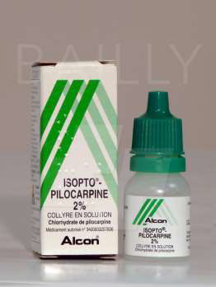
MIOTICS (cholinergic )
Parasympathomimetic
pilocarine (1% , 2%, 3%, 4%) : 4 times/day
(or gel once daily before sleep)
Action:
Contraction of constrictor pupillae muscle → widening of angle
Contraction of ciliary muscle → traction on scleral spur → ↑ T.M out flow
Indication
Iop in glaucoma (mainly in angle closure glaucoma)
Types of glaucoma ( pigmentry glaucoma)
C/I
2RY glaucoma due to uveitis
Neovascular glaucoma
Malignant glaucoma

Slide 26
Side effects
allergy +
Follicular conjunctivitis
Iris cyst
Miosis [ ↓ night vision ]
Disturb BAB (blood aqueous barrier)
Lens: cataract
Retinal detachment d.t. altered forces at vitreous base d.t. CB contraction → tear
Myopic shift d.t. spasm Of circular ciliary muscles*
Brow & temporal headache (Normally reversible 2-3 days)*
Systemic , sweating , headache , diarrhea

Slide 27
Mannitol
Hypertonic Mannitol 20% IV infusion- 1.5-2 g/kg
Action start in 30 mins and lasts 4/6 hours
Osmotic agent remains in blood → ↑ osmolarity → creating osmotic gradient between blood & vitreous → water is drawn from vitreous → ↓ IOP
Indication
1Primary angle closure glaucoma
2. Prior to I.O surgery with ↑ IOP
S/E
Congestive heart failure
Pulmonary odema
Urine retention (If prostatic enlargement)
Headache Dizziness Confusion

Slide 28
Anti-inflammatory agents
Anti-inflammatory
corticosteroid
NSAID

Slide 29
Corticosteroid
Topical corticosteriod exert anti-inflammatory action
Dexamethazone
Betamethazone
Prednisolone
Fluoromethaolone
Indications
allergic &vernal conjunctivitis,
scleritis, episcleritis
uveitis,
Keratitis (chemical , radiation)
after intraocular and extra ocular surgeries
C/I
epithelium herpes simplex keratitis
Fungal infection
Tb

Slide 30
Systemic (pathology behind the LENS)
Posterior uveitis
Optic neuritis
corneal graft rejection
Side effects
• OCULAR
glaucoma
cataract
activation of infection
delayed wound healing
SYSTEMIC
Peptic ulcer , pancreatitis
Hypertension
Increased blood sugar
Osteoporosis, suppression of growth in children
Cushinoid state , Mental changes
Activation of tuberculosis and other infections
Intravitreal
Subconjunctival
Posterior subtenon

Slide 31
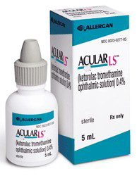
NSAIDS
• Topical use
flurbiprofen
indomethacine
ketorolac
Indications
episcleritis and scleritis
CME (decrease incidence postoperatively)
Pre operatively to maintain dilation of the pupil

Slide 32
Antiallergy
Main classes of anti-allergy drugs
1. Ocular Decongestants
2. Antihistamines
3. Mast Cell Stabilizers
4. NSAIDS
5. Corticosteroids

Slide 33
1.Ocular Decongestants
Phenylephrine 0.12% and 0.125%
Naphazoline (0.012%, 0.05%, 0.1%) Tetrahydrozoline (0.05%) Imidazole derivatives
Oxymetazoline (0.025%)
Cost effective choice for mild allergies
Mechanism of action
This drugs are adrenergic agonist
mainly alpha 1 receptor
Local vasoconstrictor, temporarily
reduces redness and swallowed blood
vessel
Does not treat itching and sneezing
S/E burning and stinging sensation ,,Chronic use lead to conjunctiva inflammation and Hyperemia,, Corneal opacity Papillary dilation ,, Dry eye

Slide 34
2.Anti-histamines-
Pheniramine, antazoline combined with naphazoline
Levocabastine HCl ophthalmic suspension 0.5% (Livostin)
Emedastine difumarate 0.05% (Emadine)
Mechanism of action
Blocks H1 receptors which control Itching
Thus providing symptomatic relief
from histamine activity
topical antihistamines do not have a long duration of action.
- Adverse reactions can include burning and stinging on instillation, headache, and dry mouth.

Slide 35
Mast cell stabilizers
First generation (older)
• Cromolyn Sodium (Sodium cromoglycate) 4% -BD
• Lodoxaminde 0.1%
• Second generation- BD dosing, same efficacy as first
generation
• Pemirolast potassium 0.1% (Alamast)
• Nedocromil sodium 2% (Alocril)
Mechanism of action
Not effective in acute disease
-Mast cell stabilizers work by
inhibiting mast cell degranulation
thereby reducing the release of histamine.
Side effect frequent-stinging burning after in installation
-Infrequently- conjunctiva injection watery or itchy eyes, dryness around the eye, puffy eyes and stys can be seen.

Slide 36
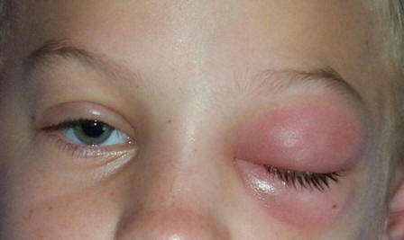
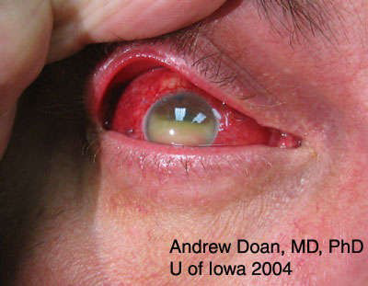
Antibiotics
Used topically treatment of ocular
Bacterial infections.
Used topically in prophylaxis (pre
and postoperatively)
Used orally for the treatment of
preseptal cellulitis
Used intravenously for the
treatment of orbital cellulitis
Can be injected intravitrally for the
treatment of endophthalmitis

Slide 37
Drugs available | MOA | Anti Bacterials
Gentamycin, Tobramycin & Amikacin | Protein synthesis inhibitors | Aminoglycosides
Ciprofloxacin, gati, moxi, besifloxacin etc | DNA gyrase inhibitors | Flouoroquinolones
Azithromycin , erythromycin | Protein synthesis inhibitors | Macrolides
Chloramphenichol, sulphaacetamide | Anti folate antibiotics | Sulphonamides
cefazoline | Cell wall synthesis inhibitors | Cephalosporins

Slide 38
Aminoglycosides
Side effects | Indication | Action | Drugs
Ocular burning & Irritation Ototoxicity Nephrotoxicity Pregnancy & child | Conjunctivitis, keratitis, corneal ulcers, absces dacrocystitis etc | Bacteriocidal Against pseudomonus , klebsiella e.Coli | Gentamycin 0.3%
Tearing, swelling of eye, stinging or blurred vision | Conjunctivitis, keratitis, corneal ulcers, dacrocystitis etc in children | Bacteriocidal More active | 1Tobramycin
Hypersensitivity |  | Bacterocidal Against staph Gram negative | Neomycin 0.3%

Slide 39
Fluroquinolones
Indications | Toxicity | formulations | Generic name
Conjunctivitis Keratitis Corneal ulcer blephritis Dacrocystitis | Hypersensitivities Drug related corneal deposits | 0.3% solution 0.3% ointment | Ciprofloxacin
Conjunctivitis Corneal ulcers | Hypersensitivity | 0.3% solution | Ofloxacin
Conjunctivitis, post op & pre op prophylaxis, corneal pathologies etc | Hypersensitivity | 0.3% solution | Gatifloxacin

Slide 40
Sulphonamides
Indications | Side effect | Formulations | Generic name
Conjuntivitis Keratitis | Bone marow supression Pancytopenia Peripheral neuritris Encephalopathy | Broad sectrum Bacteriostatic High ocular pentration , and other tissue csf | Chloramphenicol
Conjuntivitis, trachoma and other superficial ocular infections | Allergic conjunctivitis Stinging Keratopatheis | Broad sepctrum | Sulfacetamide sodium

Slide 41
Indications | Toxicity | formulations | Generic name
same as above | Hypersensitivity | 0.5% solution | Moxifloxacin
Same as above | Redness, blurring of vision, pain, irritation etc | 0.6% suspension | Besifloxacin
Macrolides
MOA: Inhibits Protein synthesis by inhibiting
the translocation on 50S ribosome
Indications | Toxicity | formulations | Generic name
Superficial infection involving cornea and conjunctiva | Hypersensitivity | 1% ointment | Azithromycin
Same as above | Hypersensitivity | 0.5% ointment | Erythromycin

Slide 42
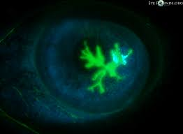
Antiviral
interfere with viral reproduction by altering DNA synthesis
Act on viral infected cells
Relatively less toxic
Able to penetrate the intact epithelium and the stroma & reach therapeutic levels in the aqueous humor
Active against
Herpes simplex keratitis
Herpes simplex 1&2
Herpes varcilla zoster virus

Slide 43
 | Ocular toxicity | Route of administration
Herpes simplex keratitis, keratoconjtivitis | Punctate keratopathy hypersensitivity | Topical 1% solution | Trifluridine
Herpes zooster ophthalmicus, HS keratitis & iridocyclitis |  | Oral(200mg cap/ 800mg tab) Topical 3% | Acyclovir
HS Keratitis HZ ophthalmicus |  | Oral (500- 1000mg) | Valacyclovir
HS Keratitis HZ ophthalmicus |  | Intravenous intravitreal | Famicyclovir
HS Keratitis HZ ophthalmicus ACUTE &RECURRENT | Lacrimation, foreign body sensation, photophobia etc | 3% ointment | Vidarabine

Slide 44
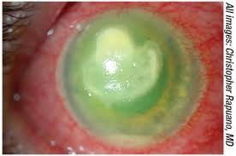
ANTIFUNGAL
INDICATIONS
Fungal corneal ulcer
Fungal retinitis/ Endophthalmitis
Commonly used drugs are
• Polyenes
– damage cell membrane of susceptible fungi
– e.g. amphotericin B, natamycin, nystatin
– side effect: nephrotoxicity
• Imidazoles
– increase fungal cell membrane permeability
– e.g. miconazole, ketoconazole,fluconazile
• Flucytocine
– act by inhibiting DNA synthesis

Slide 45
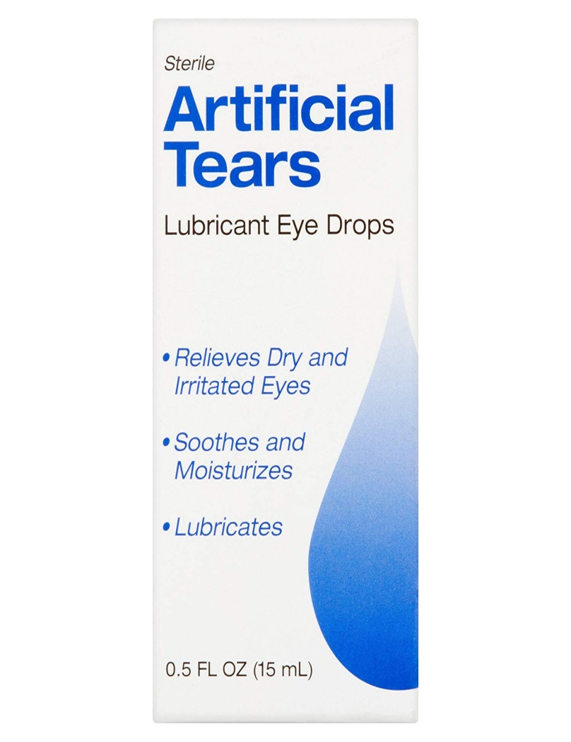
Artificial tears
Polymer composition of Artificial tears
Hydroxymethyl cellulose/ carboxy methyl cellulose
Carbomers (polyacrylic acid)
Hypomellose (hydroxypropylmethyl cellulose)
Indications
Dry eye
Facial palsy
Pollutions
Lid coloboma
Expothalmos

Slide 46
Anti VEGF
Vascular endothelial growth factor (VEGF) is a protein that promotes the growth of new blood vessels. It also makes the blood vessels more leaky. Anti- VEGF medicines stop the growth of these new blood vessels.
Anti-VEGF medicines stop the abnormal blood vessels leaking, growing and then bleeding under the retina

Slide 47
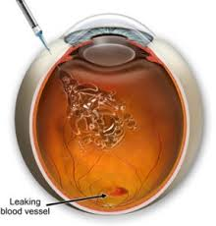
Intra vitreous route

Slide 48
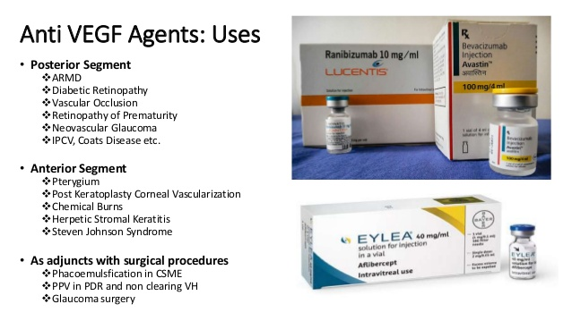

Slide 49
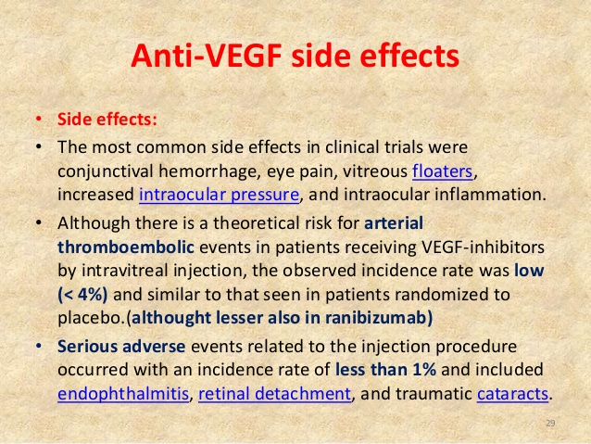

Slide 50
Thank you

