Slide 1
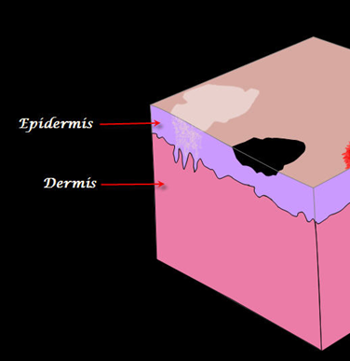
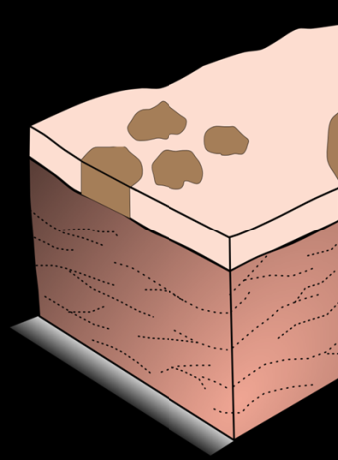
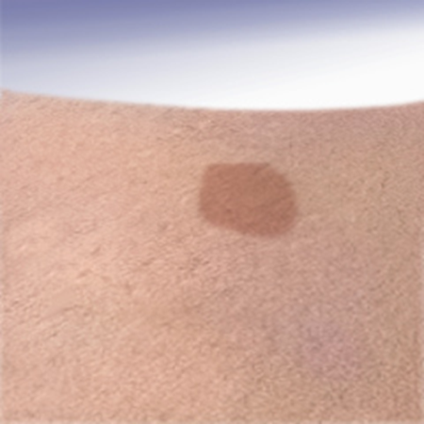
Disorders of Pigmentation Ali M. Gargoom Professor of Dermatology Faculty of Medicin Benghazi University LIMU

Slide 2
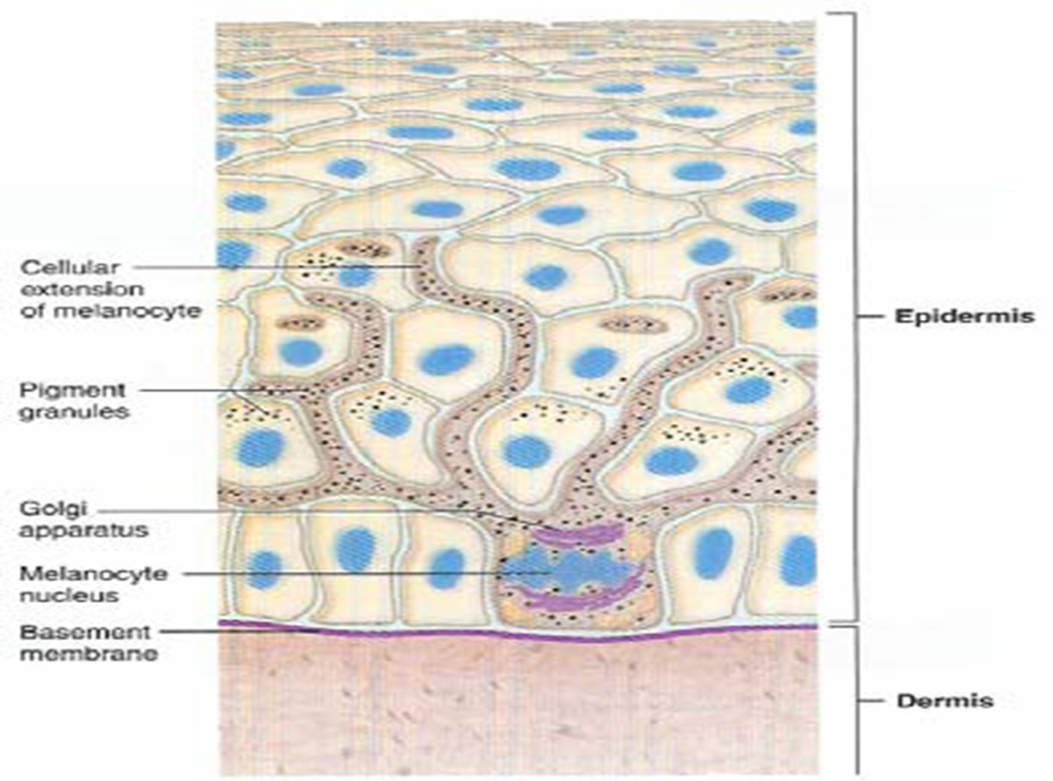
Melanocyte

Slide 3
Classification of Disorders of Pigmentation
Disorders of Hypopigmentation
Disorders of Hyperpigmentation
Vitiligo
Pityriasis alba
Albinism
Freckles
Chloasma
Post inflammatory

Slide 4
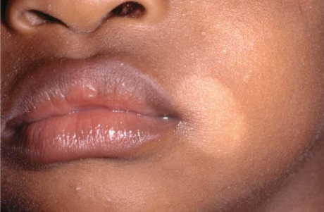
Pityriasis Alba
Very common hypopigmented, slightly scaly, macules / patches.
Face is the most frequent site.
Disease of childhood but may
be seen in adolescence.
Occurs in all races.
Vary in size from 5 to 30 mm.
Vary in number from one to >20.
No specific cause.
No specific treatment .

Slide 5
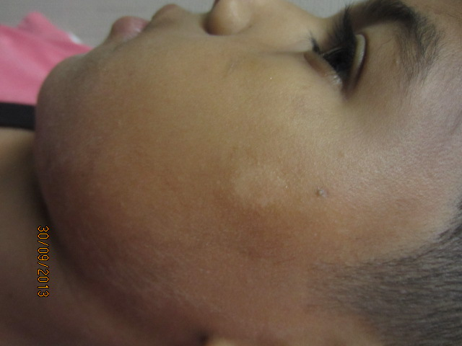
Pityriasis alba

Slide 6
Vitiligo
An acquired pigmentary disorder of the skin, characterized clinically by depigmented macules / patches and histologically by complete absence of melanocytes in the affected skin.
Epidemiology:
Common disease affecting 1% – 2% of general population.
Worldwide distribution and affects all races.
In 50% of cases it begins before the age of 20 years.
Affects both sexes equally.
In >30% of cases other member of the family may be affected.

Slide 7
Etiopathogenesis of Vitiligo
The exact etiology of vitiligo is still uncertain, but four hypothesis were proposed to explain the destruction of melanocytes.
Autoimmune theory.
Neurogenic theory.
Autotoxic theory.
Genatic theory.

Slide 8
Clinical Features
Presents with depigmented macules / patches of variable size & extent.
Asymptomatic, non-scaly, well demarcated macule / patches.
The color of the lesion is chalk-white or milky white.
Involve sites exposed to repeated trauma (Kobner phenomenon)
Commonly affected body sites; elbows, knees, digits, ankles, shins.
The hairs in the affects skin may become white ( leukotrichia ).
The onset of is insidious but the course of the disease is unpredictable.
Wood's lamp is used to confirm the depigmented macules / patches.
Skin biopsy shows complete absence of melanocytes.

Slide 9
Clinical classification of Vitiligo
Localized
Generalized
Focal
Acrofacial
Segmental
Vulgaris
Mucosal
Universalis

Slide 10
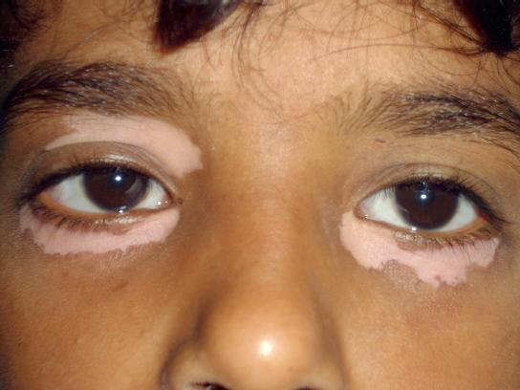
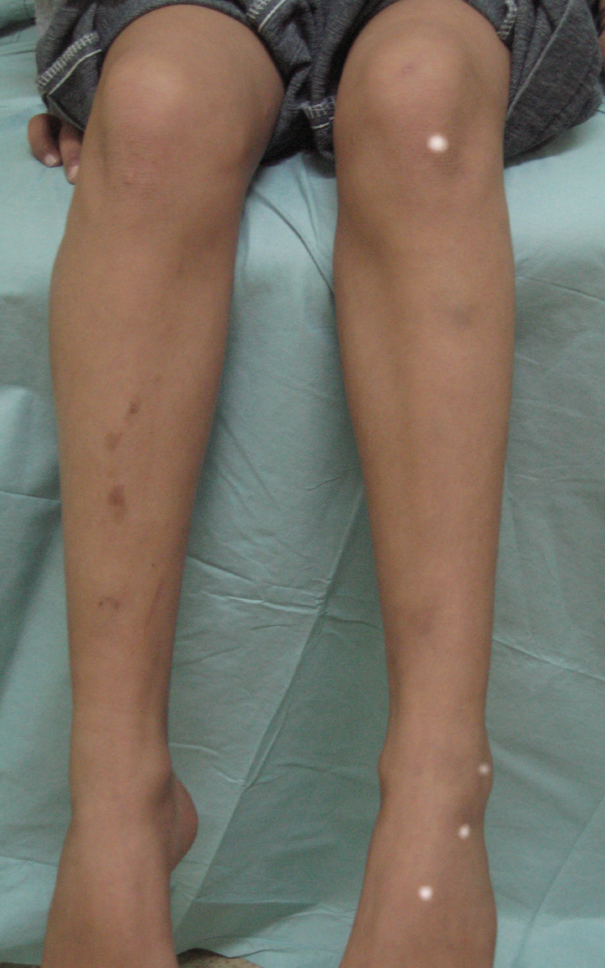
Focal vitiligo

Slide 11
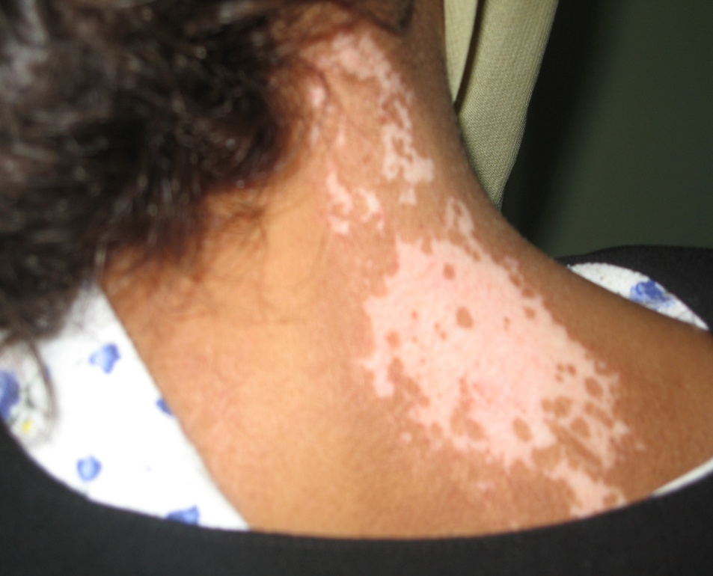
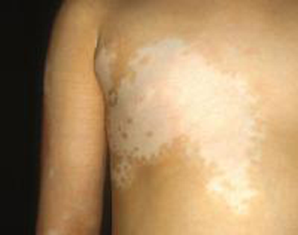
Segmental vitiligo

Slide 12
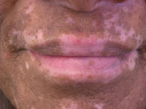
Mucosal Vitiligo

Slide 13
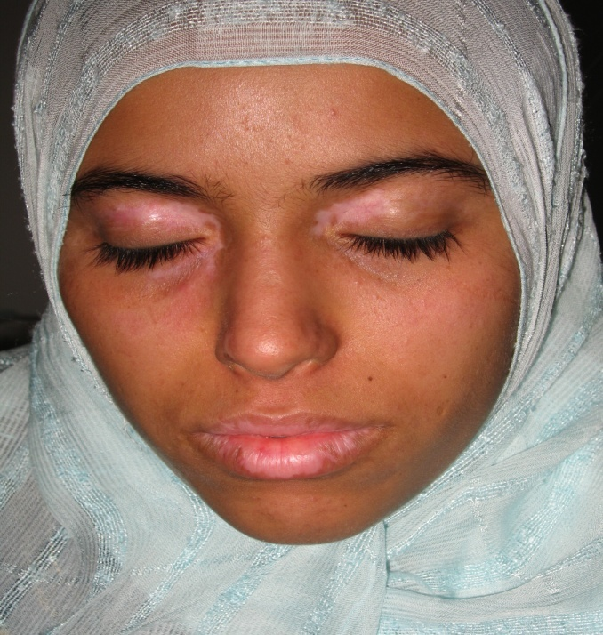
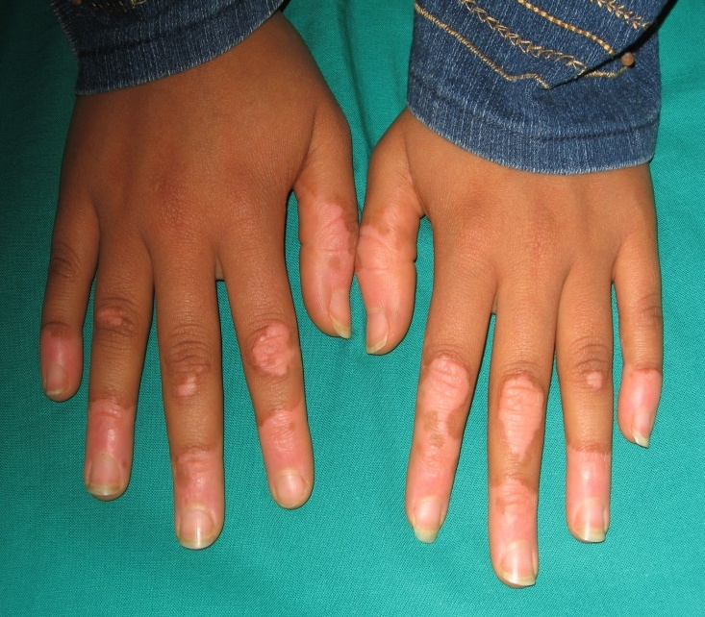
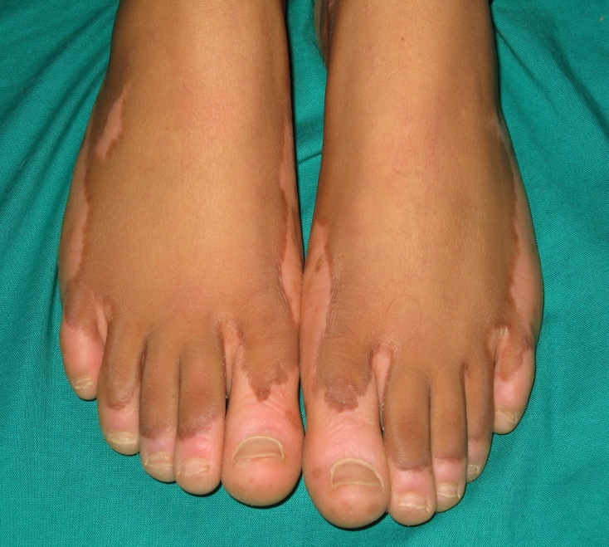
Acrofacial vitiligo

Slide 14
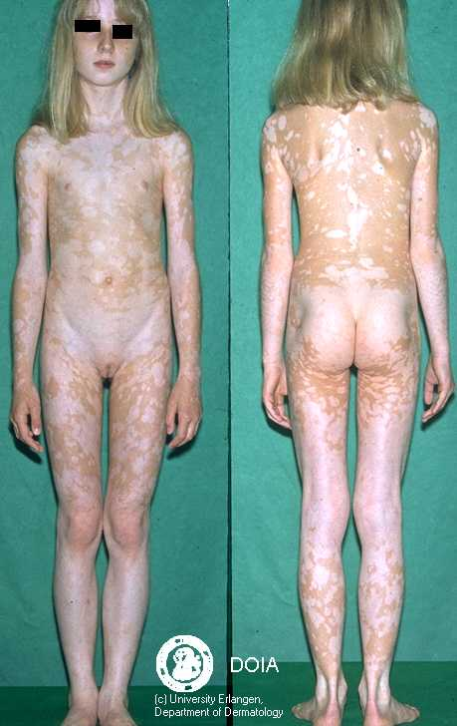
Vitiligo Universalis

Slide 15
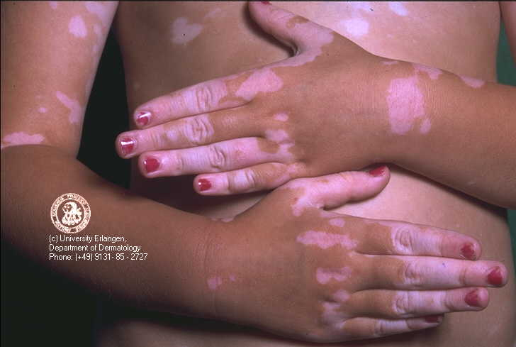
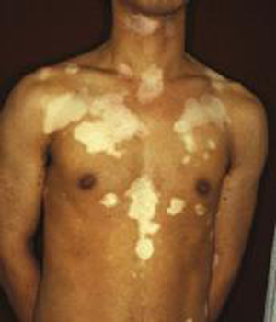
Vitiligo vulgaris

Slide 16
TREATMENT
TOPICAL
SYSTEMIC
Topical steroid
Systemic PUVA
Topical PUVA
Narrowband UVB
Calcipotrioal
Anti-oxidants
Calcinurein inhibitors

Slide 17
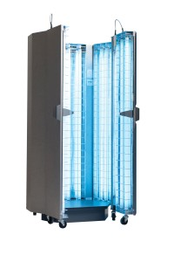
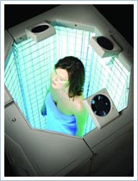

Slide 18
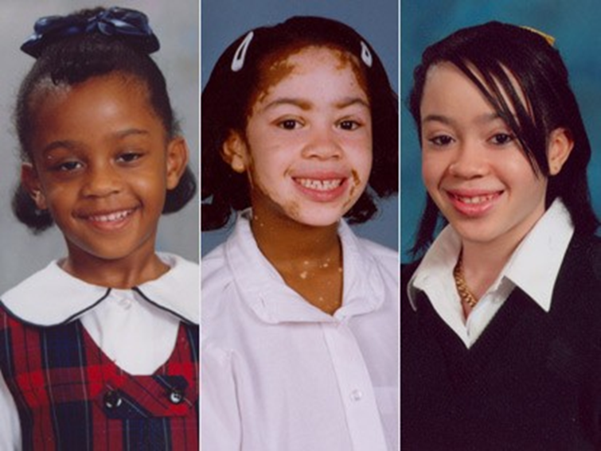
Depigmentation
Patients with widespread disease with few areas of pigmented skin can be treated with depigmenting agents.
The depigmenting agent used is 20% monobenzyl ether of hydroquinone (MBEH), applied daily for 9 -12 months will result in irreversible depigmentation.

Slide 19
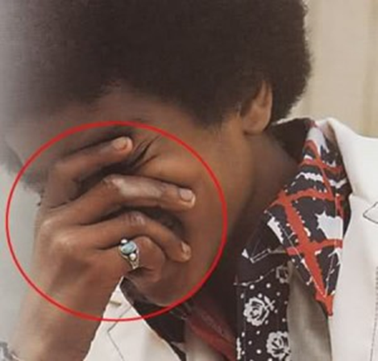
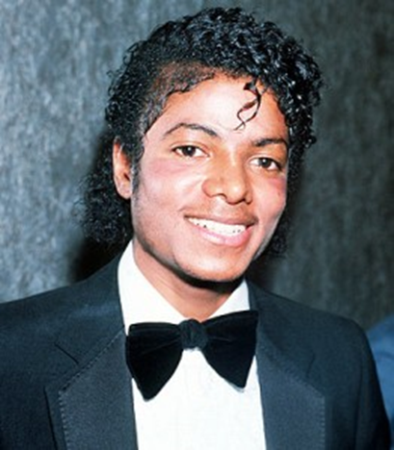
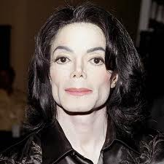
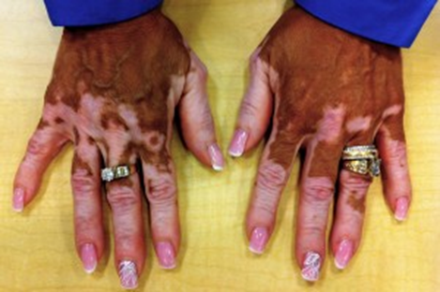

Slide 20
Melasma ( chloasma )
Melasma (mask of pregnancy) is a common acquired light or dark-brown hyperpigmentation involving the exposed area, most often the face.
It is more common in women but it does occur in men.

Slide 21
Etiology:
Genetic factors and UV radiation are the most important causes.
Other causes include:
1. Pregnancy.
2. Oral contraceptives.
3. Estrogen-progesterone therapies.
4. Thyroid dysfunction.
5. Idiopathic.

Slide 22
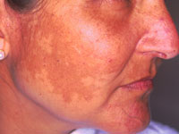
Clinical Features of Melasma
Present as a ill-defined hyperpigmented macules and patches.
Affect the forehead, malar eminences, upper lip, and chin.
Usually occurs during the 2nd or 3rd trimester of pregnancy.
Usually fades gradually after delivery.
Melasma may occurs in some women taking oral contraceptives pills.
Melasma may not resolve after delivery or cessation of pills.
Melasma rarely may affects males.

Slide 23
Clinical types of Melasma
Centrofacial Melasma (the most common)
Malar Melasma.
Mandibular Melasma.

Slide 24
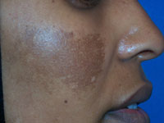
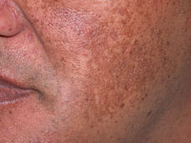

Slide 25
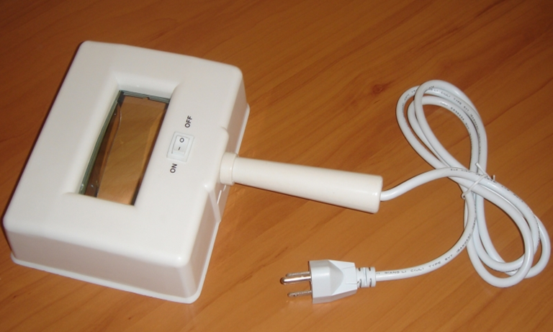
Histological types of melasma
1.The epidermal type:
Melanin increased in the epidermis.
The pigmentation is intensified under Wood's light
2.The dermal type:
Melanin increased in the superficial and deep dermis.
No pigment enhancement with the Wood's light.
3.The mixed-type.
Melanin increased in the epidermis and dermis.
Shows slight enhancement with the Wood's light.

Slide 26
Treatment of Melasma
Avoid sun exposure and use broad spectrum sunscreens.
Topical bleaching agents e.g hydroquinone or azaleic acid.
Chemical peeling using TCA for resistance melasma.
Laser is a subject of debate between laser specialists.

Slide 27
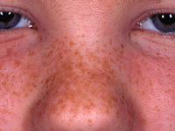
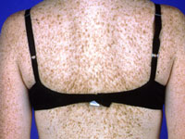
Freckles ( ephelides). | Lentigines (Lentigo)
Red or light brown macules | Brown or black macules
Occur on sun exposed skin | Sun exposed and sun protected skin
Darken with sun exposure | Does not affected with sun exposure
Fade in winter | Dose not fade in winter
Common in fair skin individuals | Occur in all complexions
H/P: Normal No. of melanocytes | H/P: Increased No. of melanocytes
Improve with sunscreen | Does not improve with sunscreen

Slide 28
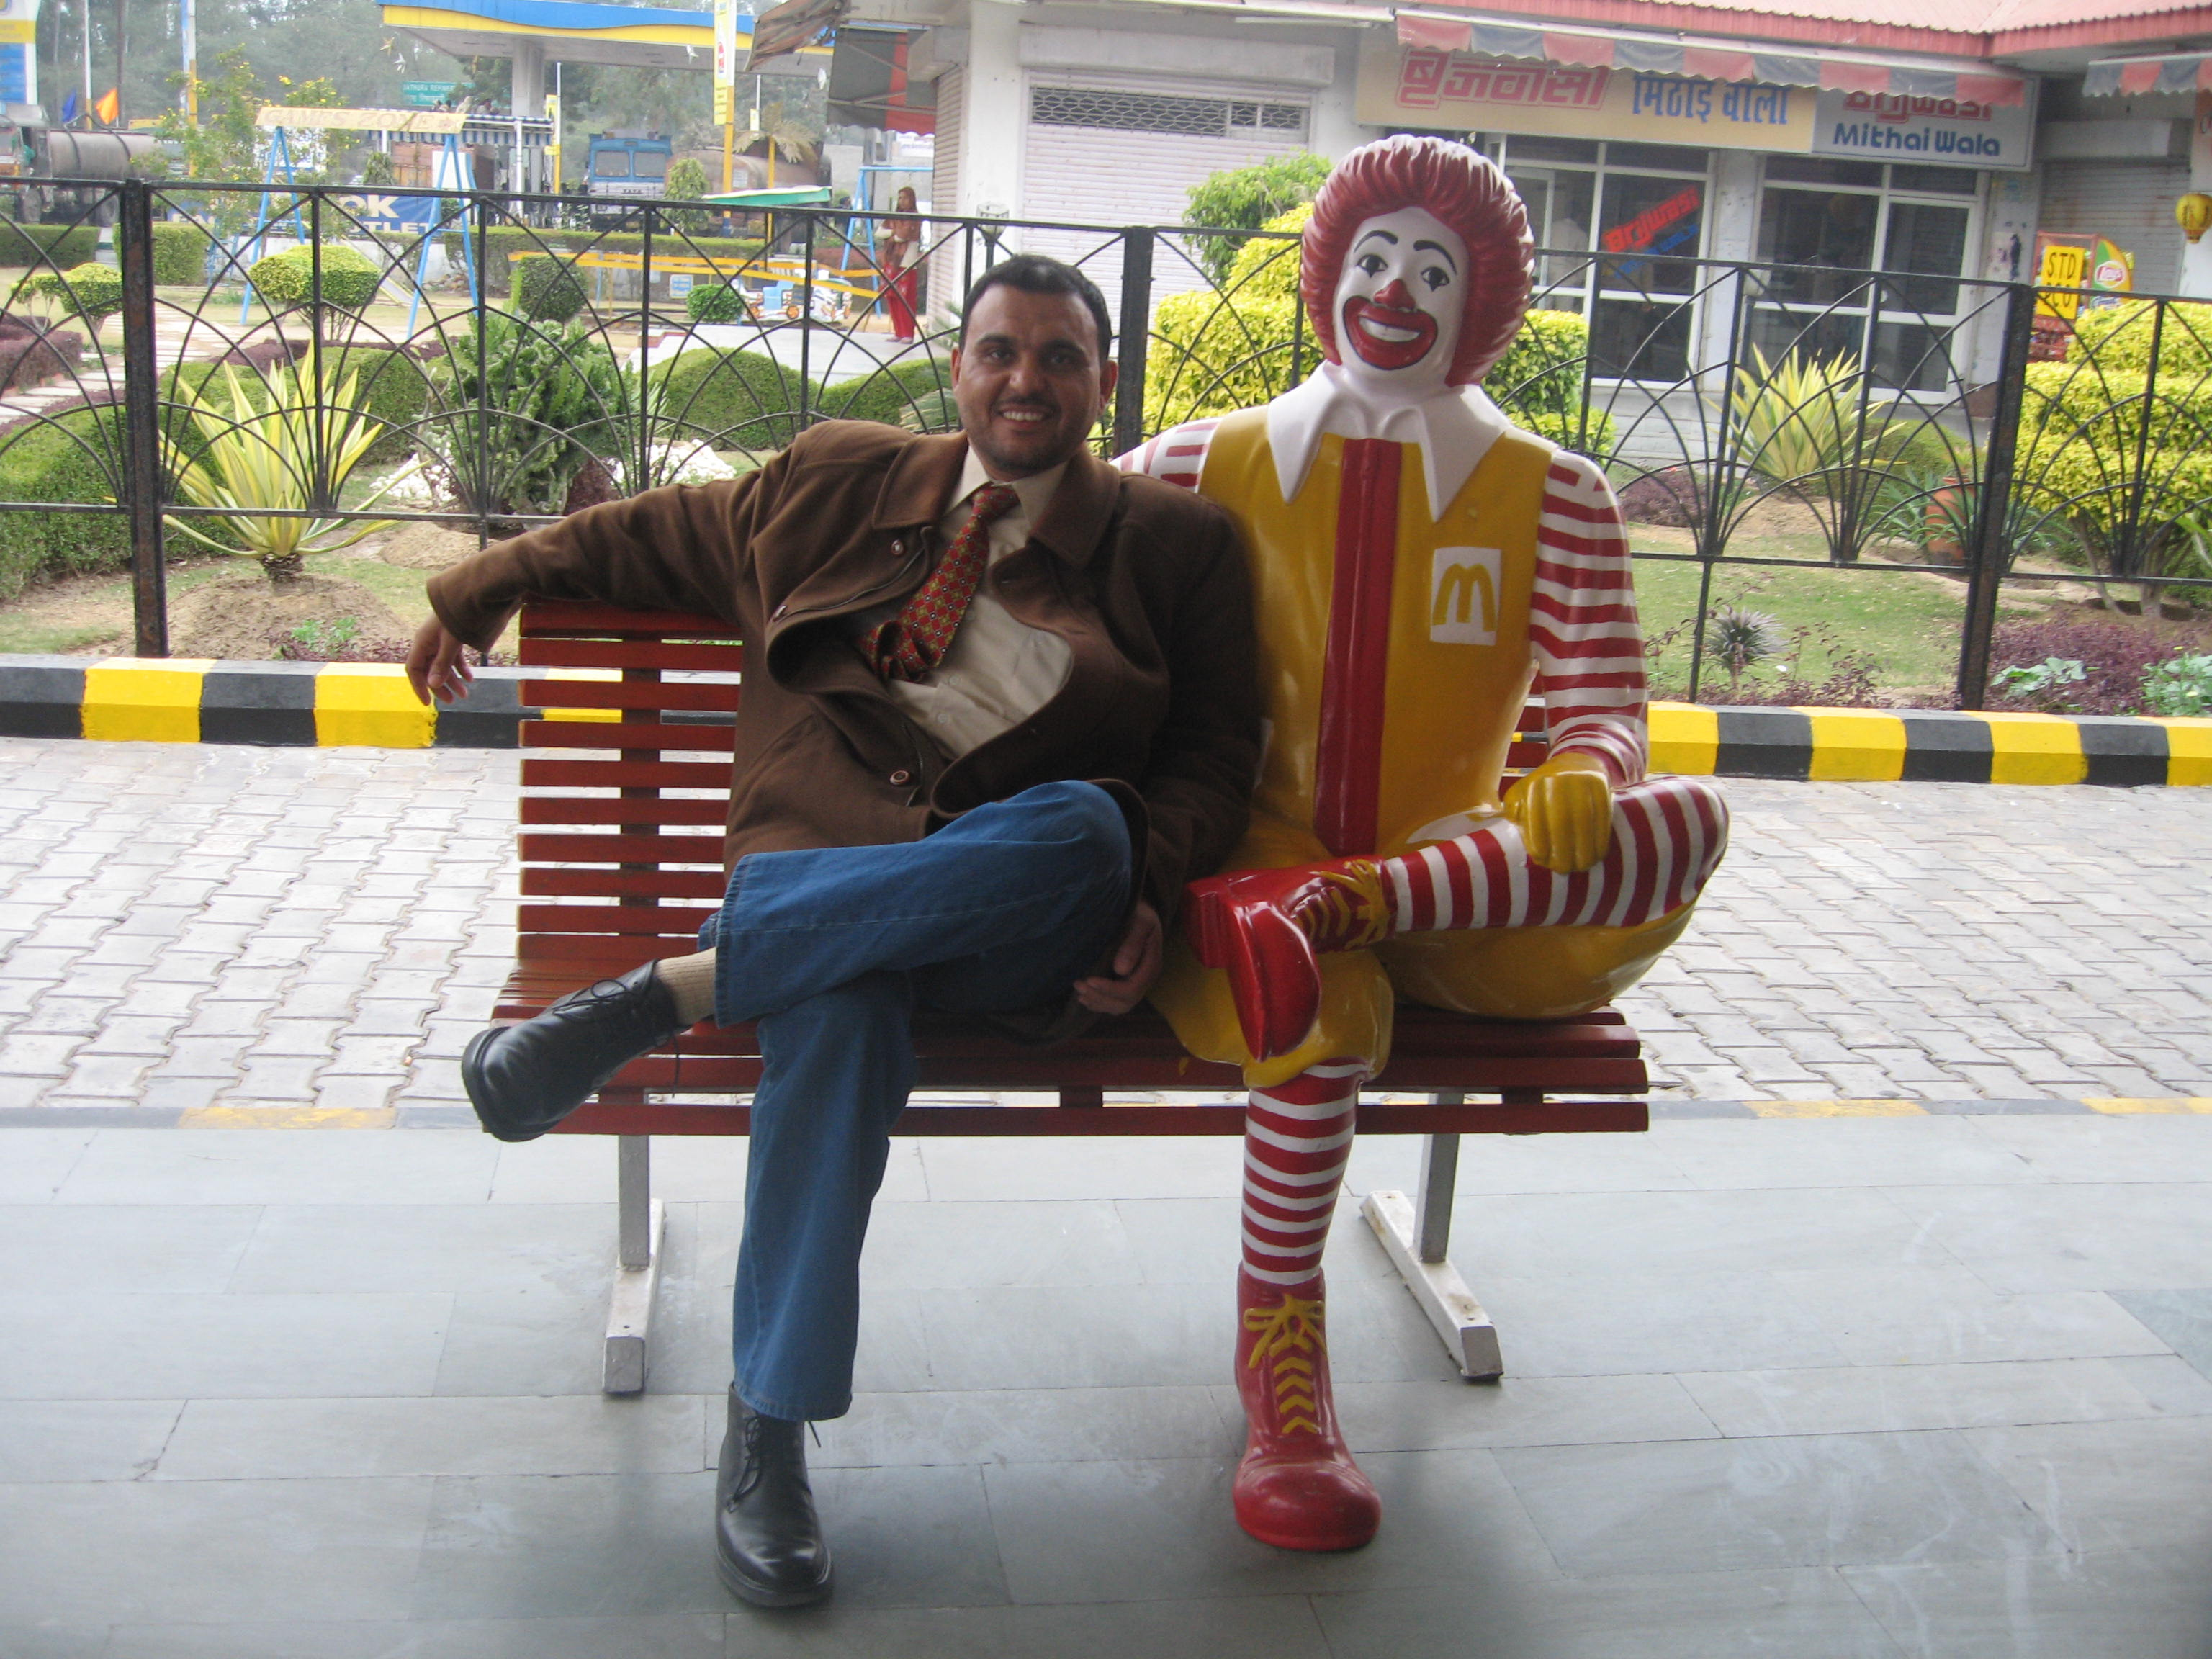
Thank you and good luck

