Slide 1
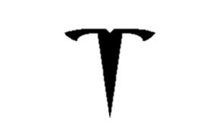
Libyan international medical university TESLA’S BUSINESS MODEL
By: najla Dhmany
E-mail: najla_1684@limu.edu.ly
Instructor: Mr. Mohammed Alzwawi

Slide 2


Content
INTRODUCTION
Tesla’s business risks
Tesla business model
Analysis of the Business model for Tesla
Information of tesla
conclusion

Slide 3

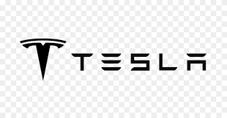
Introduction
Tesla is a company that deals with designing, developing, manufacturing, selling, and leasing energy generation and storage systems, fully electric vehicles, and other products. It was founded by Marc Tarpenning and Martin Eberhard in 2003, and is based in Palo Alto, California. Its mission is to "accelerate the advent of sustainable transport by bringing compelling mass-market electric cars to market as soon as possible". Tesla is to lead the world in adjusting from traditional energy to more clean and sustainable forms of energy in the motor vehicle sector. CEO Elon Musk, who has been a visionary leader, facilitated the high demand for electric-powered vehicles and public interest.

Slide 4
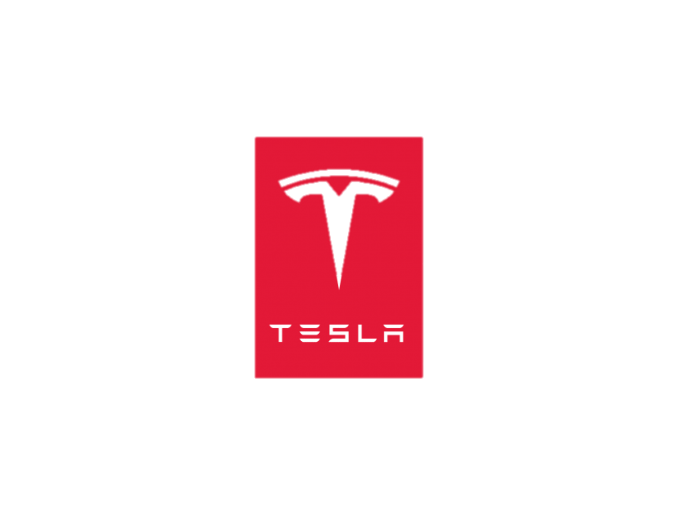
To achieve these goals, the company has opened production plants in various parts of the world. Tesla can be said to be using an anticipatory type of positioning where it anticipates that future turnover in the market may be higher.

Slide 5
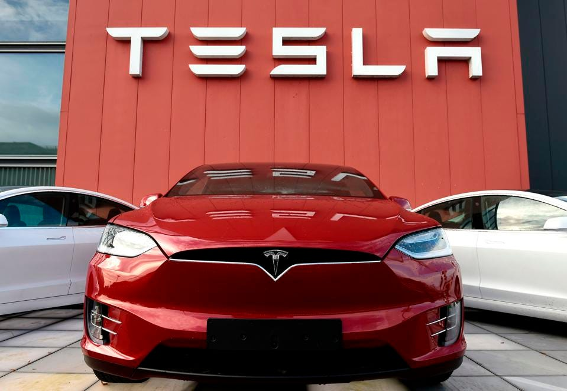
Tesla's brand value was estimated to be $42.61 billion in 2021, making it the most valuable automotive brand. The company's target market consists of people who have major concerns about maintaining a clean environment by avoiding the consumption of oil and gases. Tesla can also be said to be using an anticipatory type of positioning where it anticipates that future turnover in the market may be higher.

Slide 6
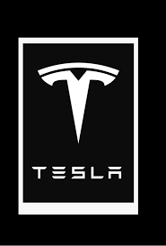
Tesla’s business risks
The success of Tesla has promoted potential but remains with various challenges that make it hard to achieve it. The company should consider and address some of these risks for a better future. Some of the risks the company faces include; the probability of running out of batteries, increased electric vehicle competition, controversy, part-time CEO, and the high cost of Tesla vehicles. Tesla is one of the most successful companies in the world, but they face high competition from other electric car companies. Some of the few competitors in the market include Nissan Leaf and Chevrolet Bolt.
The fall in gas prices forms a risk that may affect the Tesla Company. In case the price of the gas lowers, more other firms dealing with gasoline-powered vehicles will make more sales.

Slide 7
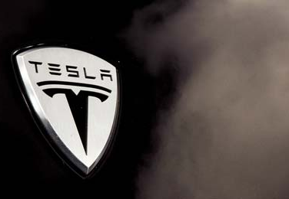
Tesla business model
Tesla operates as a direct-to-consumer as a business model. This means the company sells directly without incorporating intermediaries such as dealerships. Tesla owns the entire process on their websites, they can tailor their system to fit their brand. The company makes a higher profit margin since they sell their goods at a price higher than wholesale but lower than retail price.

Slide 8
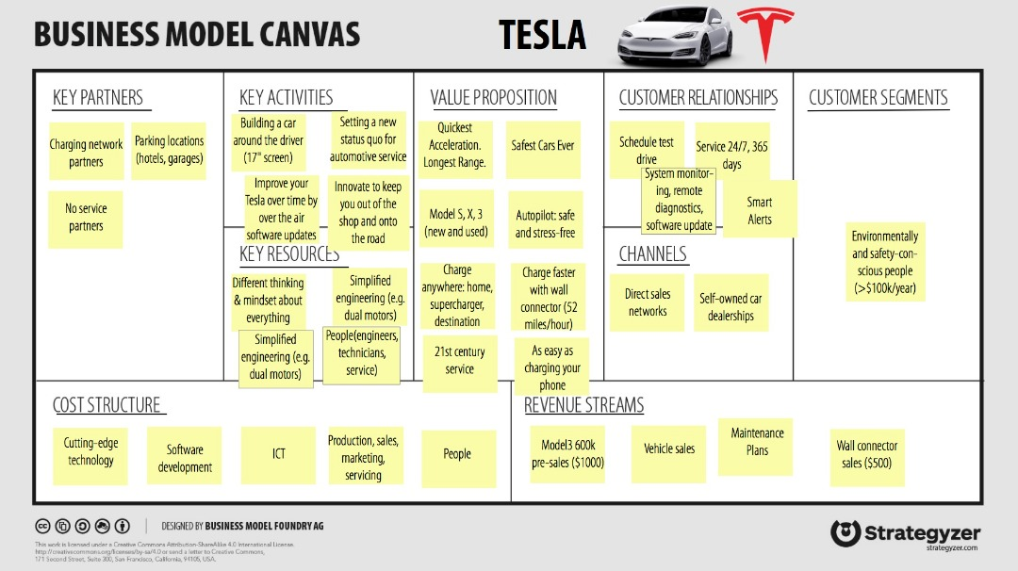
Analysis of the Business model for Tesla
A detailed business model can be summarized through the business model canvas, which is a visual representation of the company's operations and highlights key strategic factors. The canvas's major components include key activities, key partners, key resources, cost structure, revenue streams, channels, customer relationships, and customer segments. These components have been explained below.

Slide 9
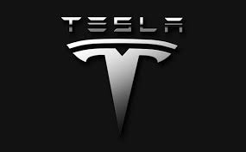
Information of tesla
Tesla operates with the assistance of certain key partners. These partners include government, alliances, charging points, and suppliers. Tesla's primary activity is to manufacture electric-powered vehicles. The company has recharge stations spread worldwide where consumers can purchase their vehicles. Tesla has also invested in their software development, using agile principles to enhance its system.

Slide 10
Information of tesla
Tesla has an overall cost structure just like how other manufacturers. Some of the revenue sources include car sales, maintenance, and upgrades. In 2021, the company generated $44 125 million from automotive sales. This was almost double the revenue collected in 2020. The company also believes in the power of its CEO, Eon Musk, as well as its brand and reputation.
Tesla has invested in developing a stronger customer relationship with their clients. They have ensured they are associated with innovative, eco-friendly, and luxurious vehicles and other products. Customers can select the product of their choice through their website and order and customize it. Tesla chose to operate through their company-owned stores in the direct-to-customer model instead of using middle agencies such as dealerships.

Slide 11




Conclusion
Tesla's success can be attributed to its business model, leadership, innovation, brand, energy efficiency, partnership, and effective strategies. The company attracted a large base of customers who want eco-friendly products to reduce the environmental carbon footprint. Tesla is a top employer globally, motivating its employees to produce the best results. It has created a platform for many young employees and embraces diversity.

Slide 12
THANK YOU
Mirjam Nilsson
mirjam@contoso.com
www.contoso.com

