Slide 1


Diabetes Mellitus type 1
Libyan International Medical University
Faculty Of AMS
1st Year Med.(2021-2022)
Block IV:GBMS 11
Week : PTS
BY: Weal Hassan
R. Number: 3247
Supervised by : Dr. Asma elshaikhy

Slide 2
Objectives:
1. Define Diabetes type I
3. Outline Causes of Diabetes type 1
4. Explain diagnosis of Diabetes type1
2.Outline the symptoms of Diabetes type 1
5. Dicuss management of Diabetes type 1

Slide 3
INTRODUCTION

Slide 4
Diabetes mellitus ?
Diabetes mellitus (DM) is a group of diseases characterized by high levels of blood glucose resulting from defects in insulin production, insulin action, or both.
The term diabetes mellitus describes a metabolic disorder.
The effects of diabetes mellitus include long–term damage, dysfunction and failure of various organs.

Slide 5
Definition Diabetes type I

Slide 6

Diabetes type I
Type 1 diabetes, insulin-dependent diabetes
is a chronic condition in which the pancreas produces little or no insulin.
Insulin is a hormone needed to allow sugar (glucose) to enter cells to produce energy.
This type usually appears during childhood or after birth , it can develop in adults.

Slide 7
sings and symtoms of DM 1

Slide 8
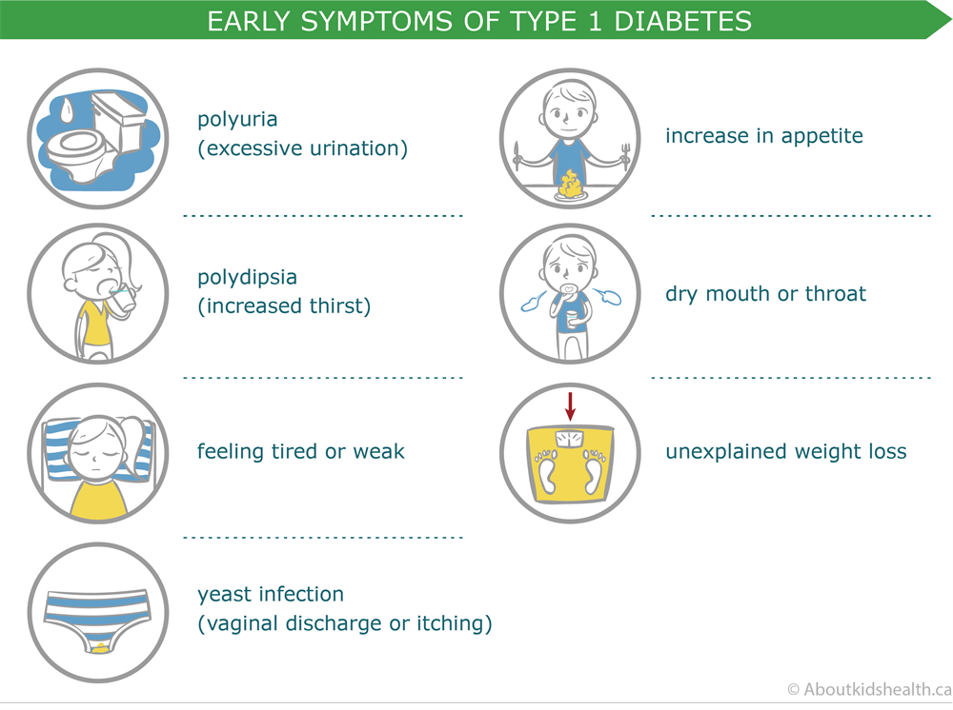
sings and symtoms of DM 1

Slide 9
Causes of Diabetes type 1

Slide 10
Causes Type 1 diabetes?
Type 1 diabetes develops when your immune system mistakenly attacks and destroys cells in your pancreas that make insulin.
This destruction can happen over months or years, ultimately resulting in a total deficiency of insulin.
Scientists don’t yet know the exact cause of Type 1 diabetes, they believe there’s
a strong genetic component.
The risk of developing the disease with no family history is approximately 0.4% :
- If the mother has Type 1 DM, the risk is 1% to 4%.
- If the father has it , the risk is 3% to 8%.
- If both parents have Type 1 DM the risk is high as 30%.

Slide 11
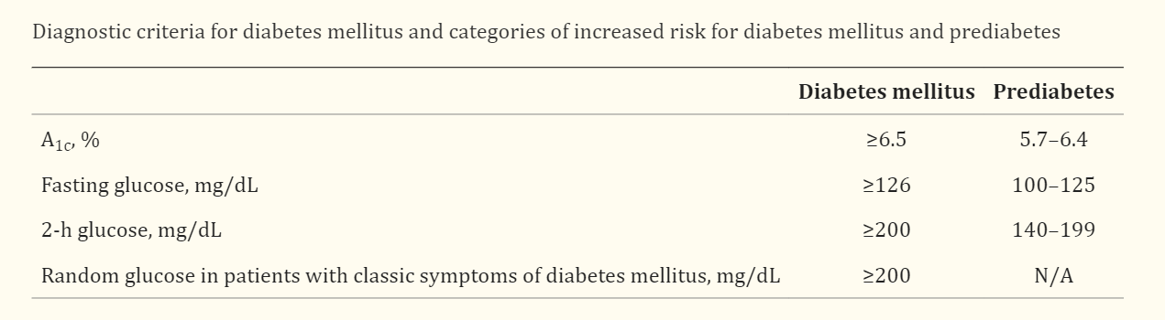
Diagnosis of Diabetes Mellitus :
Values of Diagnosis of Diabetes Mellitus

Slide 12
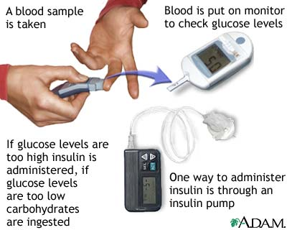
Monitoring

Slide 13
management of Diabetes type 1

Slide 14
Pharmacotherapy :Type 1 DM
The choice of therapy is simple
All patients need Insulin

Slide 15
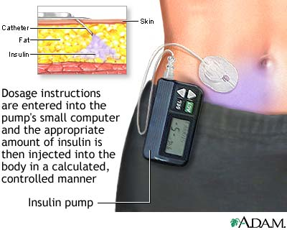
Insulin Pump:

Slide 16
Life-style modfication:
A. Diet
Diet is a basic part of management in every case.
should aim at:
ensuring weight control
providing nutritional requirements
B. Exercise
Physical activity promotes weight reduction and improves insulin sensitivity
lowering blood glucose levels.

Slide 17
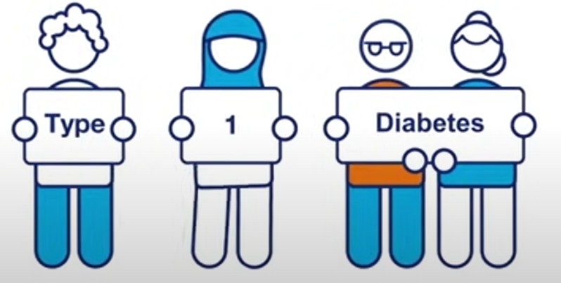
Conclusion:
It is the increase of blood glucose above normal level .
β-cell destruction – complete lake of insulin .
About 10% of people with DM have type 1
Usually during childhood or puberty .
Treatment by insulin necessary .

Slide 18
References :
1. National Diabetes Fact Sheet 2003, DEPARTMENT OF HEALTH AND HUMAN SERVICES Centres for Disease Control and Prevention 2. World Health Organization. Definition, Diagnosis and Classification of Diabetes Mellitus and its Complications. Report of WHO. Department of Non-communicable Disease Surveillance. Geneva 2022 3. Academy of Medicine. Clinical Practice Guidelines. Management of type 1 diabetes mellitus. MOH/P/PAK/87.04(GU), 2019. 4.NHS. Diabetes - insulin initiation - University Hospitals of Leicester NHS Trust Working in partnership with PCTs across Leicestershire and Rutland, May 2008.

Slide 19
THANKS!
Do you have any questions ?

