Slide 1



Business Ethics
Student name: salwa mohammed shembesh
Email: salwa_4402@limu.EDU.ly
Id:4402

Slide 2
Table of contents
Introduction
What Is Business Ethics?
Principles of Business Ethics
Conclusion
References

Slide 3
Introduction
The concept of business ethics began in the 1960s as corporations became more aware of a rising consumer-based society that showed concerns regarding the environment, social causes, and corporate responsibility. The increased focus on "social issues" was a hallmark of the decade.

Slide 4

What Is Business Ethics?
By definition, business ethics refers to the standards for morally right and wrong conduct in business, Law partially defines the conduct, but “legal” and “ethical” aren’t necessarily the same.

Slide 5
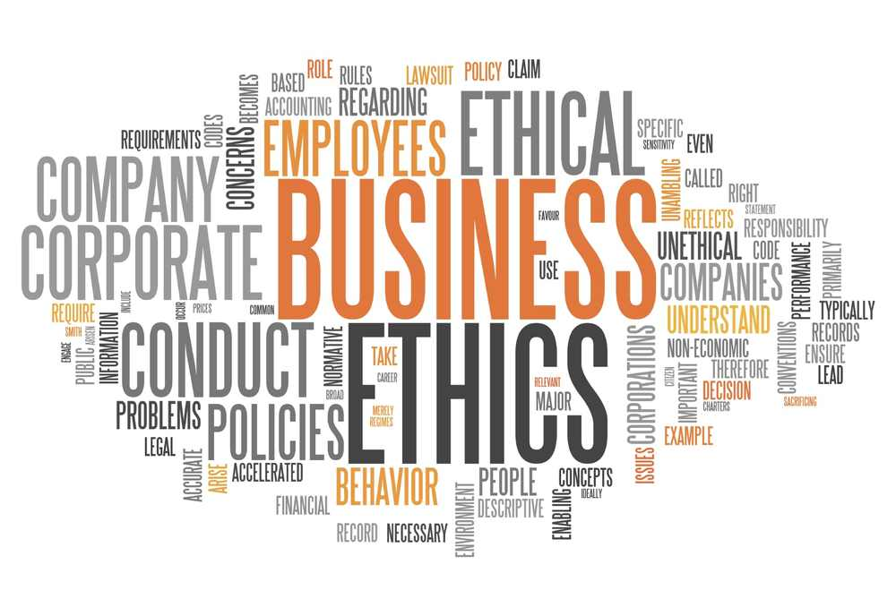
Principles of Business Ethics
It's essential to understand the underlying principles that drive desired ethical behavior and how a lack of these moral principles contributes to the downfall of many otherwise intelligent, talented people and the businesses they represent.

Slide 6
The 12 Principles of Business Ethics
Leadership: The conscious effort to adopt, integrate, and emulate the other 11 principles to guide decisions and behavior in all aspects of professional and personal life.
Accountability: Holding yourself and others responsible for their actions. Commitment to following ethical practices and ensuring others follow ethics guidelines.
Integrity: Incorporates other principles—honesty, trustworthiness, and reliability. Someone with integrity consistently does the right thing and strives to hold themselves to a higher standard.

Slide 7
Supplement…
Respect for others: To foster ethical behavior and environments in the workplace, respecting others is a critical component.
Honesty: Truth in all matters is key to fostering an ethical climate. Partial truths, omissions, and under or overstating don't help a business improve its performance
Respect for laws: Ethical leadership should include enforcing all local, state, and federal laws.

Slide 8
Supplement…
Responsibility: Promote ownership within an organization, allow employees to be responsible for their work, and be accountable for yours.
Transparency: Stakeholders are people with an interest in a business, such as shareholders, employees,the community a firm operates in. Without divulging trade secrets, companies should ensure information about their financials.
Compassion: Employees, the community surrounding a business, business partners, and customers should all be treated with concern for their well-being.

Slide 9
Supplement..
Fairness: Everyone should have the same opportunities and be treated the same.
Loyalty: Leadership should demonstrate confidentially and commitment to their employees and the company. Inspiring loyalty in employees and management ensures that they are committed to best practices.
Environmental concern: In a world where resources are limited, ecosystems have been damaged by past practices, and the climate is changing, it is of utmost importance to be aware of and concerned about the environmental impacts a business has.

Slide 10
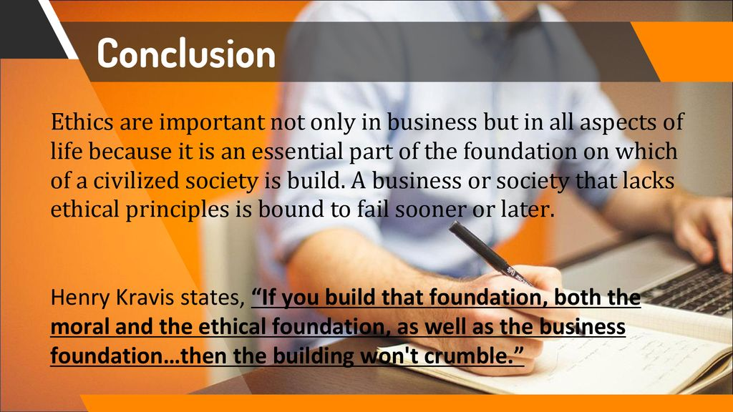
Conclusion

Slide 11
Reflection
In my opinion, Business ethics means recognizing that there is right and wrong in business as well as your personal life, And furthermore, running a business is not just about making money, it is about doing the right thing and making money through that process.

Slide 12
References
Twin, A. (2023, March 20). Business ethics: Definition, principles, why they're important. Investopedia. Retrieved March 21, 2023, from https://www.investopedia.com/terms/b/business-ethics.asp
3 reasons why business ethics is important: University of Redlands. Redlands. (2021, October 5). Retrieved March 21, 2023, from https://www.redlands.edu/study/schools-and-centers/business/sbblog/2019/may-2019/3-reasons-why-business-ethics-important/#:~:text=What%20Is%20Business%20Ethics%3F,acceptable%20behaviors%20beyond%20government%20control.

Slide 13
THANKS!

