Slide 1


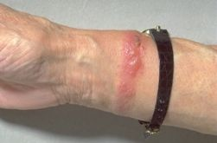
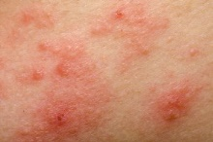
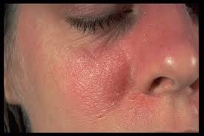
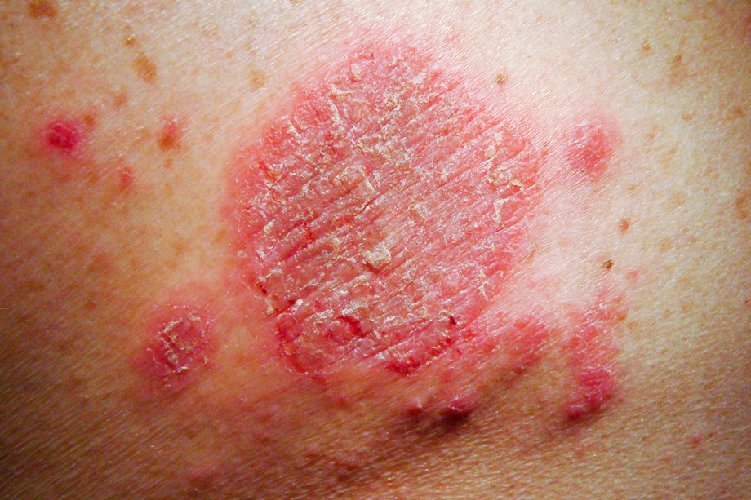
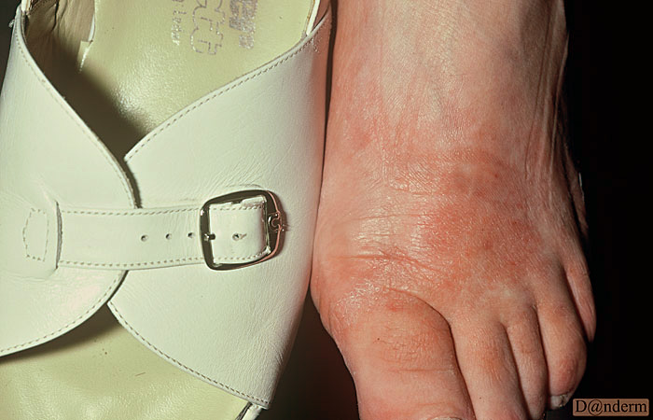
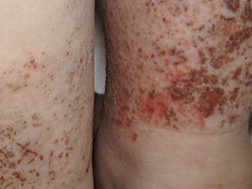
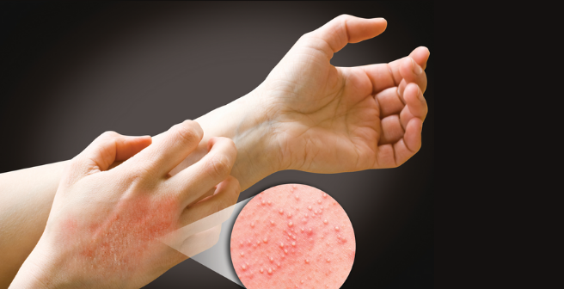
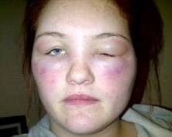
hat
What do you know about Eczema and who can get it?
By: Bushra Fathi
Faculty of Medical Science
International Libyan Medical University
Introduction:
Antigen | Common pattern/sites | Environmental source
Nickel & Cobalt (Figure 2) | Eczema under jewelry, watches | Non-precious metals
Chromates (Figure 3) | Hand, feet and face | Leather
Rubber chemicals (Figure 4) | Hand, Forearm, wrist and feet | Gloves, shoes, elasticated materials
Phenylene diamines (Figure 5) | Face, especially eyelids which are often edematous | Hair dyes
Seborrheic eczema : Very common in adult it causes scaly patches, red skin, can also affect oily areas such as side of the nose. ⁽¹⁾(Figure 7)
Discoid eczema : Both children and adults present with round or oval patches of eczema. ⁽¹⁾(Figure 8)
Eczema is a clinical term that embraces a number of conditions with different underlying
etiologies.⁽²⁾
All are characterized by red skin, itchy, scratches at an early stage, that are caused by :Exogenous: Primary irritant and Contact allergic⁽¹⁾.
Endogenous: Atopic, Seborrheic and Discoid eczema⁽¹⁾
.
Figure 2
Clinical forms of exogenous eczema:
Primary irritant: the skin is capable of withstanding a significant degree of chemical insult, Including soaps⁽¹⁾. (Figure1)
Figure 3
Figure 6
Figure 7
Figure 8
Table 1.
Conclusion:
Clinical form of endogenous eczema:
Eczema : inflammatory skin conditions caused by both exogenous and endogenous factors.
Primary irritant :caused by chemical insult.
Contact allergic : caused by develop type IV delayed cell mediated hypersensitivity to allergens.
Seborrhiec eczema : affected oily areas of body.
Discoid eczema : present with round or oval patches of
eczema.
Atopic dermatitis: One of the most common disorders, usually begins in childhood⁽¹⁾. At least 15% of children are affected by the age of 4 years, also associated with atopic disease like asthma and allergy⁽¹⁾ . Genetics are fundamentally important in atopic dermatitis and has high IgE levels⁽¹⁾.
The symptoms of it is red and dry skin and multiple scratches. ⁽¹⁾(Figure 6)
Figure 1.
Contact allergic dermatitis: Develops types IV delayed cell mediated hypersensitivity to allergens in their environment⁽¹⁾. Only minute quantities of offending agent one needle to cause a reaction. ⁽¹⁾
The reactions begin within epidermis when antigen present on surface of Langerhans cells. ⁽¹⁾ A large number of agents can induce contact allergic dermatitis. ⁽¹⁾(Table 1.)
Figure 4
References:
Mosby’s color Atlas and text of dermatology, 2ND edition 2007,page182-183-184-185-188-194-198.
Robins basic pathology 8th 20007 P 839
Figure 5

