Slide 1


McElroy Knowledge Management Cycle
Libyan International Medical University
Faculty of Business Administration
Khuloud Alshaibani
2423

Slide 2
Content
Introduction
McElroy cycle
McElroy cycle advantages
Conclusion
Reference

Slide 3
Introduction
Knowledge management cycle : is a process of transforming information into knowledge within an organization, which explains how knowledge is captured, processed, and distributed in an organization.
There are four major KM cycle, Meyer and Zack (1996), Bukowitz and Williams (2000), McElroy (1999, 2003), and Wiig (1993).

Slide 4
Introduction (KMC)
Identify existing knowledge
Distribute the knowledge where needed
Control or maintain the quality of knowledge
Dispose of knowledge if it is no longer needed
Plans what knowledge can be required and acquired

Slide 5
McElroy KM Cycle
McElroy outlines a knowledge life cycle that consists of the processes of knowledge production and knowledge integration, with a series of feedback loops to organizational memory, beliefs, and claims and the business-processing environment.

Slide 6
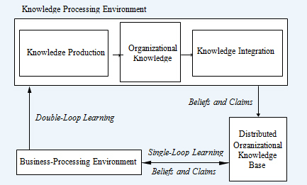
McElroy KM Cycle

Slide 7
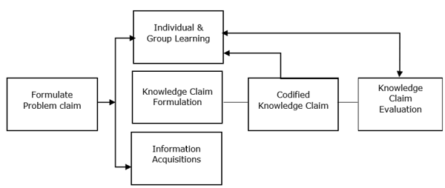
McElroy Cycle (knowledge production )

Slide 8
McElroy cycle advantages
McElroy cycle is the clear description of how knowledge is evaluated and a conscious decision is made .
With knowledge production and integration, an organization is able to determine which knowledge holds value and which no longer does and present it in a variety of way.
The McElroy KMC is substantial for organizations seeking to organize current knowledge present and ensure all knowledge integrated is useful

Slide 9
Conclusion
Knowledge management cycle explains how knowledge is captured, processed, and distributed in an organization.
The McElroy km cycle aims at processes to identify knowledge content that is of value to the organization and its employees.

Slide 10
References
Anggraini, A. (2017, May 10). Approaches to knowledge management cycle. School of Information Systems. Retrieved March 30, 2022, from https://sis.binus.ac.id/2017/05/10/approaches-to-knowledge-management-cycle/
Models of KM cycle. (n.d.). Retrieved April 1, 2022, from https://www.tutorialspoint.com/knowledge_management/models_of_km_cycle.htm
An analysis of knowledge management lifecycle frameworks ... (n.d.). Retrieved April 1, 2022, from https://academic-publishing.org/index.php/ejkm/article/download/1081/1044/1077

Slide 11
THANKS!
Any questions?

