Slide 1
Hyperlipidemia
Dr Mousa Tuwati Alfakhri

Slide 2
Major plasma lipids
Triglycerides (TG) 15%
Cholesterol esters (CE) 50%
Free Cholesterol 15%
Phospholipids 30%
Free fatty acids 5%
Water-insoluble
Apolipoproteins
Lipoproteins

Slide 3
Lipoprotein
Lipids or Fats (Hydrophobic)
TG, EC
Phospholipids Free Cholesterol (Hydrophilic)
Apoproteins A, B, C, E, (a) (Amphiphatic)

Slide 4
Lipoproteins
Chylomicrons (CM)
Very Low Density lipoproteins (VLDL)
Low Density Lipoproteins (LDL)
High Density Lipoproteins (HDL)
Lipoprotein a Lp(a)

Slide 5
Lipoproteins
TG
EC
Apoprotein boat
Apo A I and A II for HDL Apo B100 for LDL
Apo B100+C+E for VLDL, IDL Apo B100+Apo(a) for Lp(a)

Slide 6
Good, Bad, Ugly & Deadly
GOOD
HDL
LDL
BAD
C
C
TG
TG
A I, A II
B 100
VLDL
UGLY
Lp(a)
DEADLY
TG
TG
C
C
TG
B 100 + E +C
B 100+ (a)

Slide 7
Exogenous Lipoprotein Pathway (Chylomicron Metabolism)
CM Remnant
B48
CE>TG
Liver
E
Free Fatty Acids
CII
Adipose Muscle
HDL
Lipoprotein Lipase
Dietary fat:
Apolipoprotein
Cholesterol
Cholesterol esters
Phospholipids
Triglycerides
ApoC-II, apoE
B48
B48
CII
TG> CE
TG> CE
Glycerol
E
CM
Nascent CM

Slide 8
Endogenous Lipoprotein Pathway
(VLDL Metabolism)
Triglycerides
Nascent VLDL
VLDL
Apolipoprotein B
B100
B100
TG> C,CE
CII
Free Fatty Acids
Free Cholesterol
TG> CE
ApoC-II
ApoE
E
LDL Receptor
≈50%
HDL
ApoE
Adipose Muscle
CII
LPL
Free Fatty Acids
B100
B100
≈50%
CE>TG
TG=CE
Peripheral tissue
LDL Receptor
E
E
LDL
IDL
Glycerol

Slide 9
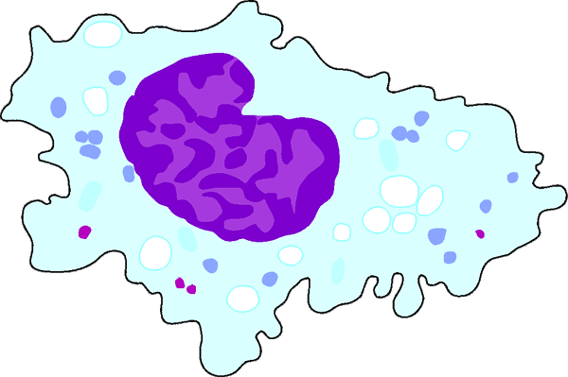
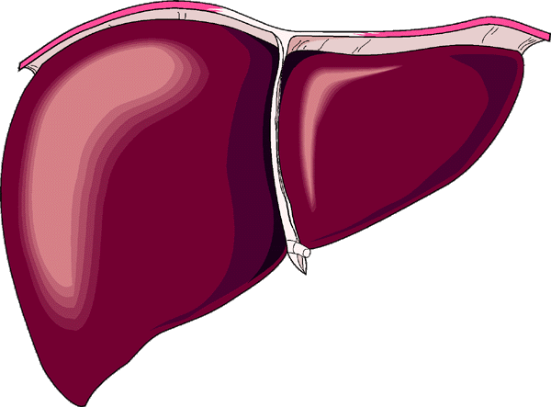
HDL Metabolism and
Reverse Cholesterol Transport
Bile
A-I
A-I
FC
CE
CE
LCAT
CE
FC
FC
ABC1
SR-BI
Nascent
HDL
Macrophage
Liver
Mature HDL
ABC1 = ATP-binding cassette protein 1; A-I = apolipoprotein A-I;
CE = cholesteryl ester; FC = free cholesterol;
LCAT = lecithin:cholesterol acyltransferase;
SR-BI = scavenger receptor class BI
Notes:
HDL Metabolism and Reverse Cholesterol Transport
Cholesterol that is synthesized or deposited in peripheral tissues is returned to the liver in a process referred to as reverse cholesterol transport in which high-density lipoprotein (HDL) plays a central role. HDL may be secreted by the liver or intestine in the form of nascent particles consisting of phospholipid and apolipoprotein A-I (apoA-I). Nascent HDL interacts with peripheral cells, such as macrophages, to facilitate the removal of excess free cholesterol (FC), a process facilitated by the ATP-binding cassette protein 1 (ABC1) gene. FC is generated in part by the hydrolysis of intracellular cholesteryl ester (CE) stores. HDL is then converted into mature CE–rich HDL as a result of the plasma cholesterol-esterifying enzyme lecithin:cholesterol acyltransferase (LCAT), which is activated by apoA-I. CE may be removed by several different pathways, including selective uptake by the liver, ie, the removal of lipid without the uptake of HDL proteins (shown in this slide). Selective uptake appears to be mediated by the scavenger receptor class-B, type I (SR-BI), which is expressed in the liver and has been shown to be a receptor for HDL. CE derived from HDL contributes to the hepatic–cholesterol pool used for bile acid synthesis. Cholesterol is eventually excreted from the body either as bile acid or as free cholesterol in the bile.
References:
Fielding CJ, Fielding PE. Molecular physiology of reverse cholesterol transport. J Lipid Res. 1995;36:211–228.
Breslow JL. Familial disorders of high-density lipoprotein metabolism. In: Scriver CR, Beaudet AL, Sly WS, Valle D, eds. The Metabolic and Molecular Bases of Inherited Disease. 7th ed. New York: McGraw-Hill; 1995:2031–2052.
Acton S, Rigotti A, Landschulz KT, et al. Identification of scavenger receptor SR-BI as a high-density lipoprotein receptor. Science. 1996;271:518–520.

Slide 10
Normal Lipid Profile
<200 | Total Cholesterol
< 150 | TG
< 100 | LDL
> 50 | HDL
< 30 | VLDL ( TG ÷ 5 )
< 20 | Lp(a)

Slide 11
Significance of hyperlipidemia
Increased risk of cardiovascular disease (CVD)
  Elevated LDL cholesterol
  Reduced HDL cholesterol
  Elevated triglycerides
Increased risk of pancreatitis
  Elevated triglycerides

Slide 12
Etiology of dyslipidemias
Primary hyperlipidemias (inherited)
  Polygenic
  Single gene
Secondary hyperlipidemias
  Due to other diseases or drugs
Primary 5%
Familial & genetic
Secondary 95%

Slide 13
Primary Hyperlipidemias
Predominant hypercholesterolemia
Familial hypercholesterolemia
  Autosomal dominant
  Moderate to severe ↑LDL
  Single gene mutation usually in LDL receptor gene
  Premature CVD
Polygenic hypercholesterolemia
  Mild to moderate ↑LDL-C
  Increased risk of CVD

Slide 14
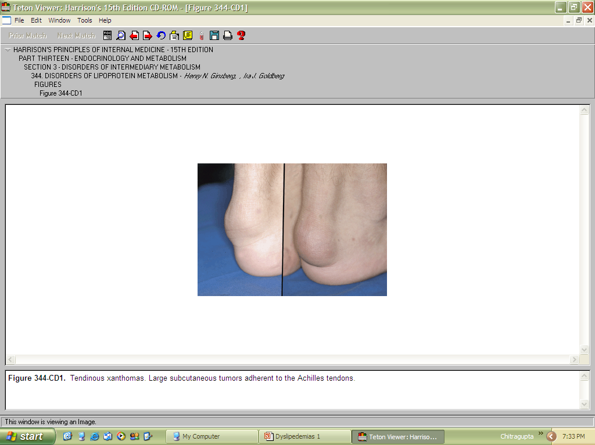
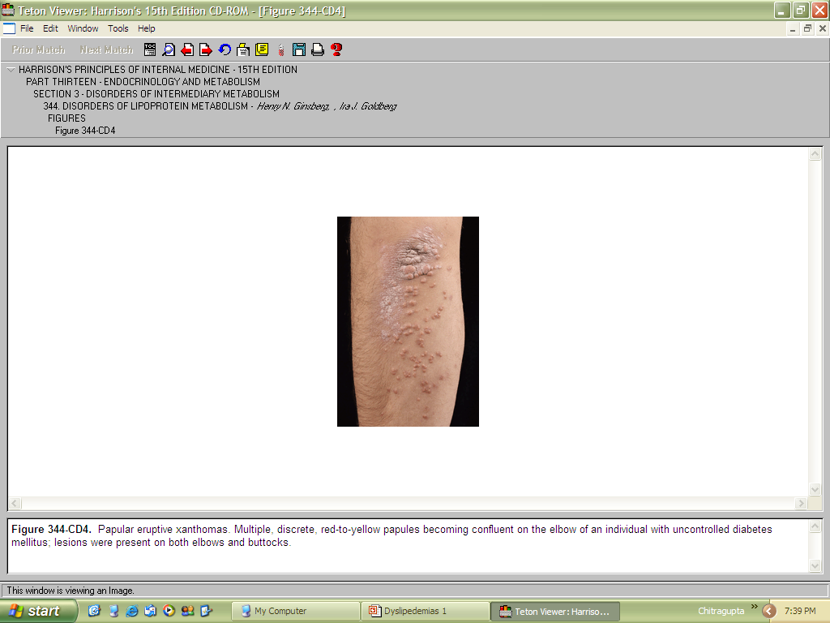
Familial hypercholesterolemia
Tendinous xanthomas.
Papular eruptive xanthomas

Slide 15
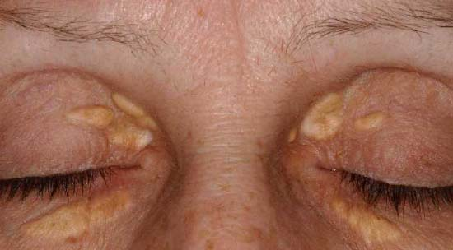
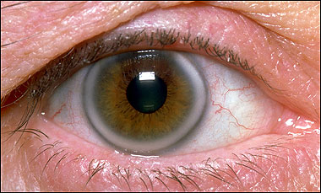
Polygenic hypercholesterolemia
corneal arcus
Xanthelasma.

Slide 16
Primary Hyperlipidemias
Predominant hypertriglyceridemia
Familial hypertriglyceridemia
  Autosomal dominant
  Extremely ↑TG
  Single gene mutation usually in Apo A5 gene
  hepatosplenomagely
  High risk of pancreatitis
Polygenic hypertriglyceridemia
  ↑ TG (+↓HDL)
  Increased risk of CVD and pancreatitis
Lipoprotein lipase deficiency and Apo CII deficiency
  autosomal recessive, rare, ↑ TG , Increased risk of pancreatitis

Slide 17
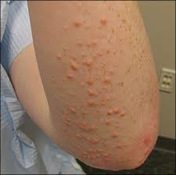
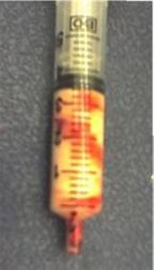
Hypertriglyceridemia
Lipaemia Retinalis
Eruptive Xanthomas

Slide 18
Primary Hyperlipidemias
Mixed hyperlipidemias
Familial combined hyperlipidemia
  Autosomal dominant
  Excess apoB production
  ↑ TG and ↑ LDL-C
  Increased risk of CVD and pancreatitis
Familial dysbetalipoproteinemia
  Autosomal recessive
  ↑ TG and ↑ LDL-C
  apoE mutation
  Premature CVD
  Palmar xanthomas, tuberous xanthomas, tendon xanthomas

Slide 19
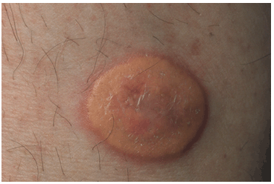
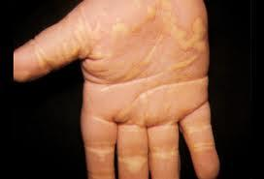
Familial dysbetalipoproteinemia
Tuberous xanthoma
( Flat-topped, yellow, firm tumor)
Palmar xanthomas

Slide 20
Secondary hyperlipidaemias
Secondary hypercholesterolemia
Secondary hypertriglyceridemia
Hypothyroidism
Pregnancy
Cholestatic liver disease
Nephrotic syndrome
Drugs
  Steroids
  Anti-retroviral drugs
  Diuretics
T2 Diabetes mellitus
Hypothyroidism
Chronic kidney disease
Obesity
Alcohol excess
Drugs
  Steroids
  Anti-retroviral drugs
  β-blockers

Slide 21
Dyslipidemia in Type 2 diabetes
Hypertriglyceridemia
Small, dense LDL
Low HDL

Slide 22
Lipid measurement
12-hour fasting is needed
Lipid profile/panel
  Total cholesterol (TC)
  TG
  HDL.C
  LDL.C (usually calculated)
    LDL.C = TC - (HDL.C+(TG/5))

Slide 23
Management of hyperlipidemia
Diagnostic work-up
Rule out secondary causes
  History and examination
  FBG
  RFT
  LFT
  TSH

Slide 24
Targets
Thresholds of starting lipid-lowering therapy depends on the risk profile of the patient
  Framingham risk score
  American college of cardiology ASCVD risk Estimator
In general:
  LDL-C <100 mg/dL (<70 mg/dL in very high risk patients or patients with CVD)
  TG < 150 mg/dL (therapy usually started when >400-500 mg/dl)
Risk profile is more important than the level itself

Slide 25
Non-pharmacological management
Dietary measures
Exercise
Weight reduction

Slide 26
Non-pharmacological management
Reduce intake of saturated and trans-unsaturated fat < 7–10% of total energy
Reduce intake of cholesterol to < 250 mg/day
Increase consumption of cardioprotective and nutrientdense foods, such as vegetables, unrefined carbohydrates, fish, nuts, legumes, and fruits
Intake of foods containing lipid-lowering nutrients such as n-3 fatty acids, dietary fibre
Increasing activity and exercise to maintain or lose weight
Stop alcohol consumption

Slide 27
Pharmacological management
Predominantly hypercholesterolemia
Statin
Ezetimibe
Bile Acid binding Resins
Nicotinic acids
Start with statin
  If intolerant to statin → ezetimibe
If suboptimal response add
  Ezetimibe or Resin or Nicotinic acid

Slide 28
Pharmacological management
Predominantly hypercholesterolemia
Statins (HMG-CoA reductase inhibitors)
Reduce hepatic cholesterol synthesis
lowering intracellular cholesterol,
Upregulation of LDL receptor
  ↓ LDL-C by up to 60%
  ↓ TG by up to 40%
  Clear evidence of reducing CVD and deaths
  Side effects: rare
    Liver enzyme abnormalities
    Myalgia, myositis and rhabdomyolysis

Slide 29
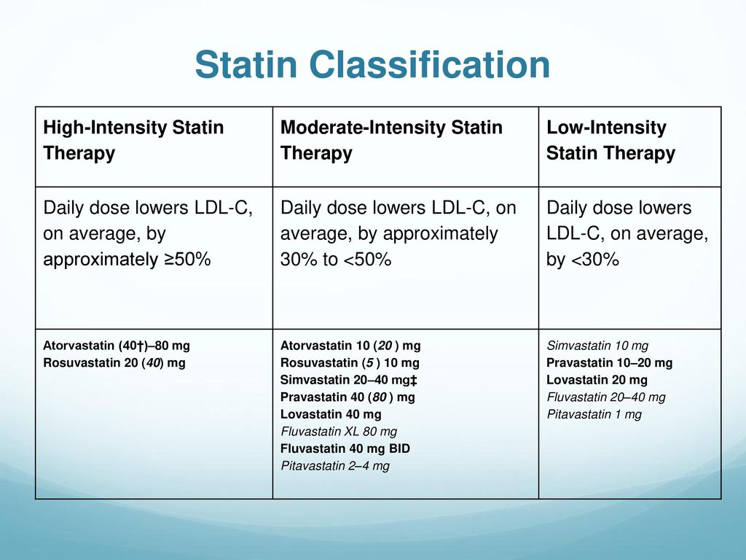

Slide 30
Pharmacological management
Predominantly hypercholesterolemia
Cholesterol absorption inhibitors(Ezetimibe)
  inhibits activity of intestinal mucosal transporter NPC1L1, which is responsible for absorption of dietary and biliary cholesterol
  ↓ LDL-C by 15-20%
  Some evidence of CV benefit
  Add-on to statin or alternative if intolerant to statin
  Side effects rare (diarrhea)

Slide 31
Pharmacological management
Predominantly hypercholesterolemia
Bile Acid binding Resins
Colestyramine, colestipol, colesevelam
  Prevent reabsorption of bile acids increasing their re-synthesis from cholesterol
  ↓ LDL 10-15% , by but ↑TG
  GI side effects (nausea, flatulence, constipation)
  Interfere with absorption of some drugs (L-thyroxine, phenytoin, warfarin)

Slide 32
Pharmacological management
Predominantly hypercholesterolemia
Nicotinic acid
  Inhibits VLDL release
  ↓ LDL-C by up to 25%
  ↑ HDL-C by up to 35%
  TG
  Side effects: flushing, GI upset, liver enzyme abnormalities

Slide 33
Pharmacological management
Predominantly hypertriglyceridemia
Fibrate
Fish oil
Nicotinic acid
Start with fibrate
  If intolerant to fibrate → fish oil
If suboptimal response add Fish oil or Nicotinic acid

Slide 34
Pharmacological management
Predominantly hypertriglyceridemia
Fibrates
  Reduce synthesis of TG and VLDL and increase synthesis of Lipoprotein lipase enzyme
  ↓ TG by 50%
  ↑ HDL by 20%
  Eg :Fenofibrate, bezafibrate, gemfibrozil
  Side effects: liver enzyme abnormalities, myalgia, myositis, cholelithiasis

Slide 35
Pharmacological management
Predominantly hypertriglyceridemia
Fish oil
  inhibit synthesis of TG and VLDL
  ↓ TG by 50%
  May reduce CVD
  Well tolerated

Slide 36
Monitoring
After 6 weeks of therapy
  Lipid panel
  CPK
  LFT
Stop treatment (statin/fibrate) if
  CPK is 5-10 times the upper limit of normal
  ALT > 2-3 times the upper limit of normal

Slide 37
Causes of Low HDL
Smoking
Obesity (visceral fat), Physical inactivity
Very high Carbohydrate diet
Type 2 Diabetes
Hyper-triglyceridemia
Drugs like beta-blockers, androgenic steroids

Slide 38
Treatment of ↓ HDLc
Low HDLc
Therapeutic Lifestyle Change
Drug Therapy
Therapy of Choice : Niacin
Add on drug - Finofibrate
Notes:
Treatment of hyperlipidemia
Statins have been and remain the drugs of first choice for lowering LDL-C. They lower LDL-C more effectively than other currently available agents, and they reduce CHD risk. Because of their LDL-C–lowering efficacy, they are able to achieve LDL-C treatment goals in the majority of patients, regardless of their risk category. In fact, the more potent the LDL-C–lowering efficacy of the statin, the greater the percentage of patients who will achieve their LDL-C goal. Statins are also remarkably safe as will be described below. About 5–10% of patients will not be able to tolerate a statin and so the only alternative agents for lowering LDL-C are a bile acid resin and niacin. These drugs are not as effective in lowering LDL-C and cause bothersome side effects which make patient compliance a problem. However, they are effective in reducing CHD risk and in the majority of patients can be successfully taken.
Reference:
Expert Panel on Detection, Evaluation, and Treatment of High Blood Cholesterol in Adults. Executive summary of the third report of the National Cholesterol Education Program (NCEP) Expert Panel on Detection, Evaluation, and Treatment of High Blood Cholesterol in Adults (Adult Treatment Panel III). JAMA 2001;285:2486-2497.

Slide 39
THANKS

