Slide 1


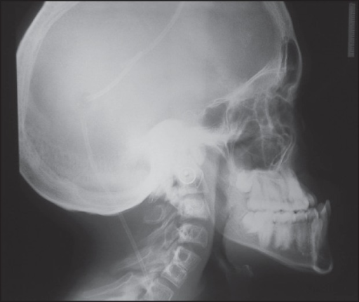
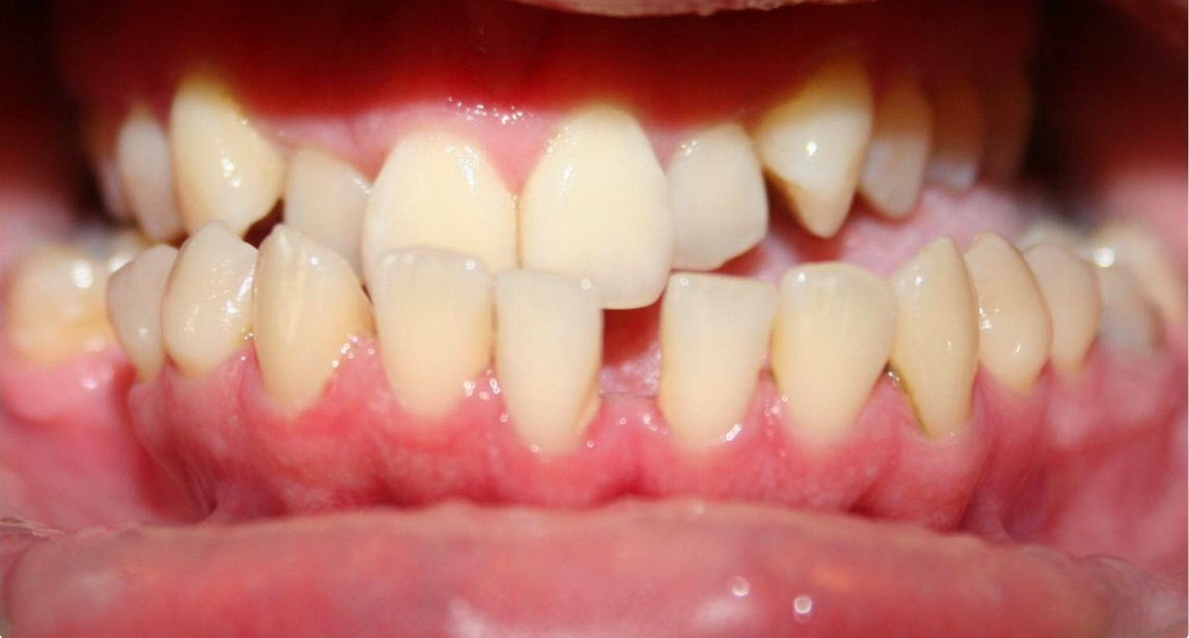
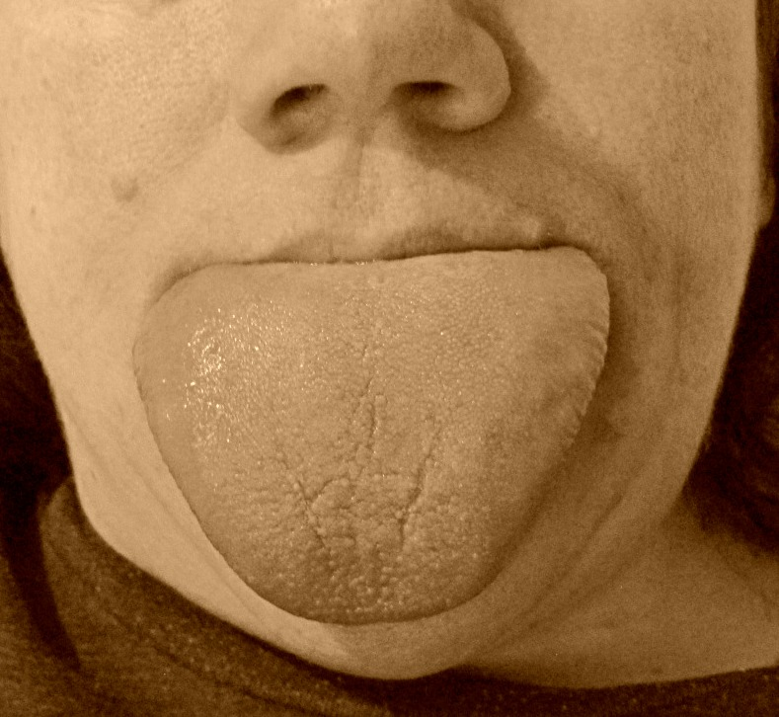
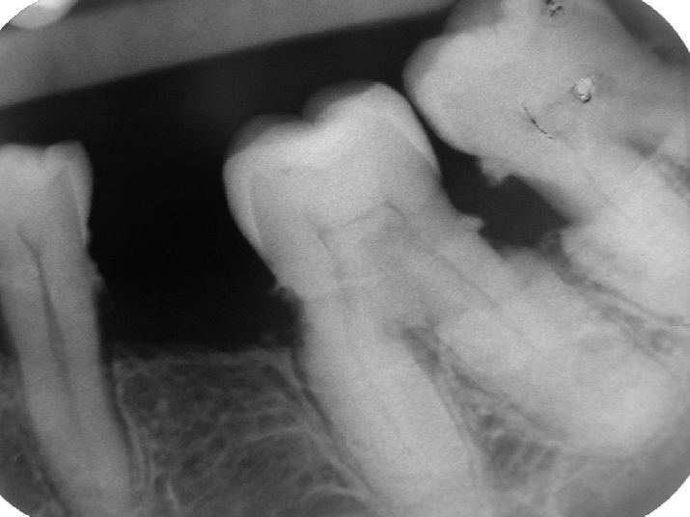
Do You Think GH Intake Is Useful?
Okba Ahmed 2nd year dentistry student
Faculty Of Basic Medical Science
Libyan International Medical University
Introduction
Acromegaly and Oral manifestations
Treatment plan
j
Growth hormone (GH), also known as somatotropin or as human growth hormone , is a peptide hormone that stimulates growth, cell reproduction, and cell regeneration in humans .
Any disturbance may occur in GH balance , lead to imbalance of metabolism and growth of the body . [2]
Acromegaly is characterized by an acquired progressive somatic disfigurement, mainly involving the face and extremities, but also many other organs, that are associated with systemic manifestations The most typical clinical signs are the coarse facial features, [1] [2]
The most characteristic craniofacial skeletal differences are potentially disfiguring disorder where the lower jaw outgrows to the anterior mandibular prognathism as in ‘’fig’’ 1. [1] [3]
and also has the affect in intraoral changes that are characterized by spacing in the teeth as showing in ‘’fig’’ 2. and abnormal enlargement of the tongue in proportion to other structures in the mouth macroglossia as in ‘’fig’’ 3. and causes excessive build-up of normal cementum (calcified tissue) on the roots of one or more teeth hypercementosis as in ‘’fig’’ 4. [3]
The mouth is frequently involved in conditions that affect the skin or other multiorgan diseases. So it is very important for endocrinologist, Orthodontic and maxillofacial surgeons dealing with corrective orthognathic surgery should be carefully aware of the complications of this diseases. [1]
Conclusion
Causes and Effects
Any changes in the oral cavity may be presented with symptoms of pituitary diseases, the dental professional may be the first healthcare provider to come across such patients. Thus the dental professional may play an important role in diagnosing and treating such patients. [3]
Deficiency of GH
(lead to dwarfism)
Hypopituitarism , may be congenital cause
Traumatic brain injury lead to pituitary hypofunction
Iatrogenic , brain surgery and removal of normal cells
Pituitary radiation [2]
References
‘’fig’’ 1
‘’fig’’ 2
Chanson P, SalenaAcromegaly. Orphanet J Rare Dis 3, 1-17.
Cordero RA, Barkan AL (2008) Current diagnosis of acromegaly. Rev Endocr Metab Disord 9, 13-19.
. Scully C, Cawson RA (2005) Medical problems in dentistry. 5th ed, Elsevier, St Louis, 95-96.
Excessive secretion of GH
(which lead to acromegaly or gigantism)
Pituitary adenoma
exogenous intake of GH
Another tumors in different parts of the body [2]
‘’fig’’ 3
‘’fig’’ 4

