Slide 1
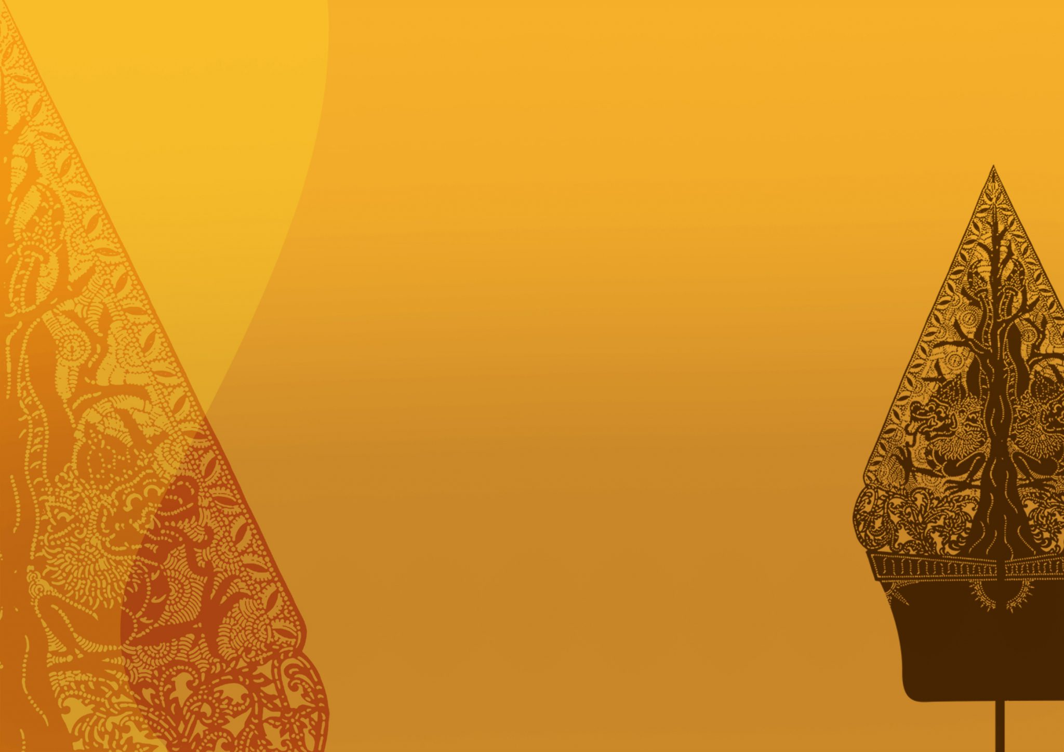


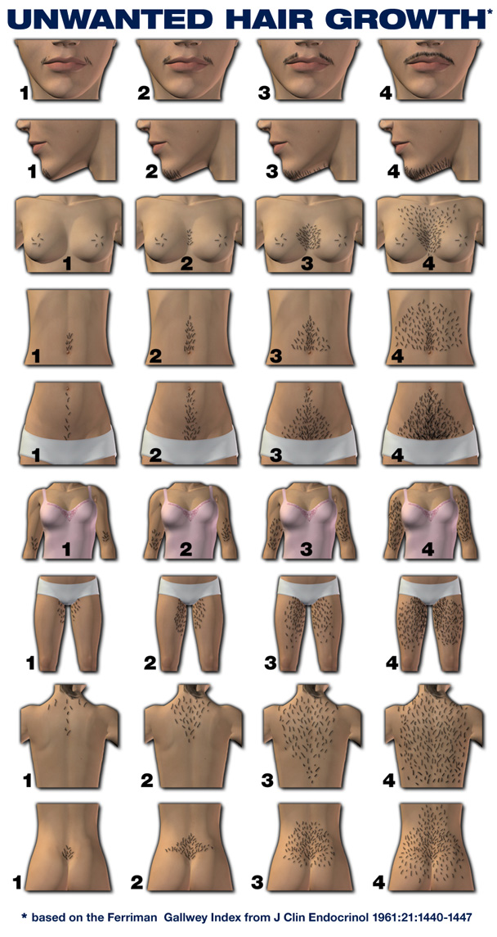
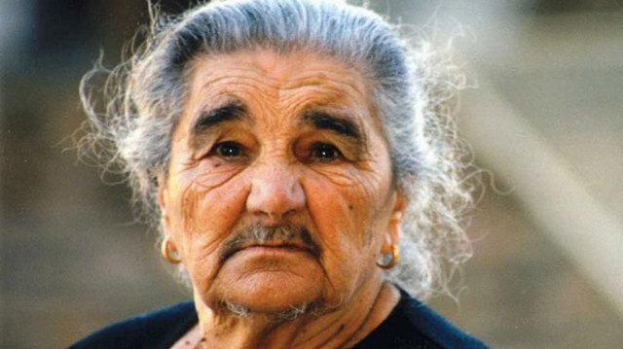
Most Common Disease Related To Hirsutism
Libyan International Medical University
Faculty of Basic Medical Science
^{By: Ali} ^{Mohamed Albreiki 1190 Y3 Med}
Introduction
HIRSUTISM : Appearance of excessive coarse (terminal)hair in a pattern not normal in the female.
The abnormal distribution of excess hair growth ,such as facial ,chest, or upper abdominal hair
Presentation of hirsutism :
Hirsutism alone.
Hirsutism and associated (ACNE).
Hirsutism & ovulatory disorders.
Hirsutism & signs of virilization. (1)
Causes
The most common causes Excess androgen production.
Relative circulating androgen excess and low binding globulins.
Excess end organ response.(1)
Figure 1,Excessive Hair Growth
Androgen
It is the steroid hormone release mainly from the genital organ and few from adrenal gland
Androgen sensitive hair : depend upon androgen input for hair growth.
Face, Neck, Chest, Abdomen, Maxillary, Upper arms ,Inner thighs and pubic hair, Part of the scalp hair.
Less Androgen independent :
Forearms ,hands .lower legs
Disorders of excess androgen production:
Source of androgen :
Exogenous .
Endogenous (most common).
:Two primary endogenous sources
Adrenal glands .
Ovaries. (3)
(2)
Figure 4, Static of the study.
Conclusion
Figure 3, Static of the first study.
While hirsutism can be genetic, or a side effect of an illness or a syndrome, it is something that can cause degradation in the quality of life of women who suffer from it.
it is important to detect the underlying issues that cause hirsutism before it can be treated successfully.
There are many ways to regulate and remove the growth of hirsute hair in women, such as hormone therapy, medication, semi permanent and permanent hair removal tools and growth inhibiting creams.
Figure 2, we see the way to give a diagnosis of the severity of the disease.
Study 1
Study 2
A total of thirty five females presenting with hirsutism , The age range from 16 to 40 years :
A majority of the patients belonged to the age group of
21-25 years (41.7%).
16-20 years (32.78%).
26-30 years (20.27%).
31-35 years (3.7%).
36 and 40 years (2.0%).
The commonest cause of hirsutism was Idiopathic hirsutism (80%).
PCOS, which was found in 11.43%.
hypothyroidism (5.70%) and congenital adrenal hyperplasia (2.86%).(2)
A A study in our department who included 340 females with hirsutism
The results was
Polycystic ovary syndrome 72 to 82 %
Idiopathic hyperandrogenemia 6 to 15 %
Idiopathic hirsutism 4 to 7 %
Adrenal hyperplasia 2 to 4 %
Androgen-secreting tumors 0.2 %
Iatrogenic hirsutism Uncommon
Acromegaly Rare to present with isolated hirsutism
Cushing syndrome Rare to present with isolated hirsutism .
Hyperprolactinemia Rare to present with isolated hirsutism.
Thyroid dysfunction Rare to present with isolated hirsutism. (3)
Diagnosis
References
Careful history regarding the timing of onset and progression.
Precocious puberty with androgen excess suggests adrenal enzyme defect.
Family history : androgen excess disorders.
Menstrual history and reproductive history . (1)
(Ahmad, Shah, Sameem, Kamili & Sultan, 2009)
Your Bibliography: Ahmad, Q., Shah, I., Sameem, F., Kamili, Q., & Sultan, J. (2009). Hirsutism in Kashmir: An etiological study. Indian Journal Of Dermatology, 54(1), 80.
Escobar-Morreale HF , Carmina E , Dewailly D , Gambineri A , Kelestimur F , Moghetti P , PugeatM , QiaoJ , Wijeyaratne CN , WitchelSF , Norman RJ. Epidemiology, diagnosis and management of hirsutism: a consensus statement by the Androgen Excess and Polycystic Ovary Syndrome.
3. Unluhizarci, K., Kaltsas, G., & Kelestimur, F. (2011). polycystic ovary syndrome-related endocrine disorders associated with hirsutism. European Journal Of Clinical Investigation, 42(1), 86-94.

