Slide 1

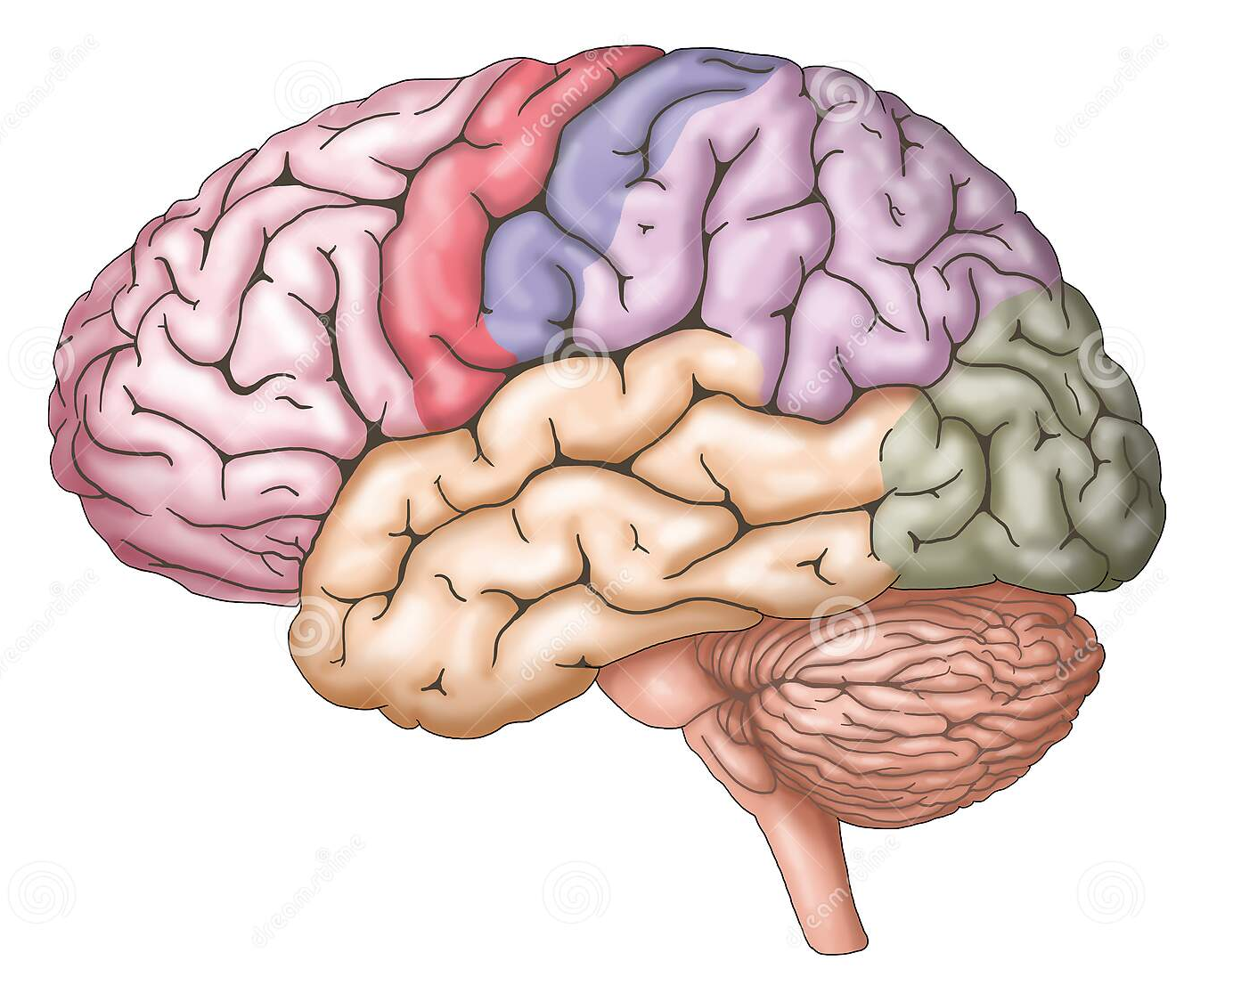

HIV Association with Neurological Disability
Name: Aseil Abdalla
Student Number: 2873
Block: PTS
Date : 15/05/2022
1

Slide 2
3
Objectives
Discuss how HIV directly leads to neurological disability.
Discuss HIV indirect association with neurological impairment.
Outline the management of neurological complications.
2

Slide 3
Introduction
Mental changes observed in HIV infected individuals may be caused by medications, psychosomatic factors or opportunistic infection psychological factors, according to the World Health Organization (WHO).
3

Slide 4
Direct effect of HIV on CNS
Most recently infected patients do not yet have compromised immunity.
Replication of the virus within the central nervous tissue escapes immune system which could lead to multifocal leukoencephalopathy.
4

Slide 5
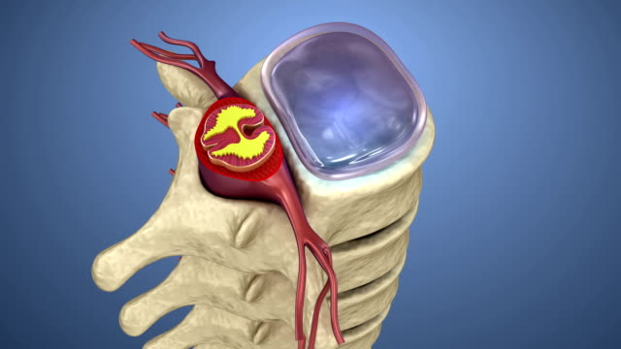
The most common spinal cord disease associated with human immunodeficiency virus infection is vacuolar myelopathy.
5

Slide 6

Distal sensory neuropathy
6

Slide 7
Cryptococcal meningitis
Hallucination
Fever
Nausea and vomiting
7

Slide 8
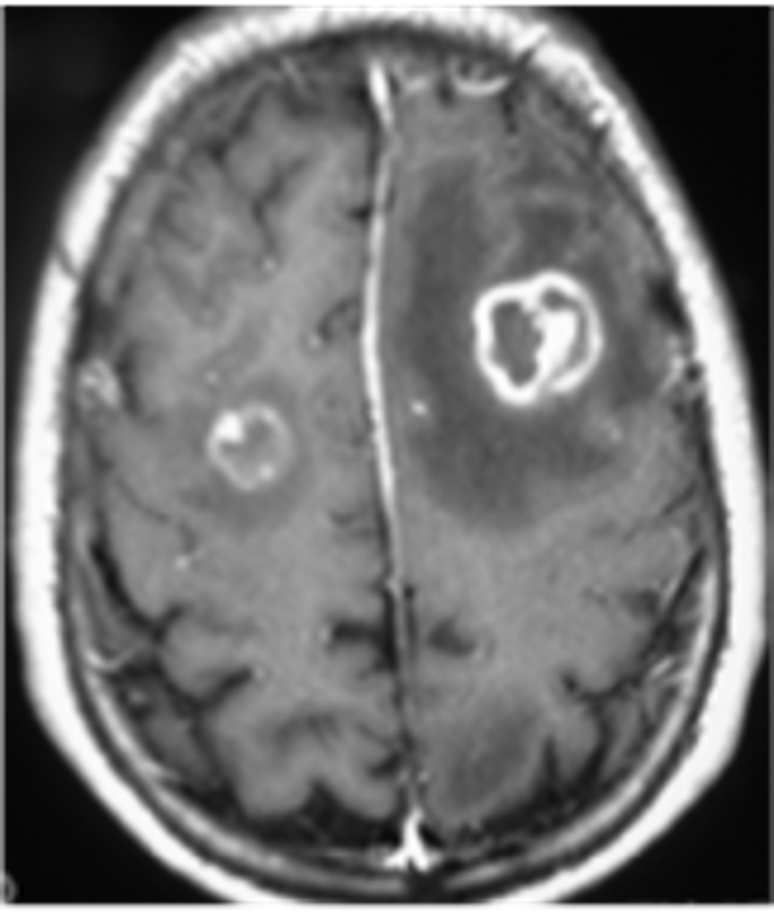
Tuberculosis
55% of HIV patient are affected by tuberculosis.
45% of them are fatalities.
8

Slide 9
Management
Direct
“ Test and Treat ” policy.
Indirect
Amphotericin B
9
Pyrazinamide , Rifampicin , INH , ethambutol.

Slide 10

“HIV is not a death sentence but it is a life sentence.”-Hydeia Broadbent
10

Slide 11

11

Slide 12

References
Howlett WP. Neurological disorders in HIV in Africa: a review. African health sciences. 2019 Aug 20;19(2):1953-77.
Perry SW. Organic mental disorders caused by HIV. Am J Psychiatry. 1990 Jun 6;147(6):696-710.
12

Slide 13
THANK you
Any questions?
13

