Slide 1

Autism Spectrum Disorders
Presented by Tasneem ALTarhuni
Student number: 2795
2nd year AMS
13/3/2022
supervised by Dr. Sarah Salah

Slide 2
Objectives
Define Autism
Outline the causes of Autism
Outline the symptoms of Autism
List important facts about Autism
Outline ways to help autism
2

Slide 3
Autism
It is defined by the presence of abnormal and or impaired development that is manifest before the age of 3 years , characterized by abnormalities of social development , communication and a restriction of behavior and interest

Slide 4
The Causes
Genetic factors
Environmental factors
Older parents
Pregnancy and birth

Slide 5
Symptoms
Social Communication and Interaction Skills
Repetitive Behaviors or Interests
Other Characteristics
Avoids or does not keep eye contact
Does not show facial expressions
Uses few or no gestures
Does not notice when others are hurt or sad
Must follow certain routines
Plays with toys the same way every time
Repeats words or phrases over and over
Delayed language skills
Delayed movement skills
Unusual eating and sleeping habits
Unusual mood or emotional reactions

Slide 6
Important Facts About Autism
Autism can affect any child
There is no cure for autism
Seen more in males than females.
7

Slide 7
75,000,000

Slide 8
Prevalence
Saudi Arabia
per 10,000 Children 100.70
USA
per 10,000 Children 80
Libya
per 10,000 Children 90
Germany
per 10,000 Children 72.20
9

Slide 9
How To Help Autism Child
01
03
02
04
Starting therapies at an early age
Create opportunities for the child to interact with you, and others
Talk to the child during routine activities
Encourage the child to try new things, and celebrate even small accomplishments
10

Slide 10
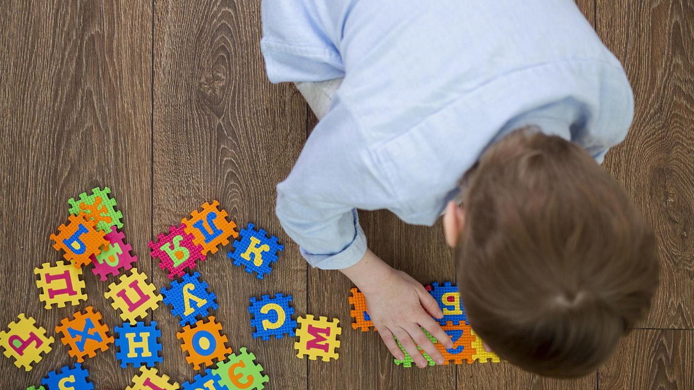
“Autism is not a disease don’t try to cure it try to understand it”

Slide 11
Conclusion
Autism is a developmental disability that can cause significant social, communication and behavioral challenges
Many people with autism spectrum disorder are successfully living, working and contributing to the well being of others in their local communities
They are different not less

Slide 12
References
HLai MC, Lombardo MV, Baron-Cohen S. Autism. Lancet. 2014;383(9920):896-910. doi:10.1016/S0140-6736(13)61539-1
Causes of autism: Autism awareness australia [Internet]. of autism | Autism Awareness Australia. [cited 2022Mar8]. Available from: https://www.autismawareness.com.au/understanding-autism/causes
Signs & Symptoms | Autism Spectrum Disorder (ASD) | NCBDDD | CDC [Internet]. Centers for Disease Control and Prevention. 2022 [cited 11 March 2022]. Available from: https://www.cdc.gov/ncbddd/autism/signs.html
Speaks A. What is autism. Retrieved on November. 2011;17:2011

Slide 13
Any Questions

Slide 14
Thanks

