Slide 1


(AI) Artificial Intelligence
Libyan International Medical University
Faculty of Business Administration
Ghadi Dreza
2830
Ghudai_2830@limu.edu.ly
7th of December 2021

Slide 2
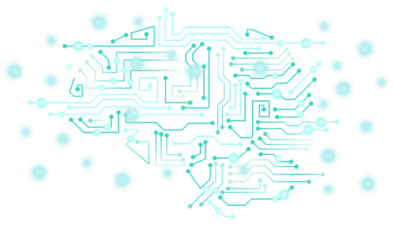
Table of Contents
01
Defining AI:
02
The History of AI
03
Future of AI
04
The Pros and Cons of AI
05
References & Conclusion
1

Slide 3
Learning Objectives
Defining the concept surrounding Artificial Intelligence.
Justifying, how will Artificial Intelligence change the future of technology.
Acknowledging the history and computing theory behind the idea of AI.
Understanding the flaws of such high technology.
2

Slide 4
Defining Artificial Intelligence:
01
3

Slide 5
Artificial Intelligence
AI refers to robotic machines that are programmed, and thereby, controlled to act and perform human-tasks.
4

Slide 6
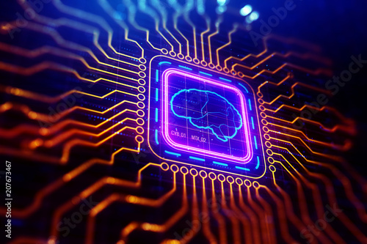
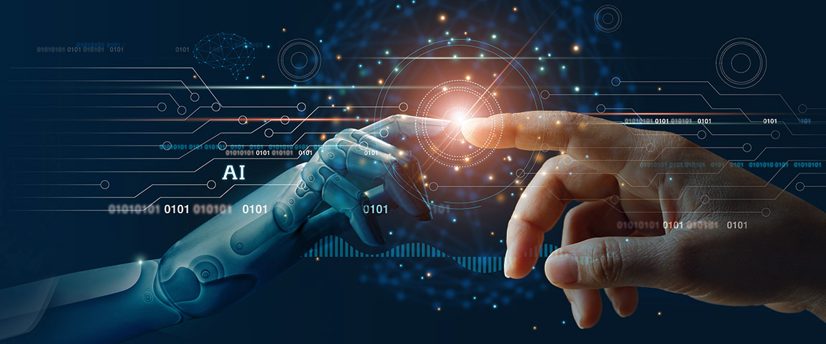
Examples of AI:
Digital Assistant; Siri, Amazon Alexa, Google Now, and Cortana.
Self-driving and parking vehicles; Companies such as Nvidia are designing AI’s to navigate and alter cars.
Banks; Transactions, and fraud detection.
Netflix; Recommendation engine
5

Slide 7
02
The History of Artificial Intelligence:
6

Slide 8
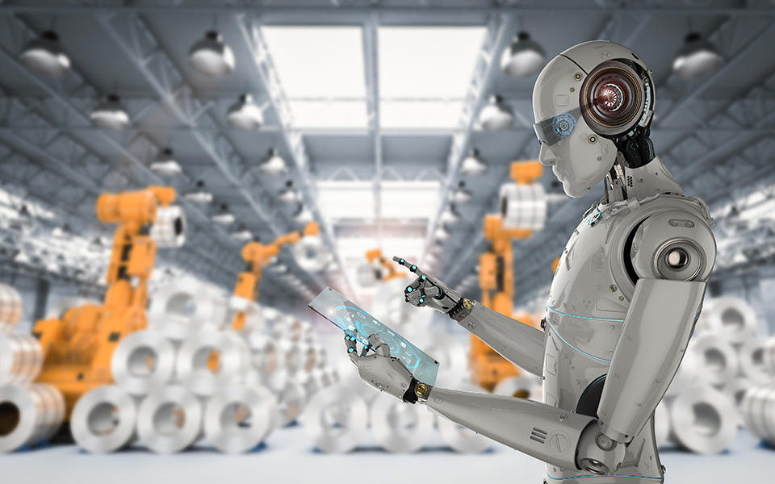
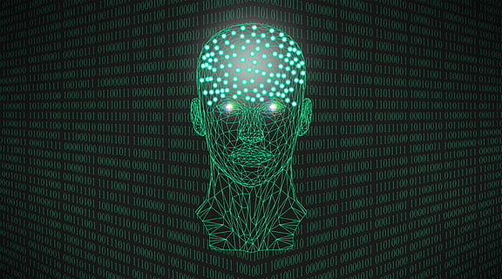
Alan Turing in 1935 described in his early works, that the future of computing will be AI.
In 1950, he designed the ‘Turing Test.’
A test that consisted of three participants: two were humans, and one was a computer.
Which ever PASSES the test is considered intelligent.
7

Slide 9
03
The Future of
Artificial Intelligence
8

Slide 10
WILL (AI) BECOME THE NEW FUTURE?
9

Slide 11
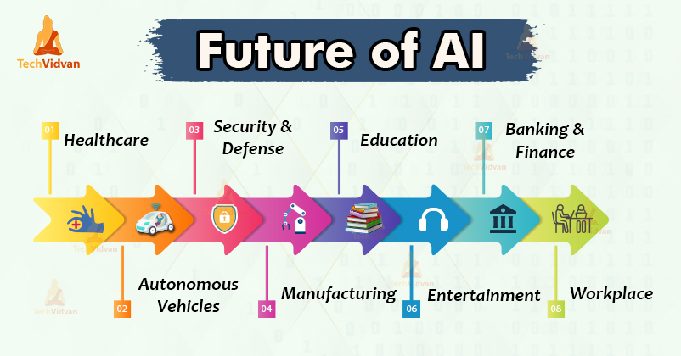
10

Slide 12
FACTS
270% growth in the business interest for AI tech
90% of businesses are ALREADY investing in AI tech
67% of hiring managers stated that AI tech were making their jobs easy
To power one AI alone costs around 4.6 million dollars
11

Slide 13
04
Pros and Cons of AI
12

Slide 14
ADVANTAGES
DISADVANTAGES
Less space for errors
Faster decision-makings
Always available
Efficiency
Takes bolder risks
Highly expensive
Mass unemployment
Makes humans lazy and more dependent on machinery
Lack human creativity
The inevitable domination of human life
13

Slide 15
05
Conclusion & References
14

Slide 16
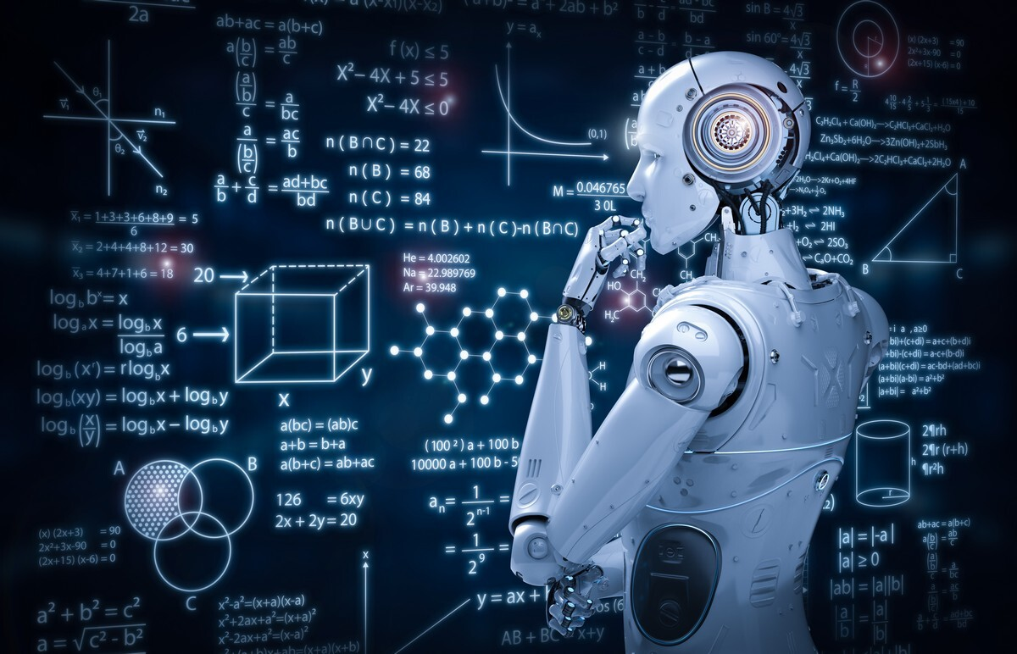
“By far the greatest danger of artificial intelligence, is that people conclude too early that they understand it” -Eliezer Yudkowsky
15

Slide 17
RESOURCES
Stahl, A. (2021, April 17). How ai will impact the future of work and life. Forbes. Retrieved December 10, 2021, from https://www.forbes.com/sites/ashleystahl/2021/03/10/how-ai-will-impact-the-future-of-work-and-life/
Encyclopædia Britannica, inc. (n.d.). The Turing test. Encyclopædia Britannica. Retrieved December 10, 2021, from https://www.britannica.com/technology/artificial-intelligence/The-Turing-test
Adhikari, B. I., & Poutintsev, B. F. (2021, March 9). 11 pros and cons of Artificial Intelligence. Honest Pros and Cons. Retrieved December 10, 2021, from https://honestproscons.com/11-pros-and-cons-of-artificial-intelligence/
Marr, B. (2019, December 16). The 10 best examples of how AI is already used in our everyday life. Forbes. Retrieved December 10, 2021, from https://www.forbes.com/sites/bernardmarr/2019/12/16/the-10-best-examples-of-how-ai-is-already-used-in-our-everyday-life/
16

Slide 18


