Slide 1
Rhinosinusitis
Dr. Salem Alzwai

Slide 2
Sinusitis is defined as inflammation of paranasal sinuses.
Rhinitis is defined as inflammation of within the nasal cavity.

Slide 3
Calssifcation
Acute rhinosinusitis.
Chronic rhinosinusitis: CRWNP
CRSNP

Slide 4
Acute rhinosinusitis is defined by the presence of the condition for up to 4 weeks.
Chronic sinusitis can be diagnosed after the condition has been present for at least 3 months.
Subacute rhinosinusitis is used when the duration is between 4 and 12 weeks.
Recurrent acute rhinosinusitis: four or more episodes of acute rhinosinusitis in one year with resolution of symptoms between the episodes.

Slide 5
Rhinosinusitis is a common disorder and has a huge economic burden

Slide 6
Acute rhinosinusitis
Pathophysiology:
Infection and inflammation

Slide 7
Acute viral rhinosinusitis
The majority of acute rhinosinusitis is caused by viruses.
The most commonly isolated virus in community acquired rhinosinusitis is rhinovirus followed by influenza virus, parainfluenza virus and adenovirus.

Slide 8
Acute Bacterial Rhinosinusitis
It typically occurs following AVRS.
Only about 0.5 to 2.0% of AVRS are complicated by bacterial infection.
The most commonly isolated bacterial species are S. pneumoniae, H. influenzae and M. catarrhalis.

Slide 9
Presentation
Nasal obstruction, nasal discharge, nasal purulence, postnasal drip, facial pressure and pain, alteration in the sense of smell, cough
fever, halitosis, fatigue, dental pain, sore throat, aural fullness, otlagia and headache.

Slide 10
Diagnostic criteria for ABRS
Up to 4 weeks of purulent nasal drainage
( anterior, posterior or both) accompanied by nasal obstruction, facial pain-pressure-fulness or both.
Symptoms or signs of acute rhinosinusitis are present for 10 day or more or worsen within 10 days after initial improvement ( double worsening ).

Slide 11
Imaging
CT scan
MRI

Slide 12
Medical management of AVRS
Analgesia
Decongestants
Nasal irrigation

Slide 13
Medical management of ABRS
Antibiotics
Analgesia
Decongestants
Topical steroids
Nasal irrigations

Slide 14
Chronic rhinosinusitis
Complex pathophysiology with contribution of chronic inflammation.
CRS subtypes:
polypoidal VS nonpoypoidal
eosinophilic VS noeosinophhilic
allergic fungal VS nonallergic fungal

Slide 15
Risk factors
Host factors:
Congenital conditions: cystic fibrosis, immotile cilia syndrome.
Allergic or immune conditions: environmental allergy, HIV, immune suppressive agents.
Vitamin D deficiency
Paranasal sinuses anatomic abnormalities: concha bullosa, sever nasal septal deviation.
Presence of neoplasm

Slide 16
Microbial factors: bacterial biofilms, super antigens( Staph. Aureus), fungal infection.
Environmental factors: smoking and exposure to second hand smoke have been identified as morbid cofactors in CRS.

Slide 17
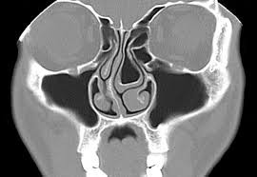

Slide 18
Diagnostic criteria for CRS
12 weeks or longer of two or more of the following signs and symptoms:
Mucopurulent drainage ( ant., post,. Or both )
Nasal obstruction ( congestion )
Facial pain-pressure-fullness
Decreased sense of smell
AND inflammation documented by one or more of the following findings:
Purulent mucous or edema in the middle meatus or ethmoid region.
Polyps in the nasal cavity or middle meatus
Radiographic imaging showing inflammation of the PNS.

Slide 19
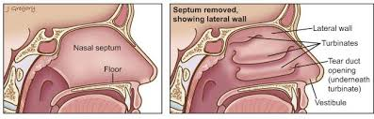

Slide 20
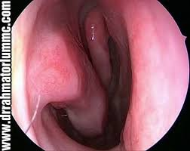

Slide 21
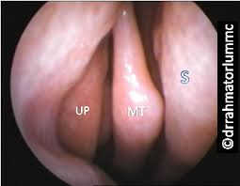

Slide 22
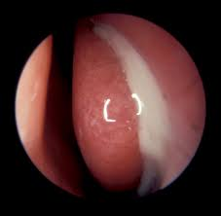

Slide 23
Treatment
Antimicrobial therapy
Anti-inflammatory therapy.
Saline irrigiation
Immunomodulating agents: leukoterien receptor antagonist ( montelukast ), 5-lipoxygenase inhibitor ( Zileuton ),
surfactants
Although medical therapy is always considered in first line, endoscopic sinus surgery is the final treatment pathway for many patients.

Slide 24
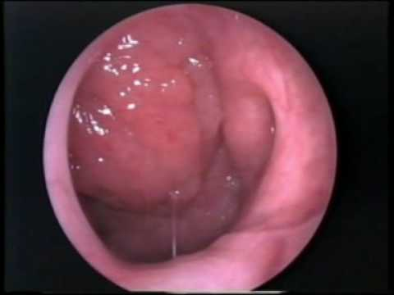

Slide 25
Complications of sinisitis
Extracranial
Intracranial

Slide 26
Extracranial complications
Orbital extension (Chandler classification)
Preseptal cellulitis
Postseptal cellulitis
Subperiosteal abscess
Orbital abscess
Cavernous sinus thrombosis
Permanent anosmia
Pott Puffy tumor

Slide 27
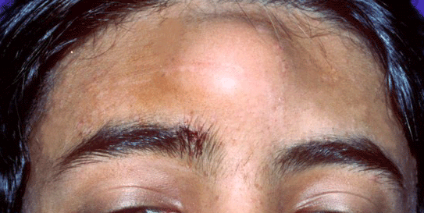

Slide 28
Management of orbital complications
All patients need antibiotics
Most cases of preseptal and postseptal cellulitis can be successfully managed medically except:
If the condition of the patient fails to improve within 48 hours of proper antibiotic use ( for C&S)
If visual acuity worsens
Progressive proptosis
Opthalmoplegia
Development of abscess
Surgery includes endoscopic and external approaches.

Slide 29
Intracranial complications
Spread of infection from PNS to the brain is through osteomyelitis, thrombophlebitis, septic emboli or a post traumatic, surgical or congenitla defects.
Meningitis
Extradural abscess
Subdural abscess
Intracerebral abscess
Cavernous and superior sagittal sinus thrombosis.

Slide 30
Thank you

