Slide 1
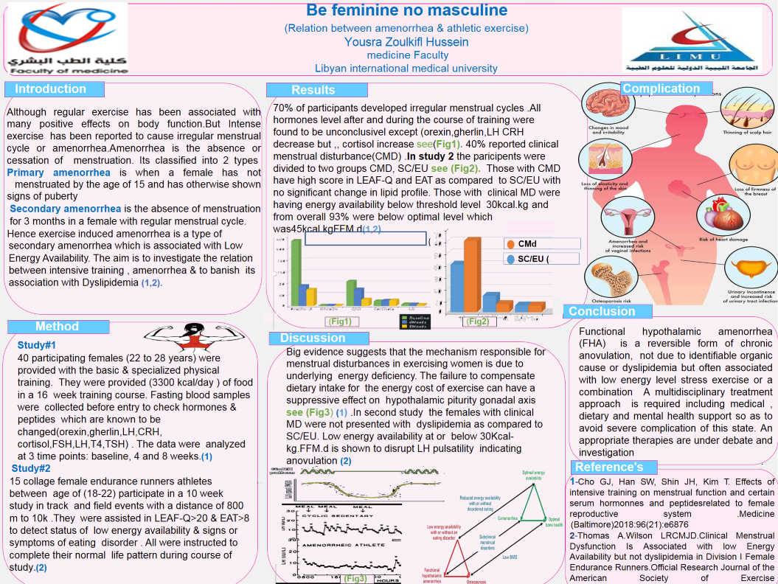
CMd (clinical menstrual disturbance)
SC/EU (subL/euclinical menstrual disturbance)
Abbreviation
EAT-Eat attitude test
LEAF (LOW ENERGY AVAILABILITY IN FEMALE)

