Slide 1


Libyan International Medical University
Faculty of Business Administration
Organizational Power, Control, and Conflict
Name: Sondos Almghrabi
ID : 2683
Email: sundus_2683@limu.edu.ly

Slide 2
Content
6_ Types of organizational control
1_Organizational power
01
2_ Modernist Definition of Power
7_Forms of Control
3_ Perspectives on Power, Politics, & Control
02
8_organizational control Postmodern
4_What is organizational control ?
9_Conflict
4_
5_3 Types of control
10_Critical Studies of Power and Control
12_ reference
04
11_ conclusion

Slide 3
Organizational power
Organizational power is the ability that you have to influence the behavior of another stakeholder in your organization. Your power is measured by the extent that you can use your influence to get that stakeholder to do something that he or she would otherwise prefer not to do.
Presentation

Slide 4
A Modernist Definition of Power
A has power over B to the extent that he can get B to do something that B would not otherwise do.

Slide 5
Perspectives on Power, Politics, & Control
Modernism
Critical Theory
Postmodernism
Objectivist
Structural determinants
Challenge
ideology
Emancipation
Objectivist
Structural
determinants
Manage to
lensure goal
achievement
Linguistic construction
Embedded in socialrelationships
Reflexive scrutiny

Slide 6
What is organizational control ?
Control play a very important role in the organization to achieve goals and objectives especially when there are different tasks to perform control helps to complete the task in appropriate sequence. There are two ways through which control can be viewed.
Hard control; it concerned with machine and equipments normally.
Soft control; it concerned with the control of people.

Slide 7
3 Types of control
1.Pre-Control
2. Concurrent Control
3. Post Control

Slide 8
Types of organizational control
1. Output control
2. Behavioral control
3. Clan control

Slide 9
Forms of Control
OUTPUT
BEHAVIORAL
Piece rate systems
Quality / waste
Standards
Quantity produced
Performance standards
Performance evaluations
Performance management

Slide 10
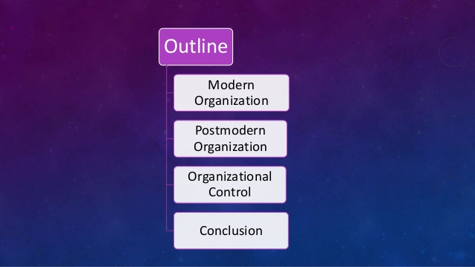
organizational control Postmodern
main virtues of new organizational paradigm are flexibility, decentralization, higher employee empowerment, knowledge and information sharing, responsibility for the system as a whole and permanent learning. On the other hand, some downsides become obvious. Those are danger from anarchy, responsibility and stress, greater employees&apos; insecurity and resistance to new practices. Furthermore, the paper shed light on power and identity dynamics through the lens of improved and still intentional methods of organizational control. The main argument is that compulsive desire to control never fades away, only the methods of control takes different, more advanced forms through organizational culture, vocabulary and discourses monitoring at a distance, peer evaluation inside teams, employee selection and many others.

Slide 11
Critical Studies of Power and Control
Critique of Ideology
Labor Process Theory
Workplace Democracy
Communicative Rationality

Slide 12
Conflict
A
.
A particular kind of interaction marked by efforts at hindering, compelling, or injuring and by resistance or retaliation against those efforts."

Slide 13
conclusion
given to timely interventions to resolve conflict. Power, Politics & Conflict if carried properly in the organization then it can make the work environment healthy and leads to the increase in productivity of the organization. They should be practice in the controlled manner which helps to maintain or balance the work situation

Slide 14
Organizational power, politics and conflict. (2009). UKEssays.com. https://www.ukessays.com/essays/management/organizational-power-politics-and-conflict.php
Loncar, D. (2005). Postmodern organization and new forms of organizational control. Ekonomski Anali, 50(165), 105–120. https://doi.org/10.2298/eka0565105l
Reference

Slide 15
THANK YOU

