Slide 1


State Definitions From Different Points of View
Libya International Medical University
Faculty of Business Administration
Weaam Fadel
Student ID: 2870
Email: weaam_2870@limu.edu.ly

Slide 2
Defining State
The different views
Contemporary views
Conclusion
References
Content

Slide 3
What is the State?
The state in political science applies to authority concentration centered on population and government territorial power. The state is an agency with a monopoly on the use of violence in a given region, according to Weber.

Slide 4
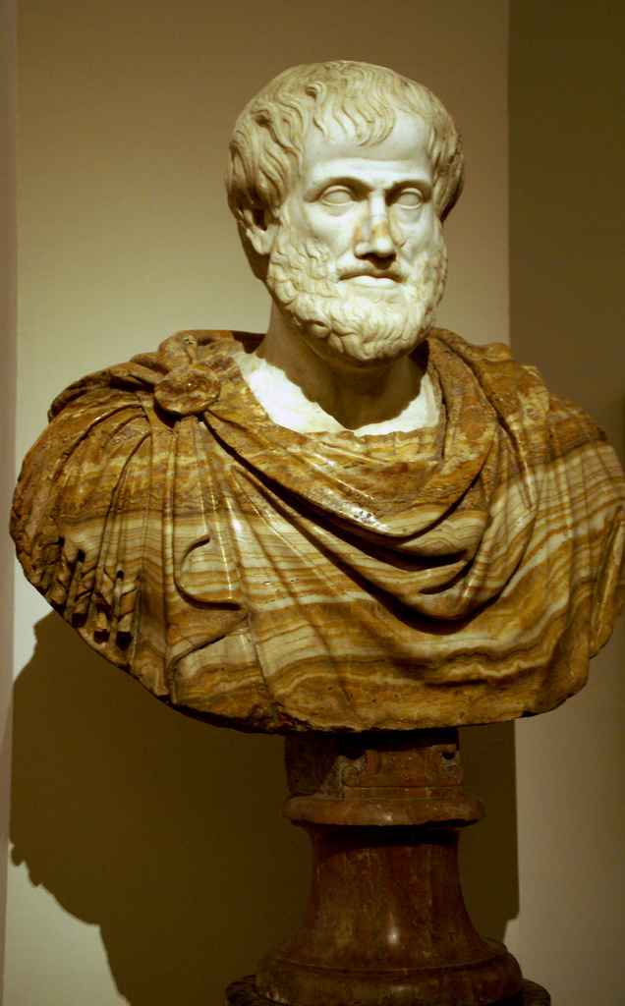
Aristotle’s view
Aristotle's opinion was that in the instinctive desire of man to fulfill his economic needs and racial impulses, the root of the state is present.

Slide 5
Plato’s view
Plato also thought of the city-state (also known as polis) as the best fitting form of association where the entire community’s needs (cultural, economic, political and religious) could be satisfied.

Slide 6
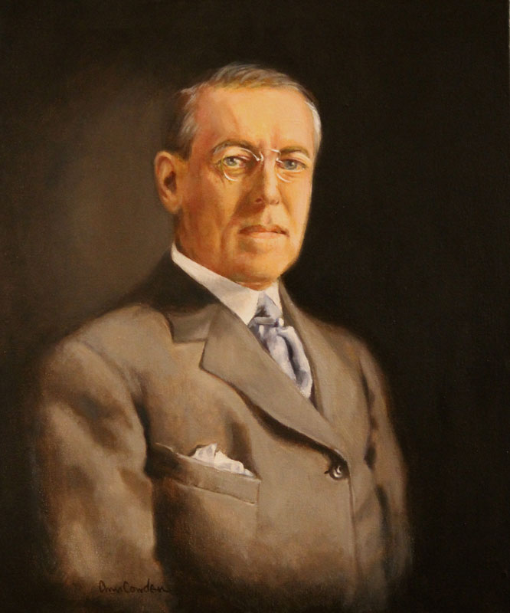
Woodrow Wilson
To Woodrow Wilson, 'State is a people organized for law within a definite territory.'

Slide 7
Rousseau´s view
The country itself is sovereign to him and the law is nothing but the will of the people as a whole. Influenced by Plato, the state was recognized by Rousseau as the setting for humanity's moral growth. Man remained inherently decent, though tainted by his society, and thus capable of assuming the moral role of striving for general welfare.

Slide 8
Contemporary views
In the twentieth and early twenty-first centuries, policy concepts varied from anarchism, in which the state was thought unnecessary and perhaps biased in that it worked by a sort of coercion, to the welfare state, in which the government was kept liable for the survival of its members, ensuring the support of those who lacked it.

Slide 9
In conclusion, the state has been seen or viewed through many different lenses throughout history which I think have shaped it into what we now the State to be as now. A much bigger number of philosophers helped this process but I have only mentioned some.

Slide 10
References
brainkart.com. (n.d.). Brainkart. http://www.brainkart.com/article/Political-Science---The-State-And-Its-Elements_1619/
Britannica.com. (n.d.). Britannica.Com. https://www.britannica.com/topic/state-sovereign-political-entity/Hegelbritannica.com. (n.d.-b).
Britannica. Retrieved December 19, 2020, from https://www.britannica.com/topic/nation-state

Slide 11
Thank you

