Slide 1


Slide 2


Imaging of Abdominal masses in pediatrics
Presented BY Dr. aliya shemisa

Slide 3
Abdominal masses are most common in children under the age of 5 years
Most abdominal masses in neonates are retroperitoneal, of kidney origin and are not malignant.
The older the child the more likely the mass represents a malignant process.

Slide 4
Neonatal Abdominal Masses
Renal origin 55%:
1. Hydronephrosis
2. MSDK multicystic dysplastic kidney
3. Congenital nephroblastoma
Pelvic / genital origin 15%:
1. Teratoma/ Sacrococcygeal Teratoma
  2. Ovarian Cysts
  3. Hydro/hematometrocolpos “due to imperforated hymen, vaginal atresia or vaginal septum”
  4. Obstructed bladder “ due to post. Urethral valve or neurogenic causes”

Slide 5
Non-renal retroperitoneal Adrenal origin 10% :
1. Hemorrhage
2. Neuroblastoma
GIT origin 15% :
1. Duplication
2. Mesenteric omental cyst
3. Meconium ileus
Hepatobiliary origin 5%:
1. Hemangioendothelioma “infantile hepatic hemangioma”
2. Hebatoblastoma
3. Choledochal cyst

Slide 6
Abdominal Masses in Older Children
Renal origin 55% :
1. Wilm’s tumor
2. Hydronephrosis
3. Cystic kidney disease
Non-renal retroperitoneal 23% :
1. Neuroblastoma
2. Teratoma

Slide 7
GIT origin 12% :
1. Appendiceal abscess
2. Lymphoma
Hepatobiliary origin 6% :
1. Hepatoblastoma
2. Hemangioma/ Hemangioendothelioma
3. Metastasis
Genital origin 4% :
Ovarian cyst & Teratoma

Slide 8
Radiological investigation
– X-rays – not usually helpful
– US – good first test
– CT Scan – good test to help plan surgery and for staging
– MRI – limited application
– Nuclear scans – selective use

Slide 9
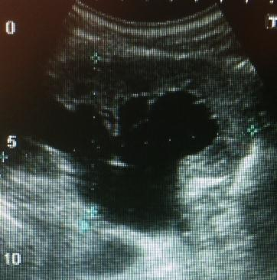
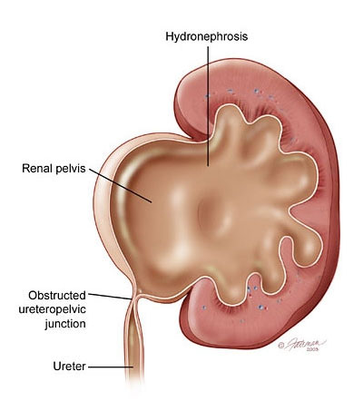
Hydronephrosis
- is dilatation of pelvicalyceal system, it can be due to a ureteropelvic junction stenosis, ureteric stenosis or vesicoureteral reflux
- ureter is not visualize in PUJ obstruction
-thin parenchyma line seen in sever hydronephrosis.
-USS is initial non invasive , no radiation effect modality.
-MRI : no-radiation good modalities.
- IVU Excretory urogram is helpful for kidney function.
- nuclear scan is modality of choice in non-functioning kidney .

Slide 10
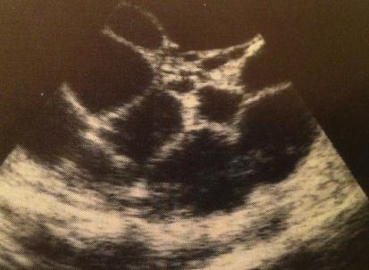
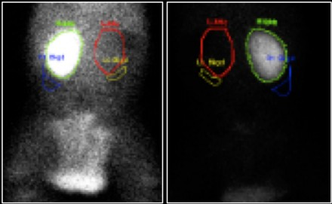
Multicystic dysplastic kidney (MCDK)
- is congenital kidney anomaly where there is no normal parenchyma , atresia of collecting system & ureter .
-kidney composed of multiple cysts of different sizes without communication .
-25% of MCDK pt. has contralateral kidney anomaly: VU Reflux, PUJ obstr. Or renal ectopia.
- USS : is initial modality & shows enlarged kidney with multiple non-connecting cyst, thin or absent renal parenchyma.
- nuclear scan of Tc-99m DMSA is modality of choice to assess the kidney uptake.

Slide 11
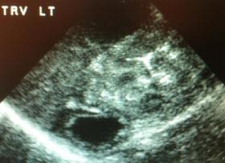
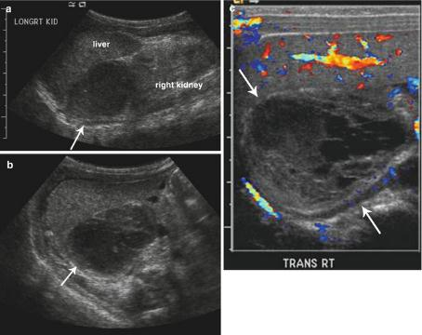
Adrenal hemorrhage
- can be unilateral or bilateral caused by birth trauma, septicemia, coagulation disorder.
Symptoms of abdominal mass, anemia and jaundice.
- Lt. side is associated with renal vein thrombosis.
USS: early presentation is echogenic (white). Solid or complex mass and then slowly cystic liquefied.
- Adrenal hemorrhage v/s adrenal neuroblastoma !!!
- absent flow & absent calcification in favor of adrenal hemorrhage.

Slide 12
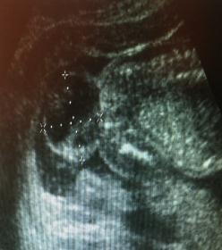
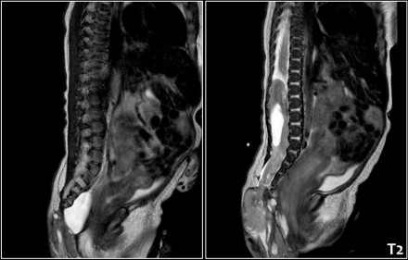
Sacrococcygeal teratoma
- germ cell tumor composed several of different types of tissue “solid tissues, cystic & calcifications “
- usually in ovaries , testicle, sacrococcygeal bone. May occur in CNS, Chest & abd.
- often detected in prenatal USS.
-is benign tumor, rarely to be malignant.
- elevate alpha fetoprotein level.
- post-natal diagnosis is made on physical examination & confirm by USS
- & often made to confirm the exaMRI is modality of choicect extension to spinal cord and content of the tumor .

Slide 13
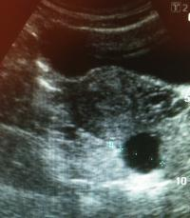
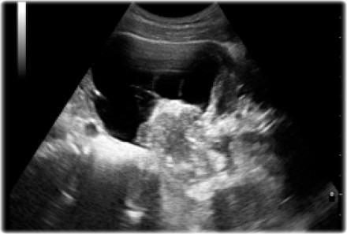
Ovarian cyst
- often detected antenatally by uss.
-may be small or large cysts, Simple thin wall or complicated thick wall with septation & internal soft tissue content.
- follicular cysts in infants due to influence of maternal hormone.
-Teratoma most common type , in uss appears as cystic mass with soft tissue , Fluid-fluid level, fat content ,calcifications, bone & teeth
- plain abdomen x-ray: shows bone & teeth
- CT scan & MRI is modality of choice
-cyst>4cm & complicated cysts are operated
-2.5-4cm cysts: F/U USS
-<2.5cm cysts: spontaneous regress in size

Slide 14
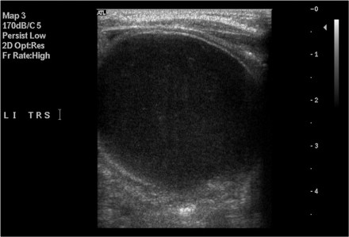
GIT intestinal duplication cyst
-is duplication of bowels , no communication with the bowel
- can occurs any where along GIT, more common at mesenteric side of jejunum & ileum
- cause GIT bleeding & obstruction
-USS is sufficient to diagnose & appear as multilayer lining cysts

Slide 15
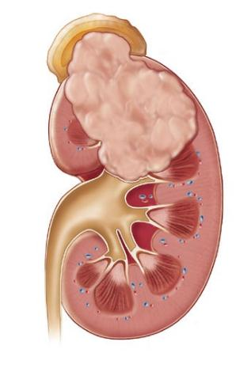
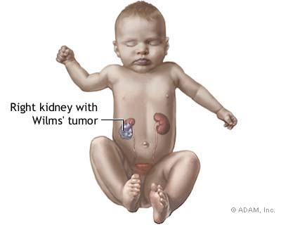
Wilm’s tumor of the kidney

Slide 16
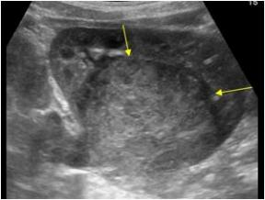
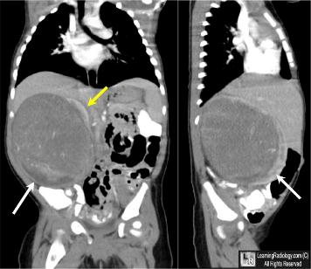
Wilm’s tumor ( nephroblastoma)
- rapidly growing vascular kidney origin tumor.
- peak age 2-3 years, rare in >5yrs
- child presented with abdominal mass, pain, malaise, hematuria in 30% & HTN in 25%
- unilateral or may be bilateral in 7%
-Mets to lung, liver & regional L.N , invade renal vein and IVC,
- USS: solid or with cystic component & Hge
-CT scan: heterogenous ,tumor localization ”claw sign” & distant mets
-MRI : for vascular invasion
ANGIOGRAPHY: road map pre-operative

Slide 17
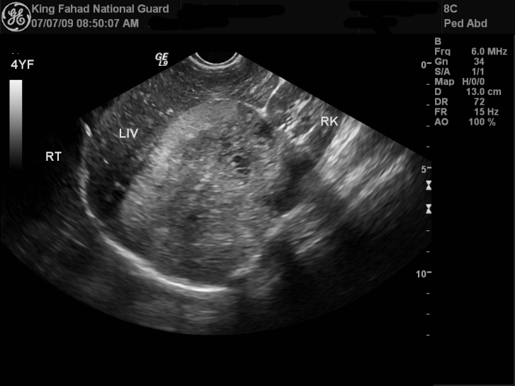
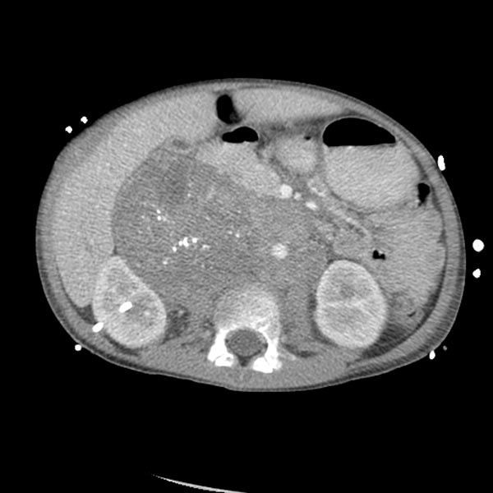
Neuroblastoma
- Malignancy in neural crest cells in sympathetic ganglia, adrenal medulla, chest, abdomen
-average age is 18 months (80%<5yrs)
- may be congenital neuroblastoma
- clinically: abd. Mass, & pain
-metastasis to bone, bone marrow, liver & L. nodes.
-USS: heterogeneous vascular soft tissue mass with necrosis & calcification, squeezing ipsilateral kidney downwards “in adrenal origin neuroblastoma”
.CT scan : for tumor localization , calcification seen in 90% of cases , tumor staging
Bone scintigraphy : for bone mets.

Slide 18
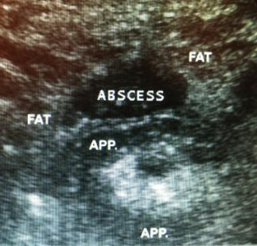
Appendicular abscess
- most common complication of acute appendicitis after perforation.
- RIF PAIN , fever, & vomiting.
- abscess formation & collection seen in the peritoneal or retroperitoneal cavity.
- USS: hypoechoic fluid collection closed to area of infected appendix.
- CT scan : thick fluid collection with or without air pockets. Appendicolith may be visualized .

Slide 19
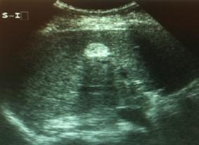
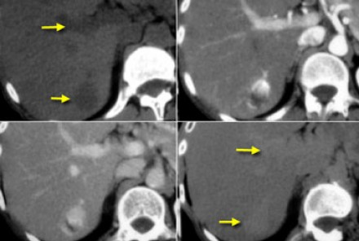
infantile HEPATIC hemangioma
- is benign vascular hepatic lesion (Arteriovenous shunting)
-Solitary or multiple.
- pt. has hepatomegally ,may cause unexplained high cardiac output failure & 10% may associated with subcutaneous hemangioma,.
USS: hyperechoic or hypoechoic or mixed with increase flow in Doppler
CT scan : triphasic study (peripheral enhancement with gradual filling-in) , hypodense, well-define with strong enhancement in small size hemangioma, may calcified.
MRI: T1 is hypointense , hyperintense on T2 weighted image.

Slide 20
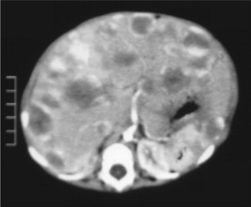
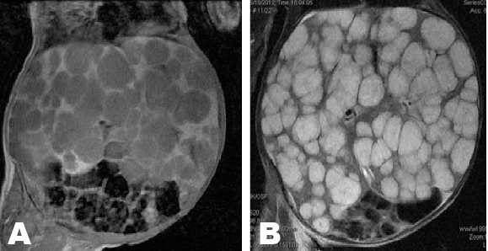

Slide 21
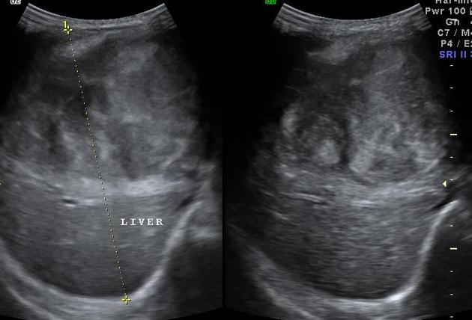
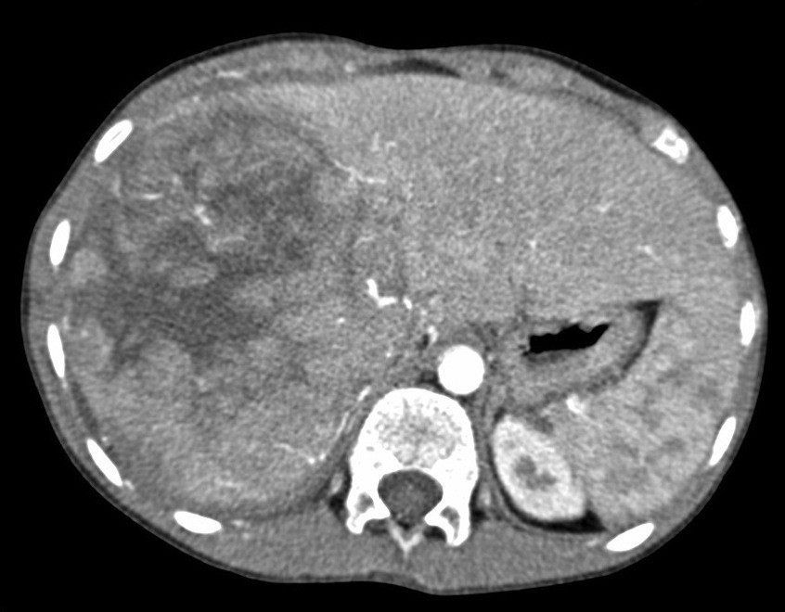
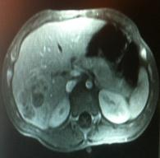
Hepatoblastoma
- most common 1ry liver tumor in children under age of 4 years, not common in neonate.
-hypervascular tumor & seeds to lung & L.nodes
- presented with painless/painful abd. distension, raised AFP
-USS: mixed echo. soft tissue mass.
CT: for tumor localization& staging, appear as enhanced mixed density mass, necrosis, hemorrhage ,calcification may be seen.
MRI: mixed intensity.

Slide 22


