Slide 1
Clinical teaching in strabismus
By Dr: HALA A. BUZAKOUK (MD.)

Slide 2
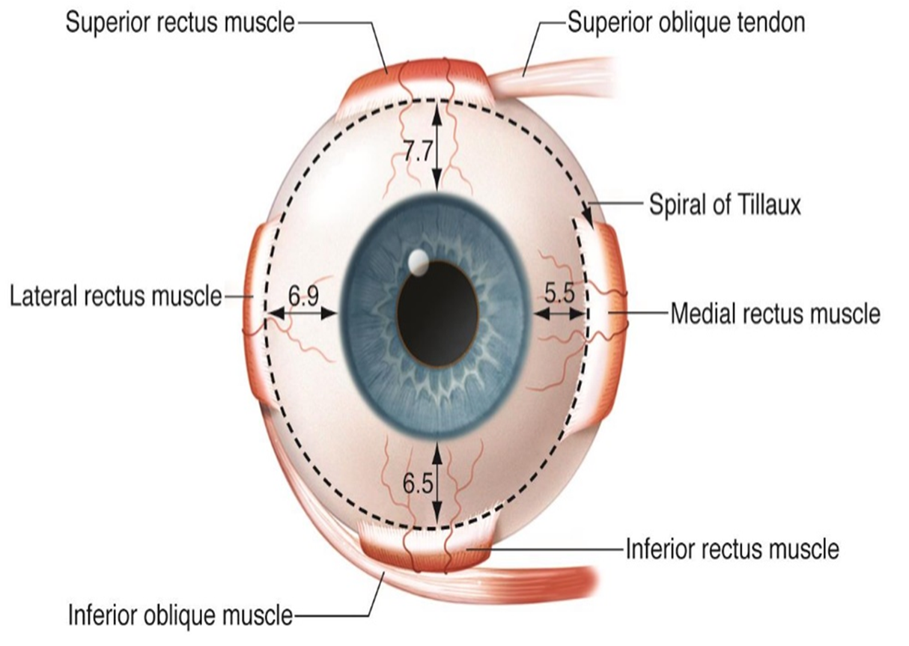
1

Slide 3
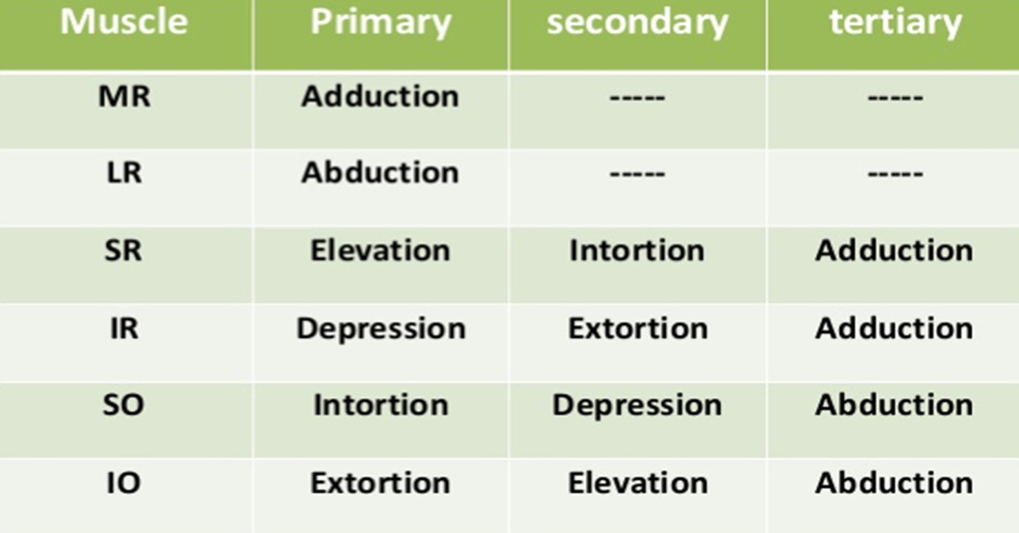
2

Slide 4
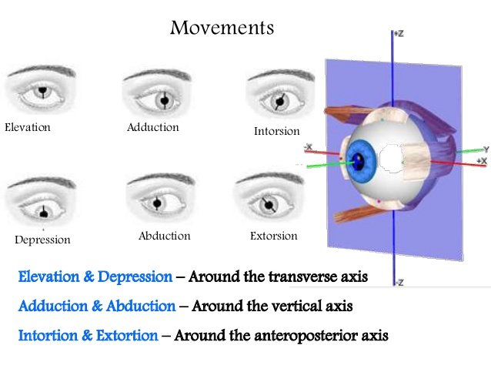
3

Slide 5
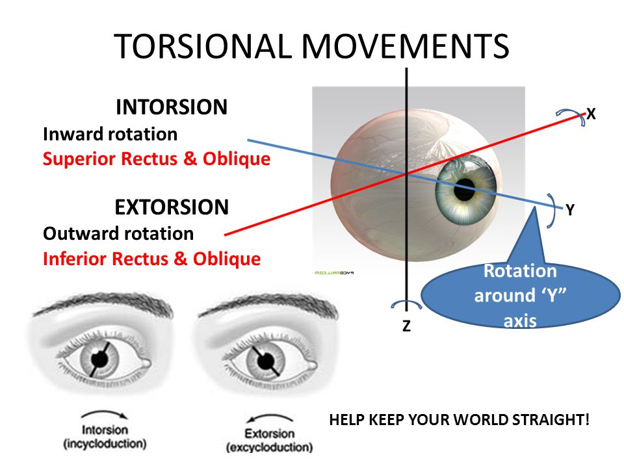
4

Slide 6
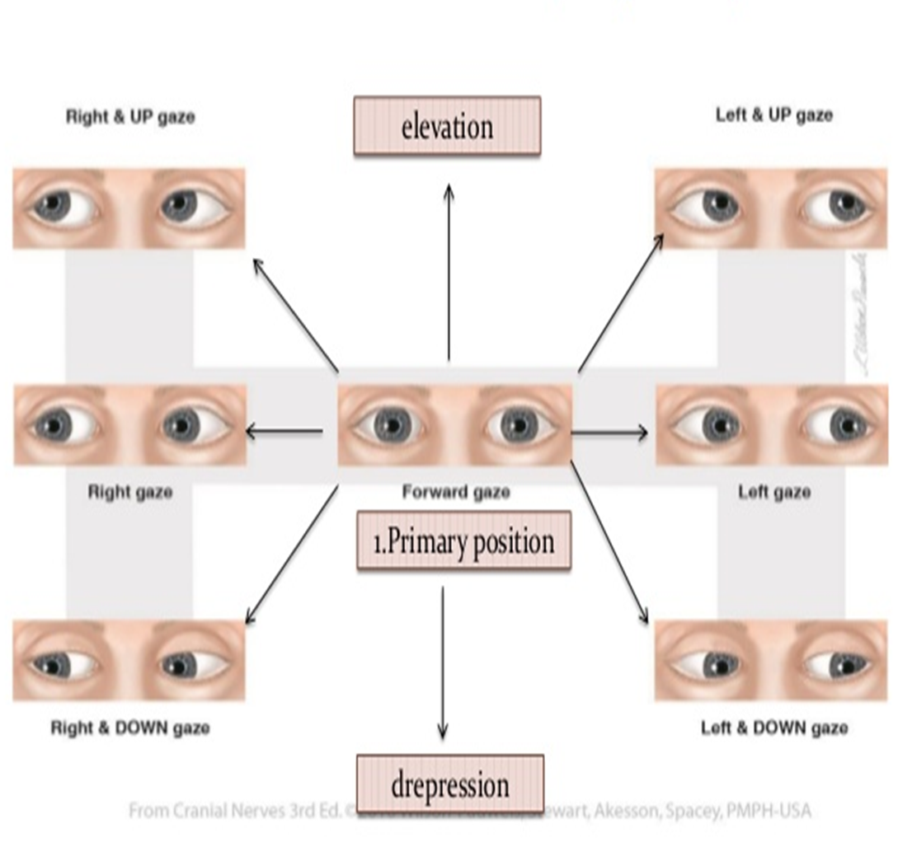
5

Slide 7
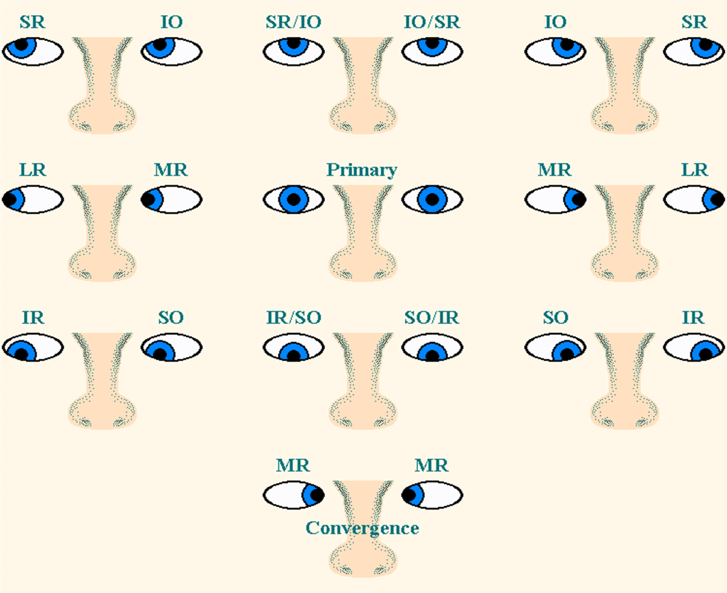
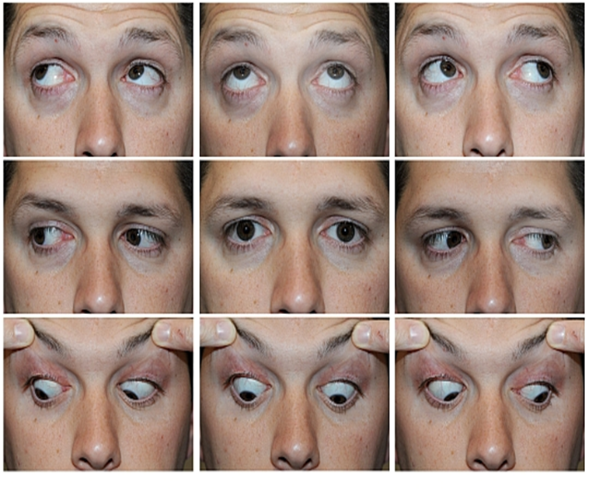
Test of ocular motility
6

Slide 8
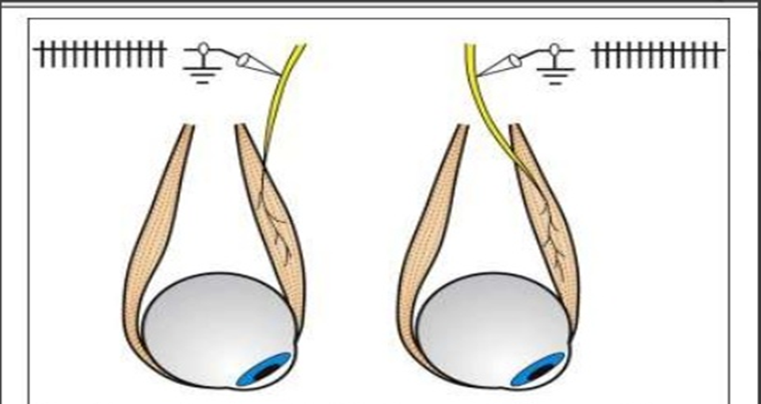
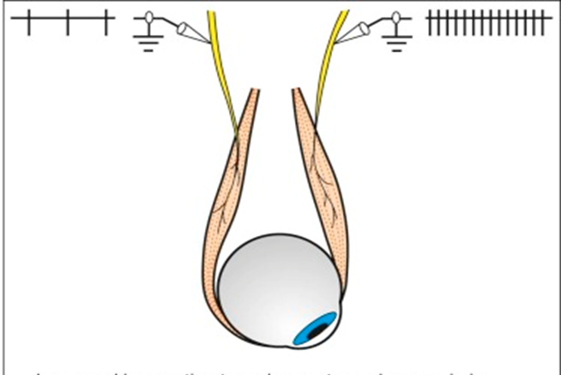
Hering law
Sherrington ‘s law
7

Slide 9
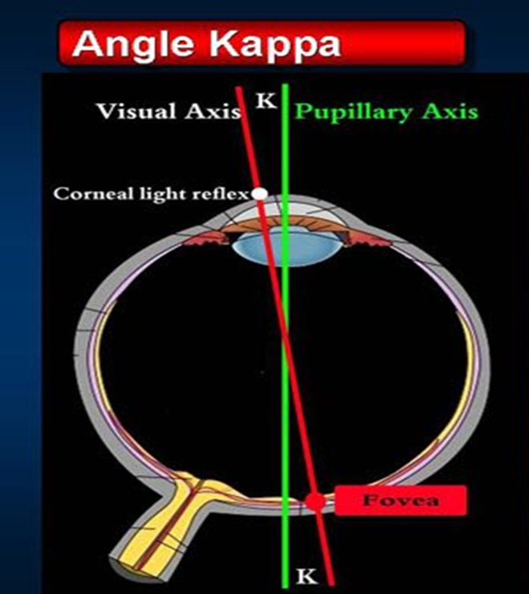
What is angle Kappa ?
8

Slide 10
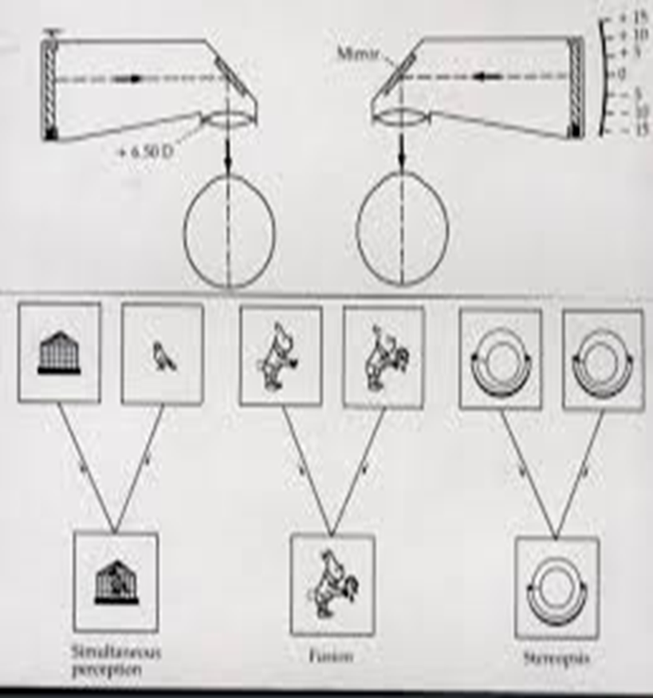

BSV
Definition?
Grades?
Name of instrument ?
9

Slide 11
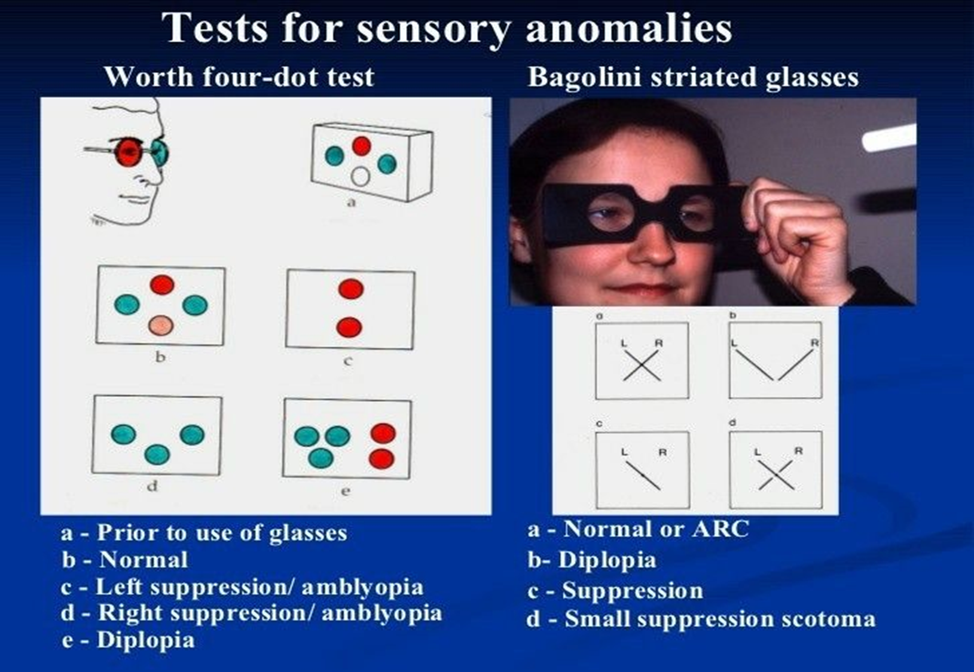
10

Slide 12
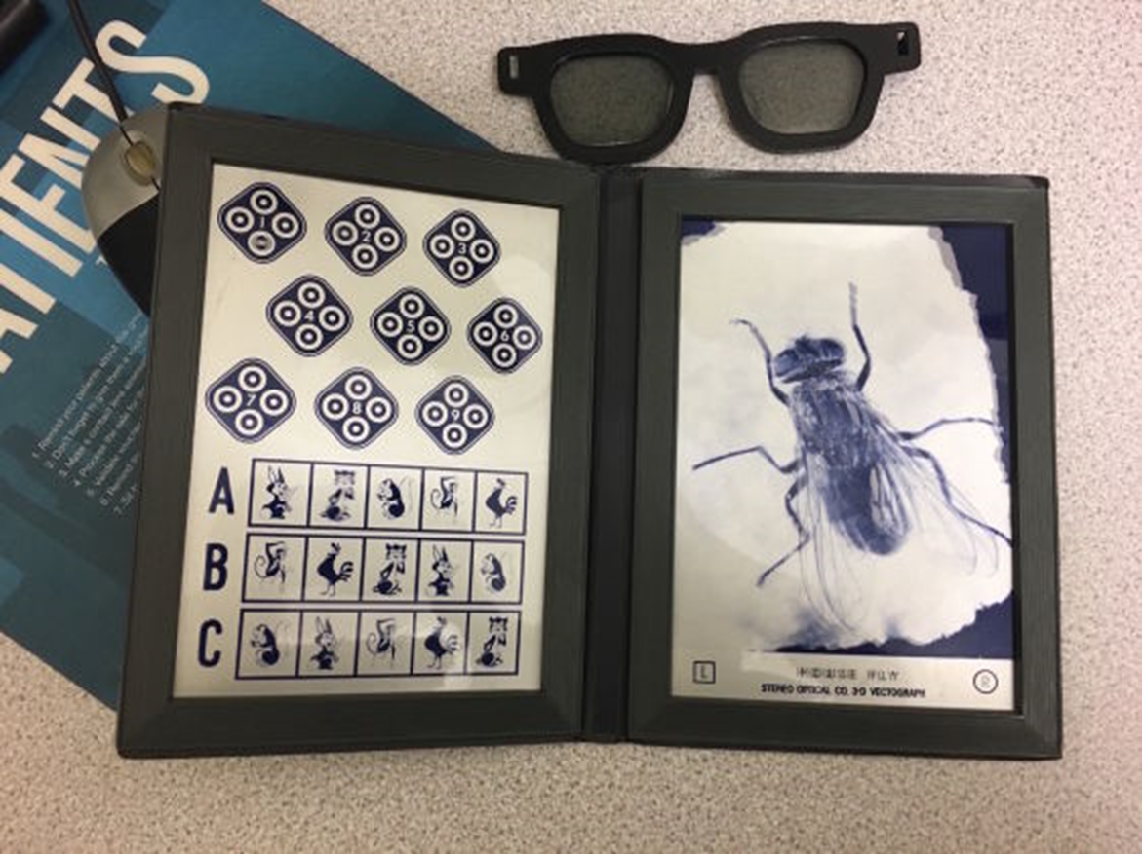
Name of the test?
Used for what ?
11

Slide 13
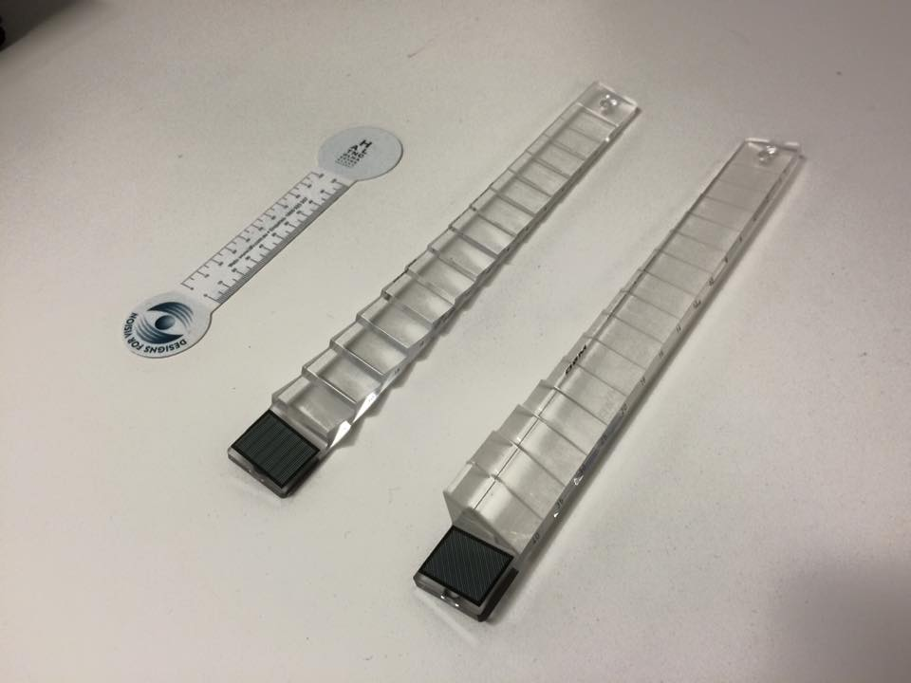
Prism bars
Horizontal and vertical
12

Slide 14
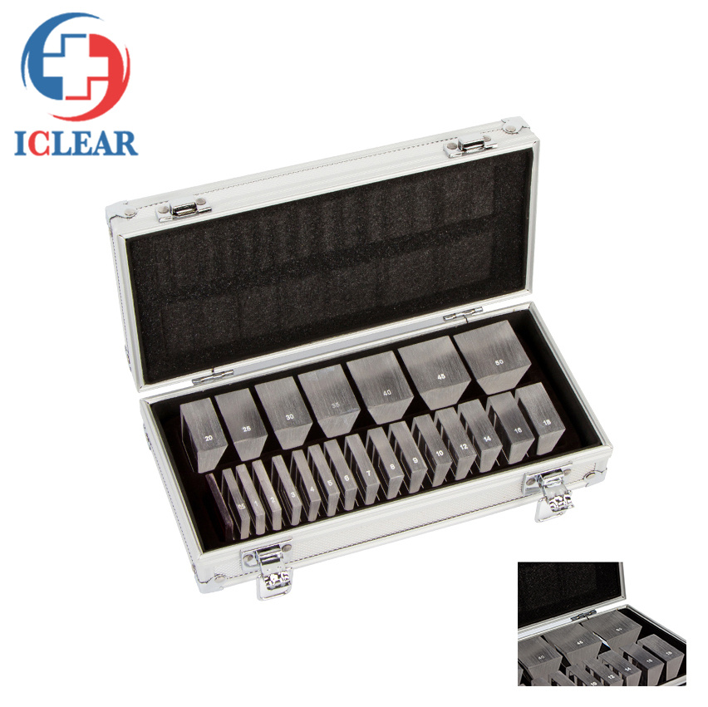
Separate prisms
13

Slide 15
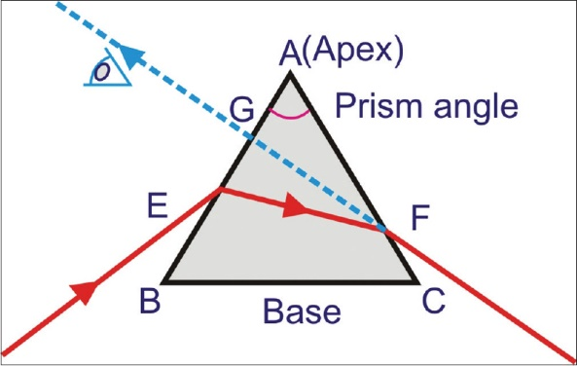
14

Slide 16
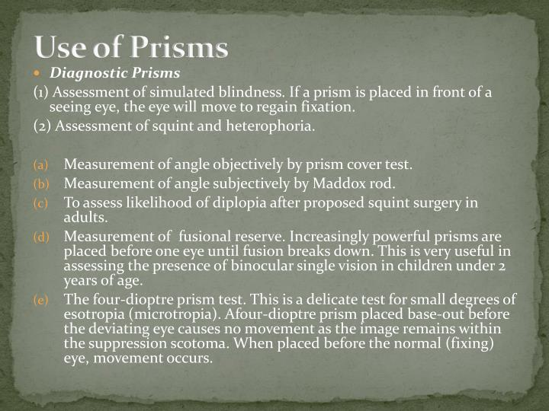
15

Slide 17
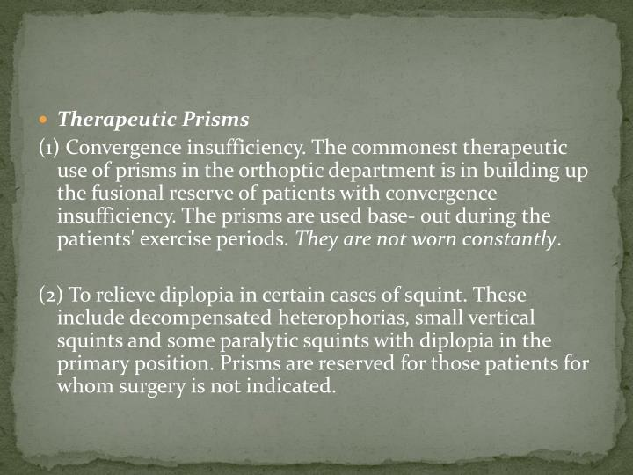
16

Slide 18
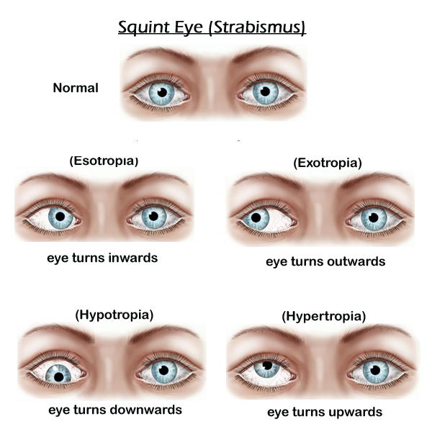
History
Type of deviation
Uniocular/alternative
Comitant/incomitant
Angle of deviation
17

Slide 19
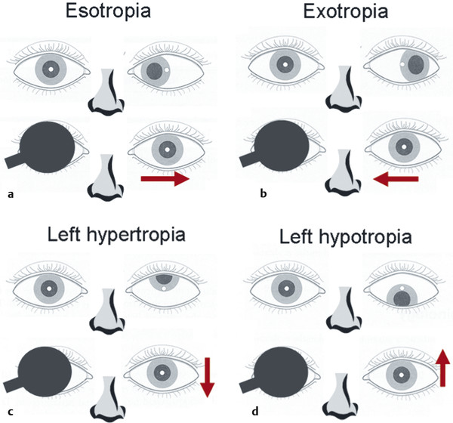
What is this test ?
Used for ……….
Cover test
18

Slide 20
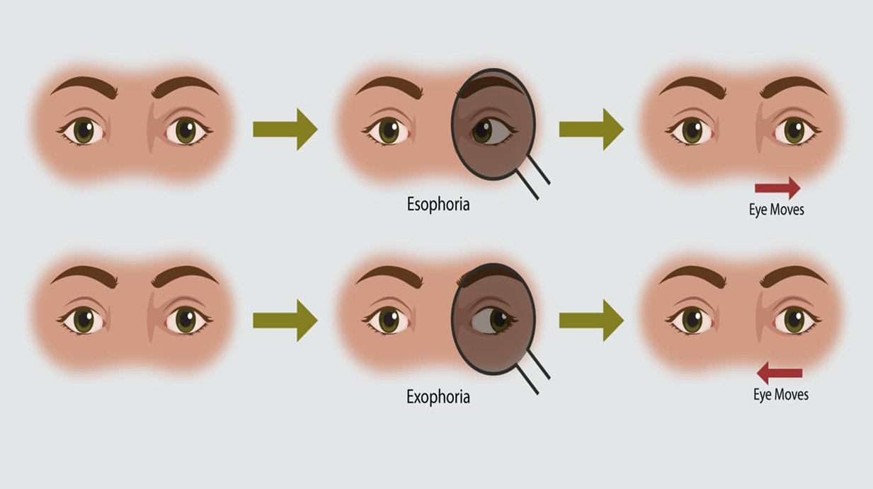
Uncover test
19

Slide 21
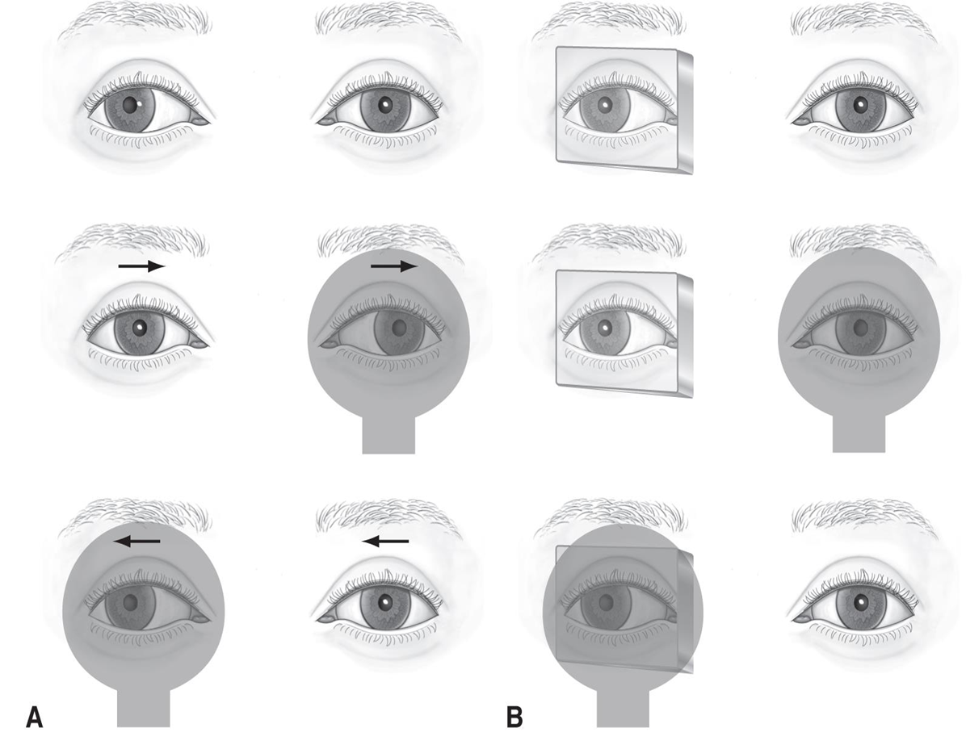
A alternative cover test
For total deviations
B prism cover test
Angle of deviaton
20

Slide 22
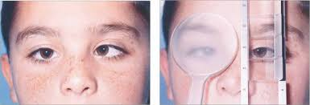
21

Slide 23
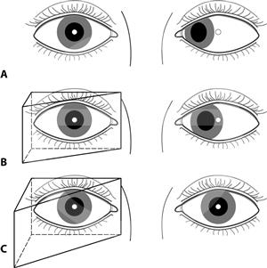
Kremisky test
Angle of deviation
22

Slide 24
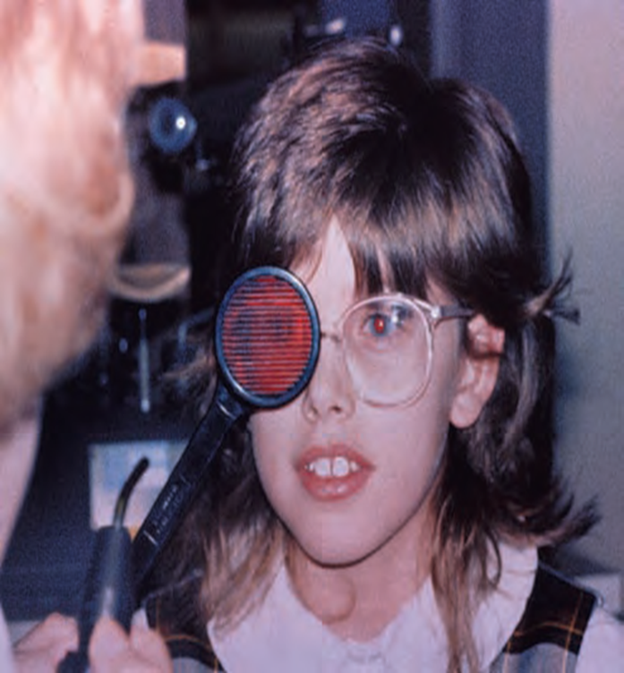
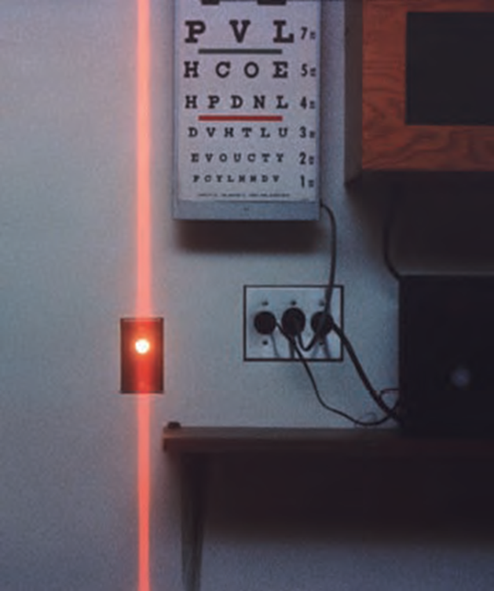
Maddox rod test
23

Slide 25
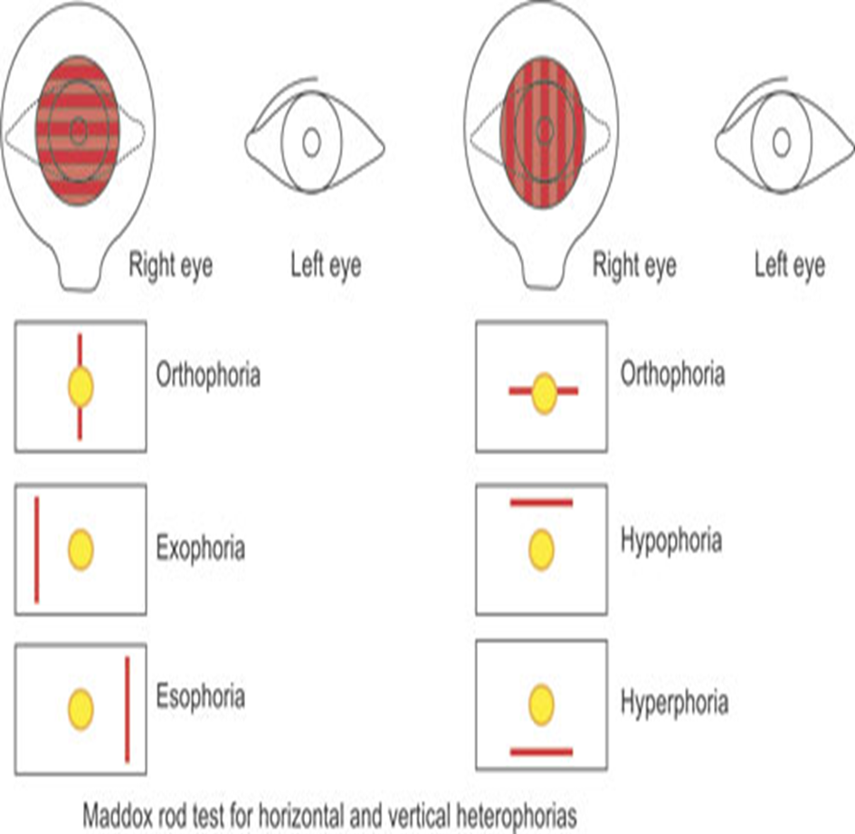
Can we measure the angle of D in this test ?
24

Slide 26
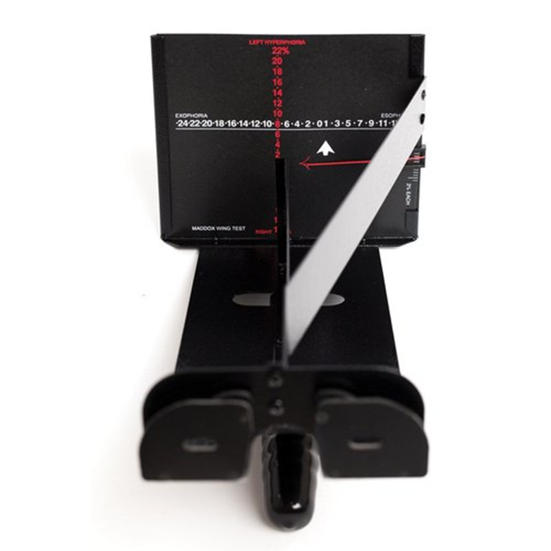
Maddox wing test
25

Slide 27
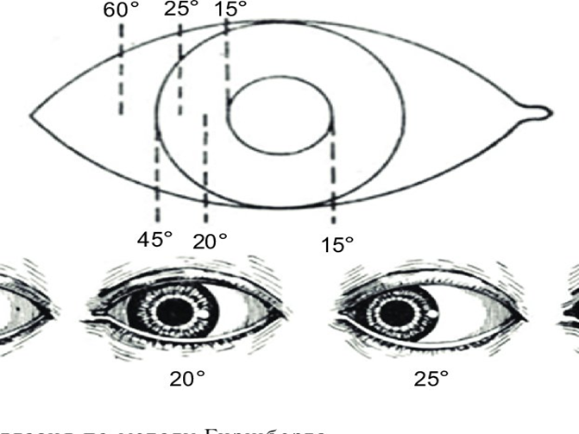
Hirschberg test
Each
1mm = 7ᵒ
1ᵒ=2Δ
26

Slide 28
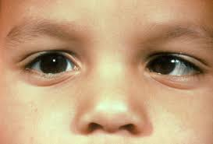
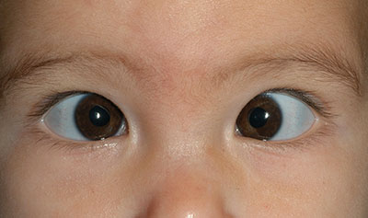
Type of squint
Angle of deviation
workup
27

Slide 29
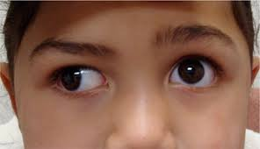
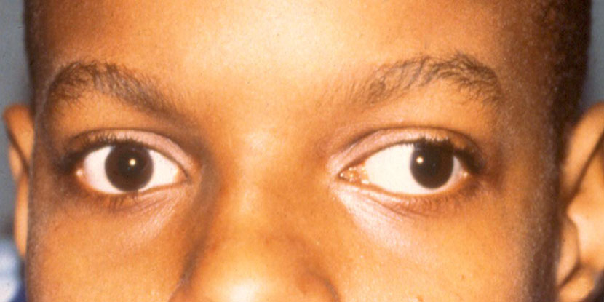
28

Slide 30
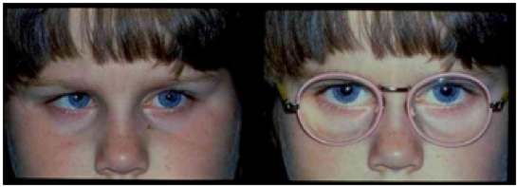
Diagnosis?
29

Slide 31
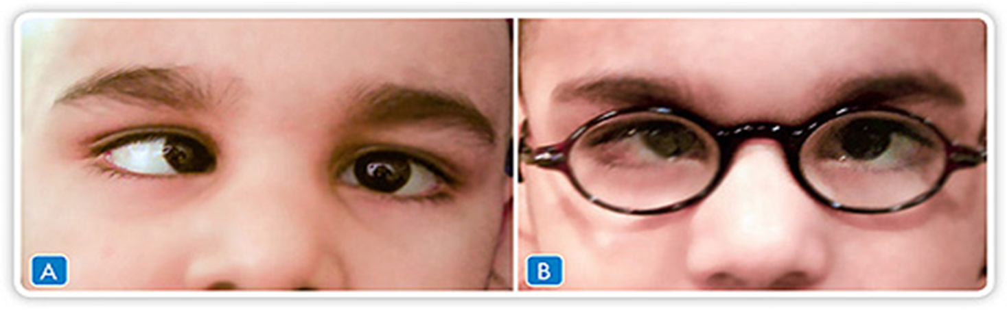
30

Slide 32
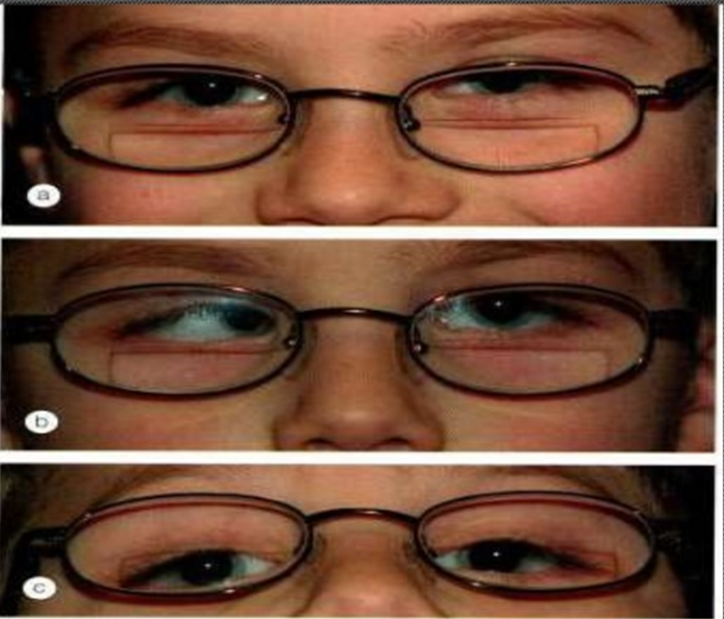
Non refractive accommodative ET
a, …………. For distant
b,………. For near
c, straight through ………
31

Slide 33
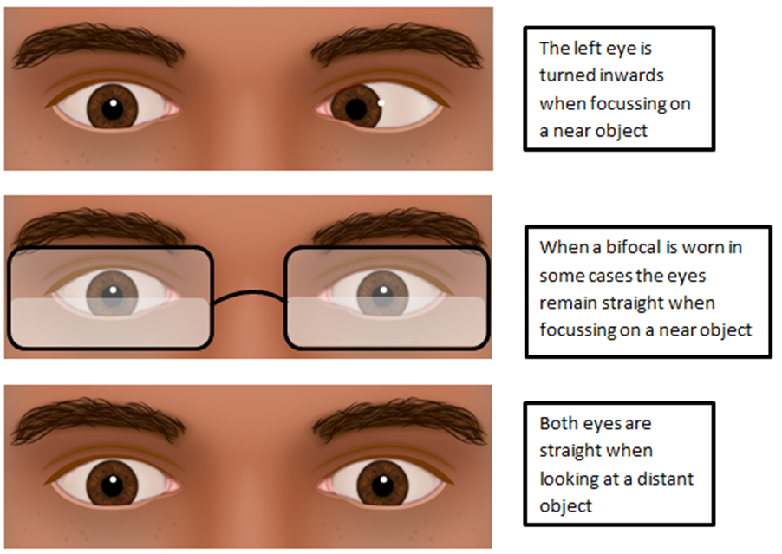
32

Slide 34
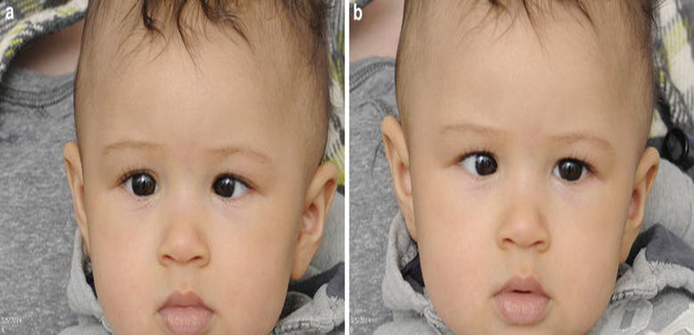
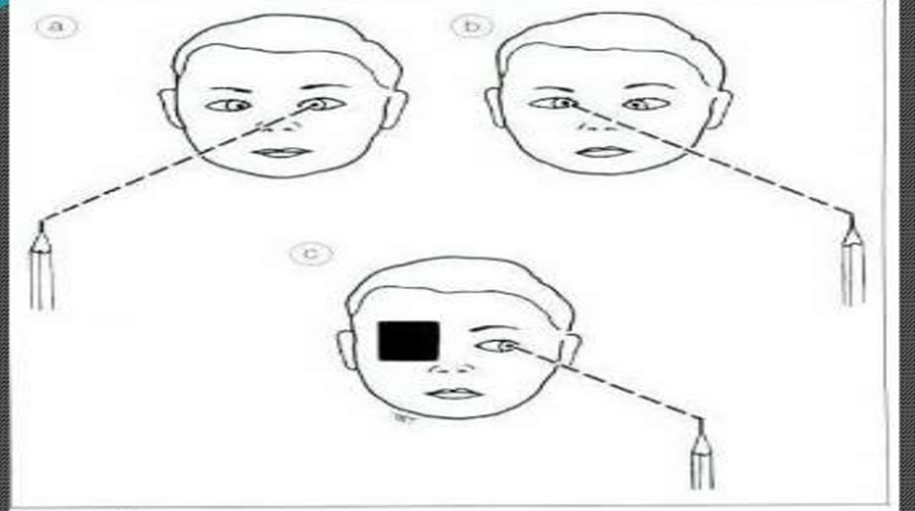
33

Slide 35
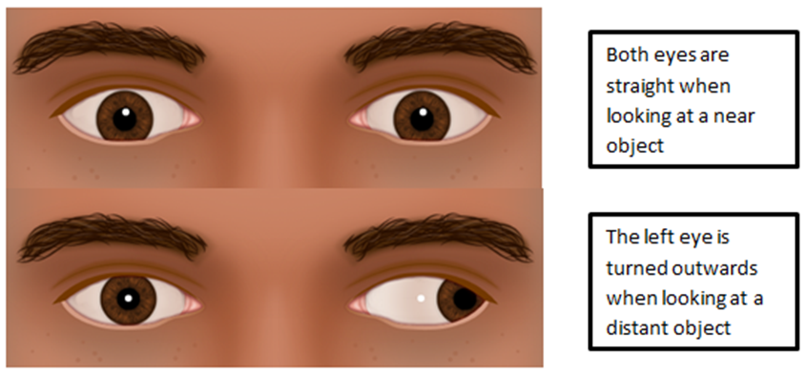
Intermittent XT
TYPES
34

Slide 36
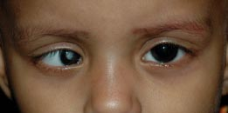
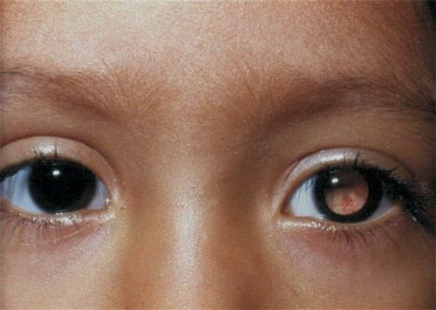
Do not foreget !
Dilated funduscopy is mandatory
35

Slide 37
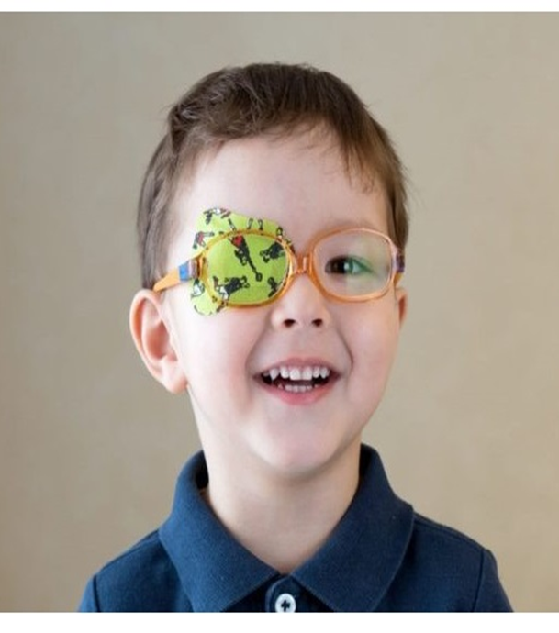
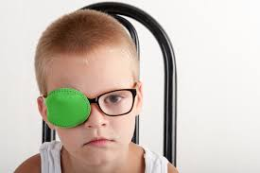
Amblyopia
Definition
Types
Treatment
36

Slide 38
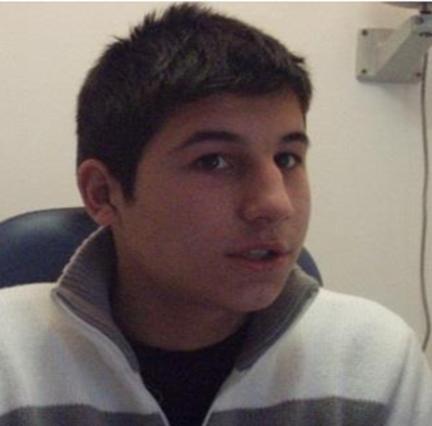
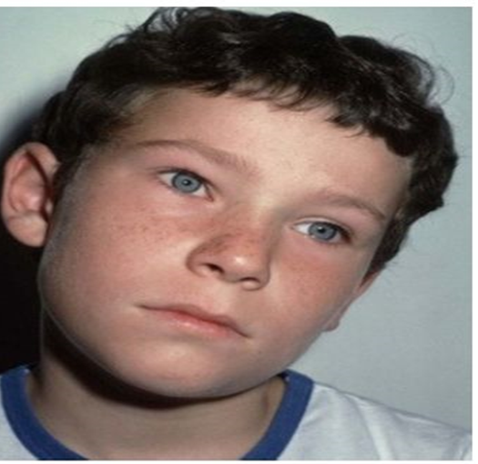
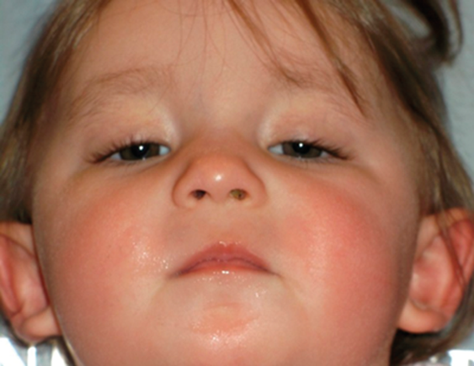
AHP
37

Slide 39
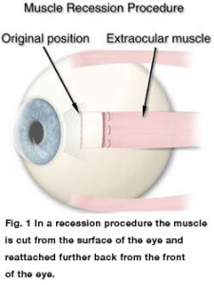
38

Slide 40
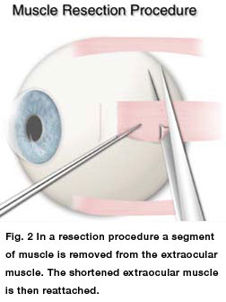
39

Slide 41
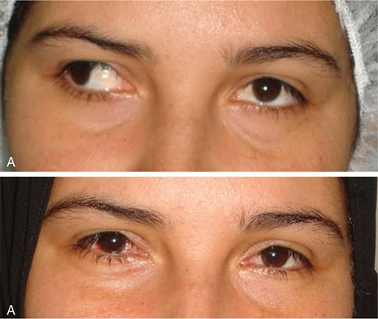
What type of surgical procedure ?
40

Slide 42


Slide 43


Slide 44


