Slide 1
محمد ونيس بالقاسم Name:
Student number: 2395
Group: A2

Slide 2
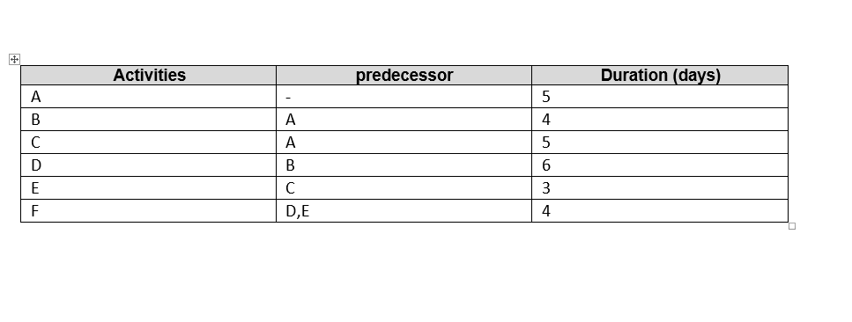
Assignment to be submitted in Moodle by 19 March 2022 3Qs
Develop a network diagram for the project specified below. (50 %)
Identify the Critical Activities and the total duration of the project. (35%)
Justify which activity would you crash based on some rationale (15%)

Slide 3



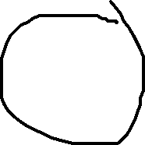
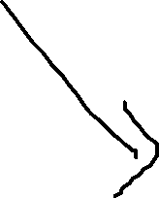











Slide 4
Identifying the critical path:
A-B-D-F = 5+4+6+4 = 19 day.
A-C-E-F = 5+5+3+4 = 17 day.
The path number 1 is a critical path
Justify: path 1 would take a lot of time when it compared with path 2 because it has activities more than that in path 2, considering the time as an important factor so path 1 would be our critical path; but there is a lot of factors would make this consideration change like the finance and the priority of sequences of activities that must be done before the other.

