Slide 1


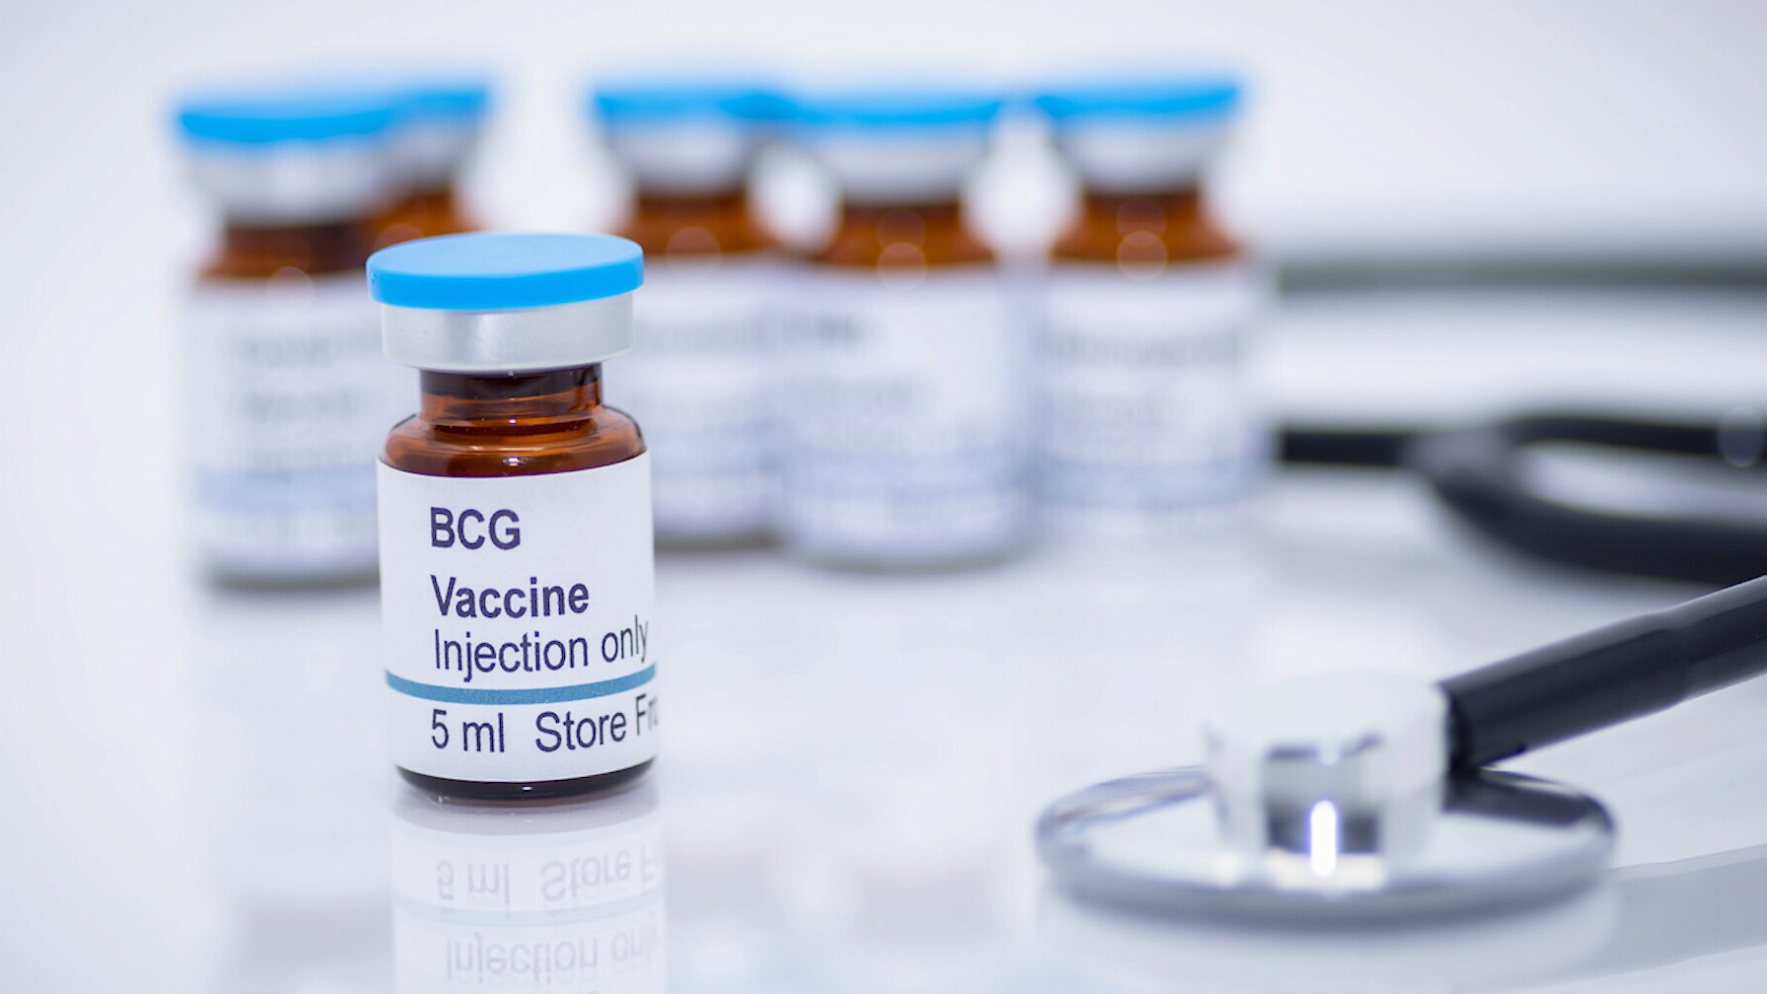
Immunization
Tuberculosis vaccine
Name:NourAlhuday Amrajaa
Number:3116
Block:PTS
Date:4\6\2022
Year:First Year

Slide 2
Objective
what is the tuberculosis vaccine.
How was the tuberculosis vaccine is developed.
How does the tuberculosis vaccine work.
List the side effect of the tuberculosis vaccine.

Slide 3
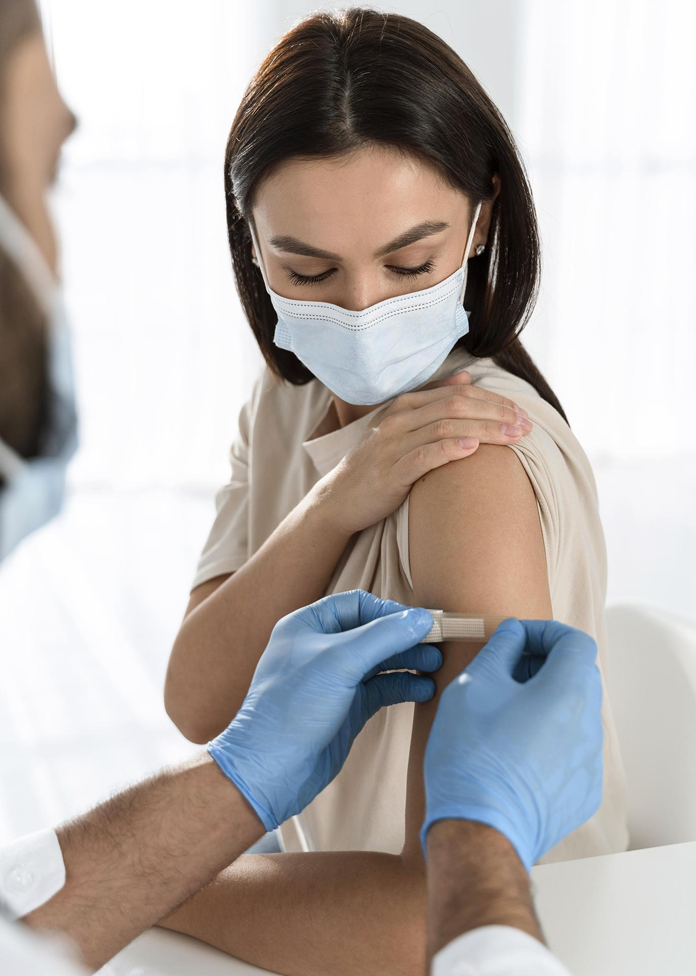
Introduction
. Vaccines train your immune system to create antibodies, just as it does when it’s exposed to a disease.
. Many dangerous infectious diseases can be prevented in this simple and effective way.

Slide 4
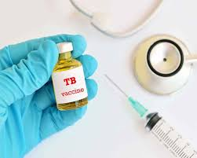
Tuberculosis Vaccine
Bacille Calmette-Guérin (BCG) is a vaccine for tuberculosis (TB) disease.
BCG vaccines provide a window into Mycobacterium tuberculosis virulence.
over 90% of children are immunized with BCG, making it the most commonly administered vaccine, with more than 120 million doses used each year.
BCG vaccination is given as an injection into the left upper arm.

Slide 5
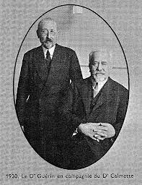
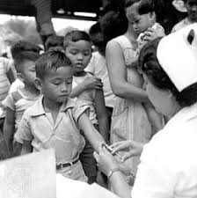
The development of the tuberculosis vaccine
Albert Calmette and Camille Guérin developed BCG at the beginning of the 20th century.
the BCG vaccine was attenuated by serially passing the strains on potato slices supplemented with glycerol over a period of 13 years until a non-virulent strain was obtained.
Trials of the newly developed vaccine were performed in cows, monkeys, and African apes and proved to be efficacious.

Slide 6
Work of tuberculosis vaccine
It provides consistent protection against the most severe forms of TB, such as TB meningitis in children.
It's less effective in preventing TB that affects the lungs in adults, so has limited impact on the spread of TB.
nitially, a small red papule forms within a 2–3 week period followed by softening and ulceration.
Healing usually occurs after several weeks with a resultant small scar. An accelerated reaction begins within 24–48 hours with induration followed by pustule formation in 5–7 days and healing within 10–15 days.

Slide 7
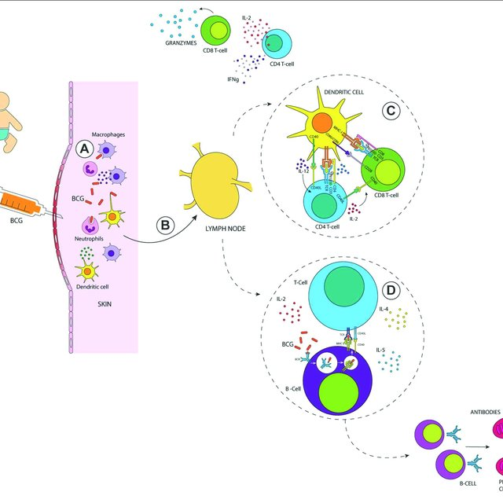
The Response Tuberculosis Vaccine On Newborn

Slide 8
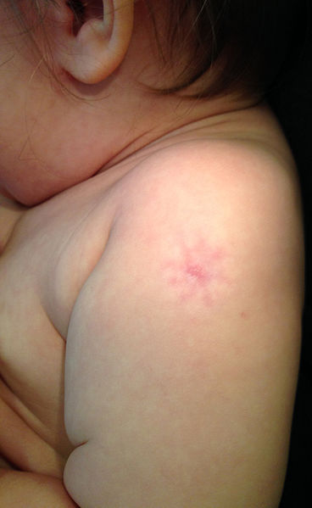
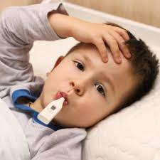
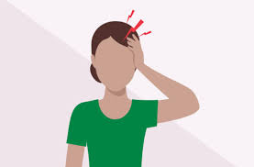
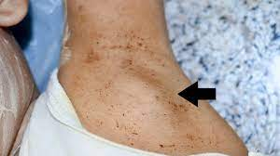
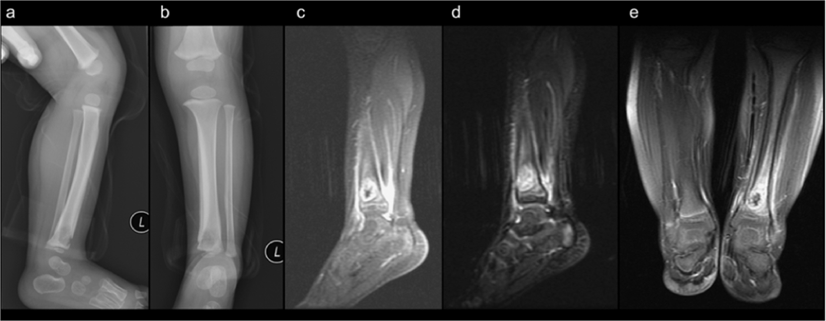
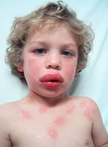
The side effect of the tuberculosis vaccine
1. soreness or discharge where the injection was given.
2. high temperature (fever).
3. headache.
4. swollen glands under the armpit in the arm where the injection was given.
5. More serious complications, such as abscesses, bone inflammation .
6. a serious allergic reaction (anaphylactic reaction), are very rare.

Slide 9
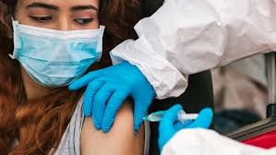
Conclusion
.Vaccines provide critical protection and is simple, safe, and effective way of protecting you against harmful diseases, before you come into contact with them.
. It uses your body’s natural defenses to build resistance to specific infections and 9makes your immune system stronger.

Slide 10
References
Why is vaccination so important? Norwegian Institute of Public Health. (n.d.). Retrieved June 3, 2022, from https://www.fhi.no/en/id/vaccines/childhood-immunisation-programme/why-is-vaccination-so-important/
NHS. (2022). NHS choices. Retrieved June 4, 2022, from https://www.nhs.uk/conditions/vaccinations/bcg-tuberculosis-tb-vaccine/#:~:text=The%20BCG%20vaccine%
2022. (n.d.). vaCCINE. UpToDate. Retrieved June 4, 2022, from https://www.uptodate.com/contents/viral-meningitis-in-children-management-prognosis-and-prevention#!
NHS. (2022). NHS choices. Retrieved June 4, 2022, from https://www.nhs.uk/conditions/vaccinations/bcg-tuberculosis-tb-vaccine/#:~:text=The%20BCG%20vaccine%

Slide 11

Thank you

