Slide 1

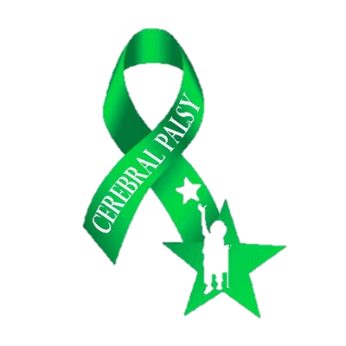



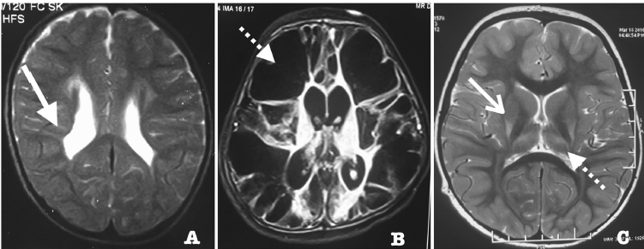
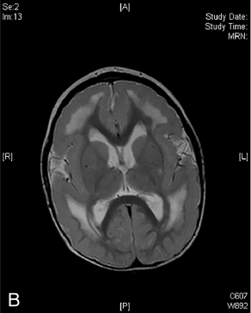
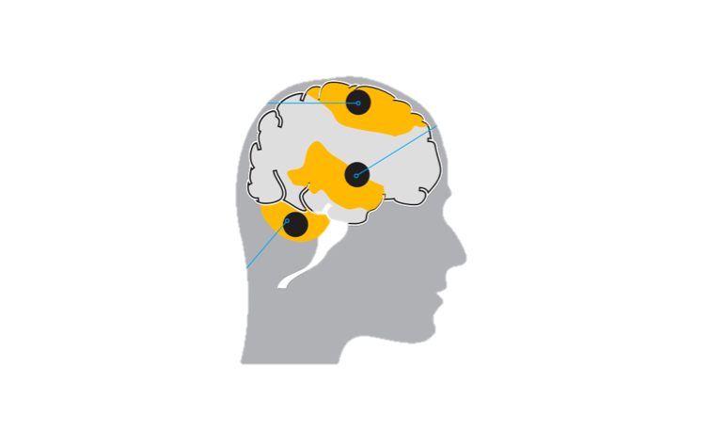
What is Cerebral Palsy?
Libya International Medical University
Tamiem Mohamed 1829 2ND year of basic medical science
Introduction
Etiology
Conclusion
Cerebral palsy (CP) is a neurodevelopmental
condition that affects muscle tone movement
and motor skills depInding on site of the
brain been affected. ⁽¹⁾
recognizable only after 3–5 y of age
suggestive signs and CP associated with
speaking, vision, and learning disability.⁽²⁾
This is not a single disease but rather a
heterogeneous clinical syndrome resulting
from injury to the developing brain Although
the disorder itself is non-progressive
cerebral palsy is classified by its motor type
and distribution into⁽¹⁾:
(85% of CP is spastic) affect upper
spastic motor neuron signs resulting
impaired ability to receive GABA
resulting hypertonia > (scissor gait)
.
• Hypoxic ischemic
• Neonatal hypoglycemia
• Congenital abnormalities
a. Inherited malformations
b. Secondary to
i. Infections ii. Radiation
• Intracranial hemorrhage
• Genetic mutation
Cerebral palsy is non-progressive heterogeneous clinical disease affecting neuromuscular development resulting abnormal muscle contractility and motor skills.
CP sometimes a combined with speaking, vision, and learning disability.
Classified into different type according site of development brain is been affected.
• Stroke
• Head trauma
• Hypoxic
• encephalopathy
a. Sepsis
b. Meningitis
Pre-neonatal causes⁽¹⁾
Post-neonatal causes⁽¹⁾
Clinical manifestation
`
References
1)- Gulati, S., & Sondhi, V. (2017).
Cerebral Palsy: An Overview The Indian
Journal Of Pediatrics, 85(11), 1006-1016.
available at:
www.ncbi.nlm.nih.gov/pubmed/29152685
2)- Wimalasundera, N., & Stevenson, VL.
(2016).Cerebral palsy.Practical Neurology
16(3),184-194. Available at:
www.ncbi.nlm.nih.gov/pubmed/26837375
Dyskinetic
(7% of CP) affect
Basal ganglia lead to involuntary movements
Fig. 2 MRI changes in cerebral palsy. Panel A shows a T2 weighted
image with periventricular hyperintensities and (solid arrow). This is
typically seen in prematurity associated insult and commonly
manifests as spastic cerebral palsy.⁽¹⁾
(B) (T2-weighted) showing extensive polymicrogyria typical of a
congenital cytomegalovirus infection. ⁽²⁾
(C) illustrates T2 hyper intensities in (open arrow) This Is typically
seen in infants with term hypoxic ischemic encephalopathy (HIE)
and manifests as dyskinetic cerebral palsy. ⁽¹⁾
Ataxic
(4% of CP) lesion in cerebrum
Generalized hypotonia with loss of muscle coordination.⁽¹⁾
Fig 1

