Slide 1




Breast Cancer
Maram Abdulsalam ALamamy
ID: 3530
First year Applied Medical Science Student
GBMS 2 Block

Slide 2
Objectives
Introduction Of Breast Cancer.
Mention The Types Of Breast Cancer.
List The Stages Of Breast Cancer.
Outline The Symptoms Of Breast Cancer.
Discuss The Prognosis And Prevention Of Breast Cancer.
List The Treatment Of Beart Cancer.

Slide 3
Introduction
Breast cancer is the most common type of cancer in the UK. most women diagnosed with breast cancer are over the age of 50, but younger women can also get breast cancer.
About 1 in 8 women are diagnosed with breast cancer during their lifetime. There's a good chance of recovery if it's detected at an early stage.
For this reason, it's vital that women check their breasts regularly for any changes and always have any changes examined by a GP.

Slide 4
Mention The Types Of Breast Cancer.

Slide 5
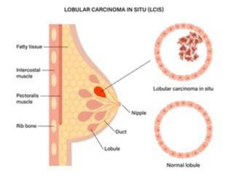
Breast cancer is often divided into either:
1- Non-invasive breast cancer (carcinoma in situ) :
found in the ducts of the breast (ductal carcinoma in situ, or DCIS) which has not spread into the breast tissue surrounding the ducts.
2- Invasive breast cancer :
where the cancer cells have spread through the lining of the ducts into the surrounding breast tissue. This is the most common type of breast cancer.

Slide 6
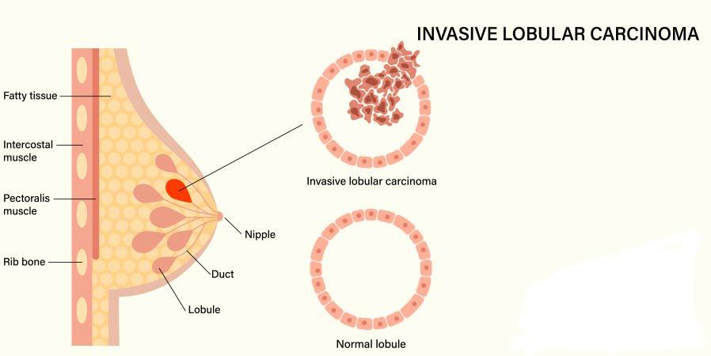
Other, less common types of breast cancer include:
invasive (and pre-invasive) lobular breast cancer
inflammatory breast cancer
Paget's disease of the breast.

Slide 7
List The Stages Of Breast Cancer.

Slide 8
There are 5 stages of breast cancer:
Stage 0: Stage zero (0) describes disease that is only in the ducts of the breast tissue and has not spread to the surrounding tissue of the breast. It is also called non-invasive or in situ cancer.
Stage IA: The tumor is small, invasive, and has not spread to the lymph nodes.
Stage IB: Cancer has spread to the lymph nodes and the cancer in the lymph node is larger than 0.2 mm but less than 2 mm in size.

Slide 9
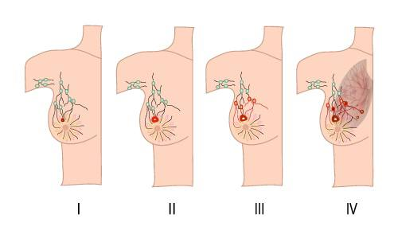
Stage IIA: There is no evidence of a tumor in the breast, but the cancer has spread to 1 to 3 axillary lymph nodes. It has not spread to distant parts of the body.
Stage IIB: Either of these conditions:
The tumor is larger than 20 mm but not larger than 50 mm and has spread to 1 to 3 axillary lymph nodes.

Slide 10
Outline The Symptoms Of Breast Cancer

Slide 11
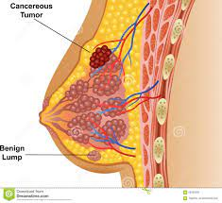
The first symptom of breast cancer that most women notice is a lump or an area of thickened tissue in their breast.
Some of the symptoms that cancer may cause include:
Local Symptom
Breast changes:
Lump or firm feeling in your breast or under your arm
Nipple changes or discharge

Slide 12
General Symptom
Bladder changes
Trouble urinating
Pain when urinating
Bowel changes
Blood in the stools
Changes in bowel habits
Fatigue that is severe and lasts.

Slide 13
Discuss The Prognosis And Prevention Of Breast Cancer.

Slide 14
Prognosis :
The stage is the main prognostic factor for breast cancer. There is less risk that early stage breast cancer will come back (recur) so it has a more favourable prognosis.
Breast cancer diagnosed at a later stage has a greater risk of recurrence, so it has a less favourable prognosis.
Doctors will consider if cancer has spread to lymph nodes and the size of the tumour when they predict a prognosis.

Slide 15
Whether or not cancer has spread to lymph nodes is the most important prognostic factor for breast cancer.
Breast cancer that has spread to lymph nodes has a higher risk of coming back and a less favourable prognosis than breast cancer that has not spread to the lymph nodes.

Slide 16
Prevention :
As the causes of breast cancer are not fully understood, it's not known if it can be prevented altogether.
Some treatments are available to reduce the risk in women who have a higher risk of developing the condition than the general population.
Diet and lifestyle :
Regular exercise and eating a healthy, balanced diet are recommended for all women, as they can help prevent many health conditions

Slide 17
Use our body mass indetx (BMI) calculator to check if you're a healthy weight.
Breastfeeding :
Studies have shown women who breastfeed are statistically less likely to develop breast cancer than those who do not.

Slide 18
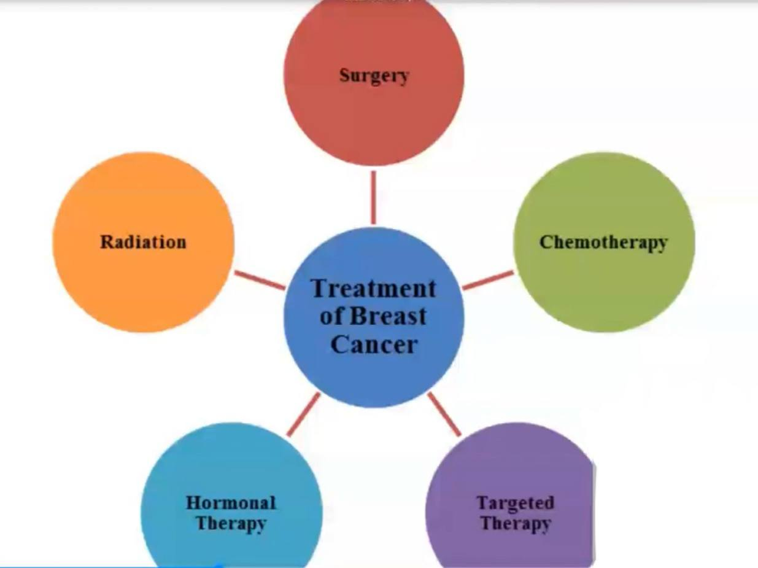
Treatment:

Slide 19
Conclusion
There are two important aspects in breast cancer prevention: early detection and risk reduction.
Screening may identify early noninvasive cancers and allow treatment before they become invasive or identify invasive cancers at an early treatable stage.

Slide 20
References
1- Waks AG, Winer EP. Breast cancer treatment: a review. Jama. 2019 Jan 22;321(3):288-300.
2- Harbeck N, Penault-Llorca F, Cortes J, Gnant M, Houssami N, Poortmans P, Ruddy K, Tsang J, Cardoso F. Breast cancer. Nature reviews Disease primers. 2019 Sep 23;5(1):1-31.

Slide 21

Thanks!!

