Slide 1


Morality, Ethics, and Law
Libyan International Medical University
Faculty Of Business
By: Sanad Nagem
2232

Slide 2
Content:
1
Introduction
Difference between morality, ethics, and law
Conclusion

Slide 3
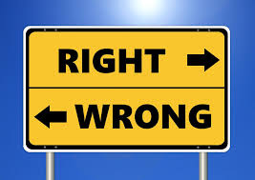
Introduction:
2
Ethics serve as a guide to moral daily living and helps us judge whether our behavior can be justified. Ethics refers to society's sense of the right way of living our daily lives. It does this by establishing rules, principles, and values on which we can base our conduct.

Slide 4
Difference between ethics, morality, and law:
3
Ethics: Is a process of reflection in which people’s decisions are shaped by their values, principles, and purpose rather than unthinking habits, social conventions, or self-interest.
Morality: Principles concerning the distinction between right and wrong or good and bad behavior.
Law: The law tries to create a basic, enforceable standard of behaviour necessary in order for a community to succeed and in which all people are treated equally.

Slide 5

4
Morality and ethics are very similar they influence people decisions. We don’t get to choose our morals instead we learn them threw our cultures and habits. Laws can also influence an individual decision since everyone is bind by the same law

Slide 6
References
5
The Importance of Ethics in the Workplace - FMLink. (2018). FMLink. https://fmlink.com/articles/the-importance-of-ethics-in-the-workplace/
‌
THE ETHICS CENTRE. (2019, July 2). Ethics, morality, Law – What’s the difference? - the Ethics Centre. THE ETHICS CENTRE. https://ethics.org.au/ethics-morality-law-whats-the-difference/
‌

Slide 7
Thank you

