Slide 1


Libyan International Medical University Faculty of business administration
Self-Esteem
name: faraj salem
ID:4157
EMAIL:Faraj-4157@limu.edu.ly

Slide 2
Content
Introduction
Describe self-estm
Conclusion
References

Slide 3
Introduction
Self-esteem refers to a person’s overall sense of his or her value or worth. It can be considered a sort of measure of how much a person “values, approves of, appreciates, prizes, or likes him or herself” (Adler & Stewart, 2004).

Slide 4
Self-Esteem and Psychology
self-esteem has been a hot topic in psychology for decades, going about as far back as psychology itself.

Slide 5
Self-Esteem vs. Self-Concept
Self-esteem is not self-concept, although self-esteem may be a part of self-concept. Self-concept is the perception that we have of ourselves.

Slide 6
Self-Esteem vs. Self-Image
Another similar term with a different meaning is self-image; self-image is similar to self-concept in that it is all about how you see yourself Instead of being based on reality, however, it can be based on false and inaccurate thoughts about ourselves (McLeod, 2008).

Slide 7
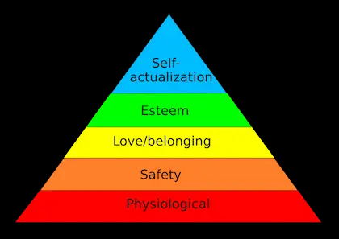
Esteem in Maslow’s Theory – The Hierarchy of Needs While these needs and the concept of self-esteem are certainly related, Maslow’s esteem needs are more focused on external measures of esteem, such as respect, status, recognition, accomplishment, and prestige (McLeod, 2017).

Slide 8
Incorporating Self-Esteem in Positive Psychology
Seligman has some concerns about openly accepting self-esteem as part of positive psychology.

Slide 9
Conclusion
we know that believing in yourself and accepting yourself for who you are is an important factor in success, relationships, and happiness and that self-esteem plays an important role in living a flourishing life

Slide 10
References
Courtney E. Ackerman, M. A. (2022, September 10). What is self-esteem? A psychologist explains. PositivePsychology.com. Retrieved November 8, 2022, from https://positivepsychology.com/self-esteem/#:~:text=Incorporating%20Self-Esteem%20in%20Positive%20Psychology%20Dr.%20Martin%20Seligman,long%20as%20the%20image%20of%20%E2%80%9Cconfidence%E2%80%9D%20is%20obtained.

Slide 11
THANK YOU
Any Question

